Slide 1
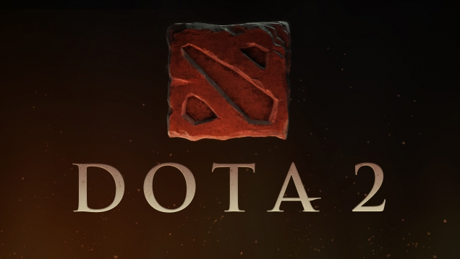
Fan Zhang
CIS 487

Slide 2
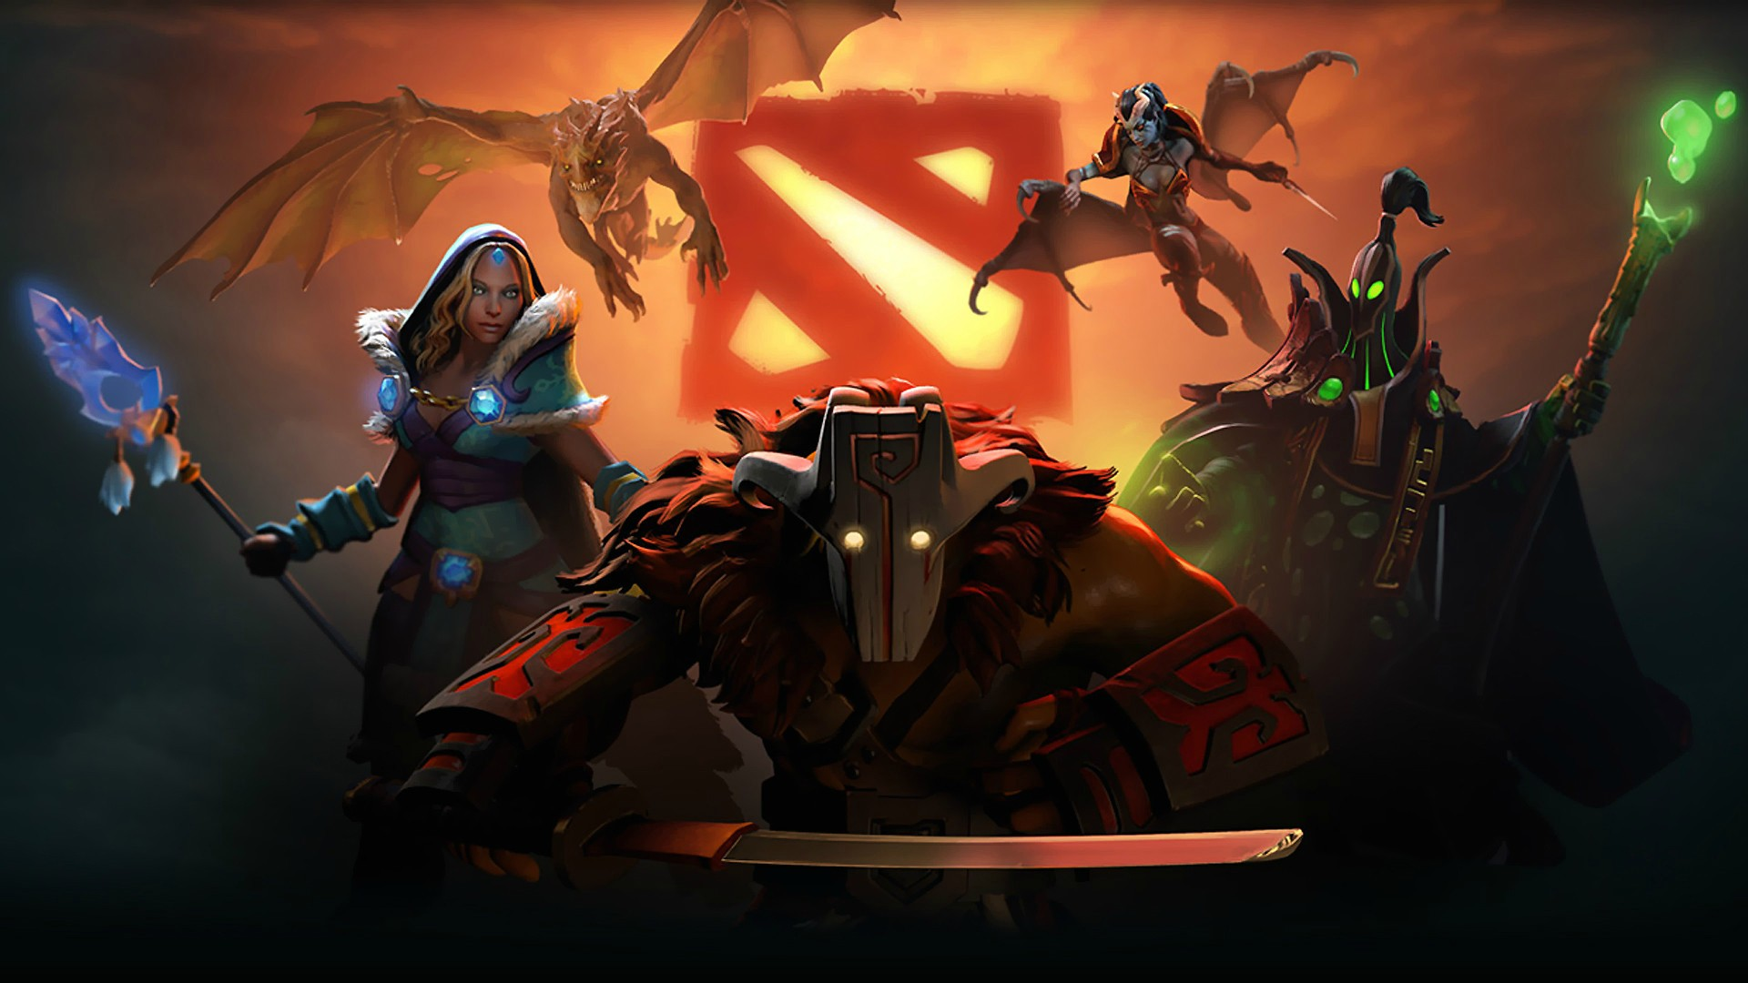
What is DotA2
Full name: Defense of the Ancients 2
Company: Valve Corporation
Game type: Multiplayer Online Battle Arena (MOBA)
Price: Free to play
OS: Microsoft Windows, Mac OS X, SteamOS+Linux

Slide 3
Minimum Hardware (windows)
OS: Windows 7
Processor: Dual core from Intel or AMD at 2.8 GHz
Memory: 4 GB RAM
Graphics: nVidia GeForce 8600/9600GT, ATI/AMD Radeon HD2600/3600
DirectX: Version 9.0c
Network: Broadband Internet connection
Hard Drive: 20 GB available space
Sound Card: DirectX Compatible

Slide 4
Minimum Hardware (Mac OS X)
OS: OS X Mavericks 10.9
Processor: Dual core from Intel
Memory: 4 GB RAM
Graphics: nVidia 320M or higher, or Radeon HD 2400 or higher, or Intel HD 3000 or higher
Network: Broadband Internet connection
Hard Drive: 20 GB available space

Slide 5
Recommended Hardware (max setting and fps 60 above)
Windows 7, 8.1 ,10
CPU: Intel CORE i3 4160
RAM: 8 GB DDR3
HDD: 40 GB free HDD space
Graphic Card: NVIDIA GTX 960/ AMD Radeon r380
DirectX 11

Slide 6
Customization video option

Slide 7
Game Summary
Installation
DotA2 requires Valve Corporations game platform (STEAM) that means you must have a steam account. (also means you have to download steam first)
Since the beta version is released you just need to search Dota2 in steam store and start to download it.
The Steam application allows you to store the game under the steam folder.

Slide 8
Steam game library

Slide 9
Game Summary
Overview
Beta Release Date: Jul 9, 2013
the stand-alone sequel to the Defense of the Ancients (DotA) Warcraft III: Reign of Chaos and The Frozen Throne mod.
Designer : IceFrog who involved with DotA began in 2005 and hired in 2009 for developing the DotA2 as a lead designer.
Dota 2 is now powered by the Source 2 engine, Valve's latest game development platform. This means that ongoing development in the new engine will continue to improve Dota 2. Source 2 includes technology for rendering improvements, performance optimizations, higher fidelity content, and richer, more dynamic games.
In DotA2, every hero has an individual brief story about their background. The game itself has a story called “Mad Moon” The Mad Moon was a large, cosmic sphere that orbited the World, the prison of the Radiant and Dire forces, until it destroyed itself in a cataclysmic event. Because of its impact, the Mad Moon ties heavily into the mythology and lore of the World.
Players will choose one out of about 108 total heroes and make a team as 5. So there will be 5 vs 5 as total 10 players in a game.

Slide 10
How to play DotA2 (in- game)
One large map is divided into 3 lanes.(functionally symmetrical map)
Each lane has 3 allied towers, and 3 enemy towers.
The end of each lane is the enemy barracks.
Each lane has AI waves of “creeps” which spawn periodically(every 30 seconds) and head towards the enemy base.
Each hero has unique abilities (most are 4 abilities including 3 regular abilities and 1 ultimate) and require experience during the match to level up your hero’s level and each level-up gives a attribution to abilities.
Every player will get gold by killing enemy heroes, creeps, structures. Using the gold to buy items from in-game shop that makes your hero stronger
The goal is take down enemy’s towers and barracks. And the game is over when either side’s base structure(called Ancient) is destroyed.
A game of DotA2 is like a basketball game. Different heroes have different position to contribute particular function. So selecting a hero that can fit your team strategy well is a key factor to win.

Slide 11
The Map

Slide 12
DOTA2 UI

Slide 13
Learn how to play dota2 Manual

Slide 14
The heroes in DotA2

Slide 15
Description and instruction of Heroes

Slide 16
Custom items created from the community

Slide 17
Game Summary (Special Features)
The game is meant to be competitive. Valve has provided the game with an amazing function which allows you to spectate any one of the live games.
This special feature could be talked about for hours so I’ll highlight some amazing features.
Live broadcasters in multiple languages for tournament matches.
The option to allow the broadcasters to control the camera, so you can see the action they are commentating on.
Live, on the fly, in game statistics about various components of the game.
Allows for full interaction with the client while watching.
Saved game replays.

Slide 18
The spectate System

Slide 19
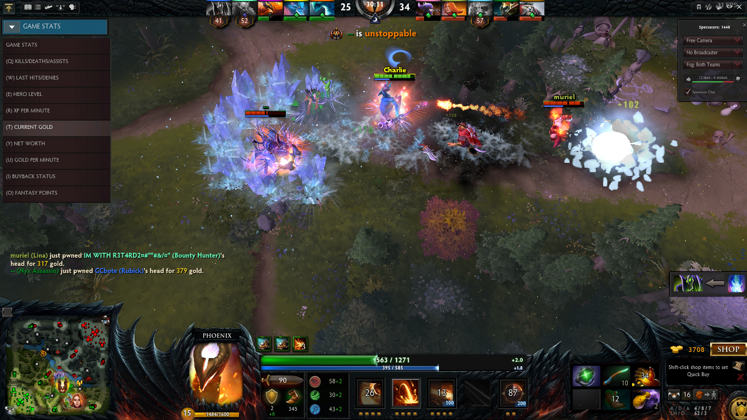
All in One function
Spectate a living game

Slide 20
Custom Games brand new part after the source2

Slide 21
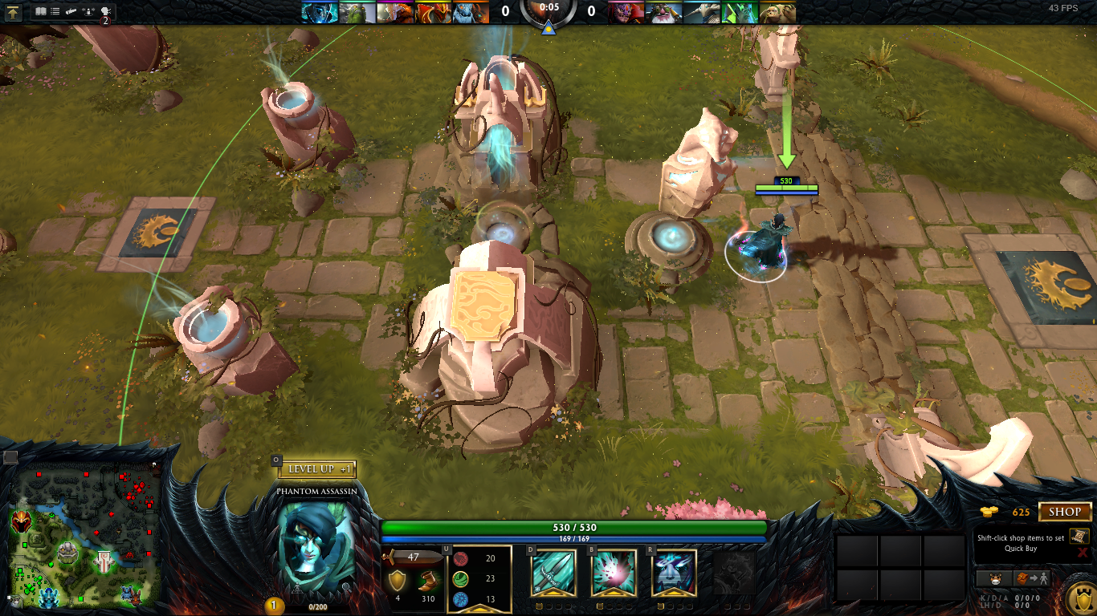
User Interface
In-game

Slide 22
Game Review
The Good Part of Game
The game spent a long time in beta version to improve the quality. Balancing issues are non-existent with team compositions and hero drafting which allows for banning of heroes before the start of each match.
The game is free to play, people from the community can get revenue by selling the custom items like the hero sets, music pack, HUDs .
As a team corporation game, DotA2 provides a in-game team voice system which allows you to communicate with your teammate while playing the game
DotA2 has a reconnect option for players who disconnect from the current game, any player in that game can pause game for waiting the reconnection.
Every hero released is free to everyone, and no buying items can influence balance of the game. This ensures the game compete fairly .
The spectate function provides a platform for all the community to improve their skills by using various functions in spectate mode.
The control by the mouse and keyboard are customizable and intelligent.
Depth of the game and unpredictable process.

Slide 23
Game Review
The Bad part of the Game
With all of the good comes an insanely steep learning curve.
This game is unfriendly for new players in the difficulty.
It is require that you spend a lot of time on familiar with all heroes’ abilities and a lot of basic knowledge to play with other players.
A mistakes could be punish heavily. And some stupid mistakes from new players will put whole team’s effort in vain, which can lead into team mates becoming angry at new players.
As with most competitive games, nobody like the feeling of lose a game, especially players are play so hard to chasing the winning. So, when they are losing a game, an emotional burden of losing, as well as screwing it up for the team can be too heavy to bear and reduce the fun.
Each game takes around 50 minutes to finish. That means during the time , you have to focus on the game to help your team get the victory. The intensive combat for a long time makes player feel tired after the game.

Slide 24
Game Review
Similar Games
League of Legends vs. DotA2
LoL released earlier than DotA2, taking the advantage of timing, has a larger number of players,due to the fact that DotA2 is still not widely available.
Character variability: Every single hero in DotA 2 is highly specialized in certain ways and lacking in others and each one has very unique play style. LoL has its greats too, but many of LoL champions feel generic compared to the distinguished personality of DotA 2 heroes
Controls are not nearly as customizable, nor as fluid feeling as DotA2.
The diversity of game strategy and hero play style in LoL is not as wide as DotA2.
In LoL, “champions” are not free to any one. You have to spend money on new heroes. And most likely, the new heroes you bought are broken(not balance) which give advantage to players who have the hero.
LoL has a rune system, which to many, feels like pay-to-win. These give slight advantages to the high-level account player than new account player.

Slide 25
Game Review
Appropriate Audience
DotA2 is definitely geared towards hardcore gamers.
People with concrete time of focus on game.
People with intense passion to compete and the desire to carry the team to win
People who can sacrifice personal emotional for the team’s victory.

Slide 26
Game Review
Design mistakes
When user create game lobby for in-house gaming, the players sometimes cannot load into game due to there are too many casters.
The other languages keyboard input works improperly in the game when you typing.
In the “Learn” tab, the video features still not available in new source2 now, and the detail hero guide written by skilled players has not delivered from old engine yet.

Slide 27
Summary
Strengths
A fair competitive environment true E-sports game
Amazing features for spectating and casting a game.
Allowed players create their own game lobby for in-house gaming.
The balance of all heroes and items has been updating alone with the every patch, IceFrog improved the balance by hearing all the voice from the community.
The fantastic visual effort in graph and delicate hero mod.
Complexity strategy and corresponding reactions from both teams.
The community can create custom items and once get qualified by Value, you can buy them form dota2 store and the author will get 50% of the total selling amount.

Slide 28
Summary
Weaknesses
Must be played online.
It is hard for new players to get into.
Requires a large time investment to be competitive.
Requires a static amount of time for each game played in order to not be shunned from the community.

Slide 29
Summary
Is the game worth purchasing?
Well, it’s free. You just need to download it and enjoy some features without paying anything. Let’s start the learning section, familiar with the basic operation and knowledge and playing with AI, spectate the first-person view of skilled players.

Slide 30
Summary
Improvements
The main menu UI need to be reorganized the layout, should show more information about player profile and able to show the tags you added on your friends in client.
Hero menu should display more productive features, now the “feature” feels like commercials.
Reduce the loading time to a game, put more useful information of players instead of just watching the loading screen pictures..

