Slide 1
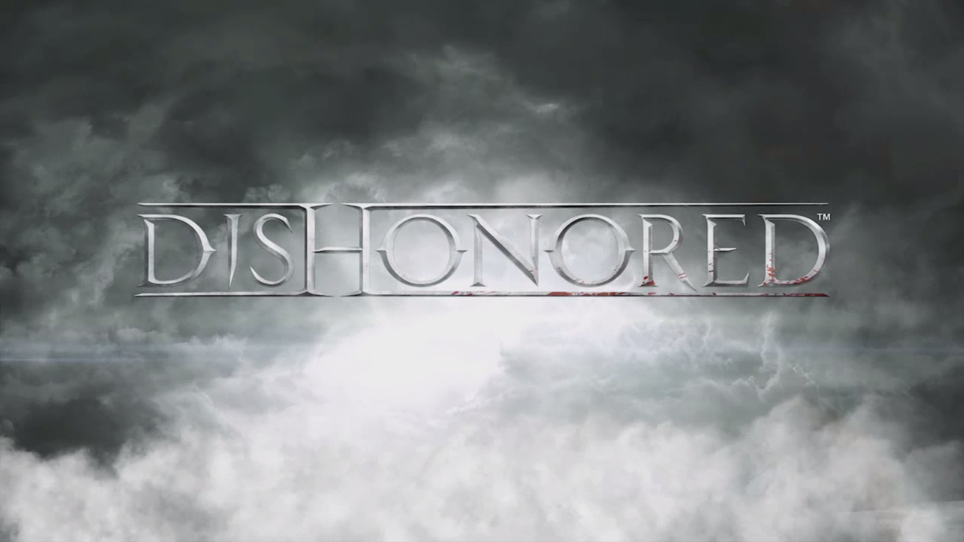
Dishonored with Distinction: A Review
Jeffrey Yackley
23 September 2015
CIS 487

Slide 2
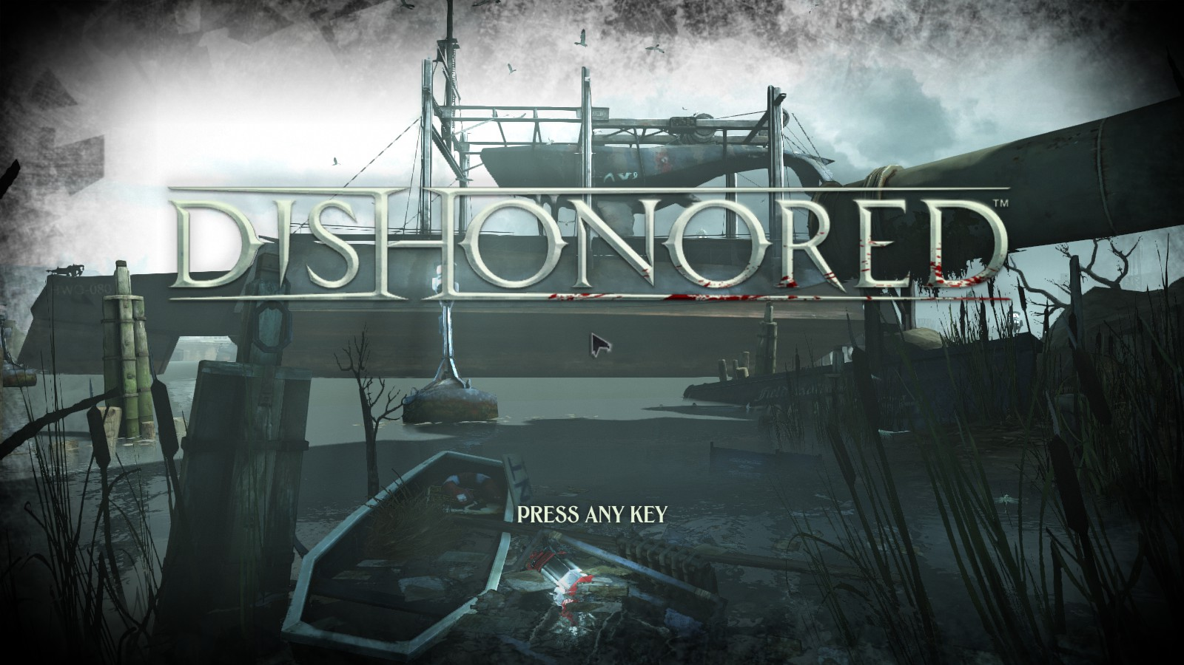
Basic Information
Game Title: Dishonored
Developer: Arkane Studios
Publisher: Bethesda Softworks
Game Engine: Unreal Engine 3
Platforms: PC (Windows), PS3/4, XBOX 360/One
Type of Game: First Person Action RPG (Single Player)
Content Rating: Mature
Current Price:
PC GOTY Edition: $29.99 (75% sale: ~$7.50)
Consoles Definitive Edition: $40 (recently announced)
Minimum Stated Hardware Requirements:
OS: Windows Vista
Processor: 3.0 GHz Dual Core
Memory: 3GB RAM
Hard Disk Space: 9 GB
Video Card: DX9 Compatible w/ 512 Video RAM
Sound: Windows Compatible Sound Card
Actual Hardware Requirements:
OS: Windows Vista
Processor: 2.2-2.4 GHz Dual Core
Memory: 4GB
Hard Disk Space: 9 GB
Video Card: DX9 Compatible w/512 Video RAM
Sound: Windows Compatible Sound Card
Sources:
Steam Dishonored Store Page
Personal Testing
Image Source: www.justpushstart.com
Image Source: In-Game Screen Capture

Slide 3
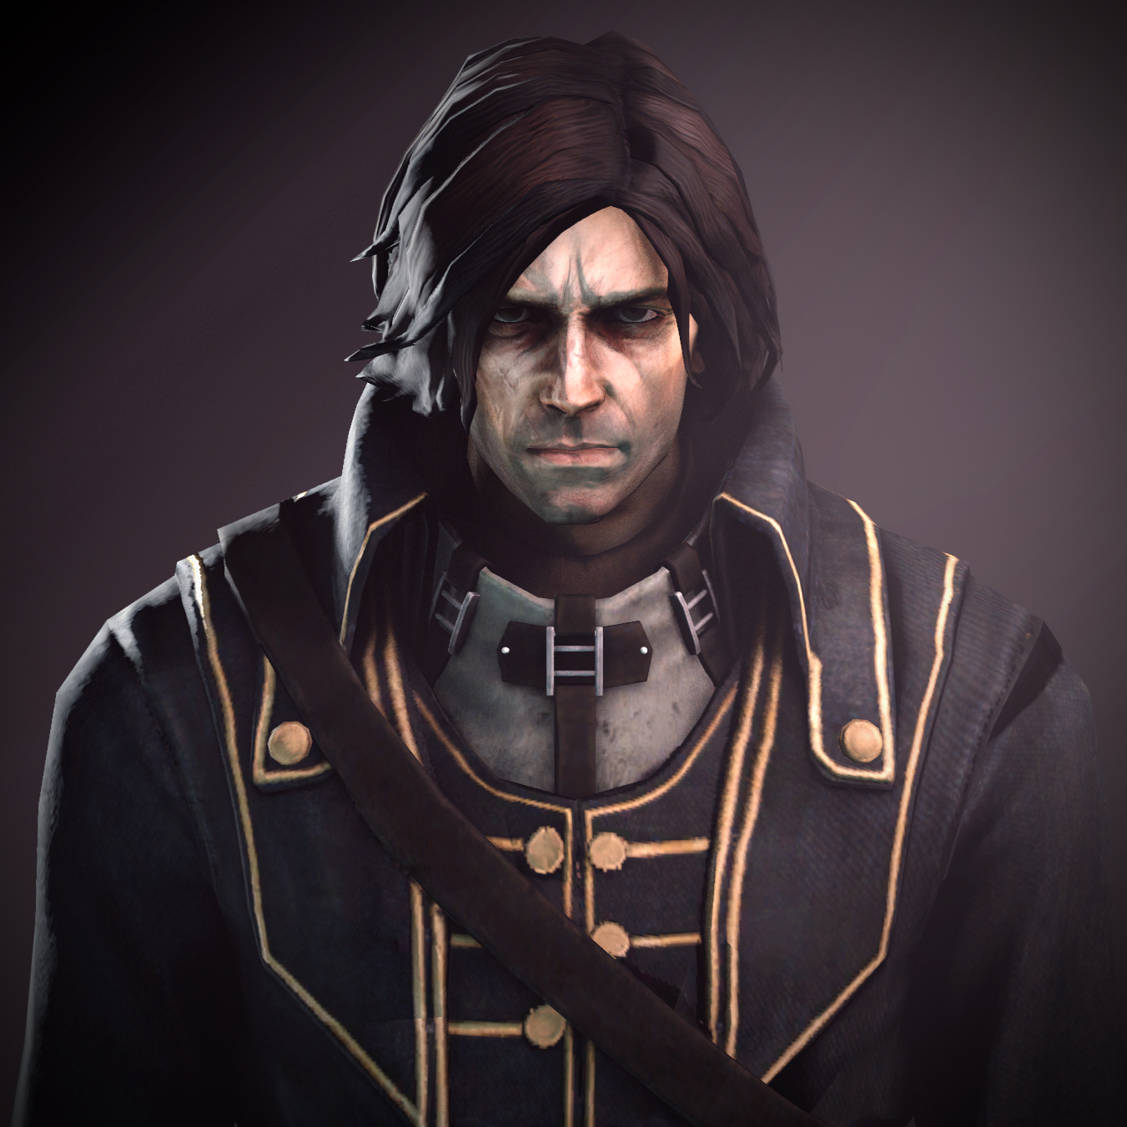
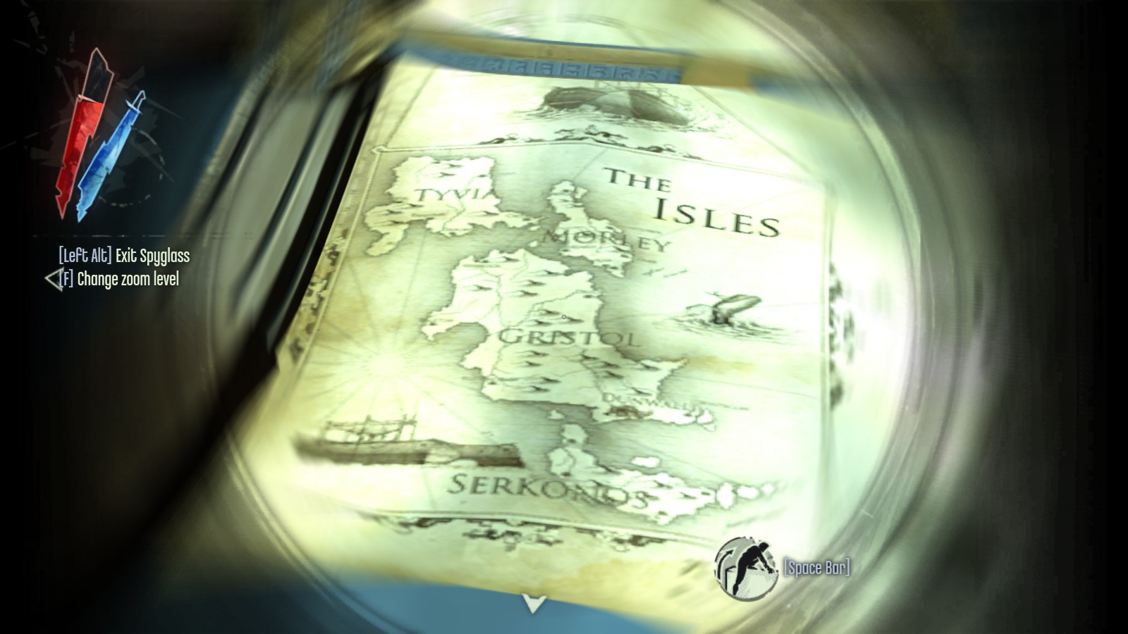
Game Summary
Quick Overview:
Dishonored is a first person tactical stealth / assassination action RPG played from the point of view of the disgraced royal protector who must uncover the conspiracy that led to his imprisonment and shape the fate of his gritty, dark world in the process.
Story Line:
A devastating plague has broken out in Dunwall, capital city of the Empire of the Isles. Compounding Dunwall’s and the Empire’s trouble is the assassination of the beloved Empress Jessamine Kaldwin and the abduction of her young heir and daughter, Lady Emily Kaldwin. The Empresses' former bodyguard, Lord Protector Corvo Attano, is imprisoned and charged with her murder. An oppressive inter-regnum is begun and headed by the former Royal Spymaster turned Lord Regent, who seeks to control the chaos of the plague and royal succession. Meanwhile, a secret group frees Corvo and sets him on the path to unravel the conspiracy against him.
Player’s Role:
The player plays through the eyes of the dishonored, former Lord Protector Corvo Attano with an arsenal of assassin’s tools and supernatural abilities on his quest for answers and vengeance. Corvo’s fate and the fate of the Empire rests on the actions and decisions of the player.
Image Source: dishonored.wikia.com/wiki/Corvo_Attano
Image Source: In-Game Screen Capture
Dunwall

Slide 4
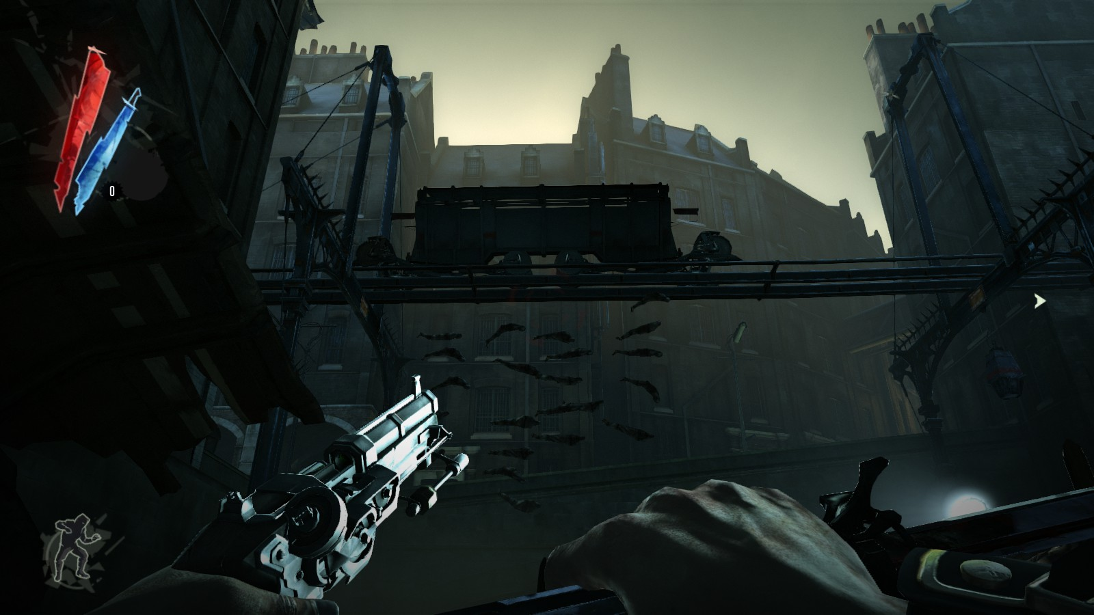
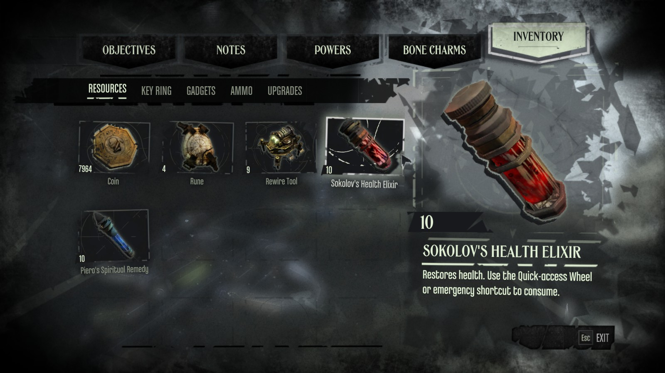
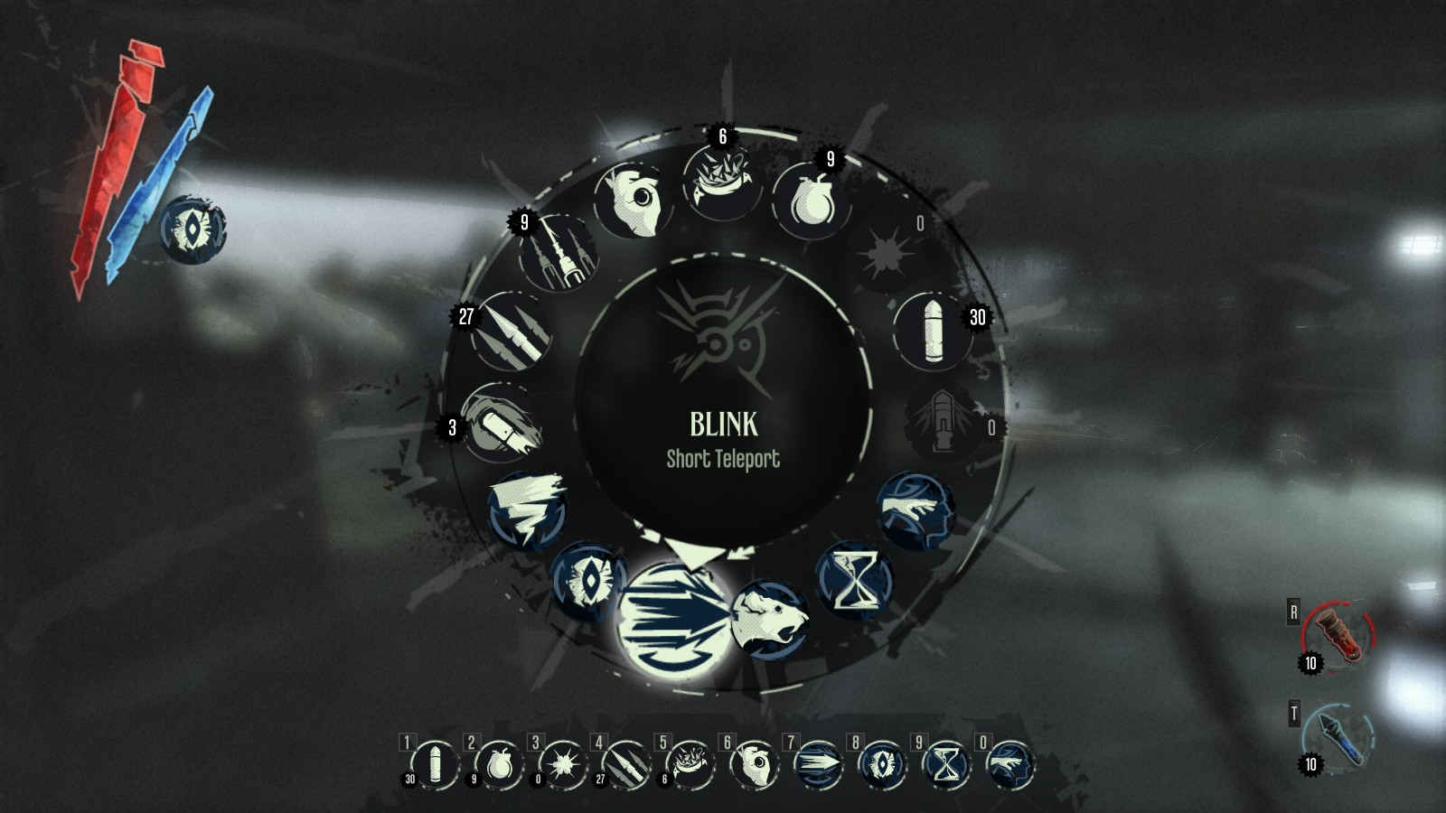
Game Summary
User Interface:
Top Left: Health / Mana / Current Left Hand Equip/ Ammo Status
Left Hand: Ranged Weapon / Power / Nothing
Right Hand: Sword / Nothing
Pull-up / Hotkeys: Powers / Potions / Weapons
Pull-up: Objectives, Notes, Powers, Charms, Inventory
Input Devices: Keyboard and Mouse or Controller
Image Source: In-Game Screen Capture
Image Source: In-Game Screen Capture
Image Source: In-Game Screen Capture

Slide 5
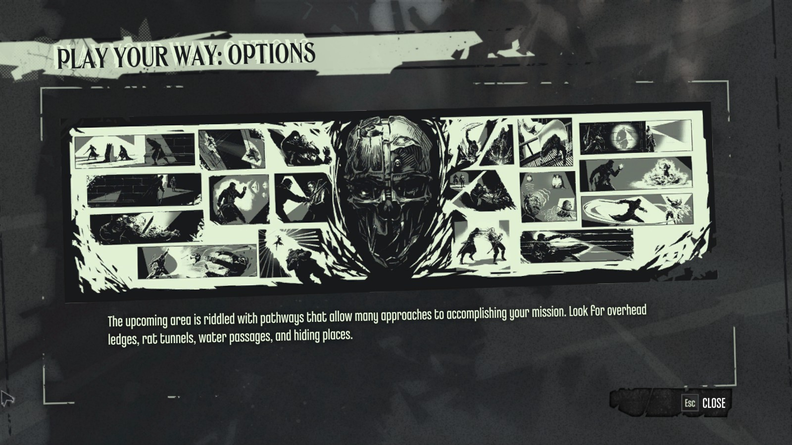
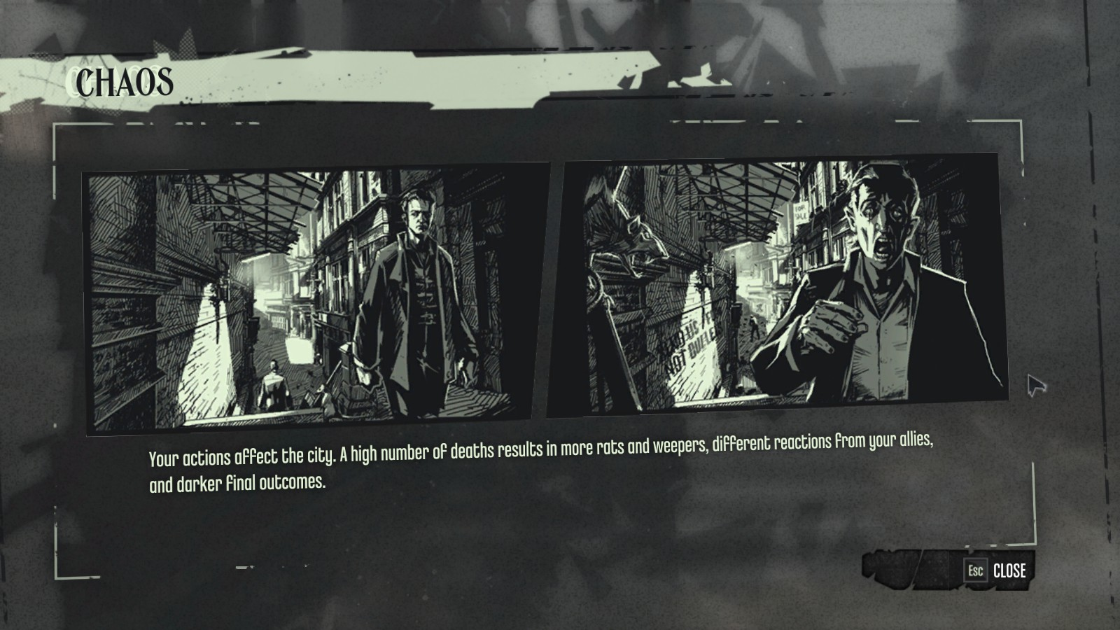
Game Summary
Game Play:
Lots of freedom for different playstlyes: See Play Your Way.
Use stealth to sneak around enemies.
Fight your way through your opposition.
Mix and match.
Use supernatural abilities to aid you or never use them.
Explore numerous different solutions to obstacles.
Your approach to how you play affects the environment through chaos.
Gain chaos from actions that harm/kill others.
High chaos results in more rat swarms and more plague victims called weepers and vice versa for low chaos.
Other environmental changes result in different character dialogue and story progression leading up to drastically different endings depending on the way you choose to play.
Results in making the player feel their actions are more integral to the story and drawing them deeper into the game.
Scoring:
No score mechanic in the main game, but there is a DLC (included in GOTY and definitive editions) that focuses on high scores called Dunwall City Trials.
Trials focus on stealth, combat, and planning.
Image Sources: In-Game Screen Captures

Slide 6
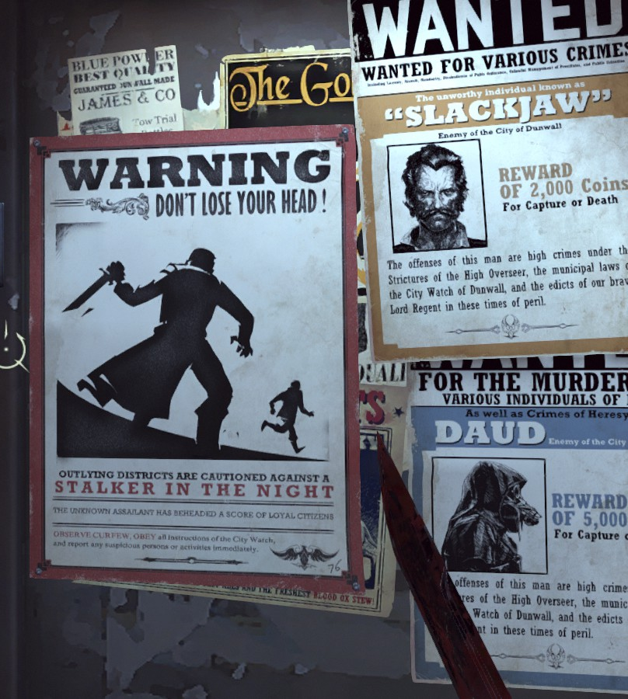
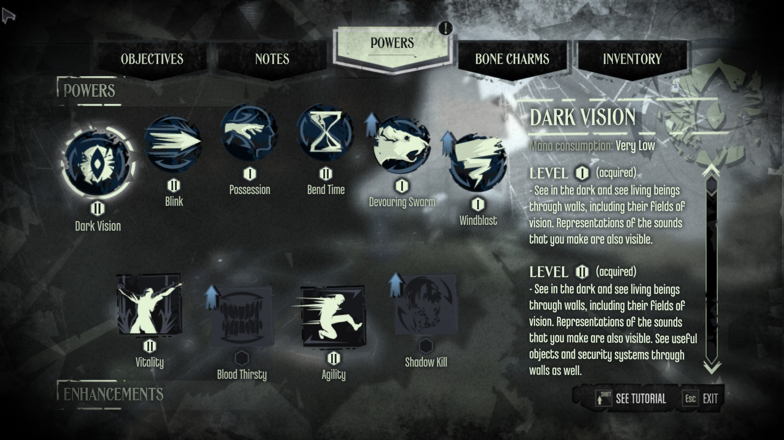
Game Summary
Special Features:
Chaos
Changes game dialogue
Changes scenery
More/fewer rat swarms
More /fewer weepers (plague victims)
Different posters
Changes endings
Supernatural Powers
Bestowed by “The Outsider” (Neither good nor evil)
Leveled through finding runes and completing objectives
Powers
Blink (Teleport)
Dark Vision (See in the dark, see enemies cone of vision)
Possession (Possess rats / fish / dogs / humans)
Slow / Stop Time
Summon Rat Swarm (Summons rats to attack foes / eat corpses)
Whirlwind (Summon a gale of wind to push back enemies)
Enhancements
Vitality (Increased health)
Blood Thirsty (Multiple Enemy Take-down)
Agility (Jump higher, makes less noise)
Shadow Kill (Unaware victims turn to ash on death)
Bone Charms
Provide various passive benefits
Image Sources: In-Game Screen Captures

Slide 7
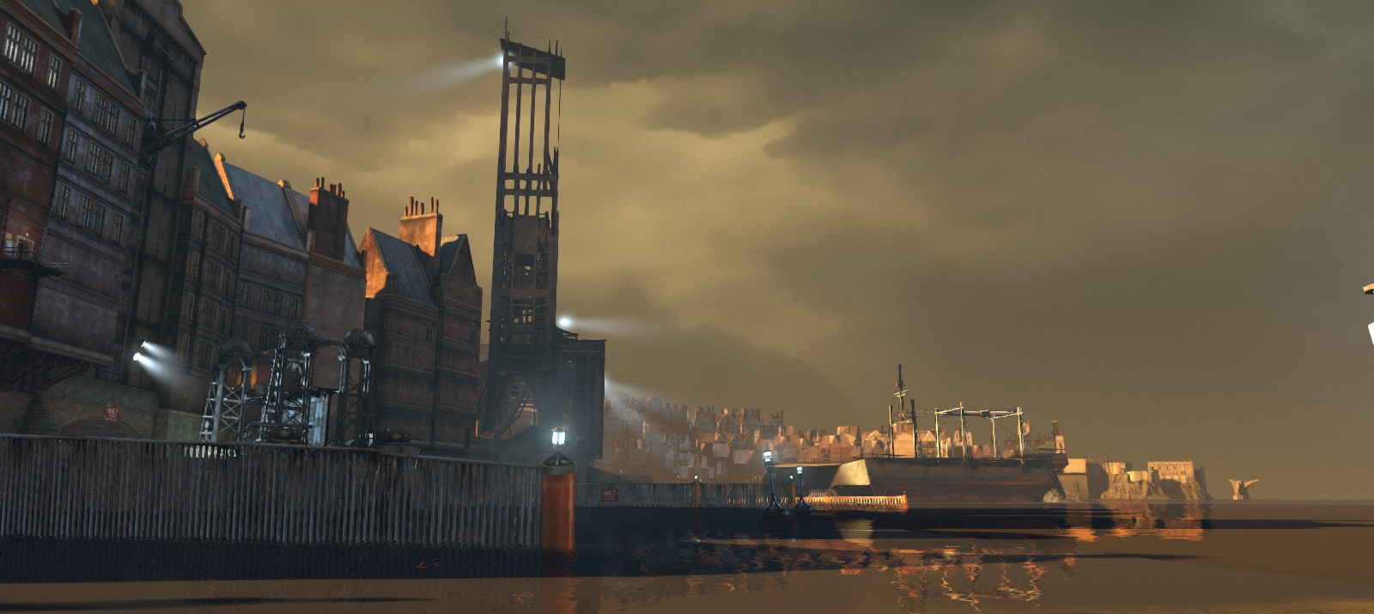
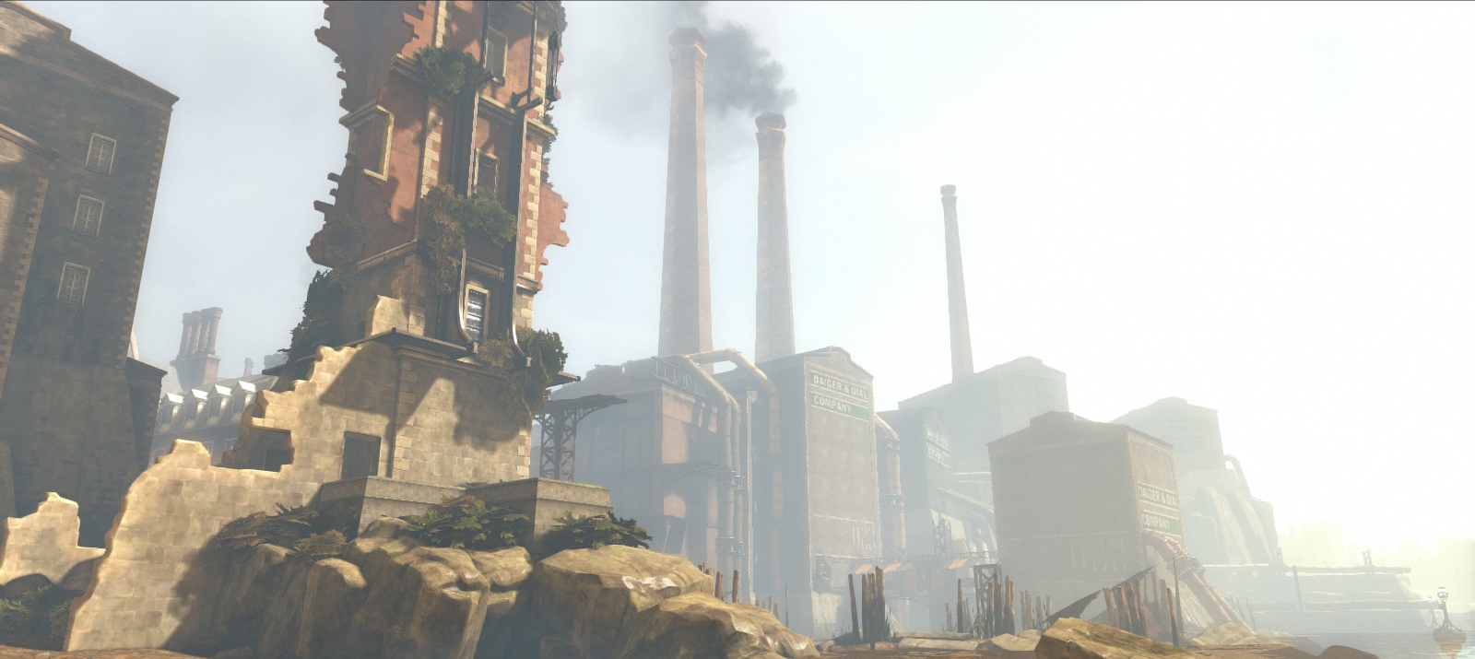
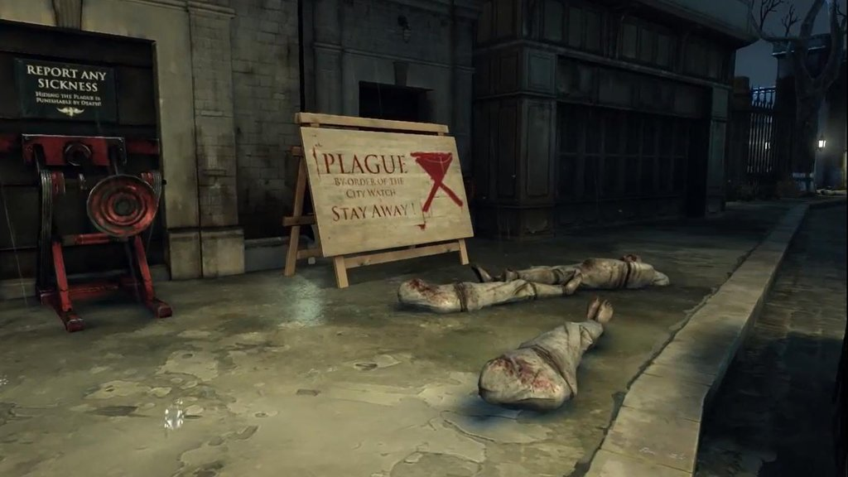
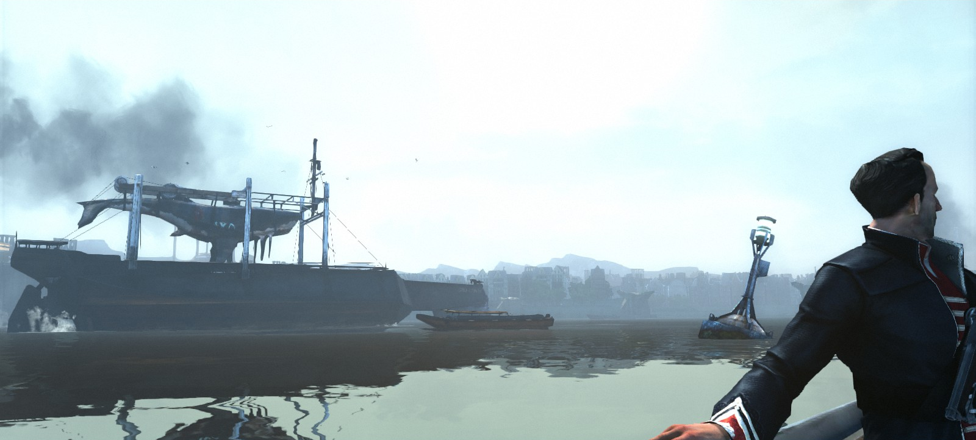
Game Summary
Setting:
City of Dunwall in the Empire of the Isles during ~seven week period
Dark, gritty, fantasy/steampunk-esq city modeled loosely on Victorian Era England.
City is in state of decay due to corruption, neglect, and the plague.
Whale oil is used to power numerous mechanical gadgets and contraptions.
Various Artwork Samples:
Right Image Sources: In-Game Screen Captures
Below Image Source: dishonored.wikia.com/wiki/Dunwall

Slide 8
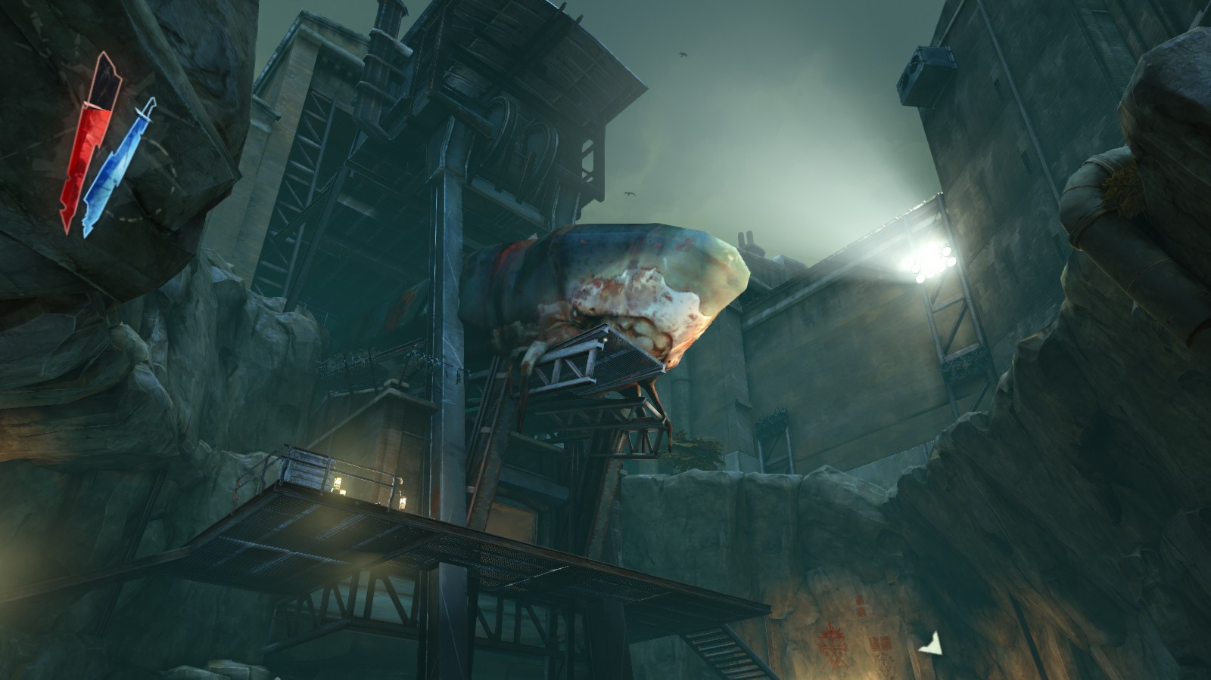
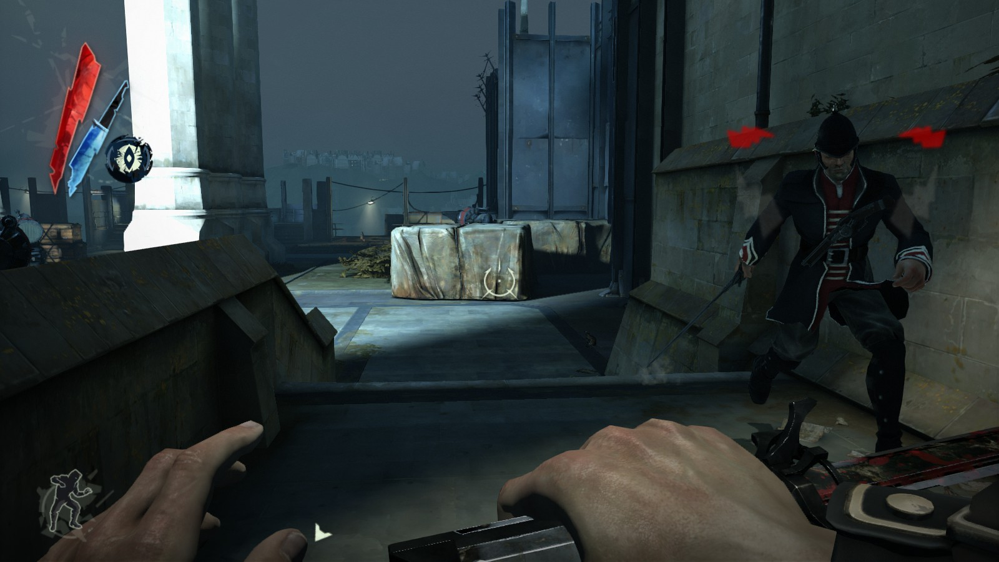
Game Summary
Sound and Music:
Sound effects largely make the world seem real.
Heavy objects sounds heave, glass is fragile and shatters.
Machines sound mechanical.
Overall the sound effects and music help with immersion and create a tense mood during most aspects of gameplay.
Music Samples:
Main Theme: https://www.youtube.com/watch?v=pPWCkhulCn8&list=PLiN9B0rz-YEwhajvBFl7qES8mTPDt3EVX
Wrenhaven River: https://www.youtube.com/watch?v=Cv0gFlcD_KQ&list=PLiN9B0rz-YEwhajvBFl7qES8mTPDt3EVX&index=8
Honor for All: https://www.youtube.com/watch?v=gFQwn6M1RMc
Drunken Whaler: https://www.youtube.com/watch?v=urV8MIcLDFk
Image Source: In-Game Screen Capture
Image Source: In-Game Screen Capture

Slide 9
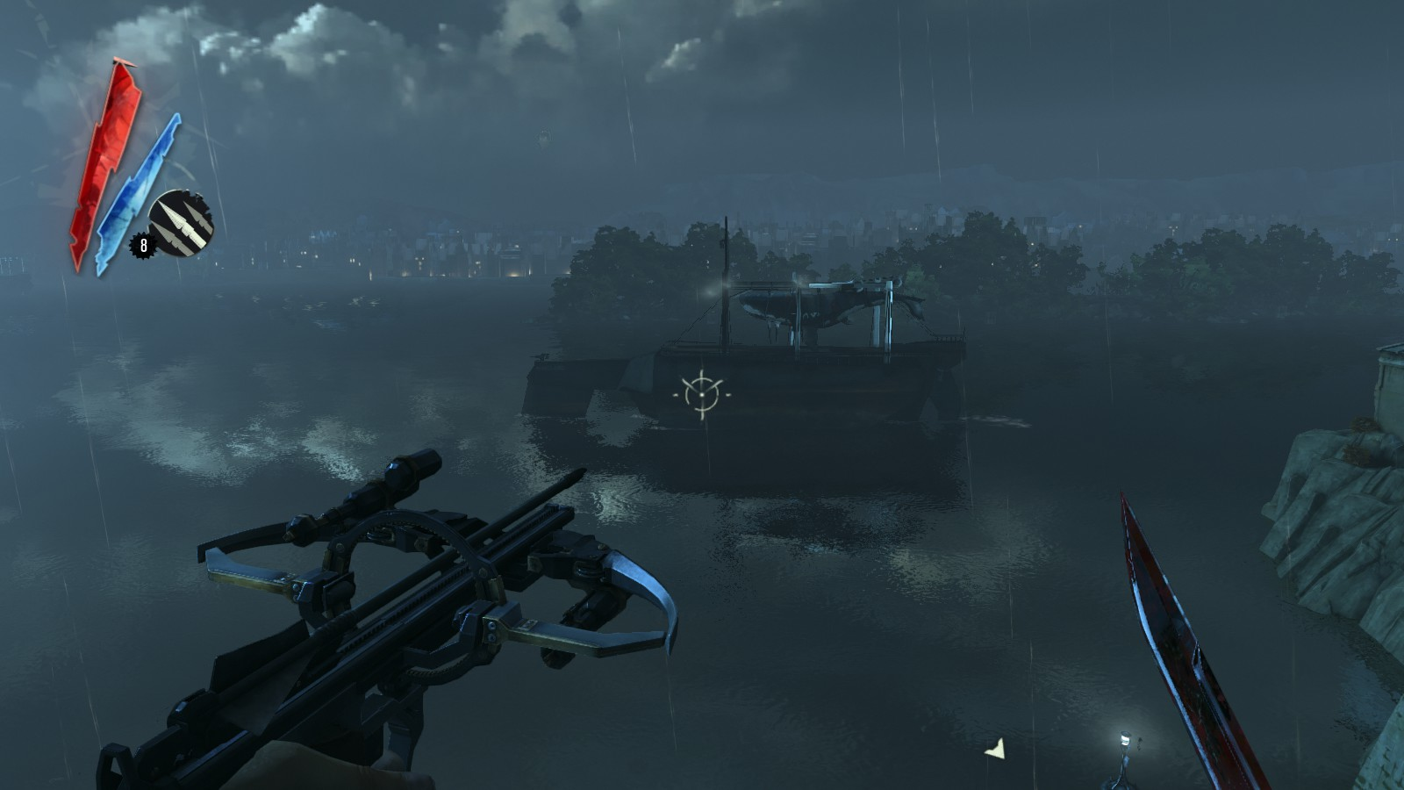
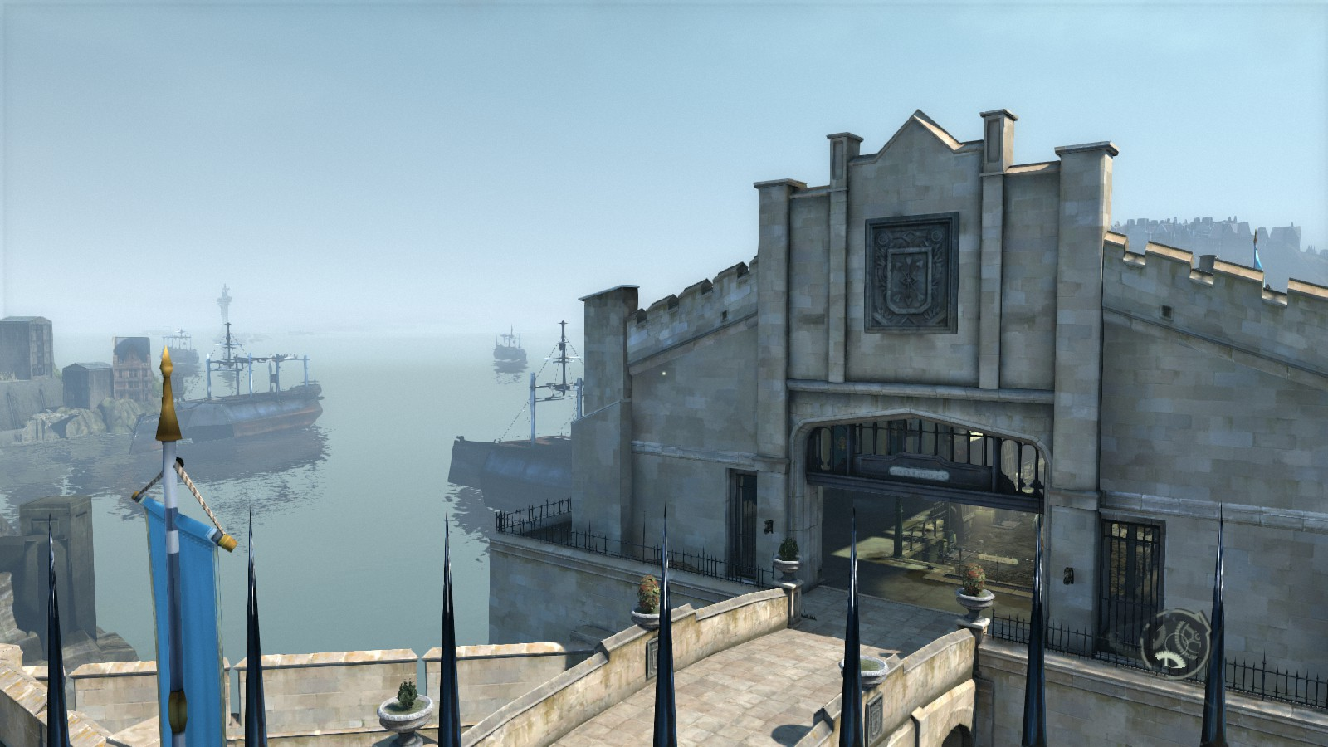
Game Summary
Installation:
Installs relatively quickly once download if using Steam
No first time setup required unless DirectX 9 or never has never been installed on your machine.
Manual:
None
The game does a good job of introducing players to core mechanics.
Bugs:
Some clipping issues cause by complicate scenery / textures.
Fairly easy to free oneself with the blink power eliminating the need to restart as every player has access to it.
Game AI fails to adapt aim if they have begun lining up a pistol shot in combat and often shoots its fellow guardsmen in the back.
“Clear the line!” –often shouted by guards before firing, but unheeded by their fellow guardsmen.
Image Source: In-Game Screen Capture
Image Source: In-Game Screen Capture

Slide 10
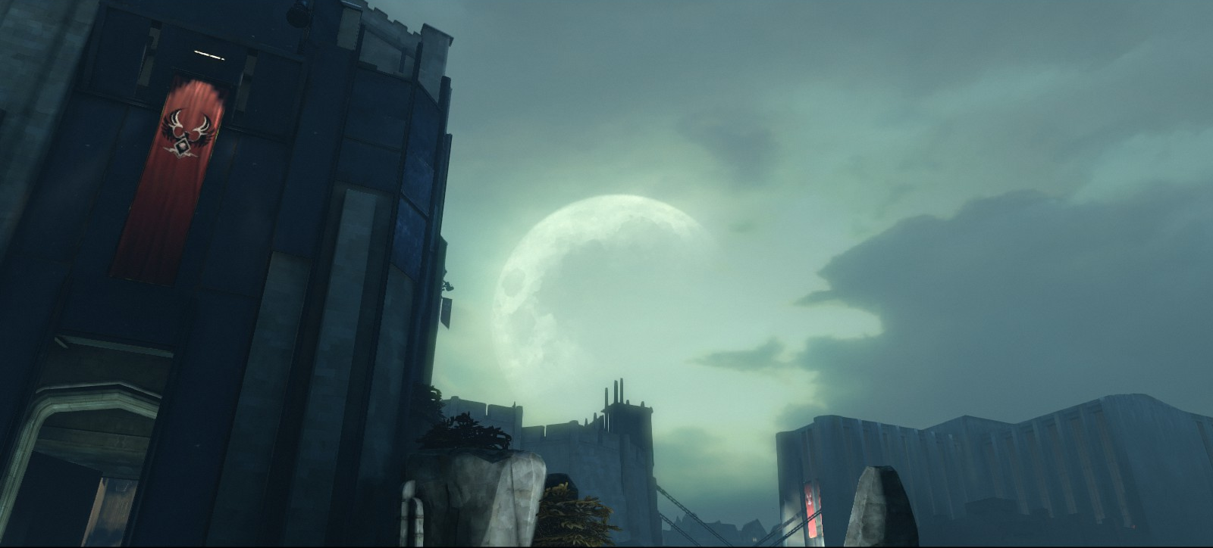
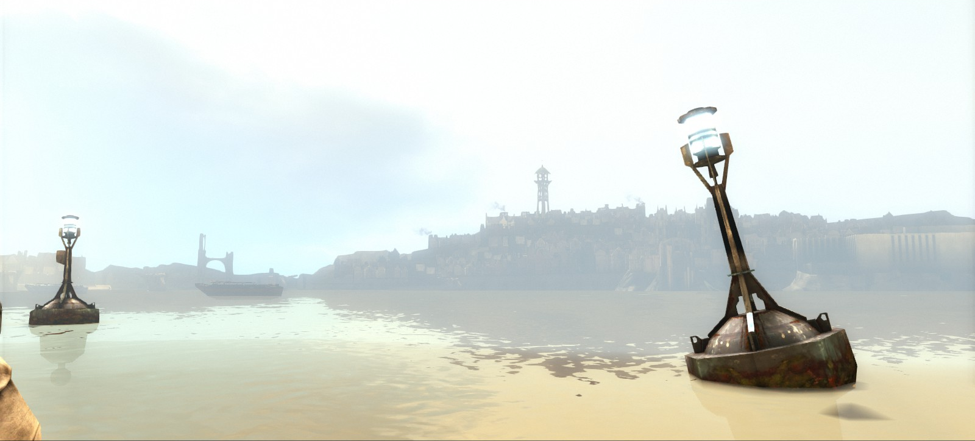
Game Review
The Good (Fun Aspects of the Game)
Excellent, immersive story
Feels like player choices matter in the game
Lots of different playstyle choices, you never feel constricted in how to play
Satisfying sword and pistol combat, various sword animations and a blocking mechanic make it feel like tense and realistic
Wide arsenal of tools and supernatural abilities
Wonderfully imaginative setting and world building
The Bad (Not Fun Aspects of the Game)
Game AI could be improved
Enemies only sometimes seem to notice that guard should be on duty at a location.
Enemies do anything but say “Hmmmm…should be someone on duty.”
It would be nice to see the enemy turn and run for the alarm if a guard was missing.
Game AI often shoots its compatriots in the back.
If an enemy yells “Clear the line!” It would be good to see his fellow guards move out of the way.
The auto-save feature only seems to work at certain doors / locations and this can result in needing to travel through a large portion of a level if you make a mistake.
Low replayability despite so many ways to accomplish objectives.
The Ugly (Design Mistakes):
The Game AI could use some minor improvements as mentioned above.
Level design can be too simple if you stumble upon a really effective route through the obstacles.
Levels need to be longer, especially with all of the powers at the players disposal.
Sometimes you could race through a level in a couple of minuets if you don’t care about exploring and stay laser focused on the main objectives.
Image Source: In-Game Screen Capture
Image Source: In-Game Screen Capture

Slide 11
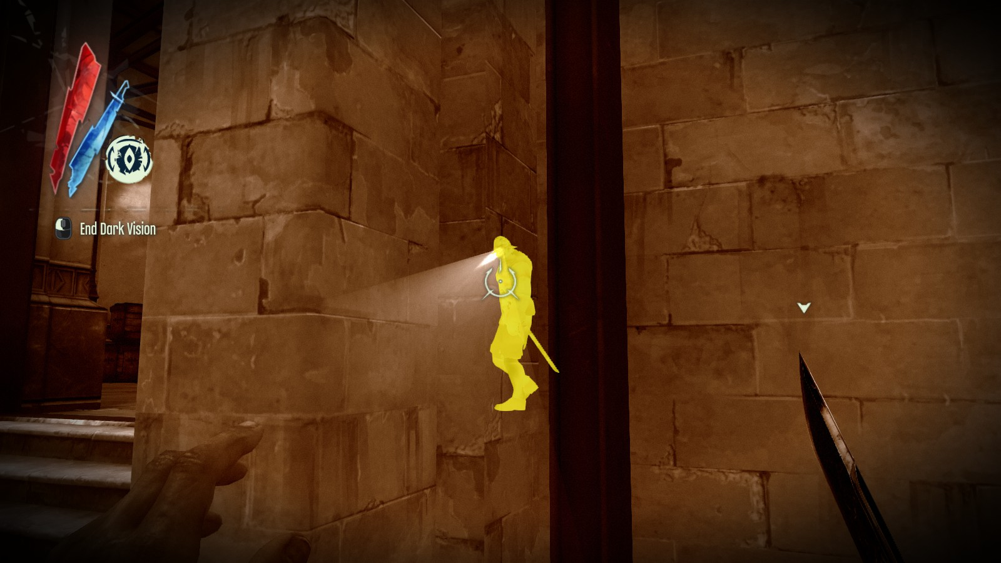
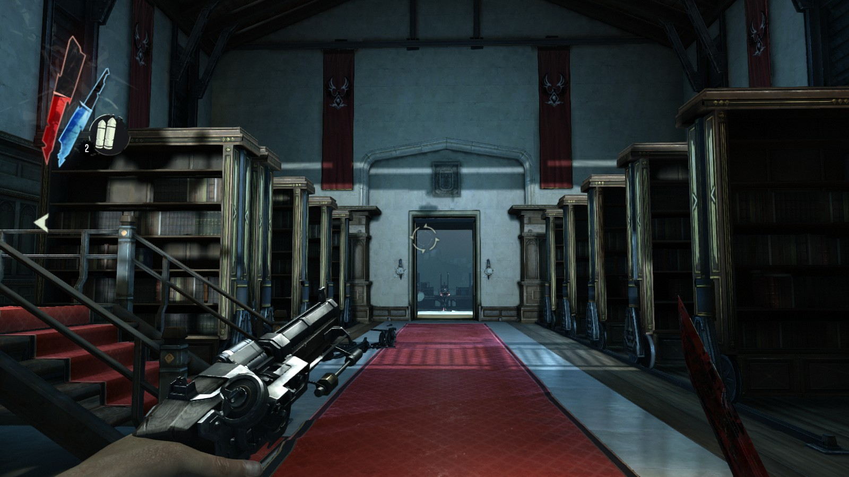
Game Review
Appropriate Audience
Rated M for Mature!
Deserves its M rating.
Combat is gory and violent with limbs and heads flying everywhere and Corvo’s sword realistically sinking into enemies’ bodies.
One level takes place partly within a brothel.
Things stay PG compared to The Witcher though.
Mostly just highly suggestive.
Plague victims act like zombies and vomit / cough blood, while blood weeps from their eyes giving the game a strong horror theme.
“Strong language” …lots of adult language.
Similar Games
Thief Series
Bioshock Series
Metal Gear Series
Deus Ex Series
Comparison Between Games
Dishonored feels more open than any of its competitors and the diversity of playstyles and challenge is on par with Deus Ex: Human Revolutions.
Dishonored also offers a world that evolves based on the player’s choice better than any of its competitors.
Dishonored’s weapons and powers all seem useful while those in its competitors seem to only have a useful subset of options.
However, Metal Gear games often have longer level design and lengthy cinematics not found in Dishonored.
I would rank Dishonored as the leader in the pack in terms of gameplay and storytelling amongst its closest competitors.
Image Source: In-Game Screen Capture
Image Source: In-Game Screen Capture

Slide 12
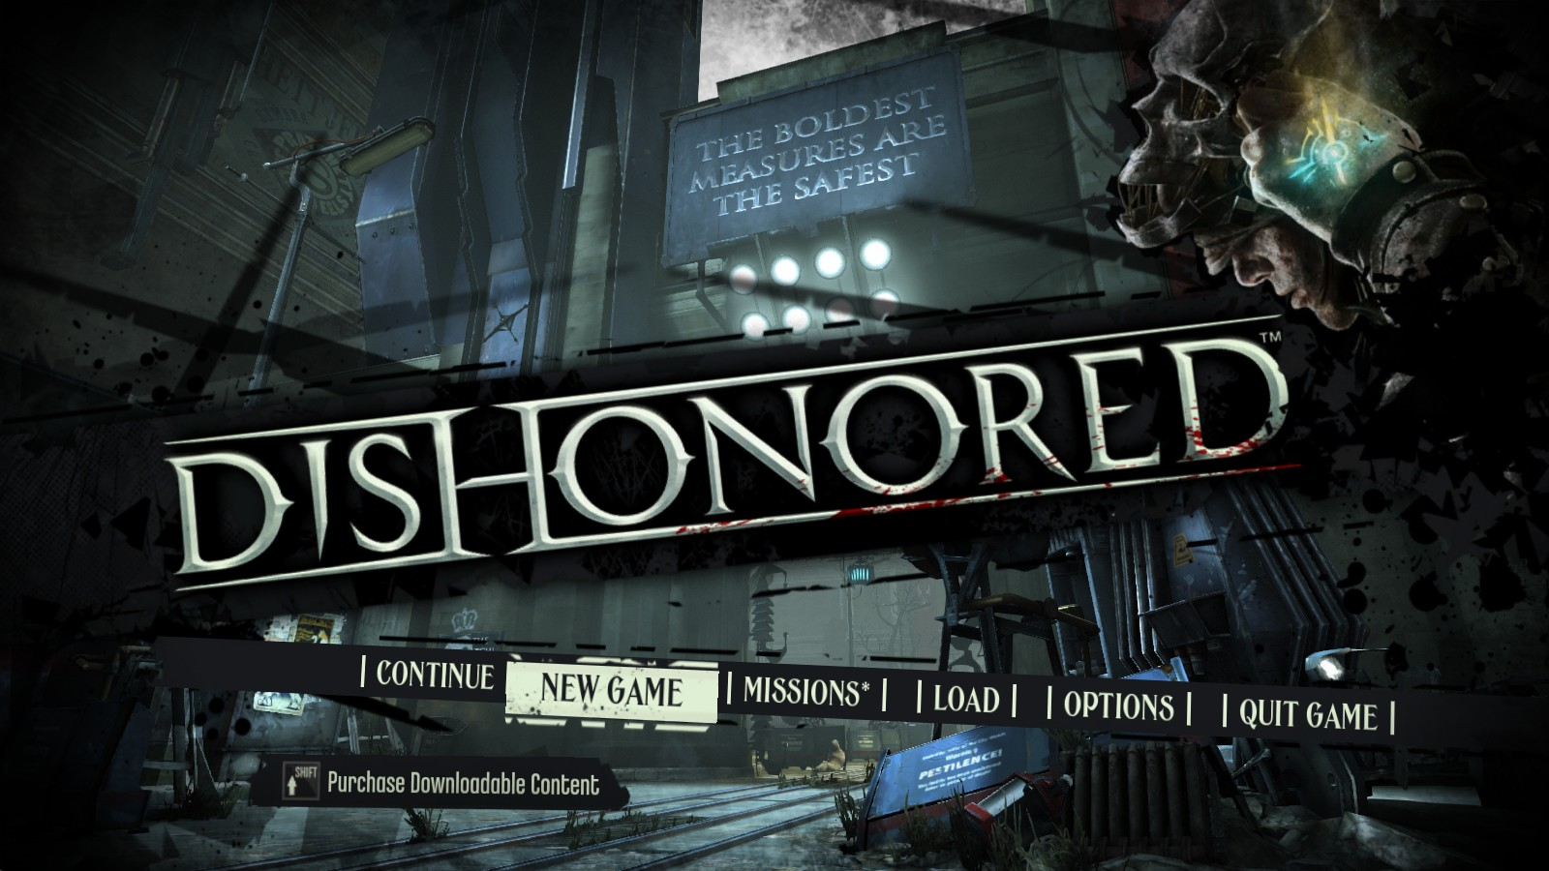
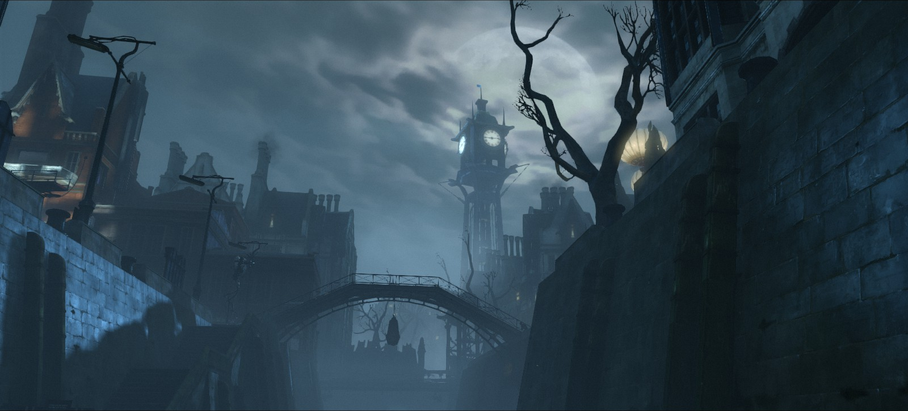
Summary
Overall Strengths
Immersive, gripping story
Player’s choices and actions change the story and world
Numerous, unrestrictive playstyle choices
Unique, creative, and mysterious setting
Well designed and challenging combat
Overall Weaknesses
Game AI needs a tweak
Level design needs some extension
Lack of Replayability due to being a story focused game
Ways it Could Be Improved
Make the Game AI more challenging by recognizing certain situations and adjusting its behavior accordingly so that:
Missing guards at posts when seen by another guard results in an alarm.
AI won’t shoot its compatriots in the back.
Extended level design to make the levels longer.
Increasing the complexity of the endings so that there are more than 3 potential endings.
Worth Purchasing?
Yes, don’t miss this fantastic gem of a game.
It’s definitely worth playing and getting to experience Dunwall and the world of Dishonored.
Final Rating: A Must Buy!
Image Source: In-Game Screen Capture
Image Source: In-Game Screen Capture

