Slide 1
Rust
Created by Facepunch Studios
Presented by Ben Walker

Slide 2
Basic Information
Rust is a survival game
Target Audience: Adults (lots of male nudity, quite violent, difficult game)
It is currently selling for $20
Can buy 4 copies for $60
Early Access Game
Available on Steam and Humble Store
Steam installs the game for you and the Humble Store gives you a key to use on Steam

Slide 3
System Requirements
Minimum Requirements:
OS: Windows 7 64bit
Processor: 2 ghz
Memory: 4 GB RAM
DirectX: Version 9.0
Hard Drive: 4 GB available space
Network: Broadband Internet connection
Actual Requirements:
OS: Windows 10 64bit
Processor: 3 ghz
Memory: 8 GB RAM
Graphics: Nvidia GTX 980
DirectX: Version 12
Network: Broadband Internet connection
Hard Drive: 10 GB available space

Slide 4
Summary
You wake up on an island naked with a rock the size of a football. With that beginning rock you must harvest resources then make tools, shelter, and weapons. Other players have this same goal. Up to 200 players can be on a server before lag issues begin. The game world is persistent; when you leave, other players do not have to stop playing.

Slide 5
User Interface
View -- First person shooter
Inventory System (Drag and Drop)
Crafting List (Buttons)
Interaction (Radial Menus)

Slide 6
Gameplay
Early Game -- Using tools to gather resources in order to build more tools and a base to protect your belongings. Hunting for food using a bow
Mid-Game – exploring the areas surrounding your base in order to find gear (armor, weapons, extra food, blueprints that allow you to craft new items) or perhaps another player to kill (when you kill a player you can take everything they have on them)
Late-Game – Taking guns and explosives to break into a player’s base in order to take everything that have gathered and stored (whether they are online...OR NOT!)

Slide 7
Gameplay
Working as a group gives people a huge advantage over solo players
A player is only as good as the amount of items they have stored, the size of their base, the number of people in their group, and the number of hours each day that they can play
More numbers or more hours played will beat out any amount of skill a player may have if they hope to compete for territory that a larger or more active group plans to control
This is not specific to Rust. Groups and activity are major components of most survival games.

Slide 8
Art and Sound/Music
Rust was made using Unity and has a 3D, realistic design
Rust has one song which is just ambient noise to block out the silence that surrounds the player.
Many people turn off the music and turn up their sound in order to hear footsteps, rustling of bushes, growls of bears or wolves, or the sounds of gunfire.
Hearing a threat from a distance can mean the difference between life or death and music can destroy that opportunity.

Slide 9
Bugs
Rust is an Early Access game. This means that the game is not officially released. The game has many bugs and that is expected since new content is added every two weeks
Major bugs are fixed almost immediately since players invest so much time and have so much to lose in this type of game
Certain bugs may have been created and others fixed since I last played a few weeks ago. The game is constantly changing.

Slide 10
Fun or Not?
I personally have over 600 hours played in Rust over the course of its development since day one on December 11th in 2013.
Over its lifespan, the original game was basically scrapped and remade from the ground up keeping true to Rust’s core elements.
I have convinced people to play the game or avoid it by giving true explanations about what is very good and very bad about Rust in its own regard and then compared to other survival games

Slide 11
Fun or Not?
There are simple things that can make Rust not very fun for people to play:
If you made a base within a 10 minute run of a group that has more people or plays more hours then it is likely that one day you will log in to see a wall blown off your base and all of your items taken
Losing hours of work put in by multiple people is much worse than dying and respawning in a shooter game
Servers tend to wipe everything every two weeks or so since people tend to abandon servers after that time anyway. Server wipes and people leaving make all your work disappear or pointless
Many people break in when you are offline. You never get to defend your base and items

Slide 12
Fun or Not?
Those negatives are also what make the game fun:
Creating a base that can deter raiding players
Raiding a poorly built base is easy loot
Raiding a well built base is a great challenge
Getting back at someone who killed you (and took all your items) is very rewarding
Stealth, planning, and coordination are all key elements to success and many people enjoy these things in a game
Exploration is rewarded with a chance to find everything from a can of tuna to an RPG Launcher and the environment is procedural so it is different every server

Slide 13
Similar Games
Major competitors are ARK: Survival Evolved, H1Z1, DayZ, 7 Days to Die, and many other survival games. I have played those survival titles and others as well
Rust’s major downfall is that the player’s only enemy is another player. Starving, Dehydration, Radiation, and Bears/Wolves pose such little threat even a half hour in that I do not even consider them obstacles to the player

Slide 14
Similar Games
ARK: Survival Evolved is Rust with Dinosaurs and a leveling system. The higher your level the more modern the tech you can build. Dinosaurs are a good non-player threat, but it takes MANY hours to level to the point of creating even a bow and arrow
DayZ is not focused on base building and everything you own is on your person. There is no offline raiding which is good, but also no base building and death is more punishing this way. Threat of zombies, starvation, and dehydration are very major.
7 Days to Die zombies are so difficult to deal with that players become the minor threat. Building is voxel based and digging is a neat feature to work with.

Slide 15
Strengths and Weaknesses
Rust is great to play with a group of friends if you have a few to many hours to play EVERY day. If you can play Monday and Thursday then everything you do Monday will be stolen or destroyed by Thursday
Solo play is hard and different than group play (smaller bases and less items) and if you put in 8 hours then 3 people who put in 2 hours have accomplished more than you because working in groups tends to be more efficient
Best base building system I have experienced in a survival game
Early Access means that if you like the game now then there is even more great content to be added

Slide 16
Strengths and Weaknesses
If you have the time to dedicate to a survival game and you would rather build a base and kill other players instead of fighting zombies, hunger, and dehydration then Rust is the best fit.
If you want to kill dinosaurs or zombies and really have to worry about food and water then there are better games out there.
Luck plays a small part in Rust. You may look in your first crate and find a blueprint for C4 or you may put 20 hours on a server and never find it. RNG can be a small issue, but nothing game breaking.

Slide 17
Possible Improvements
The first survival game to find a system to deal with offline raiding will become the most popular of the genre. People don’t like logging in to find that while they slept and went to work/school someone on a different sleep schedule broke in and undid most of the hours they put in during their limited time
They plan on adding vehicles, offline base defenses, and a non-player threat to the game as time goes on and those are much needed additions

Slide 18
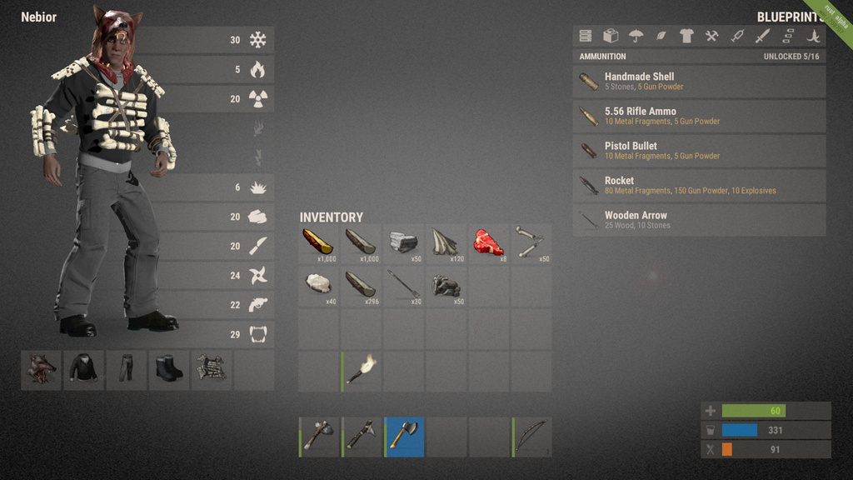

Slide 19
