Slide 1
By Alex Rebain

Slide 2
Information
Game Title: Wasteland 2
Developer: inXile Entertainment
Genre: Isometric RPG
Game Engine: Unity
Current Price: $40.00
ESRB Rating: Mature
Funded through kickstarter

Slide 3
System Requirements
MINIMUM:
OS: Windows XP/Vista/7/8/8.1 (32 or
64 bit) Processor: Intel Core 2 Duo or AMD equivalent Memory: 4 GB RAM Graphics: NVIDIA GeForce GTX 260 or Radeon HD 4850 (512 MB VRAM) DirectX: Version 9.0c Hard Drive: 30 GB available space Sound Card: DirectX compatible sound card
RECOMMENDED:
OS: Windows 7/8/8.1 (64 bit) Processor: Intel i5 series or AMD equivalent Memory: 4 GB RAM Graphics: NVIDIA GeForce GTX 460 or
Radeon HD 5770 (1 GB VRAM) DirectX: Version 9.0c Hard Drive: 30 GB available space Sound Card: DirectX compatible sound card

Slide 4
Overview
Takes place after a nuclear war
Take command of a squad of rangers
Investigate strange occurrences in the Wasteland

Slide 5
Gameplay
Isometric RPG
Real time world exploration
Strategic turn based combat

Slide 6
The Good
A non linear story where player actions affect the world and the rest of the story
High replay ability
Good artwork and immersive music
Challenging combat
Cheaper price
Destructive cover system
Good character creation

Slide 7
The Bad
Not very forgiving for newer players, and even veterans some times
Weak graphics
Some quests can be difficult to figure out how to solve them the best way
Released with many bugs
Tedious settlement design

Slide 8
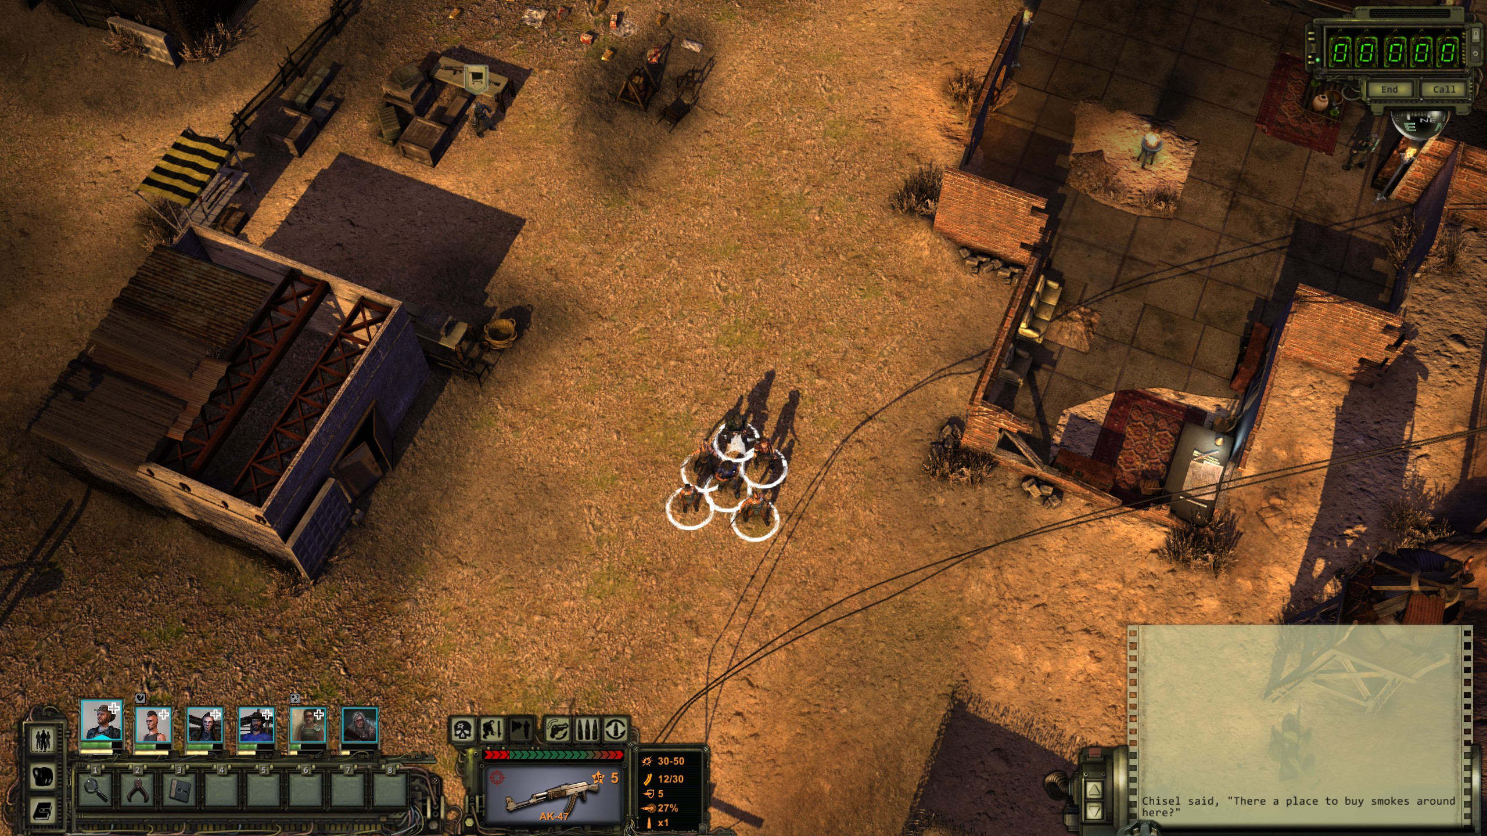
Screenshots

Slide 9
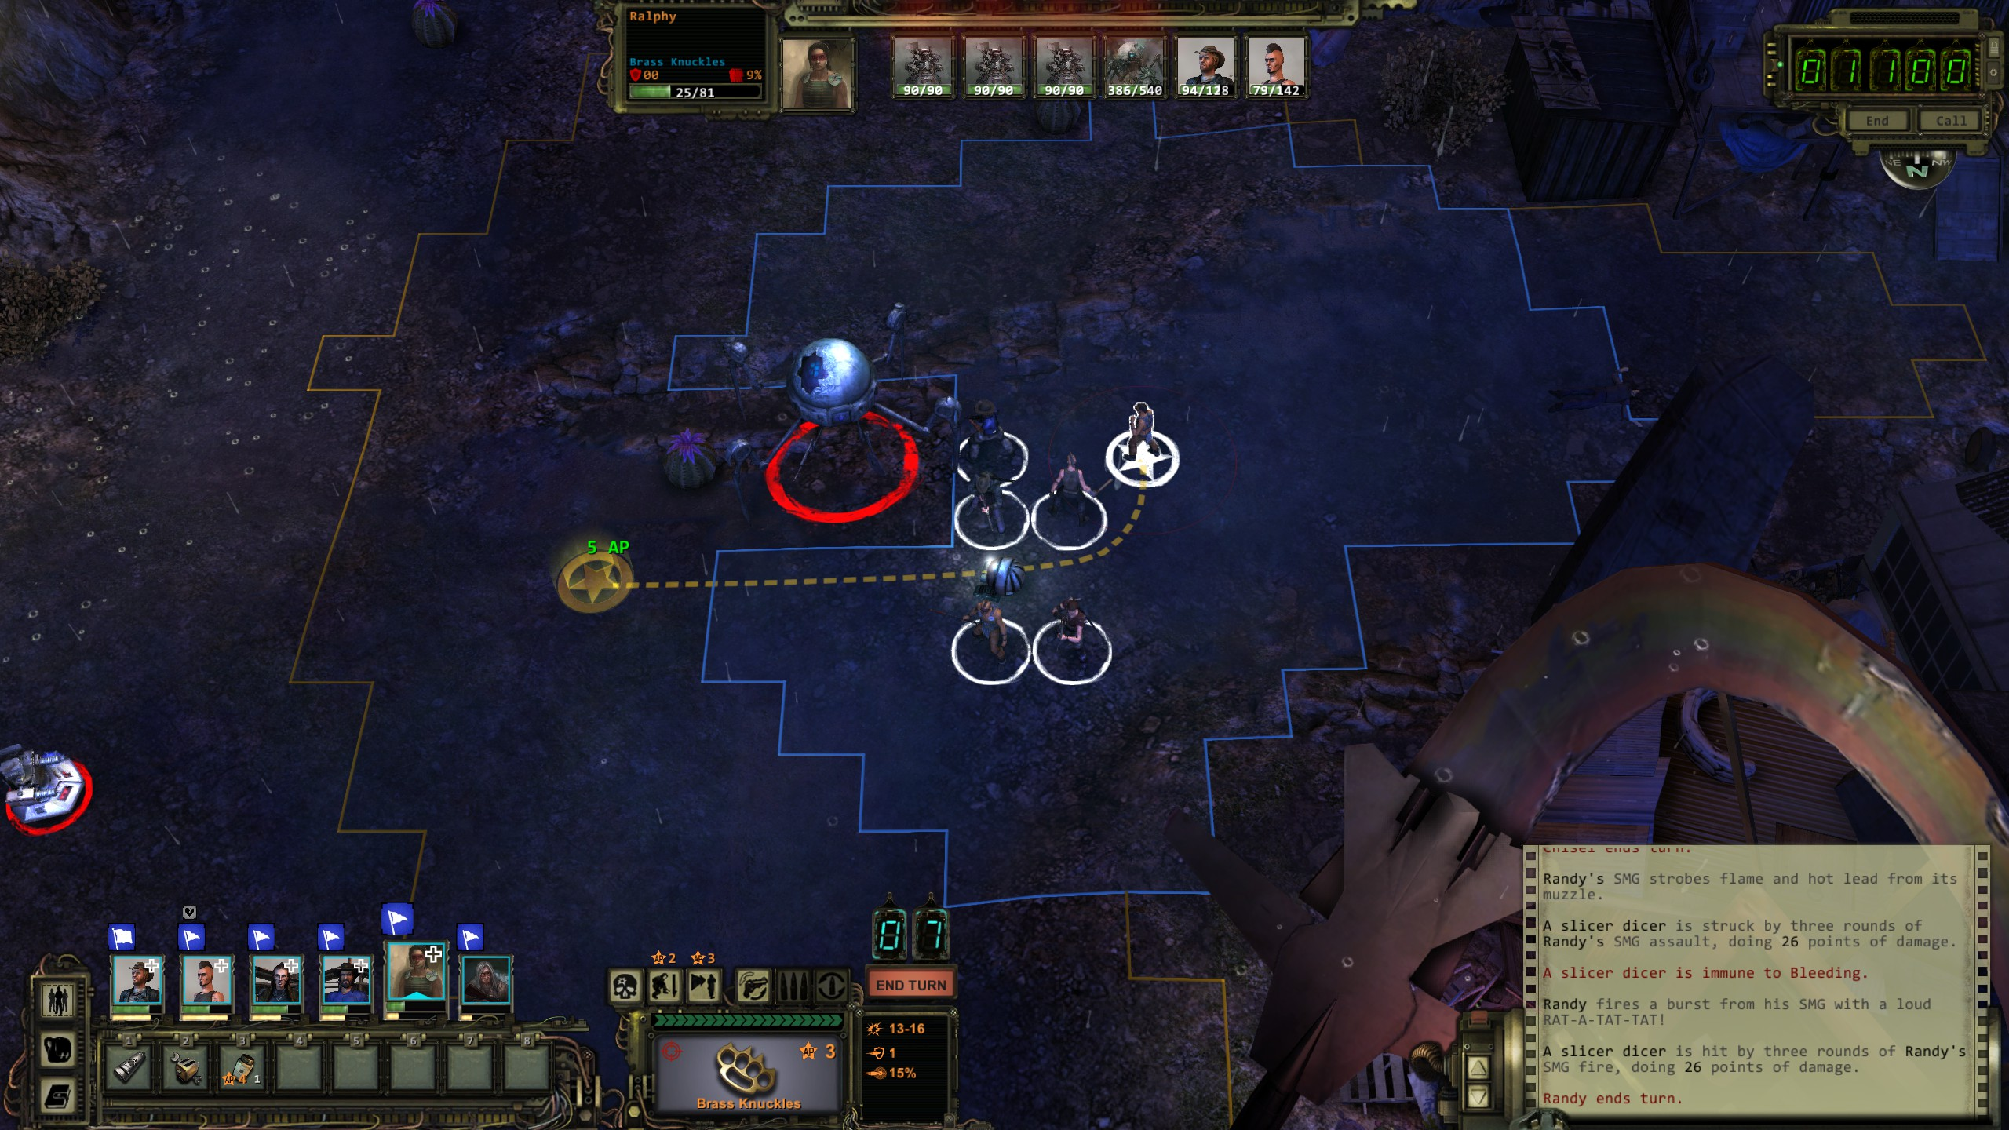
Screenshots

Slide 10
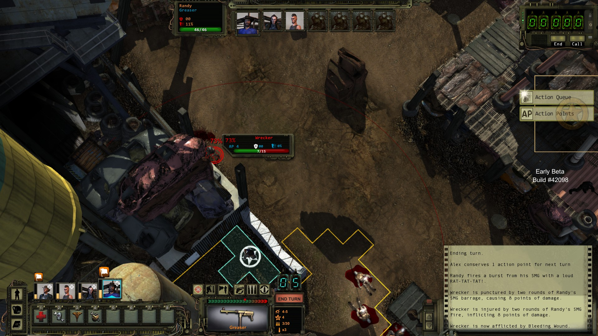
Bug Example

Slide 11
How Does it Compare?
Not many recent games in a similar genre
Divinity: Original Sin
Best comparison is Fallout 1&2

Slide 12
Comparing to Fallout 1&2
Newer graphics and sounds, not necessarily better
Better combat (more tactics and cover)
Less ways to solve problems
Slightly less interesting world
A lot of the same design aspects

Slide 13
Summary
Recommended to any RPG fans
Strengths:
Classing cRPG gameplay
Strategic and challenging combat
High replay ability
Weaknesses:
Poor graphics
Many Bugs
Weak voice acting

