Slide 1
Warframe Evaluation
By James Nelson

Slide 2
Basic Information
Game title
Warframe
Company & Author
Digital Extremes
Type of game
Co-op third-person shooter
Price
Free to play (FTP) with optional micro-transactions
The premium currency in the game can be traded with other players, making even the premium items attainable without putting money into the game.

Slide 3
Minimum/Standard stated hardware requirements
OS: Windows XP SP 3 or higher
Processor: Intel Core 2 Duo e6400 or AMD Athlon x64 4000+
Memory: 2 GB RAM
Graphics: Nvidia GeForce 8600 GT or ATI Radeon HD 3600
DirectX®: 9.0c
Hard Drive: 10 GB HD space
Other Requirements: Broadband Internet connection

Slide 4
Game Summary
Warframe is a cooperative free-to-play third person online action game that is commonly described as “Space Ninjas”. You take the role of a Tenno, an ancient warrior that has been awaken from cryo-sleep and are now tasked with maintaining the balance of power in the Sol solar system.

Slide 5
Story line
The story takes place in only a small number of missions and quests. These revolve around “Assassination” boss levels, scripted quests, and several community events that are continuously being rolled out. These missions flesh out the idea that the current state of the solar system is in disarray between the three battling factions of the Grineer, Corpus, and Infected. The quests are multi-mission contained stories that delve into the lore of the universe, whether it be bosses, allies, or powerful new objects.

Slide 6
Player's role
The varying missions task the player with fighting back against the enemy forces and dealing with the new threats that arrive from each side. This takes place in missions that span Asteroid fields, moons, spaceships, to the surfaces and sub-surfaces of the planets in the solar system. Beyond these setting are the end-game raid-style “Void” missions in separate pockets of reality.

Slide 7
Installation
The game has standalone installer/launcher that can be downloaded off Digital Extremes website or Valve’s Steam service. There is currently no official physical way of purchasing the game. The launcher will automatically check for and download updates if any are found.
User Interface
The game accepts standard mouse and keyboard input, with all the inputs remapabale, along with gamepad support.
There is no support for any type of VR headset or motion controller.

Slide 8
Game Play
Warframe’s main gameplay is a combination of parkour acrobatics and third person shooting.
Each Warframe also has unique abilities that they can use.
This varies between the two main sections of PVE missions and the newer PVP missions.
Each mission takes place in a different environment which have varying tilesets. These tilesets are used to create the randomly generated maps that each mission uses to make repeated playthroughs different.

Slide 9
Game Play
The mission types are:
Assassination
Capture
Crossfire
Deception
Defense
Excavation
Exterminate
Hijack
Interception
Mobile Defense
Recovery
Rescue
Sabotage
Spy
Survival
Trial

Slide 10
Game Play Demo

Slide 11
Scoring
At the end of each mission there is a statistic breakdown of each player that finished the current instance of the mission. This includes kills, % of total damage done, % of total damage taken, amount of pick-ups, etc.
The player also has a “Mastery Rank” which acts as their level. This level is increased by “Mastering” weapons, warframes, sentinels, etc. up to their maximum level of 30.

Slide 12
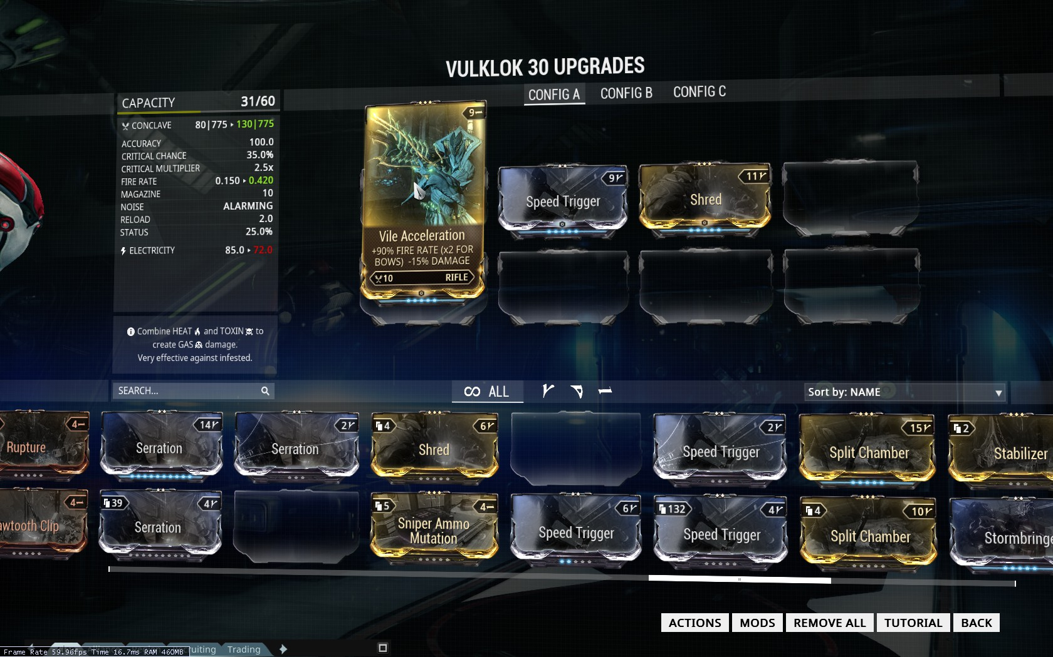
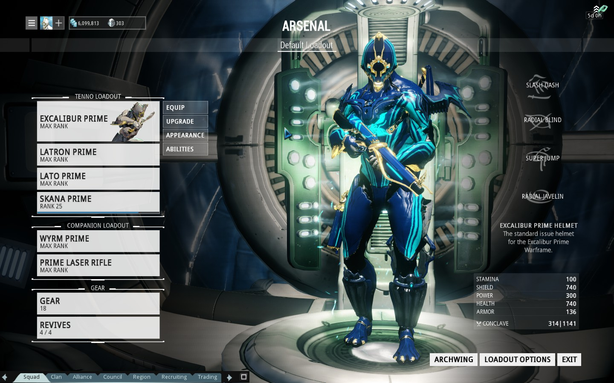
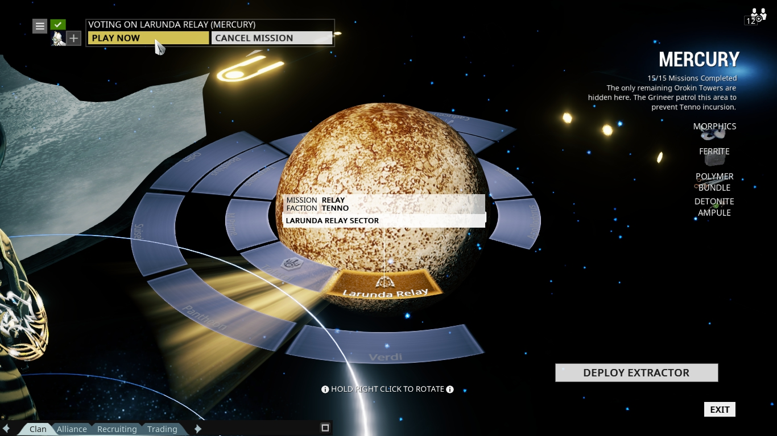
Artwork

Slide 13
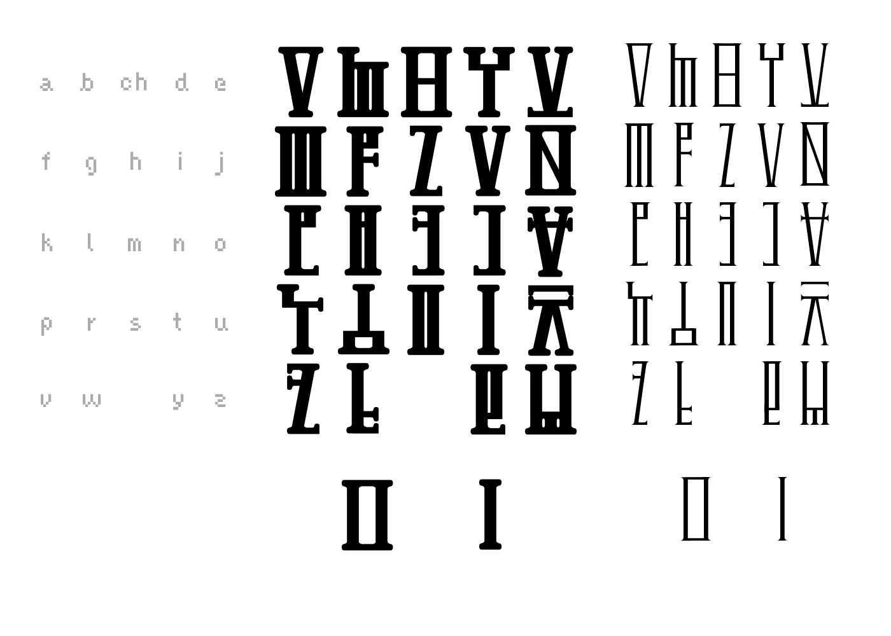
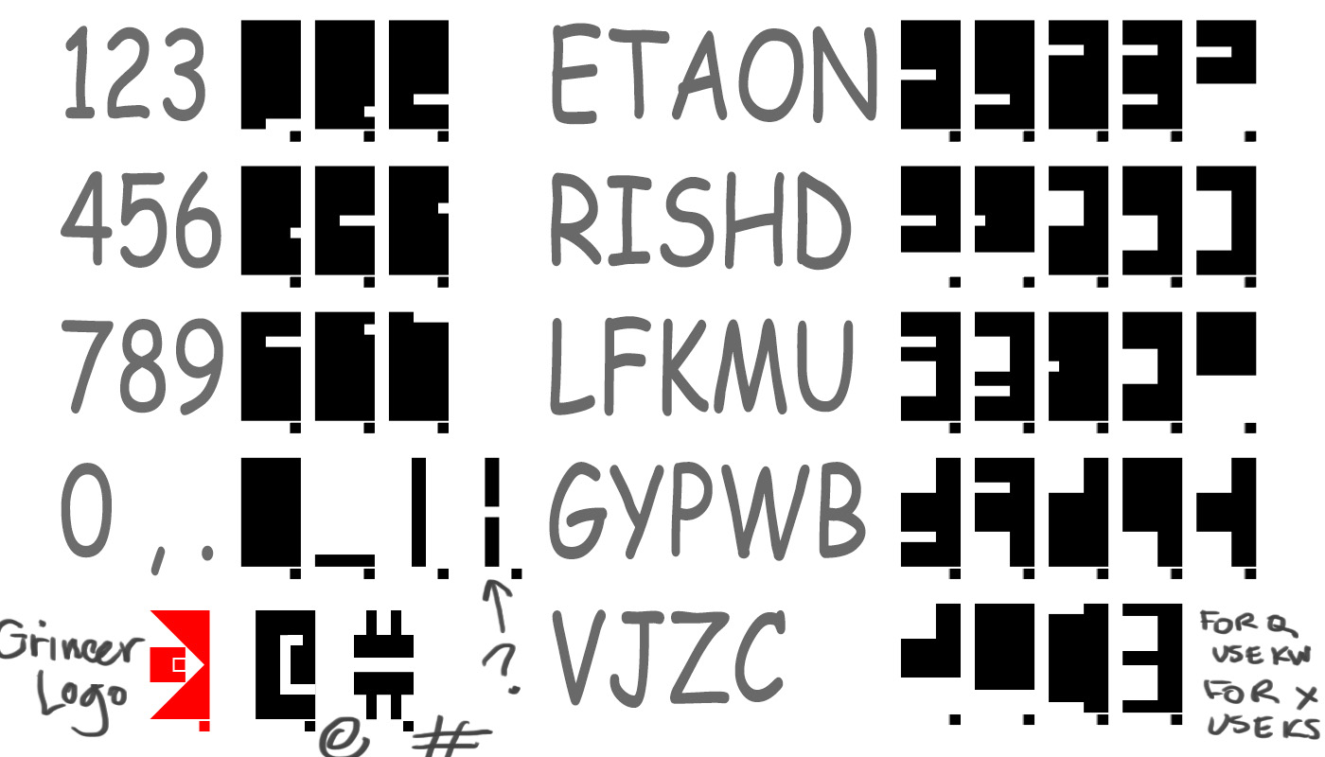
Sound and Music
Each faction has its own language with the enemies speaking in differing manners.
Every weapon and ability has unique accompanying sounds.
Each environment has different background music that is geared towards the environment it is playing in.

Slide 14
Special Features
The developers host timed events every so often. These can be as simple as double credit/XP weekends to new missions that introduce new mechanics or enemies.
Manual
There is no game manual included, although there is several tutorial missions that all new players go through.

Slide 15
Bugs
Being in open Beta, the developer is constantly rolling out new updates. Each update aims to introduce new mechanics and fix previous issues, but also ends up introducing new bugs that subsequent patches will fix.

Slide 16
Game Review
What is good (fun) about the game? Why?
The action is fast paced, always keeping the player busy with objectives and enemies. There is a large variation of enemies to use sizeable number of weapons on.
What is bad (not fun) about the game? Why?
The amount of grinding needed to acquire a needed weapon/warframe part or mod. Whole entire gaming sessions can be devoted to finding a single thing.

Slide 17
Game Review
How does it compare to similar games in the same genre?
The game maintains the standard third person shooter mechanics but aims more for run and gun gameplay instead of tactical cover based gameplay.
Compared to other Free-To-Play games, this one does not have a Pay-To-Win model. Instead it is more of a Pay-To-Not-Grind model.
Why is it better or worse than similar games?
The inclusion of parkour and acrobatics into the players arsenal makes simple tasks like traversing the environment enjoyable.
The regular updates by the developer continue to keep the game interesting

Slide 18
Game Review
What is the appropriate audience for this game?
This game is categorized as T for teen by the ESRB
Warframe is aimed towards people that want fast paced combat and action in their games while also offering the ability to socialize with other users.
Are any design mistakes present?
As of now, there is no apparent design mistakes

Slide 19
Summary
Overall strengths and weaknesses.
The game offers fast paced combat combined with very fluid player movement.
There is varying environments the player can go through with unique enemies
Acquiring the special “Prime” weapons and equipment can require a large amount of grinding.
The back story of the game is still being developed, leaving players with very few concrete details.

Slide 20
Summary
Is the game worth purchasing?
Considering that the game is free to play, it is definitely worth trying. Buying the premium currency is all based on whether you view the grinding for resources and parts tom build what can instantly be purchased worth your time or not.

Slide 21
Summary
How could it be improved?
PVP is in the middle of a large rebalance/revamp that makes it very unbalanced right now.
Implement a smart loot drop system to decrease the amount of grinding players have to do.

Slide 22
Questions?

