Slide 1
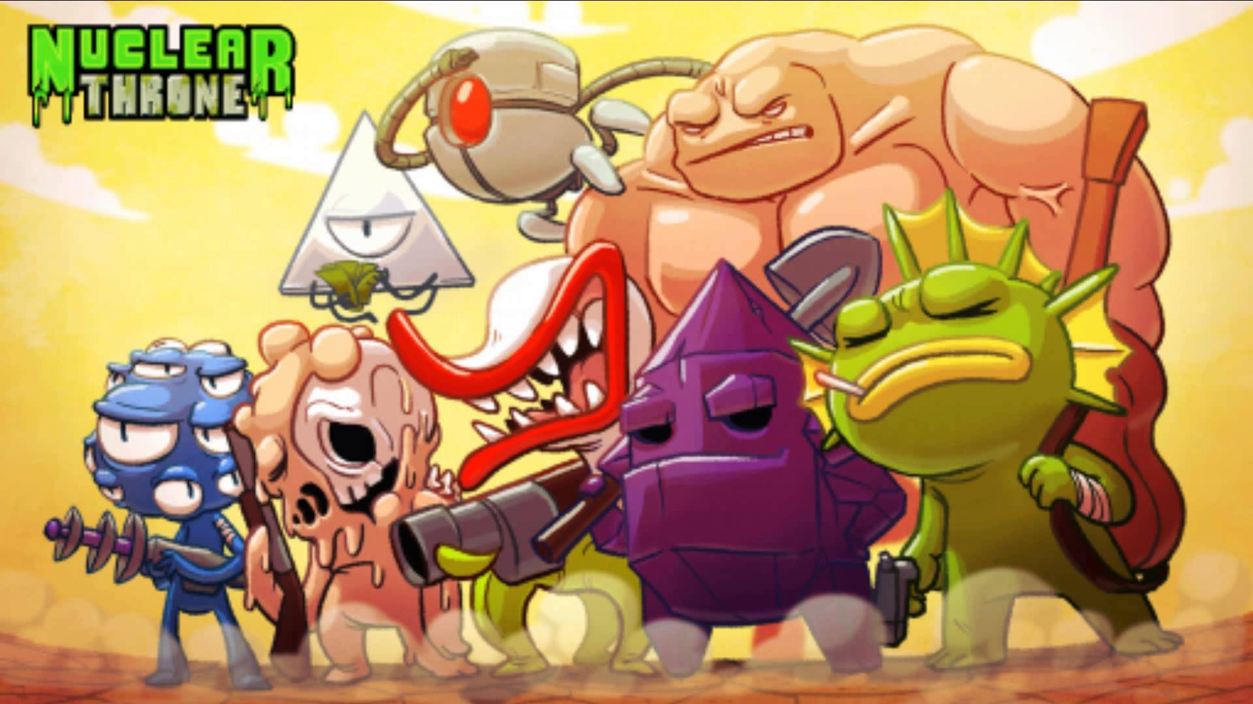
Nuclear Throne Evaluation
-By Chris Murdoch

Slide 2
Nuclear Throne Info
-Developed by Vlambeer
-Roguelike Overhead Shooter
-$13 on Steam Store

Slide 3
System Requirements
Minimum: Windows XP, 1.2+ Ghz processor, 1GB ram, 256MB Graphics memory, 200MB Hard Drive space.
Recommended: Windows XP, 2Ghz processor, 2GB ram, 1GB Graphics memory, 500MB Hard Drive space.
With today's technology, very easy to run.

Slide 4
Story Summary
You take on the role as one of many various mutants and must fight your way through a post apocalyptic world to reach the nuclear throne.
Potential spoiler: There's a final boss at the nuclear throne. Who wouldn't already assume that?
Get comfy and watch a video.
https://www.youtube.com/watch?v=2qhUTz6ldmI

Slide 5
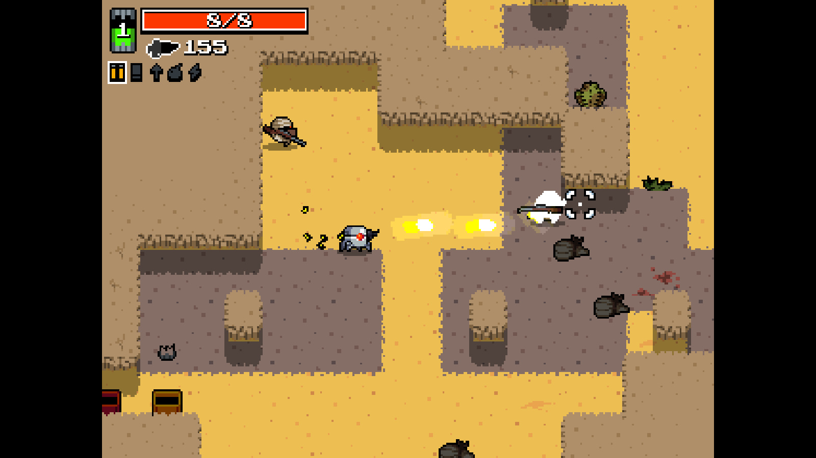
Basic Gameplay
You spawn in a desert, pick up weapons and after a few fast paced shootouts, defeat all the enemies and a portal to the next level opens.

Slide 6
Gameplay Continued
After leveling up from killing enough enemies, players can select a mutation which gives special bonuses. (Ex: More health, Energy weapons do more damage, etc...)
The farther you get, the harder it gets. There's occasional bosses, and the number of enemies goes up drastically.
IF you manage to get to the throne and beat the boss, the game loops and difficulty continues to go up.

Slide 7
Environment and Sound
Artwork: Goes with a retro-arcadey style, most everything is made from large pixels. Takes on almost an 8-bit style.
Soundtrack: Overall rock genre to it, but gets intense in the right situations and slows when necessary.

Slide 8
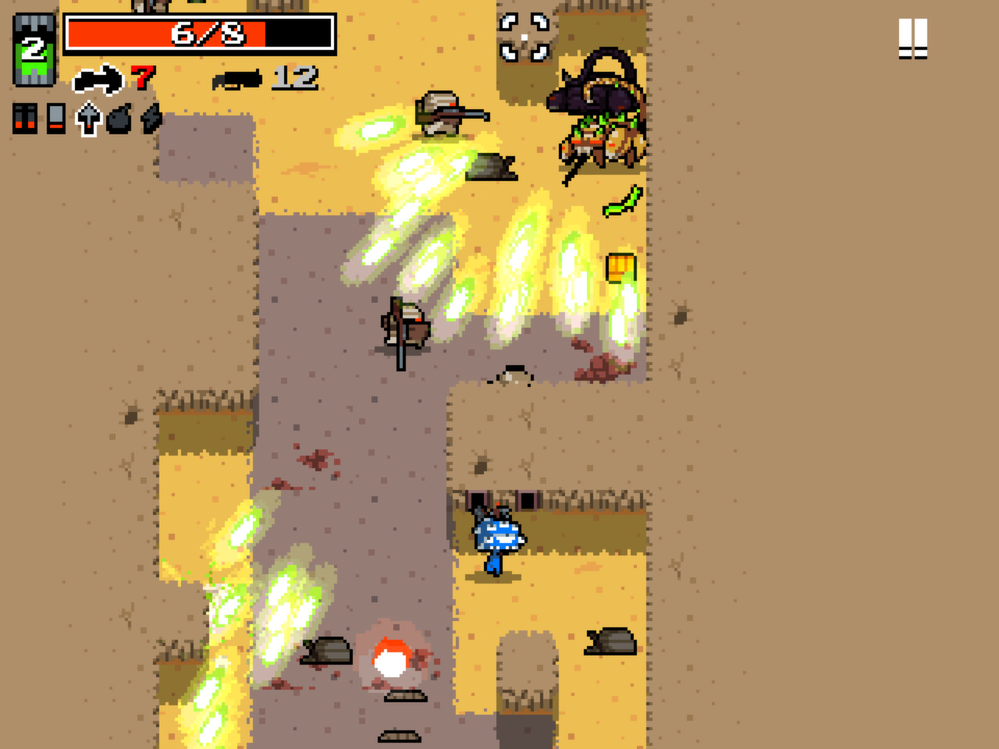
Screenshot Time

Slide 9
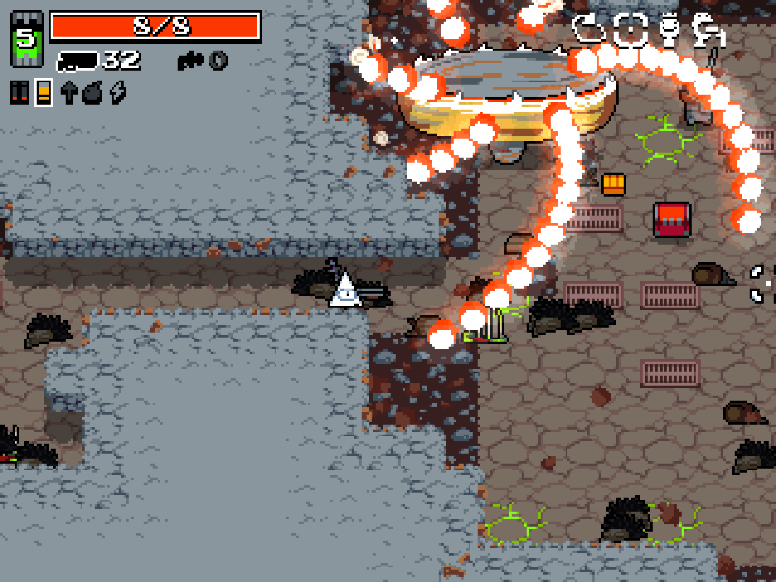

Slide 10
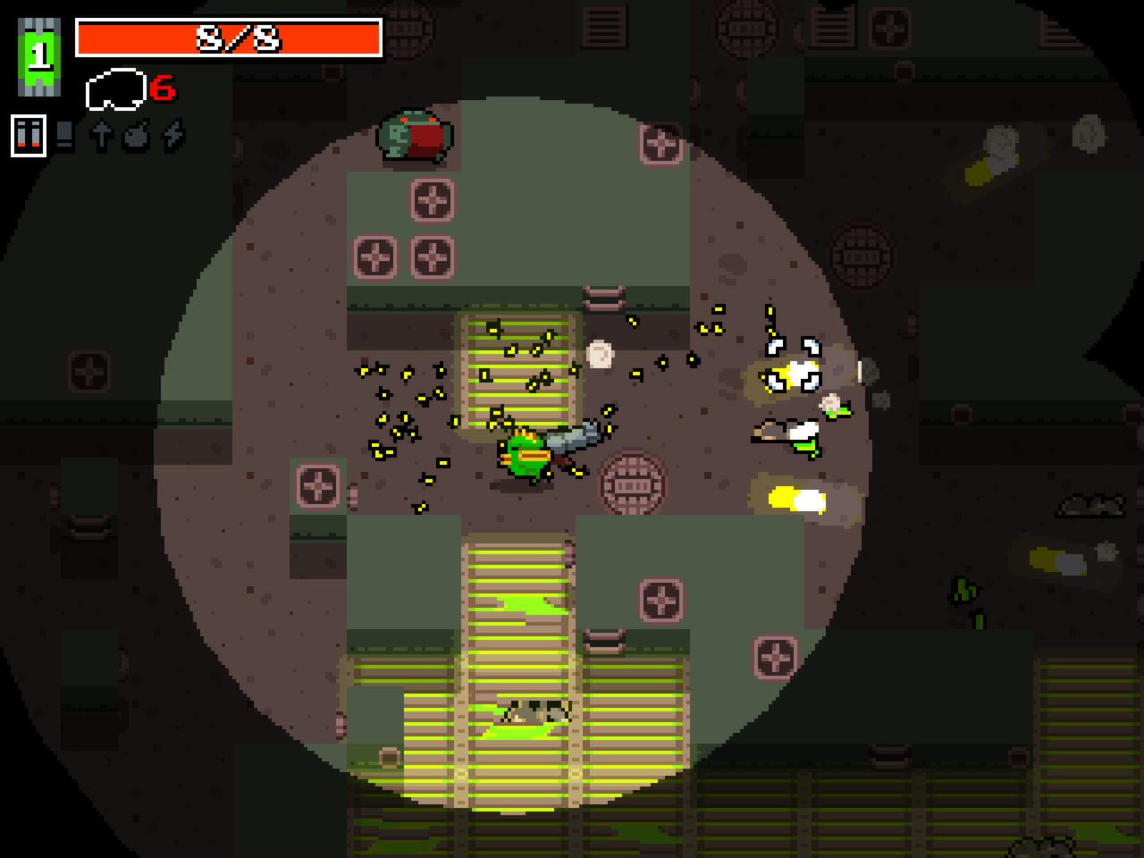

Slide 11
Pros/Cons
Why is it fun?
Tons of weapons and mutations
Currently 10 different characters with unique abilities.
Allows for many styles of play and different outcomes
Very Fast Paced, so games are quick and don't take much time.

Slide 12
Pros/Cons
Why is it NOT fun?
Pretty distinct genre. Not everybody would be into this type of game.
Very difficult. Starting out is frustrating, takes time to adjust to the game and gain skill.
Made you not hang out with your friends last weekend.

Slide 13
How could it be improved?
More guns. Add more types of guns. (There's already a ton, but still.)
Add more characters.
Currently in development weekly, so sometimes things get unbalanced and must be fixed and checked.

Slide 14
Conclusion
Super fun, fast paced roguelike that keeps you coming back.
Strong gunplay and strategy involved.
Is the game worth buying?
At only $13, it's more than worth the buy.

