Slide 1
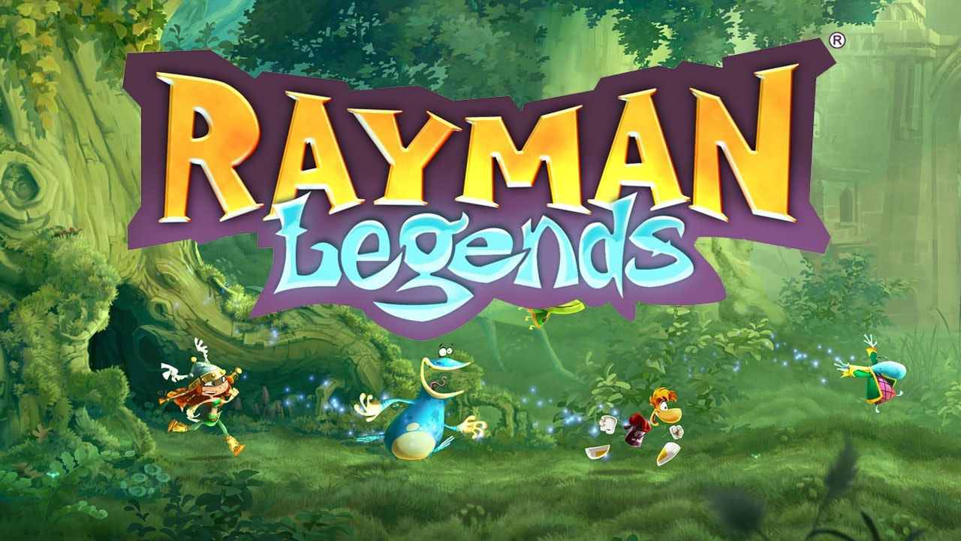
Rayman Legends
Evaluation by Samier mukhashen
CIS 487

Slide 2
Basic Information
Rayman Legends
Ubisoft in 2013
Platformer
Originally $60, Current Gen Re-release $40

Slide 3
System Requirements
Minimum
SUPPORTED OS: Windows XP SP3 or Windows Vista SP2 or Windows 7 SP1 or Windows 8 (both 32/64 bit versions) PROCESSOR: Intel Pentium® IV @ 3.0 GHz or AMD Athlon® 64 3000 + RAM: 2 GB RAM VIDEO CARD: nVidia GeForce 6800GT or AMD Radeon X1950 Pro 256MB VRAM with Shader Model 3.0 (see supported list**) HARD DISK: 6 GB available space SOUND CARD: DirectX Compatible Sound Card with latest drivers PERIPHERALS: Windows-compatible keyboard and mouse required, optional Microsoft XBOX360 controller or compatible
Recommended
OS: Windows 7 or Windows Vista SP2 or Windows 7 SP1 or Windows 8 (both 32/64 bit versions) PROCESSOR: Intel Core 2 Duo E4400 @ 2.0 GHz or AMD Athlon64 X2 3800+@ 2 GHz RAM: 4 GB RAM VIDEO CARD: nVidia GeForce 9600GT or higher, AMD Radeon HD3850 or higher 512MB VRAM with Shader Model 4.0 HARD DISK: 6 GB available space SOUND CARD: DirectX Compatible Sound Card with latest drivers PERIPHERALS: Windows-compatible keyboard and mouse required, optional Microsoft XBOX360 controller or compatible

Slide 4
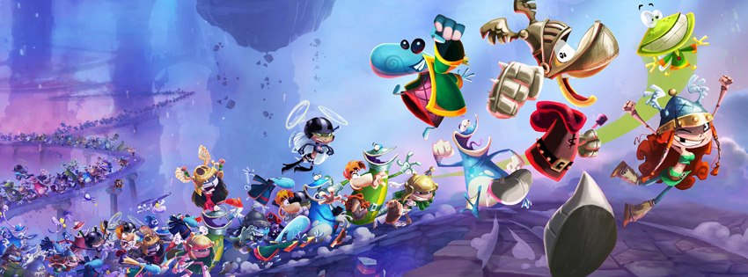
Quick Overview
Story: Rayman, Globox and the Teensies have been sleeping for a century. During that time, the Bubble Dreamer's nightmares grew in strength and numbers, and so has the Magician who by this time has split into 5 "Dark Teensies". Rayman and friends are awakened by their friend Murfy who tells them about the bad news, and tells them that the 10 princesses of the land (including Barbara) and the Teensies have been captured by the nightmares and the Dark Teensies. Rayman, Globox, the Teensies, and Murfy set out to defeat these new threats
Players Role: One of the many heroes.

Slide 5
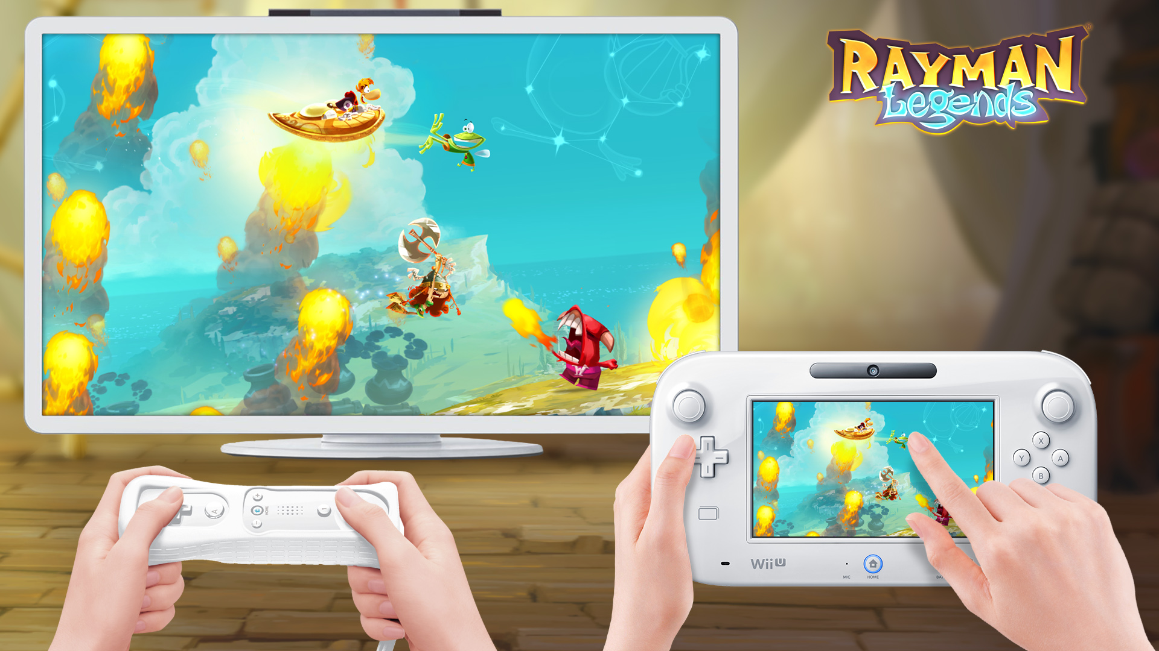
Quick Overview (cont.)
Installation: About 7 gigs
User Interface: Counter for Lums collected, Score for the level, and the Number of Teensies found on the level.
Gameplay: Players enter paintings to enter the various levels and worlds. Multiple characters to play as but its all cosmetic. There are multiple modes of play.
Single player platforming
Up to four player Co-op Platforming
Use of the touchscreen (If applicable) to control Murfy.
5th player will control Murfy If played on those devices

Slide 6
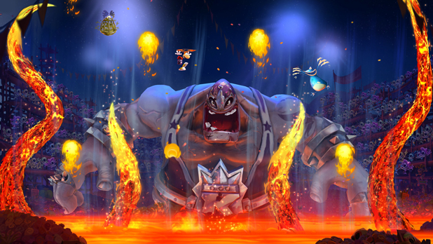
Asset Summary
Scoring: Points based on lums, and Teensies collected as well as enemies defeated.
Artwork: Very stylistic. Mostly 2D hand drawn sprites and animations. Bosses rendered in 3D but still keep the style.
Sound and Music: Each world has a different style of music. Ranging from Medieval style music to Mexican Mariachi bands.

Slide 7
Special Features
The Murfy levels where player controls Murfy and uses him to assist the main heroes in completing levels.
In the Wii U and Playstation Vita Version he is controlled by the touch screens and in the Other Console and Pc version he is controlled by a button.
Leaderboards and Weekly challenges to compete in.
Kung foot side mode where players face each other in soccer.
Most of the levels from the previous game Rayman Origins were ported over and remastered.
A mode called Invasions that consist of speeding through the level backwards under 60 seconds.
Special Musical Levels where the level is designed to follow the flow of the music.

Slide 8
Example of Music Level
https://youtu.be/HtAXSpBM8XI?t=8s

Slide 9
Miscellaneous
Manual- None
Bugs- When the game first launched on pc it wouldn’t load into the correct resolution and crash it was patched a day later.

Slide 10
Game Review
Good
All the Levels are different and varied.
The Music Levels provide a challenge as well as incredibly entertaining
The Weekly challenges are easy to do but hard to master
Tons of Content to do such as the Origins levels and collecting all the Teensies unlocks bonus Music levels.
If done correctly you can play a level in one single motion
Levels are a decent size. They don’t take too long and don’t feel too short.
Game wants you to explore to find all the Teensies but it doesn’t force you.
The Game feels great to control. All the characters have a slight float to them but it works well into the flow of the game

Slide 11
Game Review (cont.)
Bad
When playing with multiple players you can hit each other. Sometimes it will cause you to die or a friend will just repeatedly hit you into a box
Murfy levels on Wii U and PS Vita aren’t as fun due to being forced to play as him when playing alone. The AI will take over for Rayman and can move very slow.
Some of the menu system is clunky.
To get into any level you have to physically run to the painting. Those can get long.
There is no online play. All Co-op must be done locally

Slide 12
How does it compare?
It perfects the platforming genre as well as adding a bit of challenge to it.
Some people find Mario games too easy this takes it and adds a bit of difficulty along with many movement abilities. Such as flying, swimming, shooting, and wall running.
No two levels are the same. And are all well thought out so it doesn’t become stale.

Slide 13
Appropriate Audience
Anyone over the age of 5.
The visuals and music will keep people in
Allows you to take it at your own pace most of the time.
You can set your own difficulty.

Slide 14
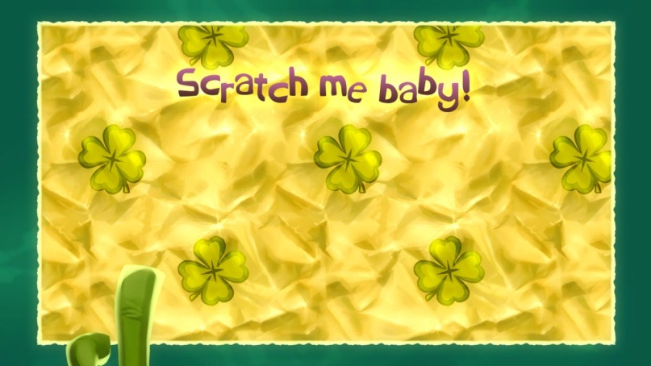
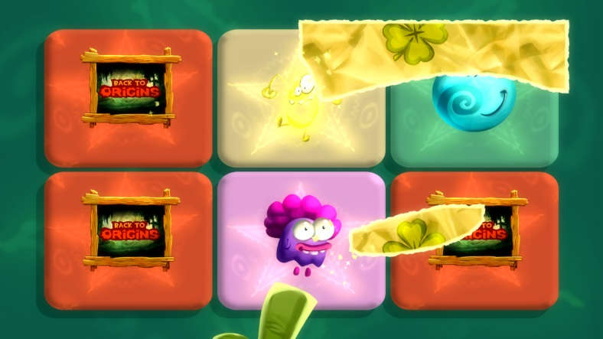
Design Mistakes?
The Menu system is pretty clunky
There is a thing called Lucky Ticket that you accumulate as you beat levels. Scratching them off wins you something like an extra level or Lums. When you scratch one off and you have multiple you have to navigate back to the menu and open another.

Slide 15
Summary
Strengths
Level Design
Visuals
The game feel (control of you’re characters)
The Amount of Content available to do
Weakness
Hitting each other at the wrong moment
No online
Forced Murfy levels on Wii U
There is no quick way to navigate to levels

Slide 16
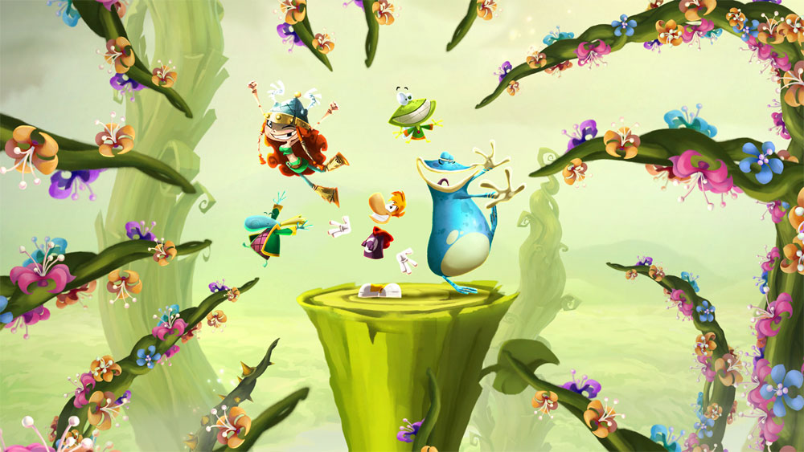
Should you buy it?
Yes, as long as you like platformers this game is one the best I have ever played.

Slide 17
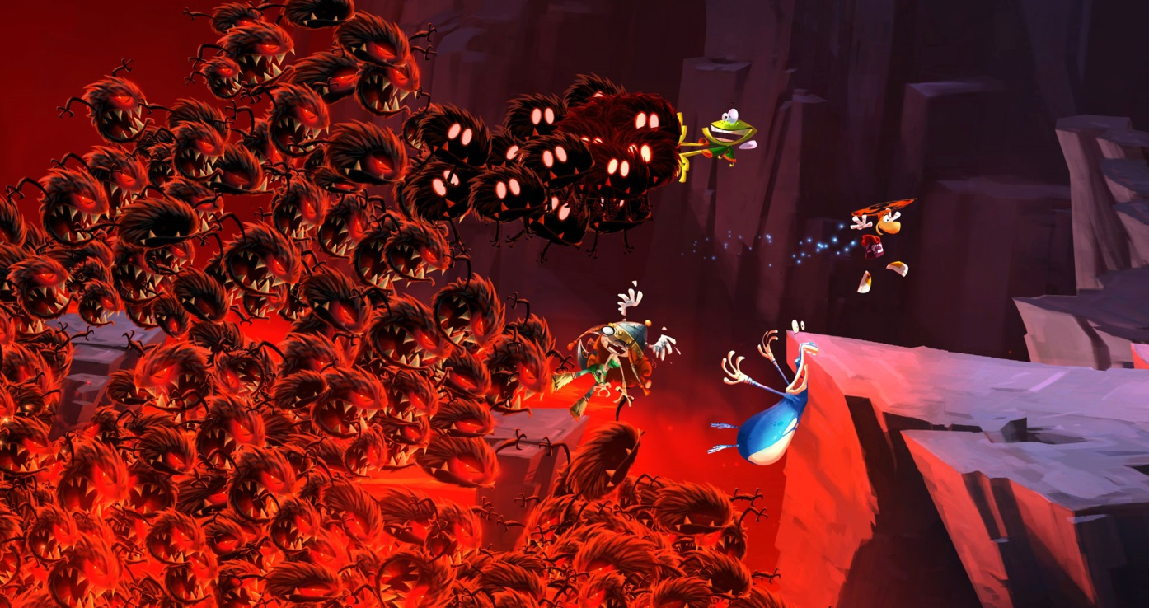
How to improve it?
Add the ability to fast navigate to the levels. Like a list
Make the menu less clunky.
Online play

