Slide 1
Magicka Game Evaluation
Ryan McNichol
CIS 487

Slide 2
Magicka
Publisher: Paradox Interactive
Developer: Arrowhead Game Studios
Genre: Action/Adventure
Price: $9.99 (without Steam sale)

Slide 3
Hardware Requirements
OS: Windows XP/Vista/7 (32- or 64-bit)
Processor: Intel® Pentium® IV 2.4 GHz or AMD 3500+
Memory: 2 GB RAM
Hard Disk Space: 2 GB Available Space
Video Card: NVIDIA® GeForce 8800 or ATI Radeon® X1900
DirectX®: DirectX 9
Sound: DirectX-compatible sound card
Additional: 3-button mouse, keyboard and speakers. DSL Internet connection for multiplayer. .NET 3.5 required

Slide 4
Installation
The game is primarily purchased through Valve’s Steam platform
Once purchased through Steam, the game will be downloaded and installed automatically

Slide 5
Game Summary/Description
Single-player or online multiplayer (up to four)
Combine elemental magic to create and cast powerful spells in battle
Progress through 12 chapters (levels) of story, each ending with a unique boss

Slide 6
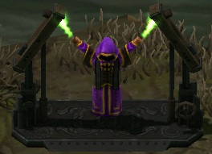
Storyline
Some time ago a powerful wizard named Grimnir was jailed by the Order of Magick for having too much magic-related ambition
Now, from the location of his imprisonment at World’s End, he is causing all kinds of trouble for the people of Midgard

Slide 7
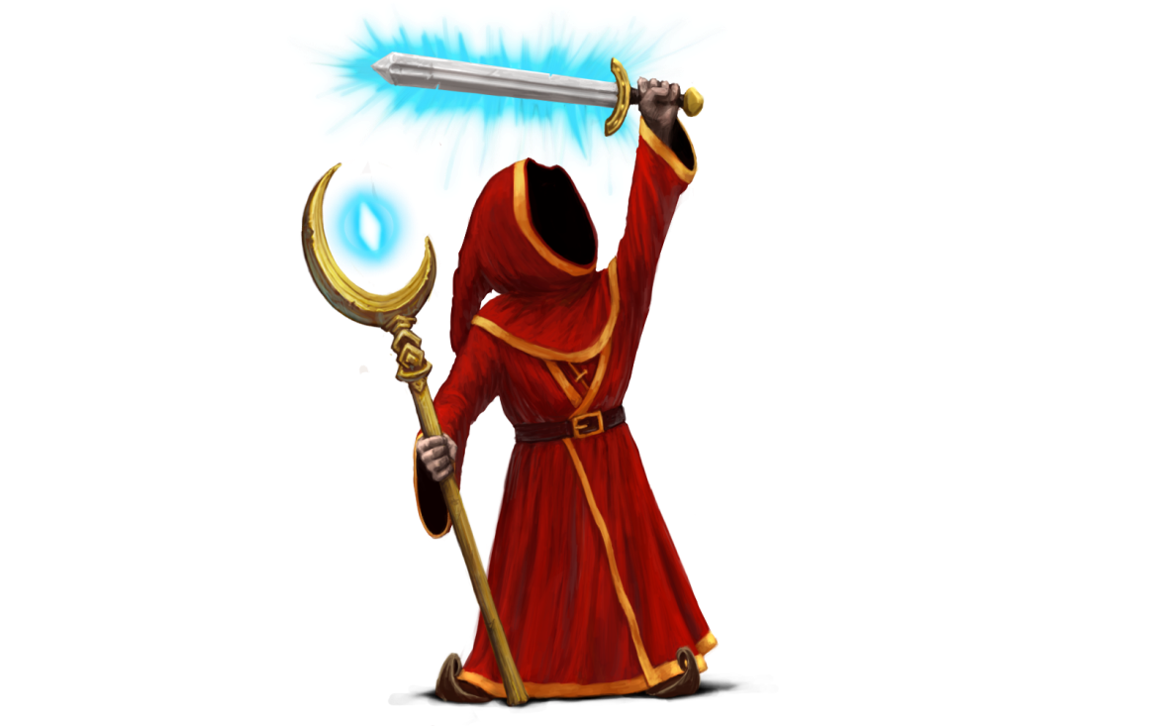
Player’s Role
Player takes the form of a single mage (along with up to three other mages in cooperative play)
The player and friends are tasked
with using their mastery of magic
to stop the troll invasions,
ultimately leading them to Grimnir

Slide 8
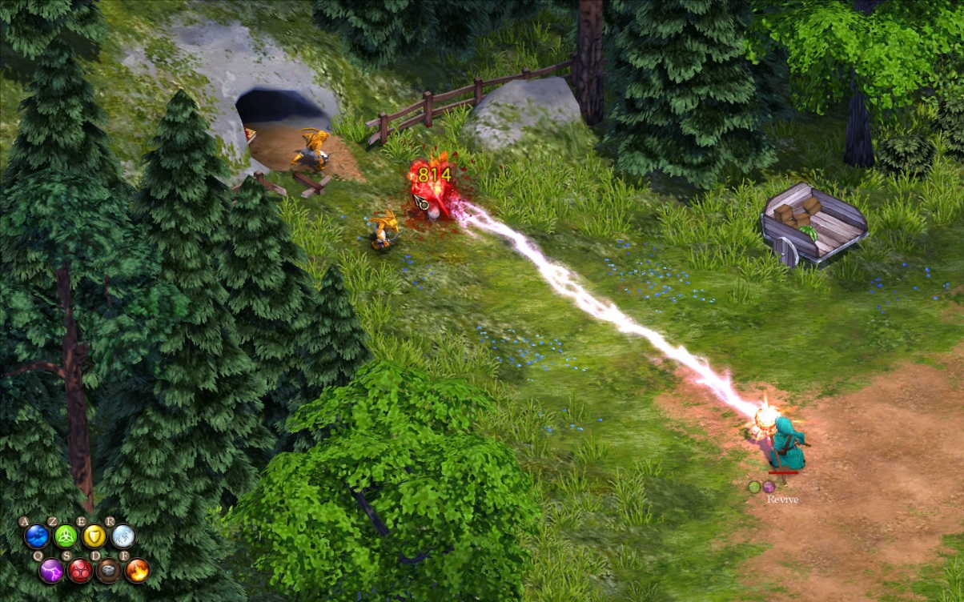
User Interface
Isometric camera centered on the player(s)
8 Elements always on screen
Health bars present over each player and each damaged enemy

Slide 9
Gameplay
Gameplay consists of using elemental magic to kill enemies
The player has access to a total of ten elements, eight basic ones and two which are created from combining pairs of basic elements

Slide 10
Gameplay (cont’d)
Water (Spray)
Soaks
Knockback
Hazardous to mix with Lightning
Life (Beam)
Locks On
Healing
Opposite to Arcane
Shield
Protective barrier
Can be boosted
Opposite to Shield
Cold (Spray)
Slows
Effective vs. wet targets
Opposite to Fire

Slide 11
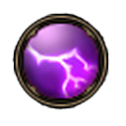
Gameplay (cont’d)
Lightning
Effective vs. wet
targets
Effective vs. armor
Hazardous to mix with Water
Opposite to Earth
Arcane (Beam)
Locks On
Explosive
Opposite to Life
Earth (Projectile)
High damage
Knockdown
Opposite to Lightning
Fire (Spray)
Damage over time
Causes Panic
Opposite to Cold

Slide 12
Gameplay (cont’d)
Steam (Spray)
Fire+Water
Soaks
Causes Panic
Opposite to Cold
Ice (Projectile)
Cold+Water
Multiple Shards
Piercing
Opposite to Fire

Slide 13
Gameplay (cont’d)
Pressing the respective key on the keyboard for an element will cause the player to “queue” up that element, with a total of 5 elements per cast
The player can then cast the spell in one of four ways: target direction, area of effect, cast on self, or imbue weapon

Slide 14
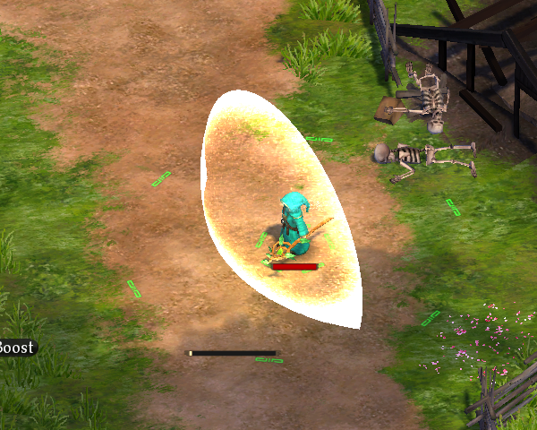
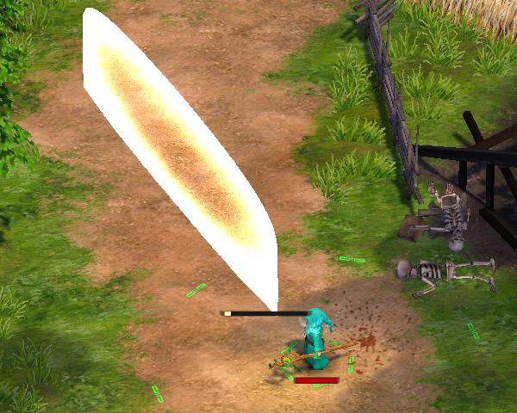
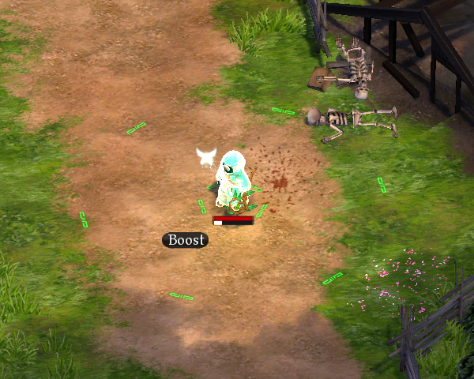
Gameplay (cont’d)
Normal Cast
Area Cast
Imbue Cast
Self Cast

Slide 15
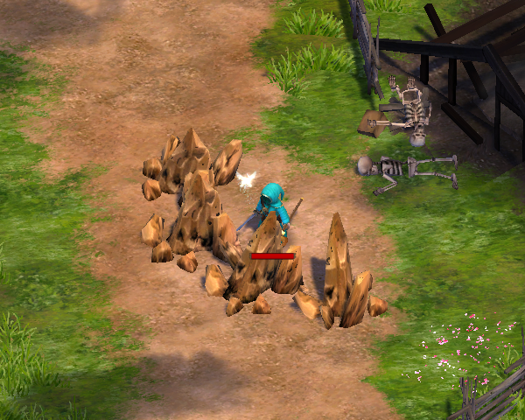
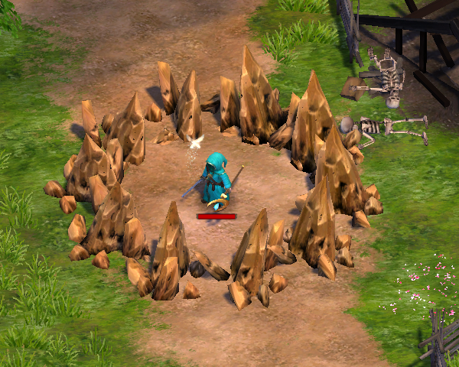
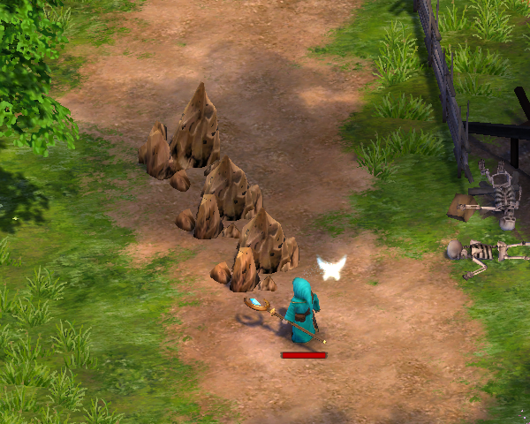
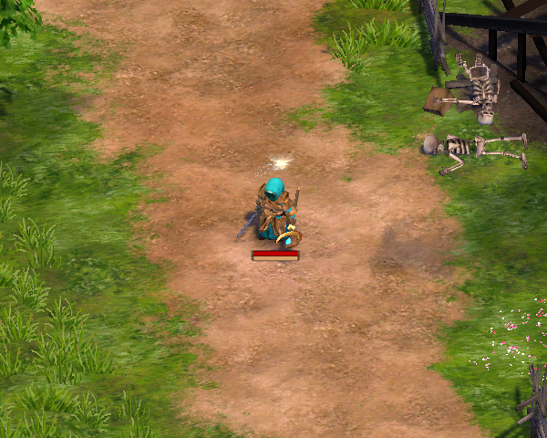
Gameplay (cont’d)
Normal Cast
Area Cast
Imbue Cast
Self Cast

Slide 16
Scoring
Campaign: Definitive “scoring” nonexistent – player progress through chapters is only factor
Challenge Mode: Players fight continuous waves of enemies, with points earned for each slain foe. Killing many enemies in quick succession earns a combo multiplier on points

Slide 17
Media
Artwork: Vibrant and lighthearted, with a medieval focus
Sound and music: Powerful emotion-driven music during boss battles, lighthearted tunes elsewhere. NPC voices recorded with most voice actors speaking in a mix of English, Swedish, and gibberish for comedic effect (subtitles are always on for clarity)

Slide 18
Bugs
On the game’s initial release in Jan 2011, dozens of bugs were prevalent in the game
Most bugs were cooperative/network related ones; characters getting stuck, loading screens freezing for one player in the party, etc.
A few months after release, these issues were cleaned up through patches and the game is and has been stable since

Slide 19
Review – Positives
Complexity/Diversity of casting system
Rewarding feeling when mastering the mechanics of chaining elements to create powerful spells
Number of possible spell combinations is immense, gives players many decisions in the heat of battle
Allows individual players to develop their own sense of “style” in their casting preferences, anonymity of character design reinforces this

Slide 20
Review – Positives (cont’d)
Player skill development
Without significant loot or “skill tree”, player skill alone dictates how the character grows in strength
Cooperative play
Adding more players gives rise to even more diverse means of dispatching enemies (e.g. crossing beam spells)
Friendly fire is always enabled, hilarity ensues

Slide 21
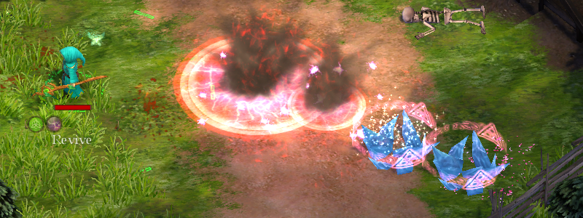
Review – Negatives
Single-player is substantially less enjoyable than cooperative play
Certain elemental combinations outclass others by miles, undermines spell diversity
(QRQREAS – Ice+Ice+Shield+Lightning+Arcane)

Slide 22
Comparison – Similar Games
Diablo and Torchlight are similar games in the sense that they are RPG-esque dungeon crawlers
Other RPG/adventure games which have spellcasting components often use mana bars and cooldowns to cast spells, in comparison to the fast-paced spellcasting of Magicka

Slide 23
Appropriate Audiences
Familiarity and mastery with keyboard controls is a requirement for performing well and progressing – spellcasting demands dexterity and quick reactions
Moderate to hardcore gamers should all be able to enjoy the game, though the most casual of gamers may be put off from the playstyle

Slide 24
Summary
Magicka is a game that shines through with its innovative spellcasting system, and is a very positive cooperative experience with friends

Slide 25
Summary – Purchase Value
The game is definitely worth purchasing if only to try out the unique spellcasting system, but especially for dedicated fans of the action/adventure genre and/or those with friends to play cooperatively
Single play-through of the game can provide a few dozen hours of gameplay

Slide 26
Summary – Improvements
Balancing spells a bit more could keep the casting system at a level where players are incentivized to use multiple spells in different scenarios
Offering an option to disable friendly fire could be a benefit to players who are turned off by the feature

Slide 27
References
http://www.magickagame.com/game-info
http://cdn.akamai.steamstatic.com/steam/apps/42910/manuals/Magicka%20manual%20body%20--%20English.pdf

