Slide 1
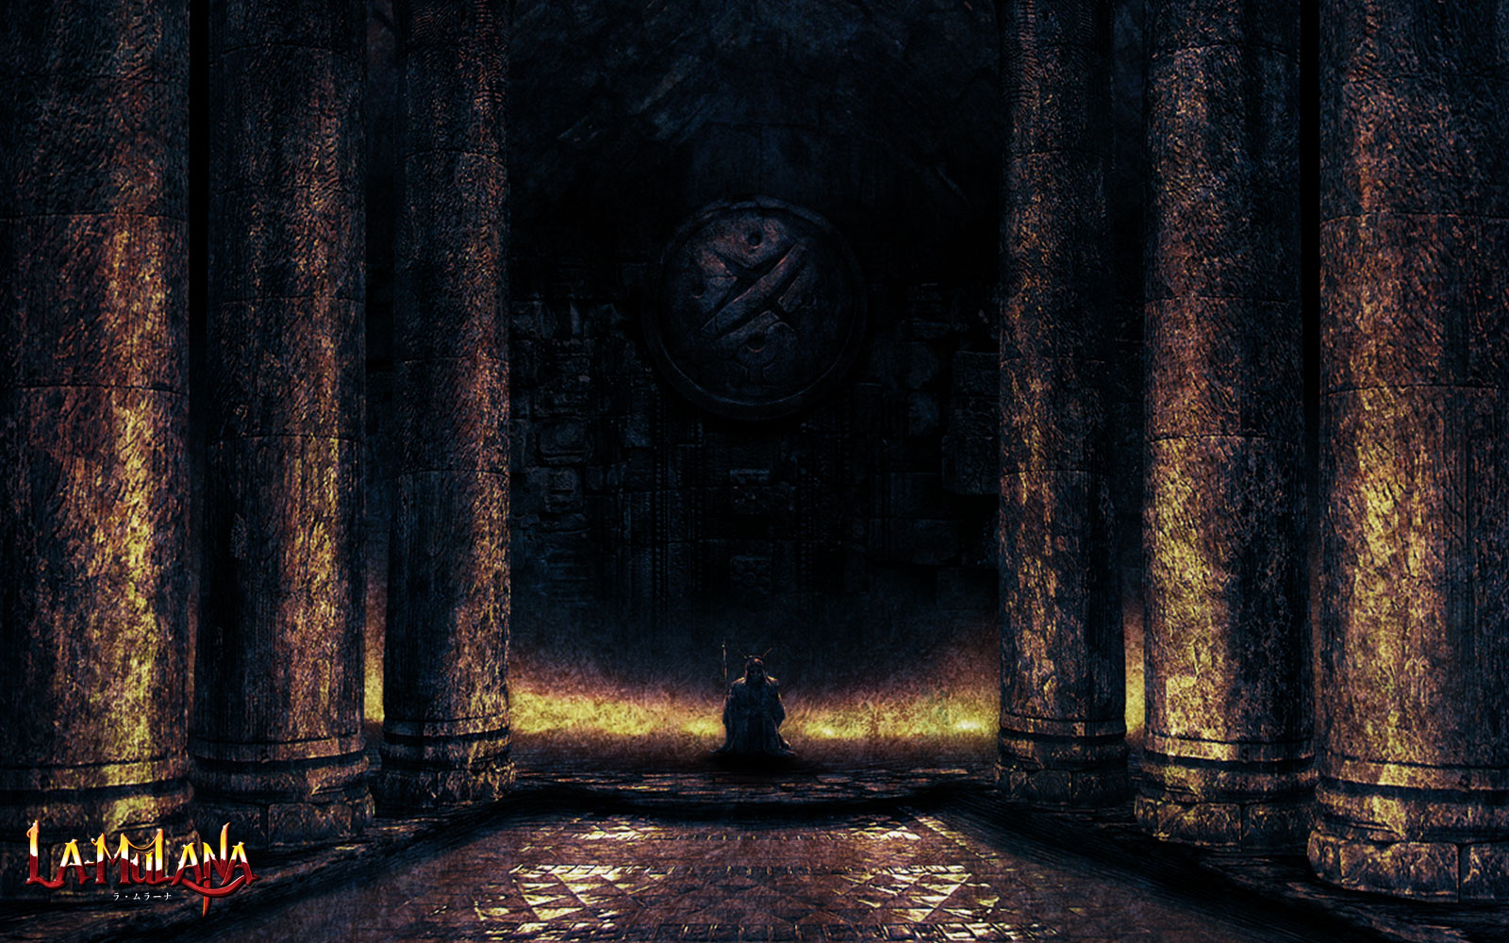
Developed by: NIGORO
Published by: AGM PLAYISM

Slide 2
What is La-mulana?
Going to be talking about the remake
Platformer action puzzler
Movement like castlevenia
Indie developed
HARD!
“Be sure to play through, or clear in hard mode, or give up.” –From the Manual
But not hard to run

Slide 3
What do I need to run La-mulana?
OS:Windows XP
Processor:Intel® Pentium 4 / 2.0GHz
Memory:1 GB RAM
Graphics:DirectX 9.0c compatible card, 128MB of VRAM
DirectX®:9.0c
Hard Drive:500 MB HD space
Sound:DirectX 9.0c compatible card
Anything higher should run the game with no lag

Slide 4
Recommended System Requirements
OS: Windows XP/Vista/7(latest service packs) with DX 9.0c
CPU: Intel® Core 2 Duo 2.4 GHz or AMD Athlon™ 64 X2 4400+ 2.8 GHz Memory:
2 GB RAM Graphics: 256 MB VRAM, 3D accelerator compatible w/ DirectX 9.0c
HDD: 1 GB HD space
Sound: Compatible with DirectX 9.0c DirectX: DirectX 9.0c

Slide 5
Quick overview
Play as Lemeza
Every thing is in 32 bit including art and sounds
Explore the ruins to find treasure!
Kill enemies/avoid traps
Solve puzzles
Defeat the Boss of each area
Collect various items
No score just progress

Slide 6
Exploring La-mulana
Different kinds of puzzles ex: block, story, weight
Broken up into sections that have a back side Enemies are usually not used to kill you, but bug you while trying to platform around.
Certain weapons make it easier to hit enemies
Can be part of puzzles
Bosses are paternistic, need preparation, and have no health bar

Slide 8
Important items
Weapons ex: whip, katana, axe
Sub-Weapons ex: shuriken, flair, caltrops
Passive Items ex: Hermes boots, laptop, bronze mirror
Useable Items ex: lamp of time, pepper, handy scanner.

Slide 9
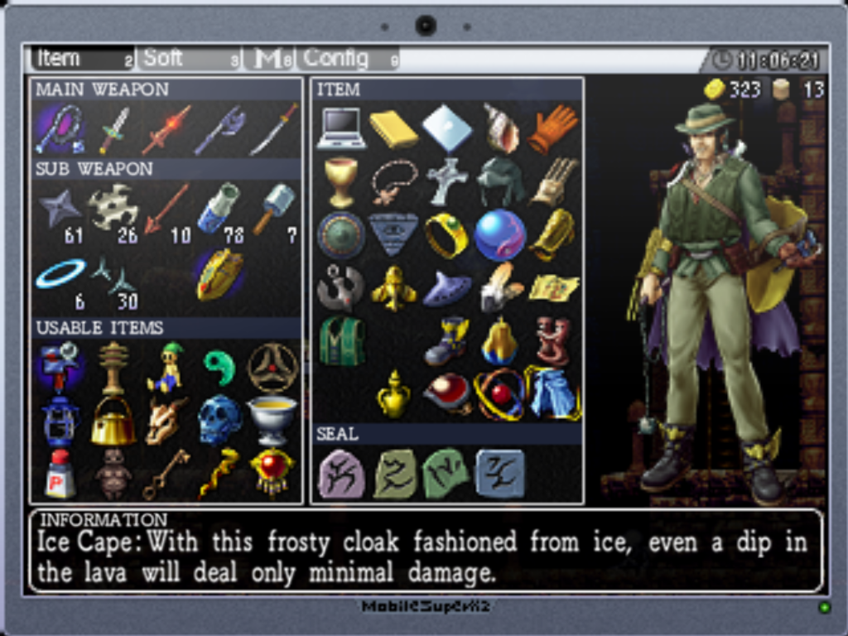

Slide 10
Bronze mirror importance
Every side/area has a back and front with exception of twin labyrinths.
The bronze mirror shows the back side of each place
Example of some front side areas: Gate of Guidance, and Endless Corridor with their back sides being Gate of Confusion and Dimensional Corridor respectively
There are 10 areas each with a back side making 20 areas.

Slide 11
Story
Use handy scanner to find clues from skeletons and tablets
Scan parts of the background
Looking at the map
Talk to NPC’s
Look around!

Slide 12
Story in a nutshell
Mother comes down from the sky
She wants to get back to her home (heaven)
Mother creates life so she can return home
Everyone fails… because you can’t return someone to heaven
Mother gets mad and banishes her children
You learn that only your generation can kill her and put her to rest

Slide 13
What makes La-Mulana good?
Exploration
Go where you want with some limits
Great story
Challenging
Does not hold your hand
Atmosphere
Every thing has a purpose
Lots of hidden optional treasure

Slide 14
Similarities
Similar feel to castlevania movement wise. With more options however
Similar exploration to super metroid where areas are locked off till an item is obtained. However its less obvious what item would unlock what area.
Bosses have no heath bar so… Monster Hunter but two dimensional?

Slide 15
Mistakes?
AI is to pattern dependent
Know you solved a puzzle, but don’t know where to go after that.
To much freedom of roaming.

Slide 16
What could be improved?
When a puzzle is solved, you have no clue what was changed. Being fixed in sequel!
UI(PC)
TOO HARD!

Slide 17
Who is this for?
Anybody looking for a challenge
Discovering a whole made up world
Enjoy unique movement
Puzzle driven

Slide 18
Is the frustration worth it?
For $14.99 on steam, can’t really go wrong if you spend around 50 hours worth of game play.
Must be determined, insane, or genius.
Probably a mix
Not to much replay value, but the DLC will provide more frustration!

Slide 19
Sequel!

