Slide 1
DADDY LONG LEGS
FORMAL EVALUATION
SAM LIVESON
CIS 587
SEPTEMBER 23, 2015

Slide 2
BASIC INFORMATION
Game Title:
Daddy Long Legs
Company:
Set Snail
Denmark
Three Designers/Developers
Ranks in Top 500 Games
Type of Game:
Runner / Arcade
Kills Time
Price:
Free with ads
$0.99 for no ads
$1.17 - $4.17 in-app purchases
Minimum Requirement:
Android 2.3 and up
iOS 6.0 and up
Actual Hardware:
LG G2 with Android 5.0

Slide 3
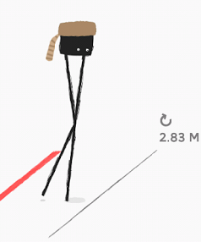
GAME SUMMARY
Quick Overview
Travel as far as you can before falling
Storyline / Player’s Role
You are a walking two-legged spider or horse
Game Play
Tap anywhere once for each step
Scoring
Farthest distance
Installation
Google Play (23 MB), iTunes App Store (64 MB)
Bugs
Slow to load
Flashes between screens on startup

Slide 4
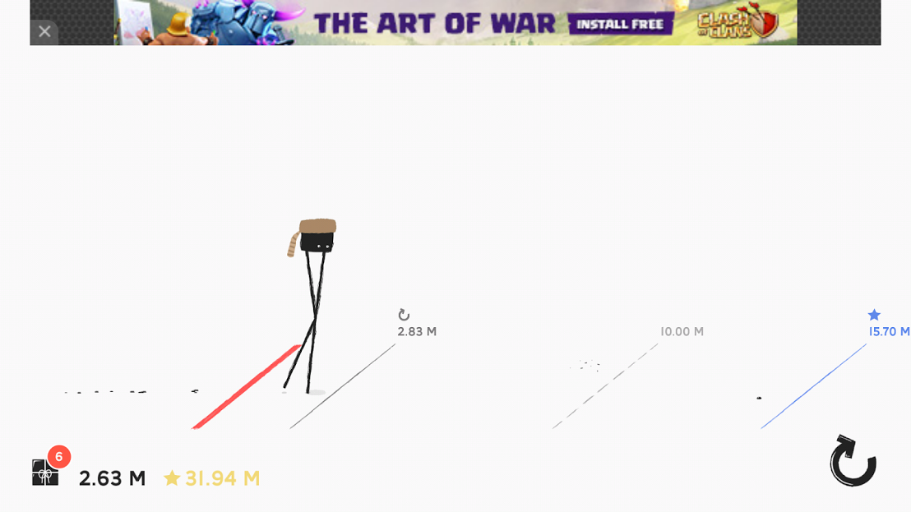
GAME SUMMARY
User Interface:

Slide 5
GAME SUMMARY
Artwork/Sounds/Music:
http://www.dailymotion.com/video/x2w5iha_daddy-long-legs-teaser_videogames

Slide 6
GAME REVIEW
Good:
Funny
Wobbles, Splats, Slapstick Humor
Simple
Tap anywhere once for each step
Unpredicable
Polished physics make each step unique
Goal-Oriented
Beat previous furthest distance, beat friends
Universal
Good for all ages

Slide 7
GAME REVIEW
Bad:
Repetitive
Start from scratch
No customization besides clothing
Mind-Numbing
No decision making except when to step
No Difficulty Levels
Too hard for beginners, too easy for experts
Luck over Skill
World’s best time only 3 minutes

Slide 8
GAME REVIEW
Comparison to Similar Games:
Runner-type Game
Sonic the Hedgehog, Google Dinosaur
More Defined Physics
Funnier
More Boring
No changes over time

Slide 9
GAME REVIEW
Appropriate Audience:
2+
Design Mistakes:
Small character relative to screen
Difficult to press on gift icons
Difficult to exit full-screen
Able to freeze player between step and fall

Slide 10
SUMMARY
Overall Strengths:
Simple
Funny
Universal
Intelligent Physics
Overall Weaknesses
Repetitive
Mind-Numbing
Lucky
Worth Purchasing: Yes
Improvements:
Walk → run
Hills
Earn physics changes
Walk on Moon
Walk on Ice
Trampoline Floor

