Slide 1
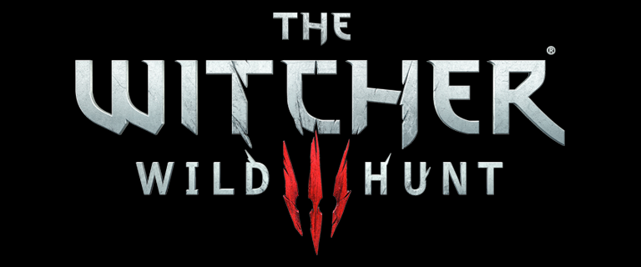
Game Evaluation by Kevin Learned

Slide 2
Basis Information
Created by: Polish developer CD Projekt RED
Engine:REDengine 3
Type of Game: 3rd person action role playing with an open world environment
Price: $60 for PS4
Also available for Xbox One and PC

Slide 3
Hardware Requirements
Minimum:
OS: 64-bit Windows 7 or 64-bit Windows 8 (8.1). DirectX 11 is necessary to run the game.
Processor: Intel CPU Core i5-2500K 3.3GHz, AMD CPU Phenom II X4 940
Graphics: Nvidia GPU GeForce GTX 660 or AMD GPU Radeon HD 7870
RAM: 6GB
Disk space: 40 GB

Slide 4
Hardware Requirements
Recommended:
OS: 64-bit Windows 7 or 64-bit Windows 8 (8.1). DirectX 11 is necessary to run the game.
Processor: Intel CPU Core i7 3770 3,4 GHz, AMD CPU AMD FX-8350 4 GHz
Graphics: Nvidia GPU GeForce GTX 770 or AMD GPU Radeon R9 290
RAM: 6GB
Disk space: 40 GB

Slide 5
Game Installation
Put disc into the PS4
Wait for patch to download
Current patch version 1.08 as of August 7, 2015
Start game

Slide 6
Game Description
Storyline: Based on a series of fantasy novels written by Polish author Andrzej Sapkowski. The games take place after the events in the novels.
Player’s role: Geralt of Rivia who is on a journey to search for Ciri, who is like a daughter to him. The demonic entity, The Wild Hunt is also after her for unknown reasons. Geralt is a master swordsmen and has several magical powers.

Slide 7
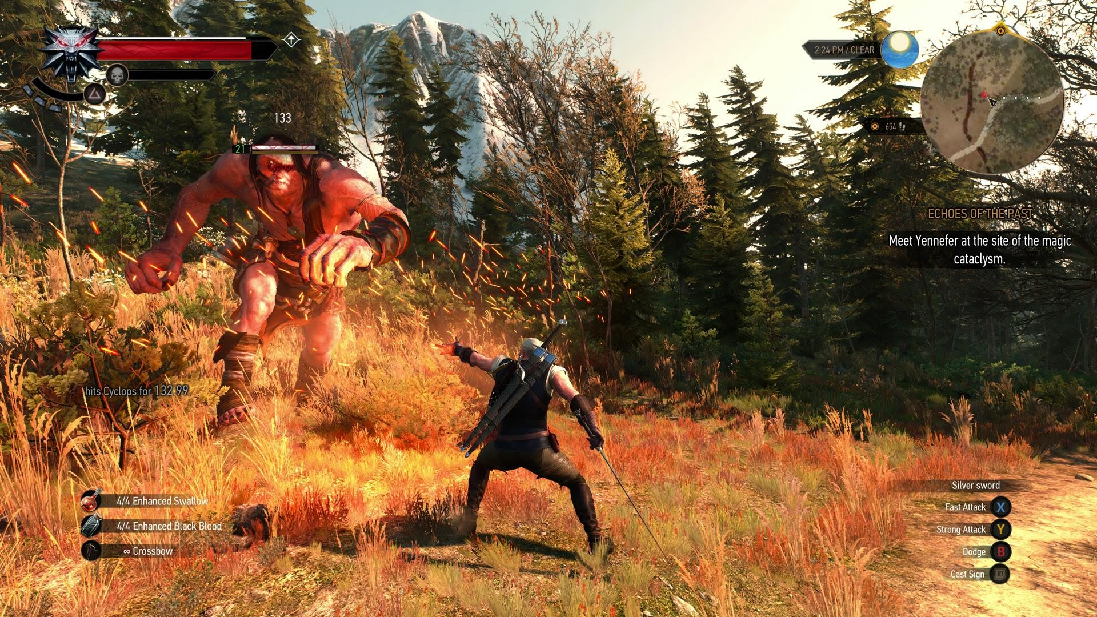
Health/Stamina/Magic
Mini Map/Time/Quest
Available Actions
Equipped Items

Slide 8
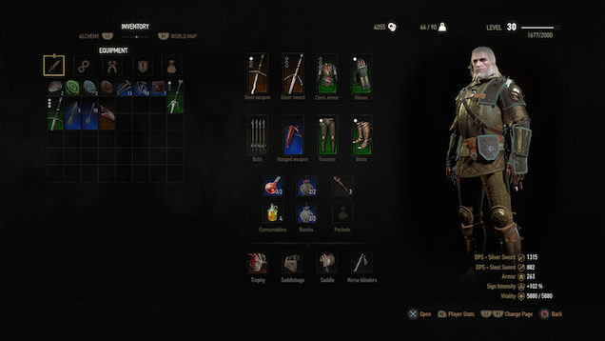
Coin/Weight/Level
Equipped Items
Inventory
Current Stats
Map/Skills/References

Slide 9
Game Description
Gameplay: The majority of the game play is third person view with controls for your movement, weapons, and magic abilities. The player using these controls to fight enemies (humans, ghosts, monsters, etc.) , complete quest and explore the open environment.
Scoring:
Leveling System: Completing quests, side or main, award the player with experience points that are used to level up the character and grant them with new upgrades

Slide 10
Game Description
Currency: Players can earn currency by completing quests and playing a in-game card game called gwent
Card games are played against non-playable characters where they can win other cards or currency
Items such as weapons, armor, alchemy ingredients, etc. can be purchased with currency
These items help the player complete the game more easily

Slide 11
Sounds
Soundtrack:
The soundtrack for the game consist of 35 original songs and all together has a runtime of 81 minutes
Certain songs are played when the player enters specific areas like cities, villages, forest, caves, etc
Dialogue:
All NPC have dialogue
Conversations are happening between NPC all the time
Geralt as multiple dialogue options for most conversations

Slide 12
Game Description
Special Features:
No online features
No mobile companion app for either iOS or Android
Upcoming DLC
Probably $25+
Bugs: None that I encountered. Other reviews online say they saw a lost in frame rate.

Slide 13
Game Review
The Good:
Many hours of gameplay
All dialogue is done by voice acting and no text
Numerous enemy types
The Bad:
Long periods of dialogue that take time away from the action
Slow/boring combat

Slide 14
Game Review
The Competition:
Assassin’s Creed:
Better combat
Climbing system
Smaller world/not as open
Mass Effect:
Dialogue decisions effects story more
Gun combat, not hand to hand
Skyrim:
Similar combat
Playable in 1st or 3rd person
Similar open environment
Witcher 3 map size is reported to be 3.5 times bigger than Skyrim and 1.5 times bigger than GTA V

Slide 15
Game Review
The Audience:
Adults because there are nude/sex scenes and blood/gore
Fans of fantasy and scifi
The Mistakes:
The combat could have been more fast pace and more exciting but, it does have some sense of realness
Also, for some gamers, the length and amount of dialogue scenes takes away from the excitement of the game. But, on the other hand, it helps immerse the player into the world and is a lot more entertaining than text

Slide 16
Overall Summary
Strengths:
Size of world
Character development
Hours of gameplay
Weaknesses:
Combat
Amount of dialogue
Lack of multiplayer
Is it worth the money?:
Yes, if you like storytelling and don’t mind long cutscenes
Suggested Improvements:
Change the combat system

Slide 17
Sources
http://www.techtimes.com/articles/50240/20150502/the-witcher-3-is-how-big-we-break-down-the-size-of-cd-projekt-reds-ambitious-rpg.htm
http://en.cdprojektred.com/support/tw3-system-requirements/
https://en.wikipedia.org/wiki/The_Witcher_3:_Wild_Hunt

