Slide 1
Andrew Kuelbs
CIS 487
9/23/2015

Slide 2
Game Information
Developer/Publisher: Psyonix
Platforms: PC/PS4, OS X & Linux (Future)
Game Type: Sport
Price: PC ($20) & PS4 (Free)

Slide 3
System Requirements

Slide 4
Game Summary
Overview: Sports game, soccer with cars that have rocket engines
Story Line: None
Roles: Players have no defined roles, but can be attackers and defenders
Installation: Once downloaded, Steam takes care of the installation process

Slide 5
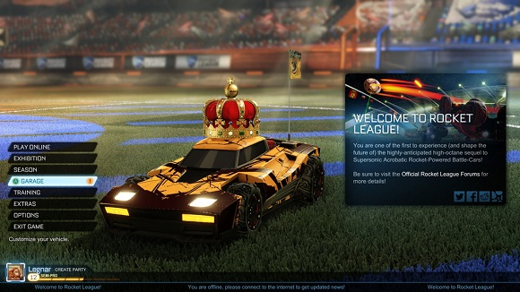
Main Menu
Online:Ranked and Unranked 1v1,2v2,3v3,4v4
Exhibition: Single Game
Season: Season with 10 teams
Garage: Customize Car
Training: Learn game skills

Slide 6
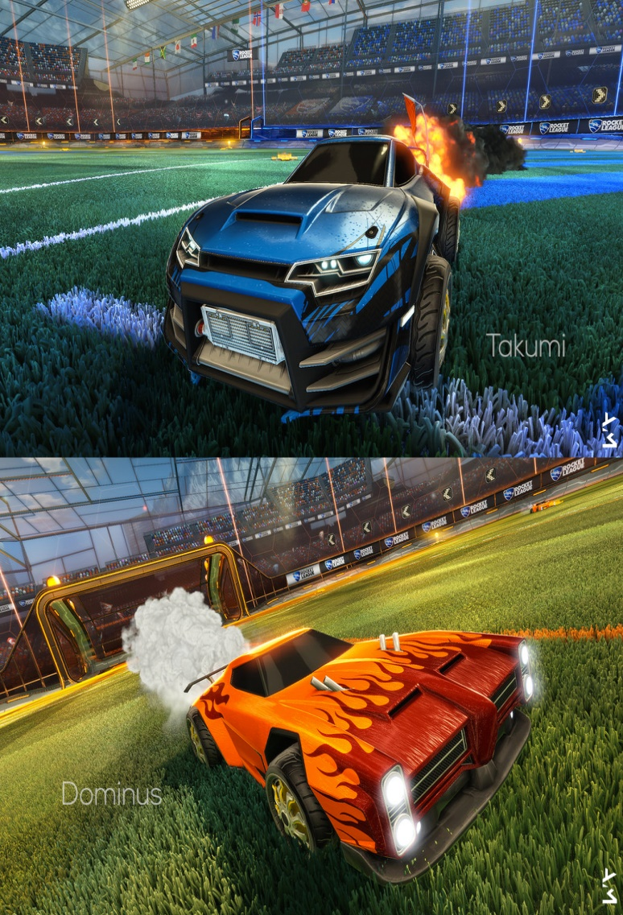
Cars

Slide 7
Map Layout

Slide 8
Additional Game Information
Sound/Music: Main menu plays tracklist. In game, crowd and car sound effects
Special Features: Rockets/Flying
Manual: No physical Manual
Bugs: Flying out of map

Slide 9
Review
Fun: Competitive, Teamwork, Accomplishment, Entertaining,
Bad: Somewhat Repetitive, Poor Communication, Bad Teammates
Compare: Only Game similar is the prequel. This is much better. Better collisions and game reactions

Slide 10
Review Cont.
Audience: Sports Fans that like demolition derby and a twist to normal sports games
Design Mistake: Haven’t been able to find any
Additional Hardware: Controller is suggested to make the gameplay better

Slide 11
Summary
Strengths: Entertaining and a game that isnt matched by any other. The game is unique
Weakness: No way to communicate in game with just your team, has voice chat, but to all
Worth Purchasing?: Definitely
Improvement: Add Team Voice Chat

