Slide 1
CIS 487 Game Evaluation
By: Austin horton

Slide 2
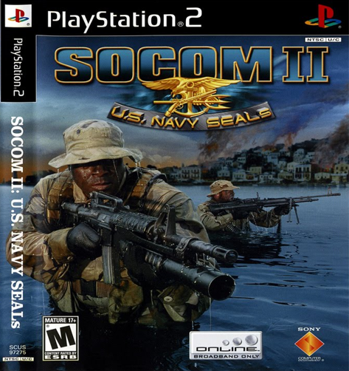
SOCOM II U.S. NAVY SEALs
Developer: Zipper Interactive
Publisher: Sony Computer Entertainment
Director: David Sears
Third-Person Tactical Shooter
Squad/Team based shooter
Designed around real U.S. NAVY SEALs
Price: $59.99 (At release)
Hardware Requirements
PS2
Memory Card
Broadband connection for Multiplayer

Slide 3
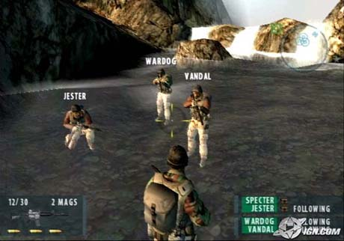
Game Summary
Quick Overview
Takes place in Brazil, Russia, Albania and Algeria in 1990s
Second Major installment of the series
First Online Multiplayer Series for PS2
Story Line
12 playable offline missions
4 player SEAL team (Specter, Jester, Wardog, and Vandal)
Missions include destroying weapons, drug labs, saving hostages,
Player’s Role
Move with the team to complete the mission
Eliminate enemies and protect team

Slide 4
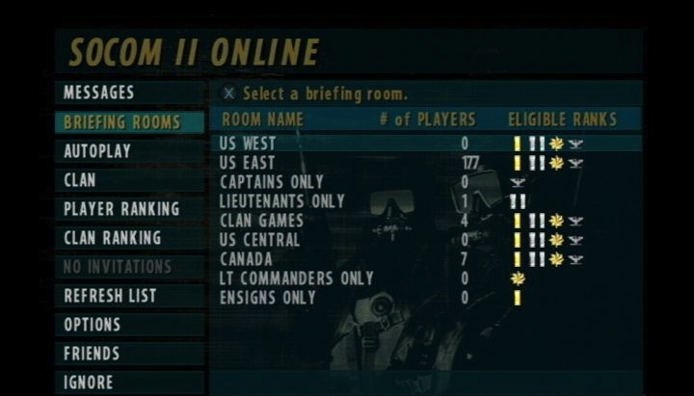
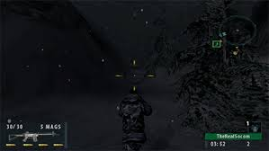
Game Summary
Installation
None, on disk
User Interface (UI)
Main Menus
Very Simple
Concise and can navigate with ease
HUD (Heads-up Display)
Just enough!
Mini Map
Crosshairs
Weapon and Ammo
Health
Kill/Death log
Microphone Communication
Mission Map
First person camera

Slide 5
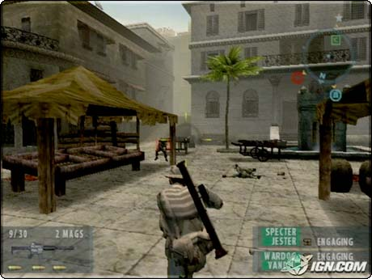
Game Summary
Scoring
Kills
Accuracy
Objectives
Artwork
Decent graphics for time
Maps are very well designed
Great balance/unbalance in maps
Sound and Music
Great theme music
Voice overs
HQ Narrator
Characters talk
Very few cinematic scenes

Slide 6
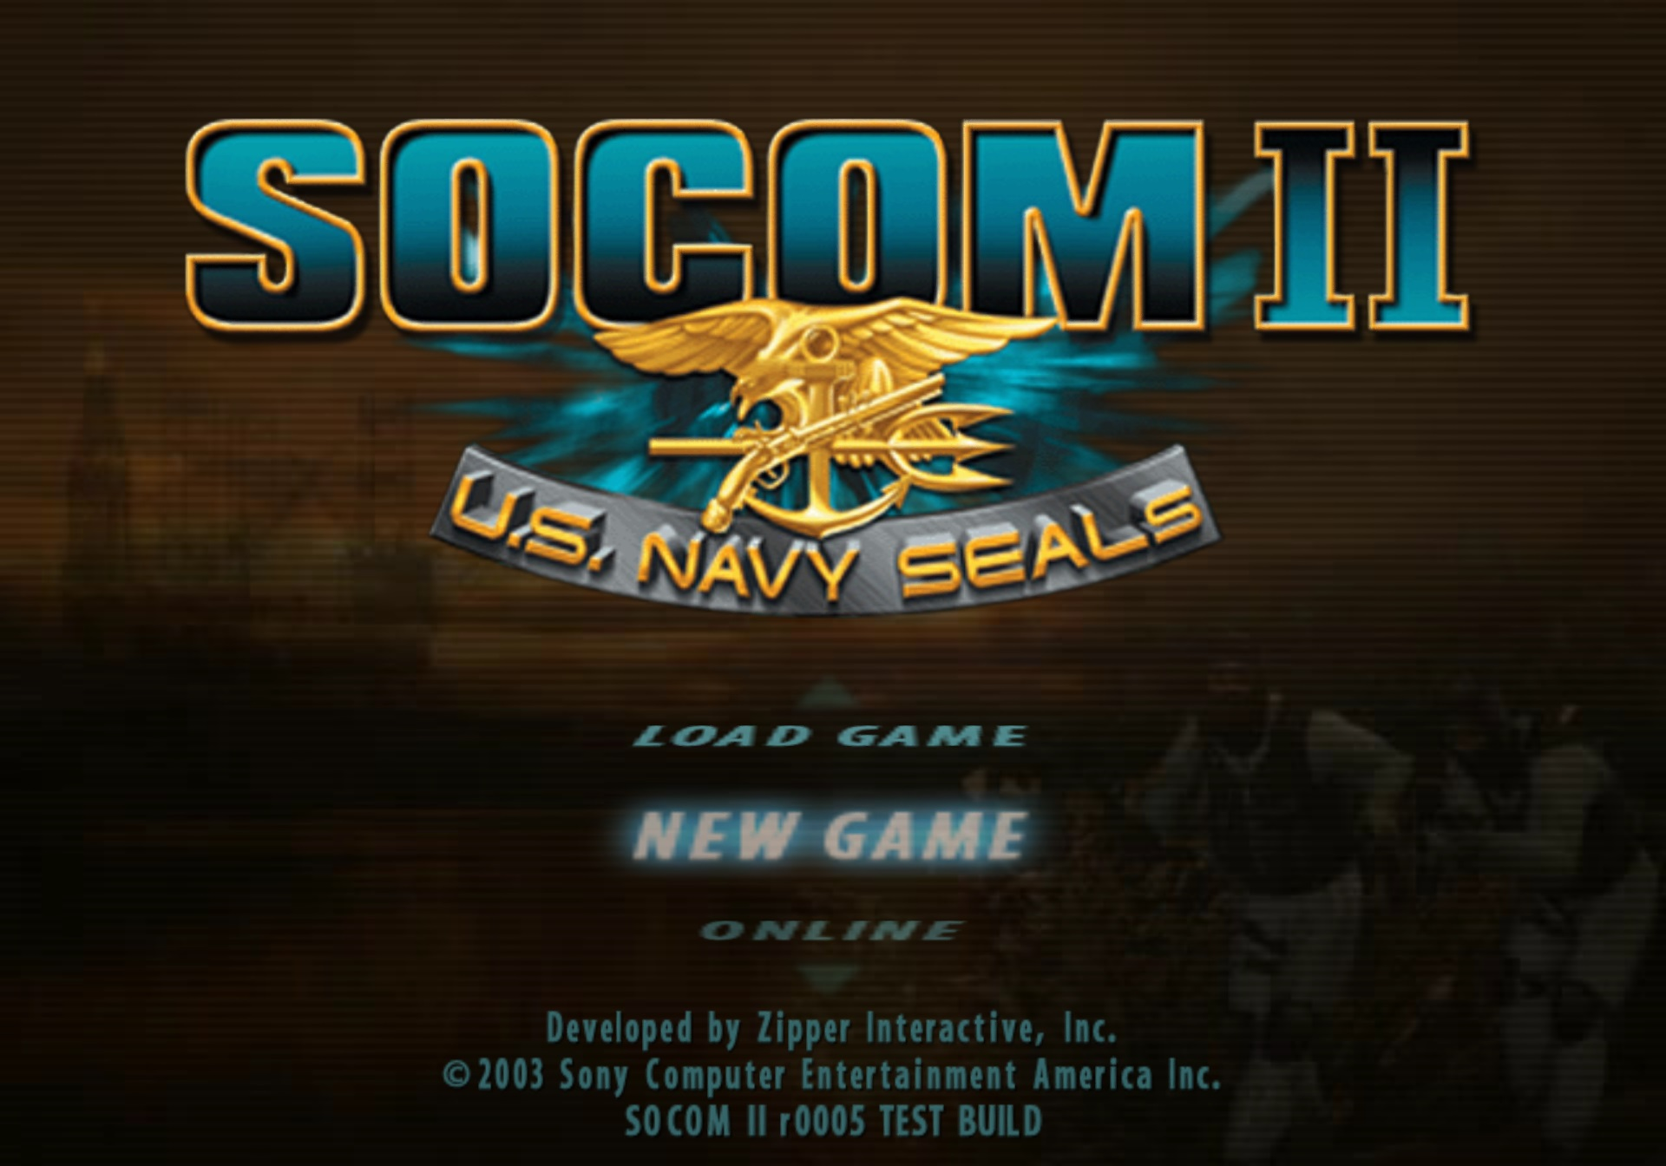
Game Summary
Bugs
Glitches were found by the tenfold online
Sometimes bullets did not register
Bad hit detection in certain hit boxes
Clipping outside of map in certain spots
Many people exploited these bugs
Mission Objections
Finding Intel
Killing Leaders
Diffuse Bombs
Rescuing Hostages
Destroying Drug Operations
Special Features
Unlock different characters
Play online or LAN
MULTIPLAYER!
Unlockable sound tracks

Slide 7
Gameplay
Engine: Kinetica
Secluded on a mission map with designated areas to stay in
12 Missions to play offline
About 12 hours of play
4 player team (AI controller 3 other teammates)
22 Multiplayer Maps
Designed for 8v8 Combat
Dedicated Servers/Lobbies
Headset Communication
5 Game Modes
Extraction
Escort
Demolition
Breach
Suppression
Types of combat
Stealth kills (melee or rifle but)
Long Sniper Rifle Shots
Quick gun battles
Grenade explosion
Mine explosion
Bomb detonations
Equipment
Many different types of guns
Grenades, flash bangs, smoke
Grenade launchers and Rocket Launchers
No vehicles
Characters
Many different characters to play as that are diverse and even include females

Slide 8
Gameplay
https://www.youtube.com/watch?v=WBVWLUXdH68

Slide 9
Game Review
What is good (fun) about the game?
Team based strategy
Clans and Clan Wars
Well balanced maps
Maps designed around one game mode
Realism is well balanced with fantasy
Infinitely repayable over multiplayer
Small things (victory dancing)
Weapons and character movement
Structure of match making
Ability to vote players out
Learning curve (challenging)
Animations
One life based (respawn optional, not ranked)
What is bad (not fun) about the game?
Short story line
Not much of a story
Hit detection
Lag occasionally
Too many grenades
Graphics could be better
Multiplayer learning curve
Exploiters/Glitchers

Slide 10
Game Review
How does it compare to similar games in the same genre?
Pretty much Counter Strike
Many more game modes/maps
Lots of added features
Third-Person Vs First Person
Call of duty
Respawn based
Not tactical
Not team based
Why is it better or worse than similar games?
Multiplayer is phenomenal
Team tactical
Third Person
Slightly Larger Maps (8v8)
Graphics
Small single player
International Servers
What is the appropriate audience for this game?
Mature Teens
Military shooter fans
Multiplayer players

Slide 11
Summary
Overall Strengths
Great Multiplayer
Great to play with friends
Not too realistic
Great Gameplay Esthetics
Overall Weaknesses
Small single player
Bugs and exploits
Learning curve
Is the game worth purchasing?
This day and age, No
If you like multiplayer, Yes
Only for single player, No
How could it be improved?
Better Graphics
More content
Bigger multiplayer
Cheat detection

Slide 12
Thanks For Listening
Questions?

