Slide 1
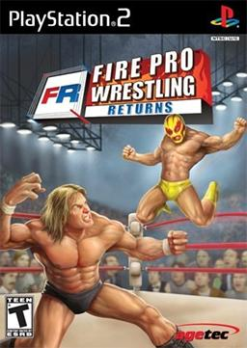
Evaluation by: Kyle Hicks

Slide 2
Basic Information
Name: Fire Pro Wrestling Returns
Developer: Spike
Publisher: Spike (JP), Agetec (NA), 505 Games (EU)
Type of Game: Fighting/Wrestling
Price: $5.99 (PS2), $9.99 (PS3), Free (PCSX2 . . . A PS2 emulator on PC)
Hardware Requirements
PS2: Said Console, a PS2 memory card, PS2 controller and a ARMax/CodeBreaker (if you want to download saves/edits)
PS3: Said Console, at least 5 GB of save data, PS3 controller and a USB device (for installing saves/edits)
PC: Playstation 2 emulator, a controller (if you refuse to use keyboard), some free space on proccessing machine

Slide 3
About the Game (series)
Overview: A 2D Sprite Based Wrestling Game
Created by Masato Masuda of Human Entertainment, Fire Pro Wrestling was an innovated series at its time for introducing players to the ability of creating their own wrestlers.
The games gives players the ability to not only play as their favorite wrestler (who’s names are changed due to legal reasons) but also create said wrestlers with 100% accuracy (see Features for how).

Slide 4
Gameplay
Timing and Physics based gameplay where the player must plan out their attacks.
Top Down isometric view allowing the player to see all the action.
Intelligent computer AI that has their own set of strategy and adaptability (more under features)

Slide 5
Scoring
Due to its more open ended sandbox gameplay and lack of a Career mode, there is no valid scoring system/goal.
Unless, the player choose to play Match Maker which is pretty much a booking simulator for players to create a great wrestling show where the goal is to draw in an audience with said shows and acquire a lot of money.
Tournament and League mode in the game also have a goal for the player to defeat all his/her opponents and rank up to first place (or for league, generate the most points).
Hit point system in the game is interesting as it is all base on how fatigue the wrestlers appear rather then an actual hit bar used in many fighting games.

Slide 6
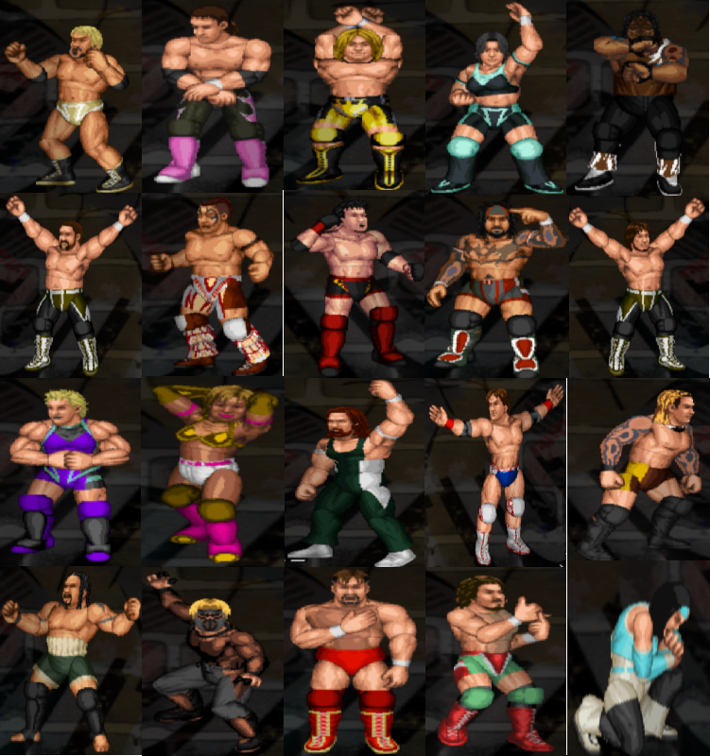
Artwork

Slide 7
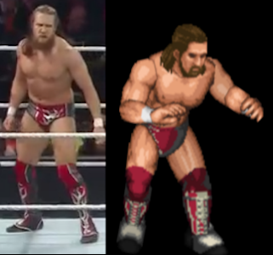
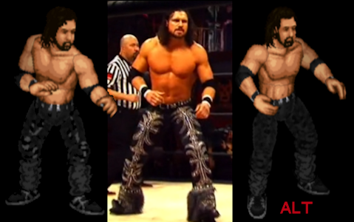
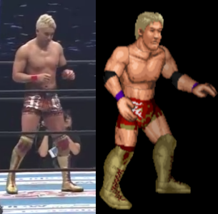
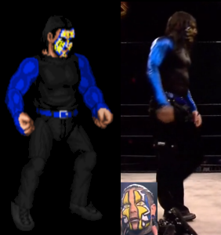
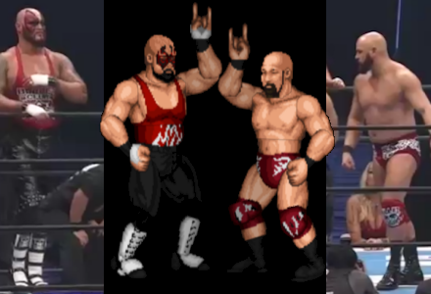
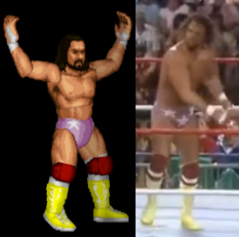
Artwork

Slide 8
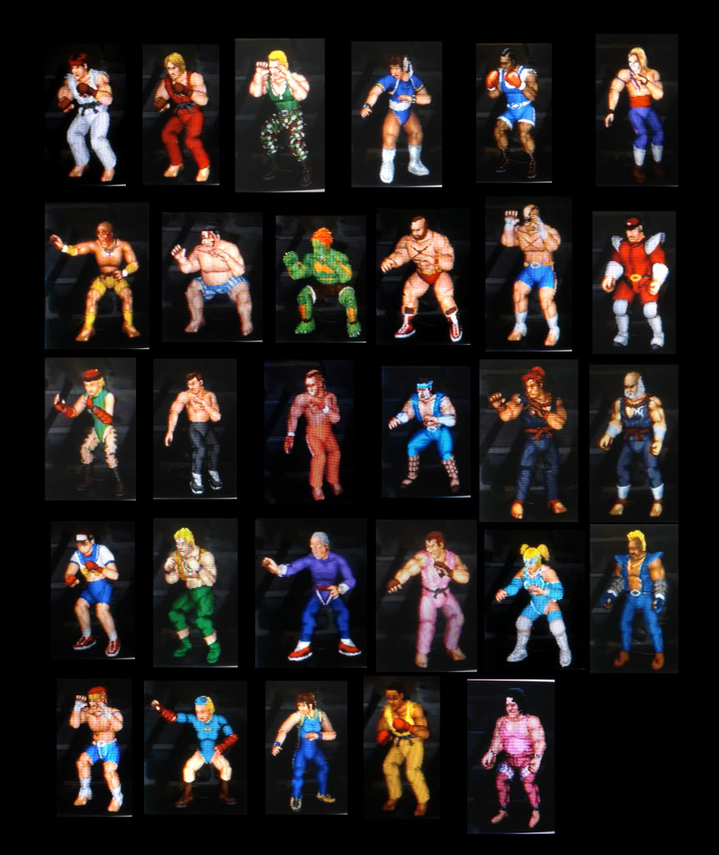
Artwork

Slide 9
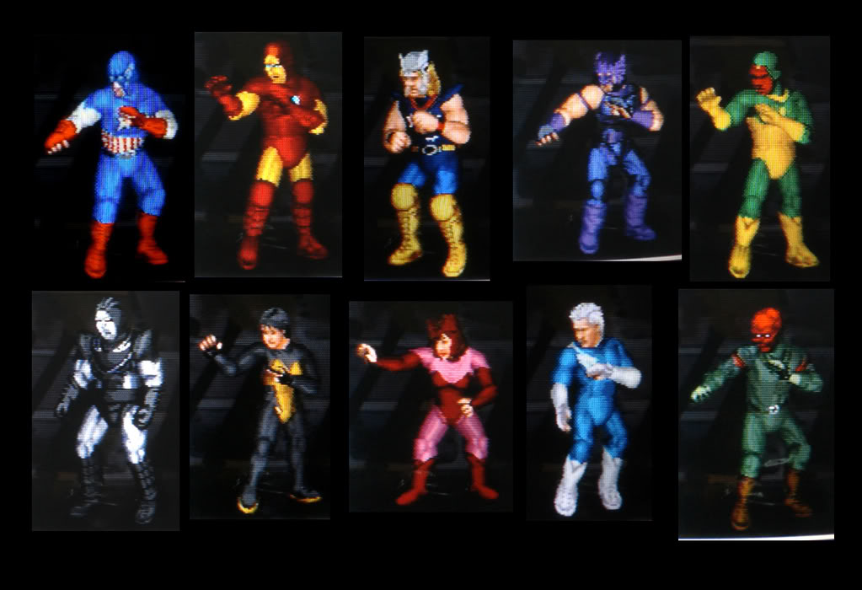
Artwork

Slide 10
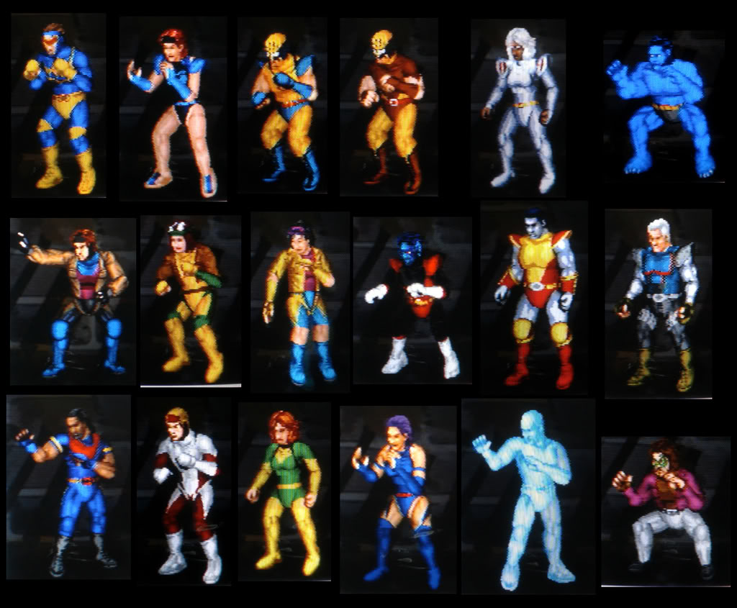
Artwork

Slide 11
Sound & Music
In-game matches features well orchestrated background music reminiscent of classic arcade games.
Entrance themes are all “Jimmy Hart” version of actual wrestlers themes from Japan fan favorites like Mitsuhara Misawa, Jushin Liger and Keiji Mutoh/Great Muta to American classics like Hulk Hogan, Stone Cold Steve Austin and The Rock.
Edits in the game have two sets of sound clip for whatever move they perform.

Slide 12
Features (Cpu Logic)
CPU Logic allows players the ability to change up their edits overall gameplay.
Uses a statistic based system that determines how often the wrestler performs a move.
All created wrestlers have this and it is the LARGEST part of the game.

Slide 13
Other Things
Manuel
Bugs
There is a manual for the game online for new players to read.
There are some good additional guides on GameFAQs to help people get familiar with the game.
Still active online community of this game has boards/threads based on many things related to the game itself.
Some move animation can come off wrong when performing (like the move The Worm)
Cage Match isn’t well polished in terms of Escape rules.
(For emulators) Entrance sometimes have the edits walk animation appear at moments where they are not meant to.
The Personality Logic is inverted.

Slide 14
Whats Good and Bad
Pros
Cons
Innovative combat mechanic
Very in-depth character creation system
Game modes and matches that provide hours of entertainment just for its variety in results
Cheap game, long lifespan.
There isn’t a lot of specialty matches to play (most of which are poorly done).
There is no single player (Career) mode to play and Match Maker mode doesn’t allow the use of created characters.
Getting a feel for the controls isn’t newbie friendly.

Slide 15
Compare to other games
Compare to wrestling games like the classic AKI wrestling games and recent WWE games, gameplay and graphics are completely different.
Players are given the ability to edit their wrestler’s behavior which is something most wrestling games don’t feature at all.
This game can also play like a boxing game (S-1 Match with a boxing theme CAW) or an MMA game (Gruesome Match with a MMA theme CAW).
Fan favorite specialty matches are either absent (ladder, ironman, first blood, table, etc) or not well done (cage and over the top rope match).
The color selector in editing the CAWS give unlimited possibilities in designing the wrestlers.
OVER 500 CAWS!!!!!

Slide 16
Summary
The game is strong in its detailed combat system and extensive creation category.
The game is weak in its variety of matches and lack of a true single player mode for people to really enjoy.
The game could improve by adding in more gimmick matches to play, improve upon the gameplay of cage match, update its create system with more moves and attire, and an improvement to Match Maker that allows the use of edits as part of the game.
The game is worth purchasing if you enjoy arcade style gameplay and an extensive create a wrestler system.

Slide 17
Appropriate Audience
Wrestling Fans – For how accurate the CAWs are in emulating the wrestlers they are based on.
Video Game Lovers – For being one of the few wrestling games since No Mercy and Here Comes the Game to have immersive gameplay.
Creative Sandbox Players – For the very extensive Edit Mode that allows players to create any character they want and their behavior in spite of the limited resources they are given.

Slide 18
Credit
Wikipedia – For the info it provided me on the basic information about the game.
Game Stop – Same as Wikipedia
GameFAQs – For all the guides that help me know more about the game
FPW Arena – For being a good forum site for providing me great info and edits that I like to use (before it recently lost a lot of its content)
You Tube – For showcasing videos of its gameplay that introduce me to the game and having samples of its soundtrack.
PCSX2 – For being the emulator I use for playing this game.

