Slide 1
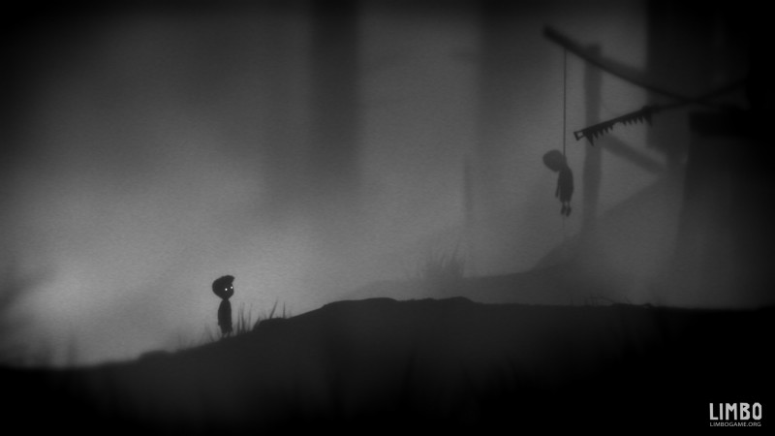
CIS 487 Fall 2015 Game Evaluation
By: Rod M Hermiz
https://youtu.be/POqLq4gDDxY

Slide 2
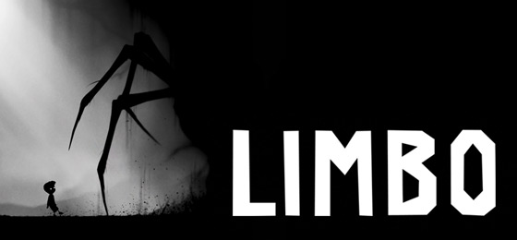
Basic Information
Stated Hardware Requirements:
CPU: Any CPU with 2 GHz or more. RAM: 512 MB VGA: Any VGA card in last 5 years. Some integrated graphics may work. Shader Model 3.0 required DX: 9.0c OS: Windows XP, Vista, 7, OSX, iOS, Android HDD: 150MB
Installation: 150 MB
Company: Playdead, Double Eleven
Type: 2D Puzzle, Frameworker Price: XBox, App store: $9.99
Google Play: $5
I paid: $0.00 as an Amazon promo

Slide 3
Game Summary
Quick overview: A puzzle platform game. Each level is a puzzle that gets progressively more difficult.
Story Line: A nameless little boy gets into limbo (edge of hell) to find his recently-deceased sister. The lack of clarity has led the fan-base to come up with more chilling story lines. (e.g. boy has killed his sister and now trying to find and kill her soul in limbo)
The main idea was taken from the author’s grandmother answer to his question:
“Do little boys go to heaven when they die?”
“No, honey. They go to limbo”

Slide 4
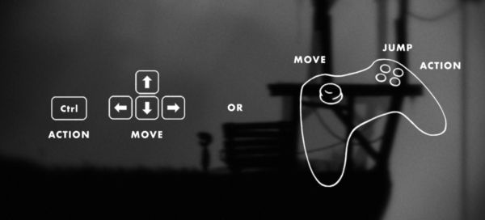
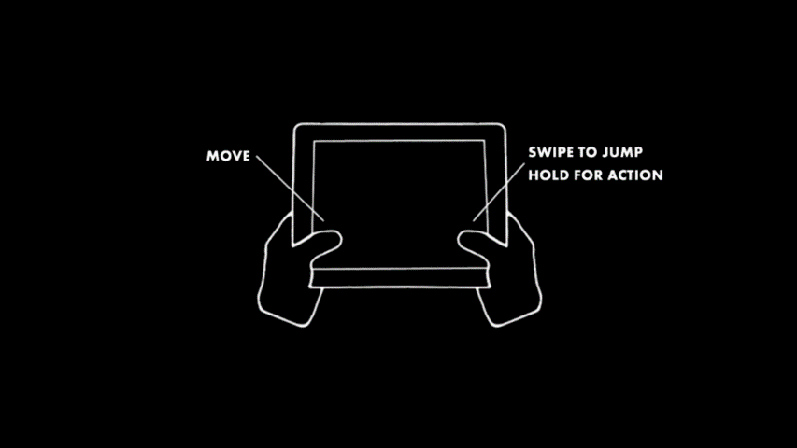
Game Summary
Player's role: Player controls the boy through puzzles. When puzzle is solved, game progresses to next level.
User interface: There is no level marking or score display to be consistent with the mystery atmosphere.
PC and Console
Touch

Slide 5
Game Summary
Game Play: The nameless little boy tries to find his way through the scary limbo, the player’s role is to help him through the ordeal.
The deaths are particularly gruesome. I had to uninstall the game from my phone so my 3-year-old doesn’t get a hold of it.
The beginning is a completely empty black screen then things start to appear, although still hazy. But it gives you an idea on how to play. The chilling atmosphere is a part of the appeal.
Initially the puzzles are simple then gets a little complicated with the introduction of cogwheels and other machinery.

Slide 6
Game Summary
Scoring: There is none. The only prize is to progress to the next level. And some glimpses of information about what the story may be.
Artwork: Monochrome silhouettes add with some distortion filters that adds to the mystery and suspense. The boy’s death is always heartbreaking, makes you feel sorry for the little guy.
Sound and Music: Music is scarce and of course it’s ominous and chilling when played.
Sound effects are very consistent with the grassy environment. Crunching and bone-breaking sounds when boy plunges to his death.

Slide 7
Game Summary
Scoring: There is none. The only prize is to progress to the next level. And some glimpses of information about what the story may be.
Artwork: Monochrome silhouettes add with some distortion filters that adds to the mystery and suspense. The boy’s death is always heartbreaking, makes you feel sorry for the little guy.
Sound and Music: Music is scarce and of course it’s ominous and chilling when played.
Sound effects are very consistent with the grassy environment. Crunching and bone-breaking sounds when boy plunges to his death.
Bugs: None, currently. The game has been in production for 4 years.

Slide 8
Game Review
What’s good: Successfully creates a consistent world of mystery and horror. Makes you root for the little boy since his very first step.
The consistent mystery theme makes you wonder about what’s next. Not much explanation is offered till the very end. Even then It’s still shrouded in mystery. Probably buildup for a sequel.
What’s bad: Puzzles start too easy they end up being very difficult. The most annoying factor is that there is only one way to solve a puzzle. Which is fine for simple ones; but complicated ones sometime require some wrist action. Not just logic.

Slide 9
Game Review
How does it c0mpare: Game is not directly comparable to many games. But as a 2D platrofmer, it doesn’t beat a lot of the available games.
Audience: It seems to be targeting horror fans.

Slide 10
Summary
Biggest Strength: Uniqueness
Weakness: Short.
Relies heavily on a few rigid puzzles. Therefore,
Not playable more than once.
Nothing is configurable, not even resolution.
Improvements: More puzzles. More flexiblility to have several outcomes.
Give the user some options/settings.
Worth it? I got it for free on Android (legally). Don’t think I would have paid $10.00 for it

Slide 11
Sources
https://en.wikipedia.org/wiki/Limbo_(video_game)
http://playdead.com/limbo/
Limbo Font: http://fontmeme.com/freefonts/34794/limbo.font

