Slide 1
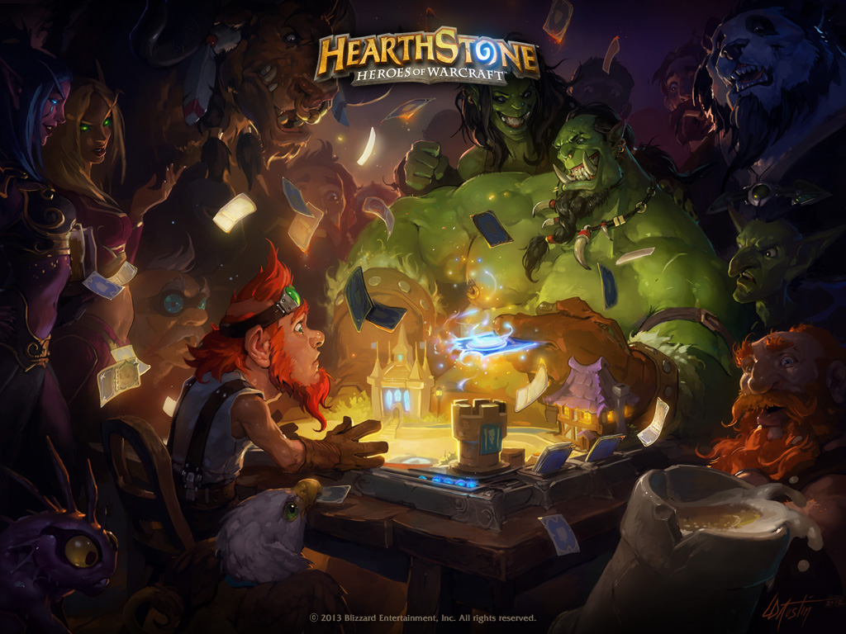
Hearthstone:
Heroes of Warcraft
By: Abdullah Hadid

Slide 2
Basic Information
Blizzard Entertainment
Online collectible card game
Initial release: March 11, 2014
Free to play – with optional purchases
Supports Windows, Mac, IOS, and Android
Available for Tablets and smartphones

Slide 3
System Requirements
Minimal Requirements
Recommended Requirements
OS: Windows xp/vista/7/8
Processor: Intel Pentium D or AMD Athlon 64 x2
Video: NVIDA GeForce 6800(256 MB) or ATI Radeon X1600 Pro(256 MB)
Memory: 2 GB RAM
3 GB HD storage
OS: Windows 7/8/10(64 BIT)
Processor: Intel Core 2 duo E6600 (2.2 GHz) or AMD Athlon 664 x2 5000+(2.6 GHz)
Video: NVIDA GeForce 8800 GT(512 MB) or ATI Radeon HD 4850(512 MB)
Memory: 4 GB RAM
3 GB HD storage

Slide 4
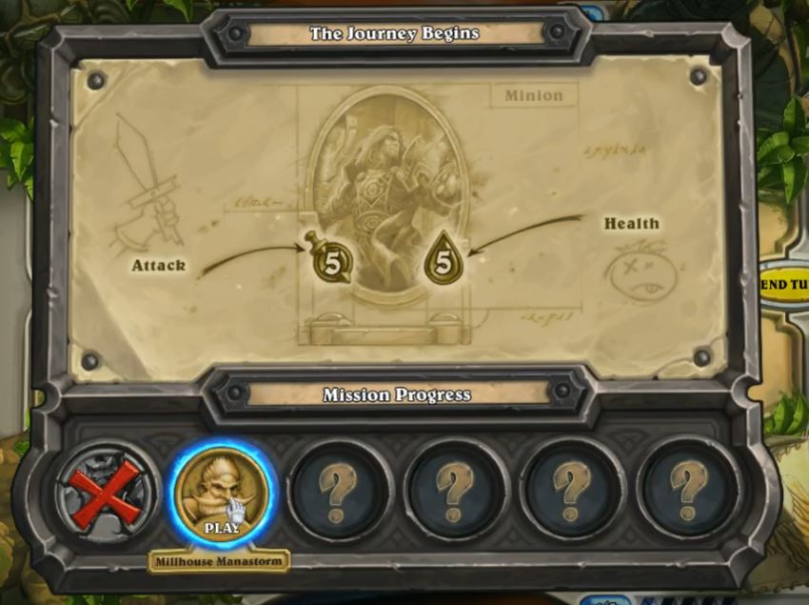
Game Summary

Slide 5
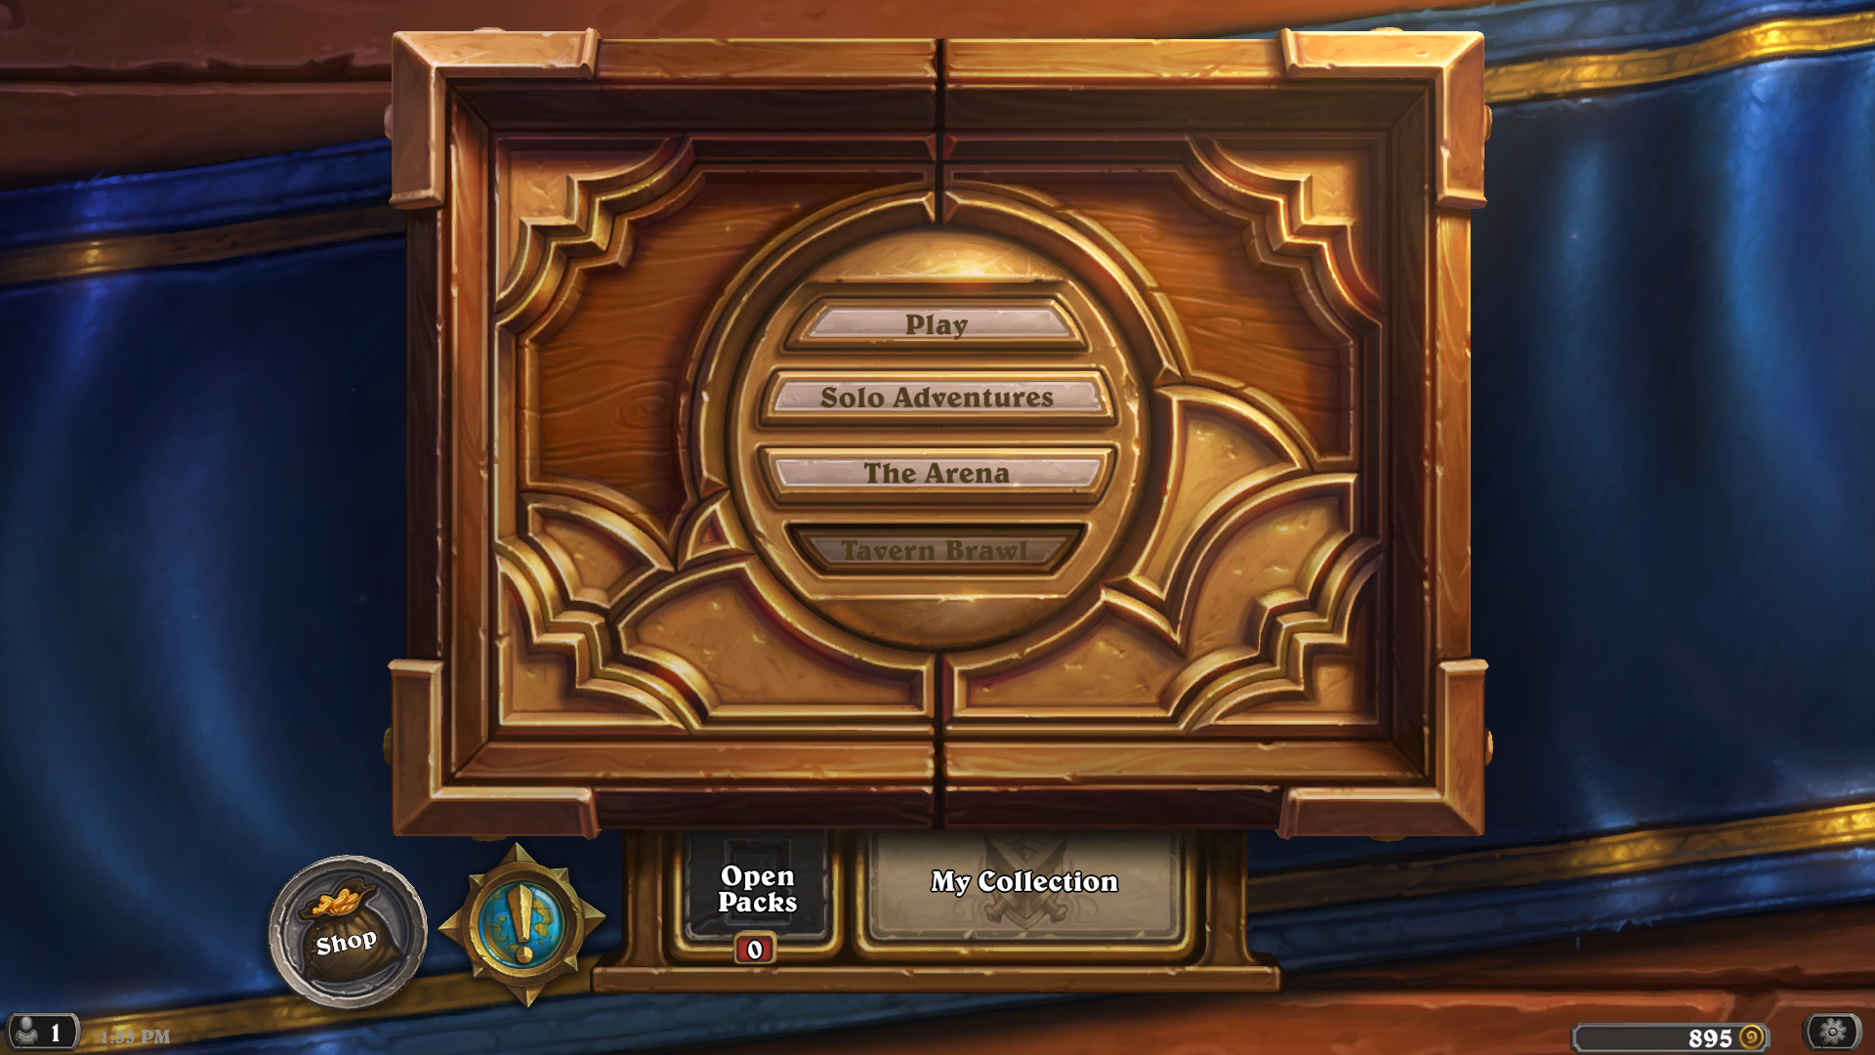
Game Summary

Slide 6
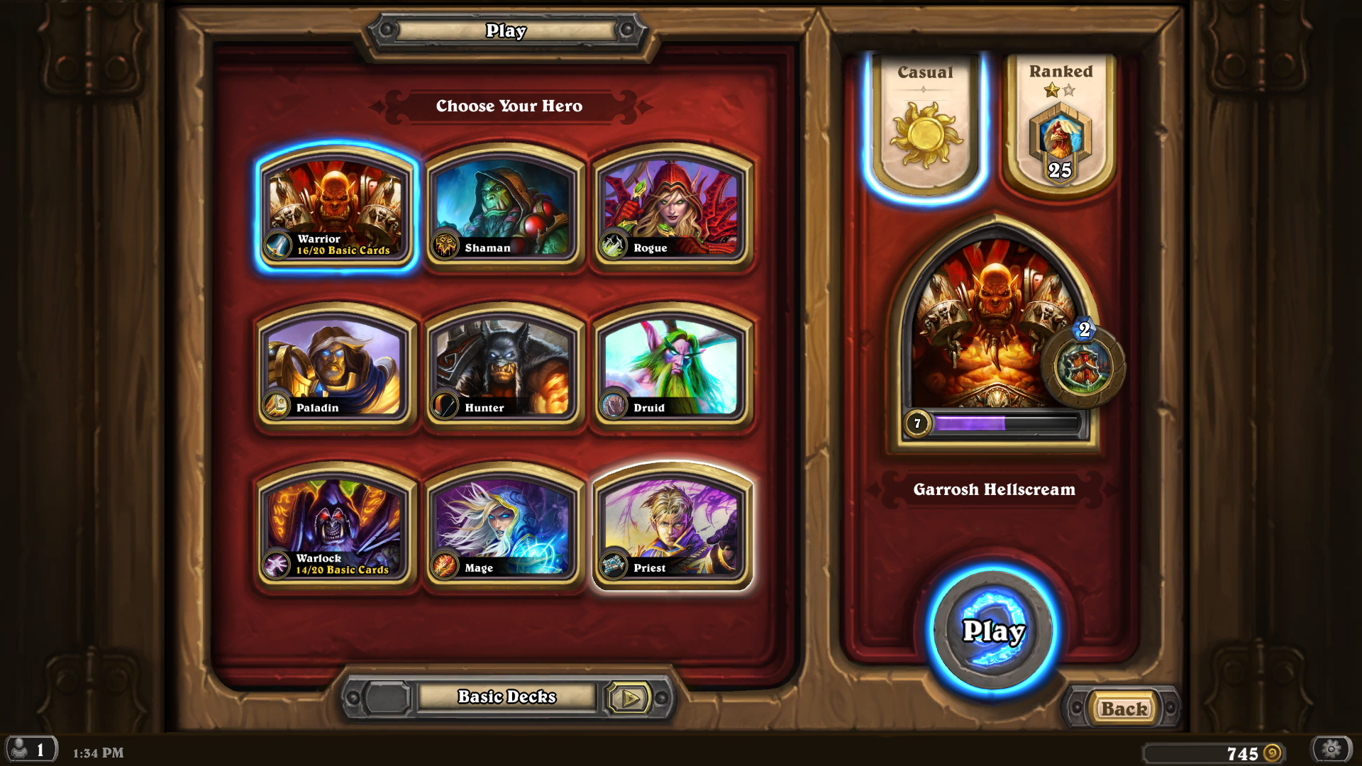
Game Summary

Slide 7
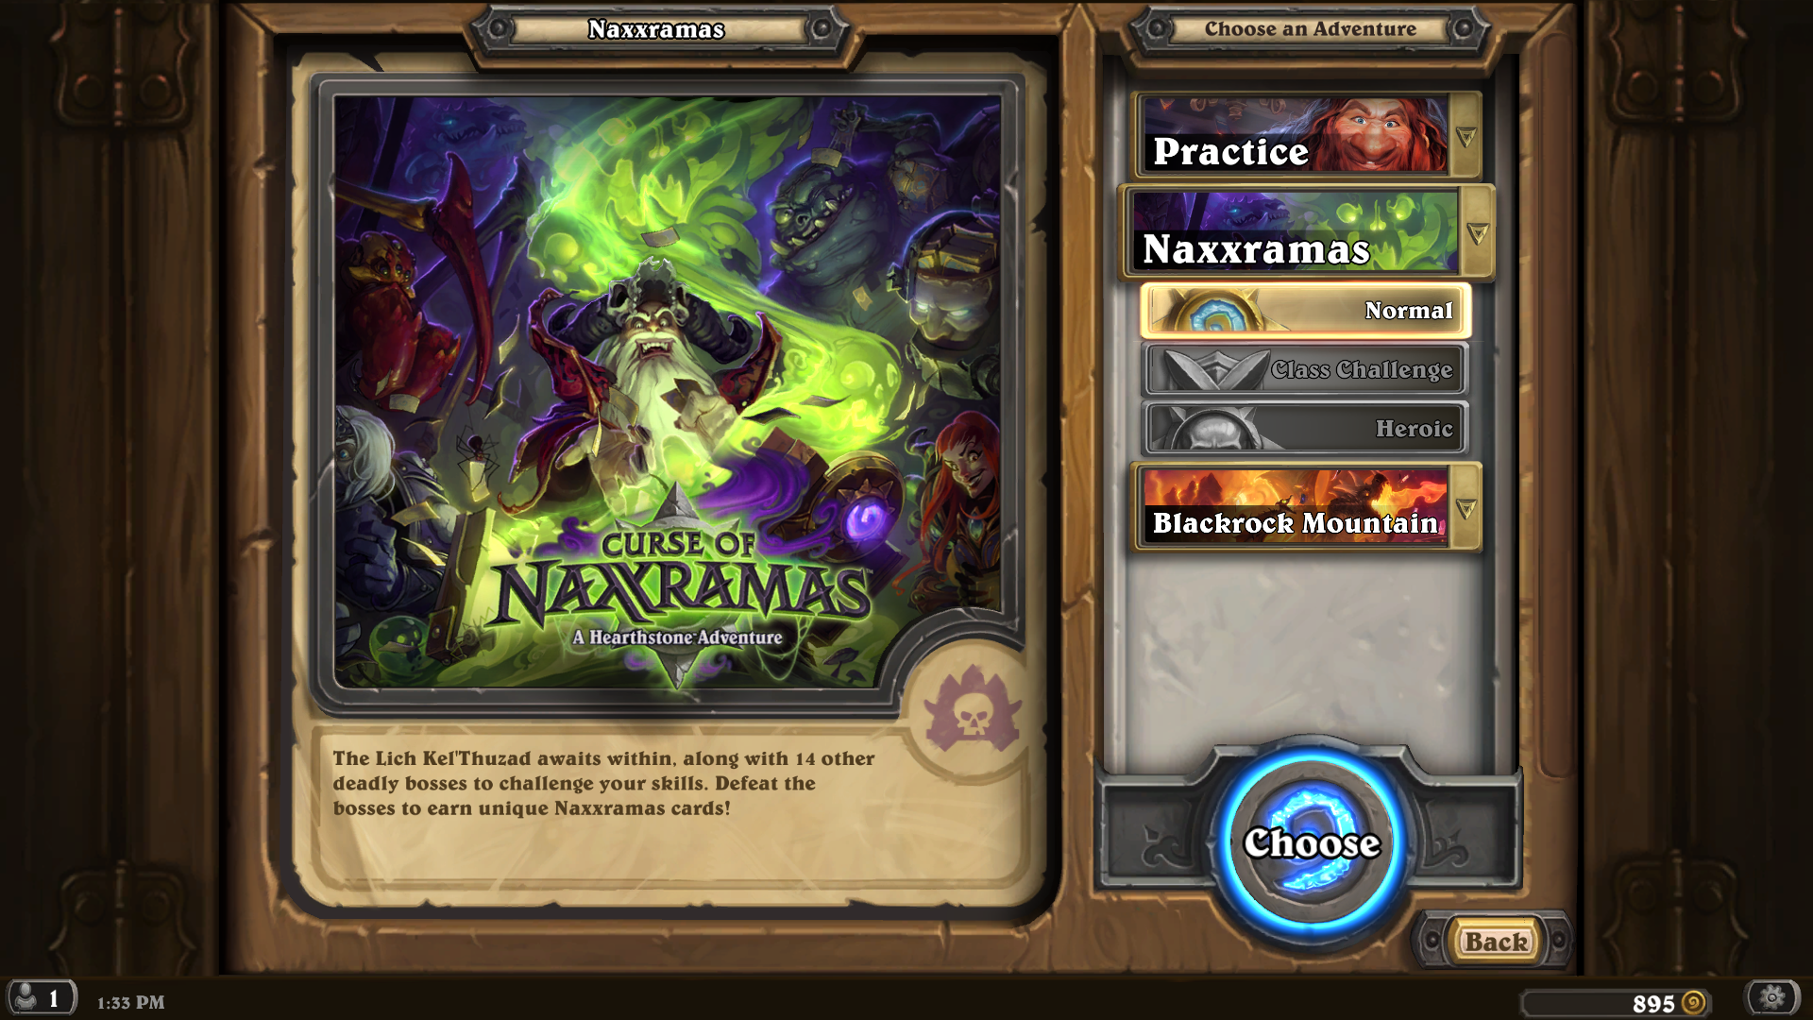
Game Summary

Slide 8
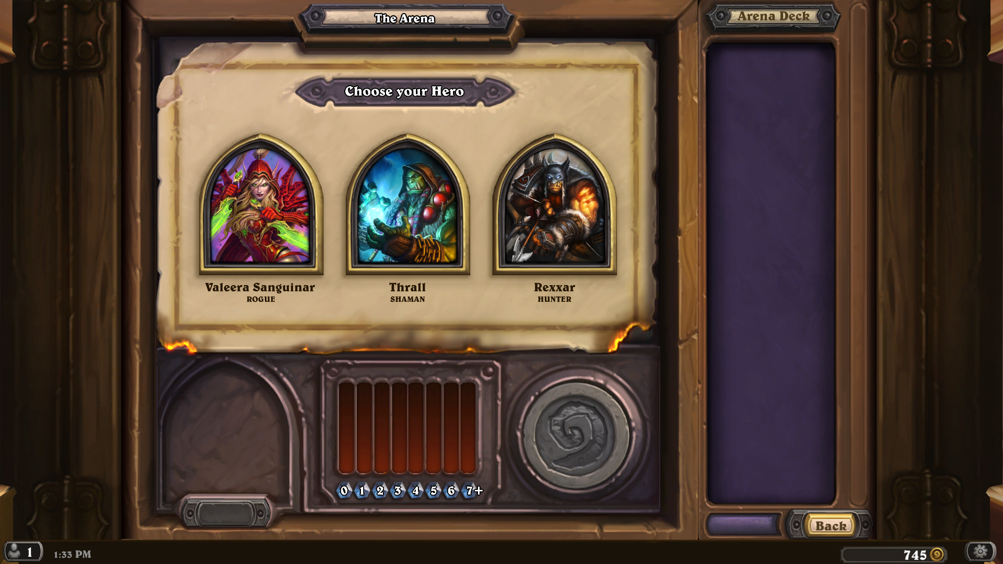
Game Summary

Slide 9
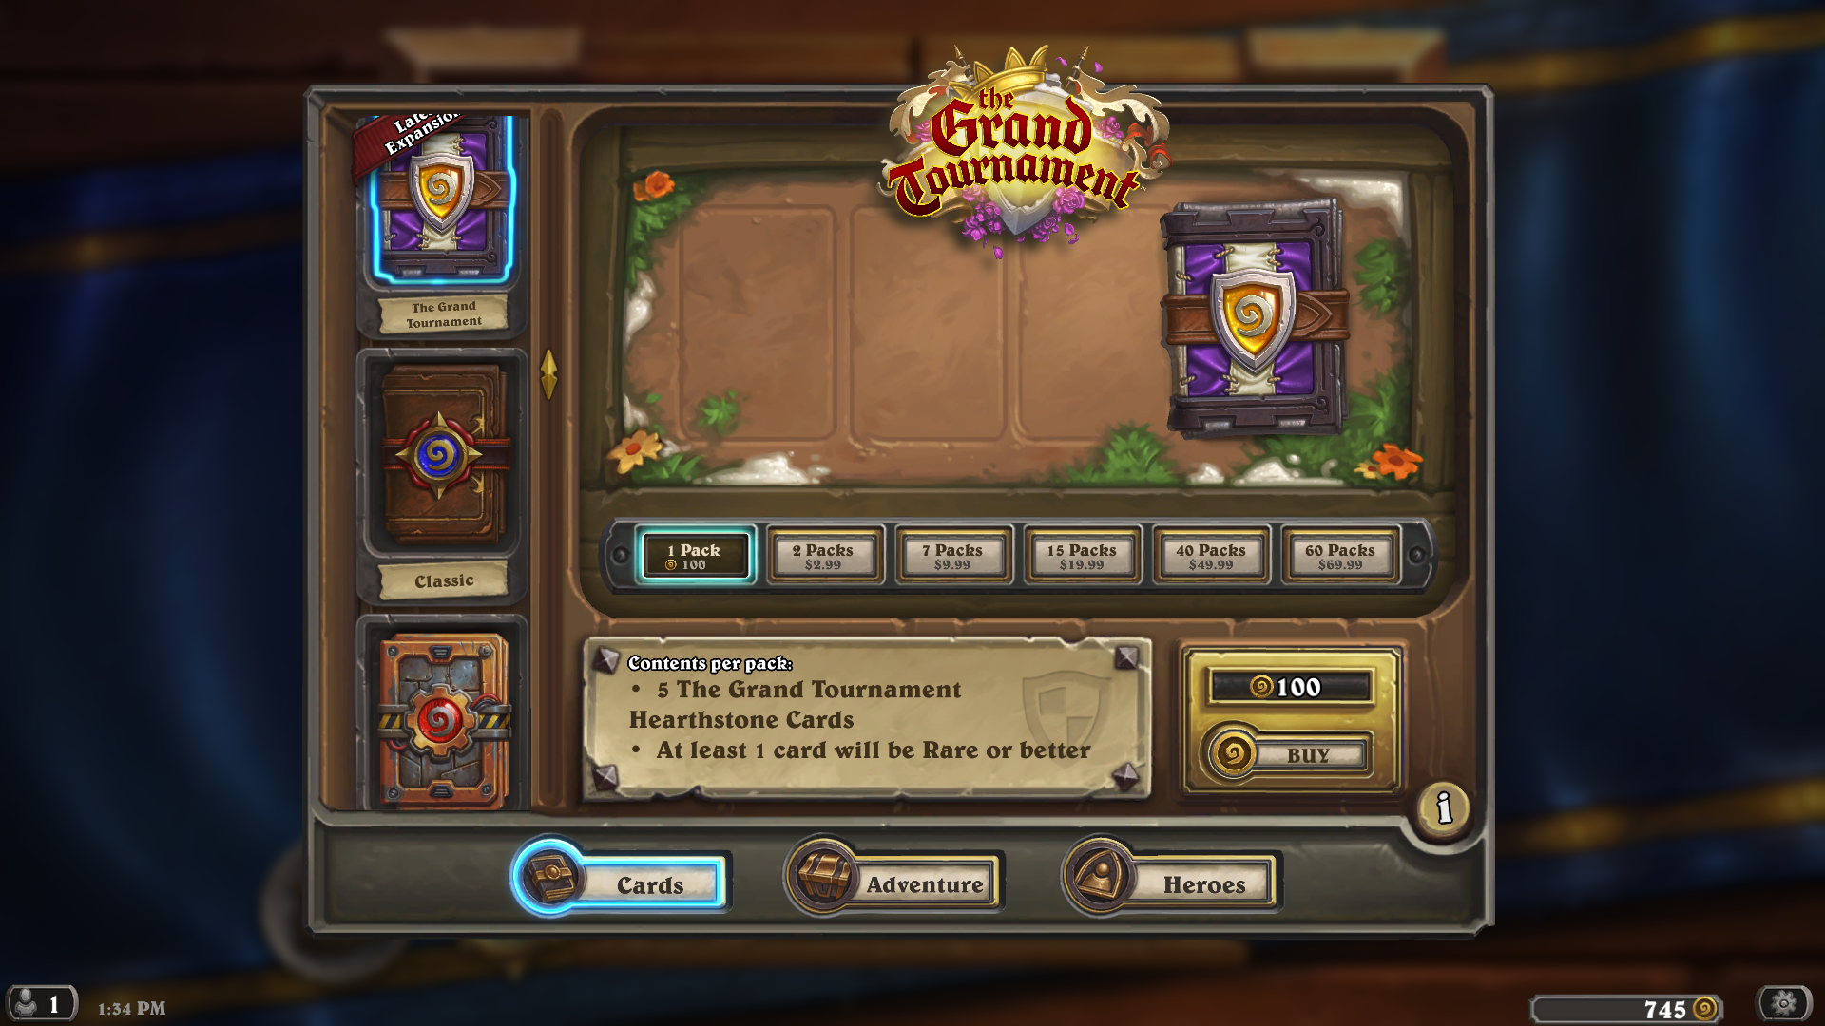
Game Summary

Slide 10
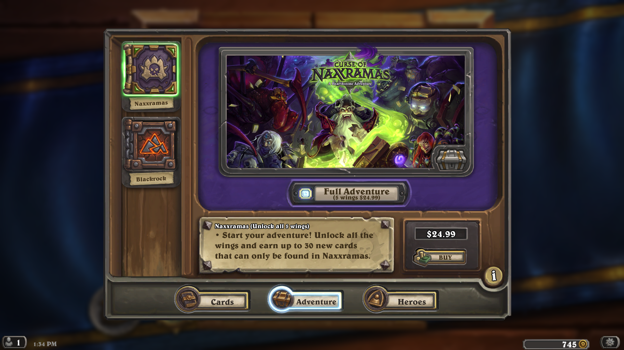
Game Summary

Slide 11
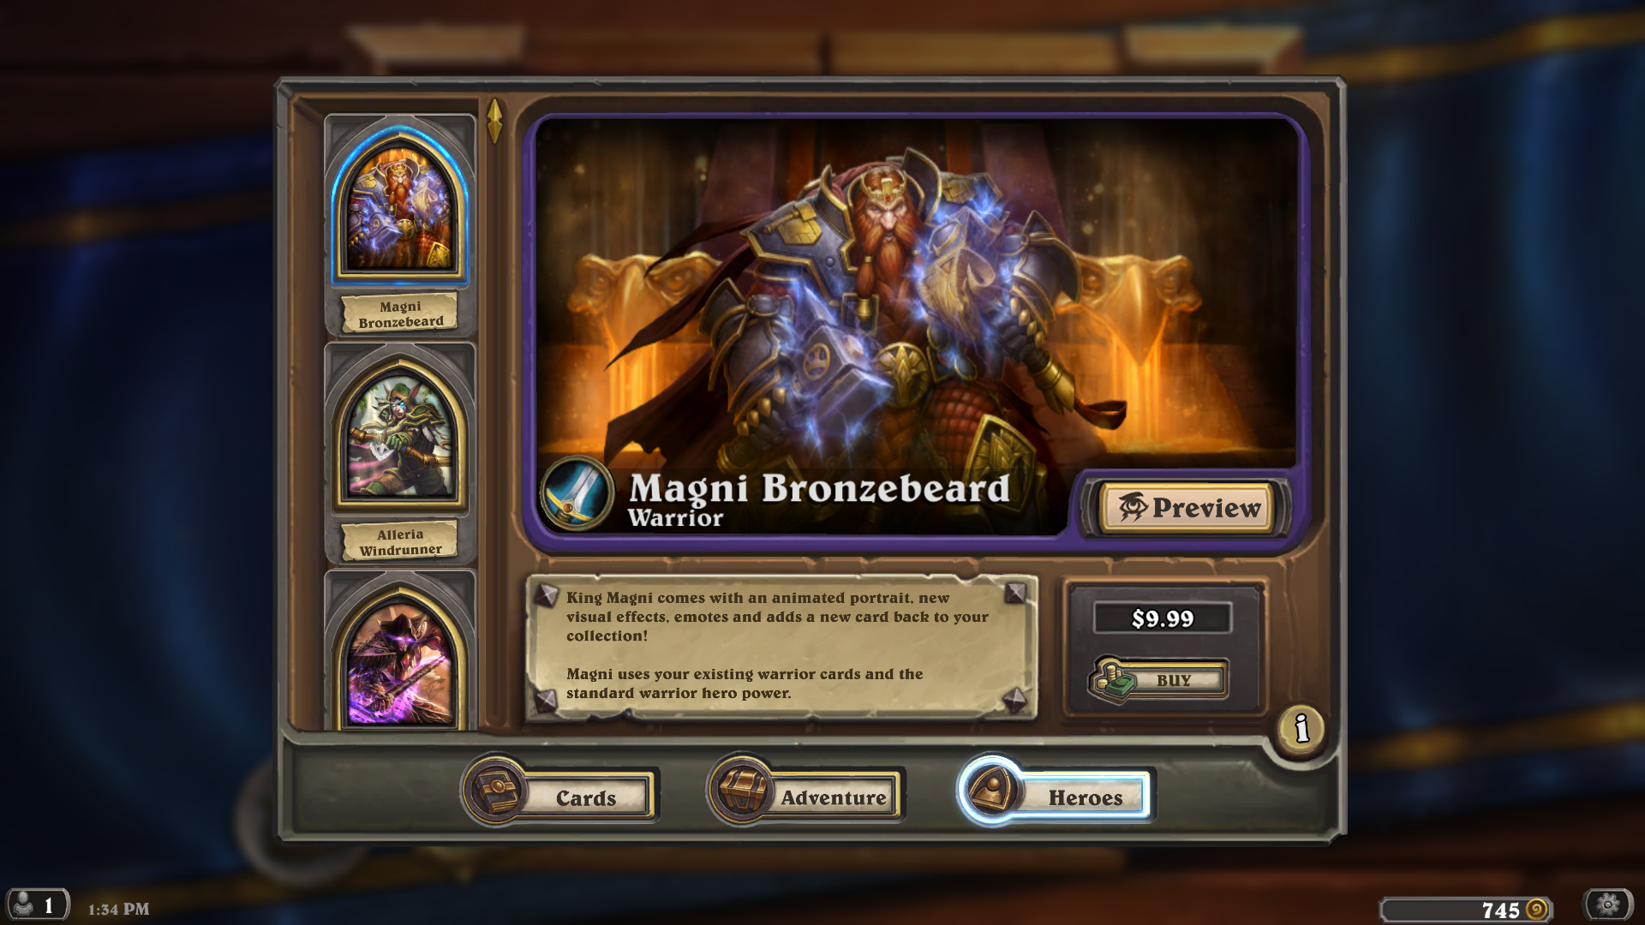
Game Summary

Slide 12
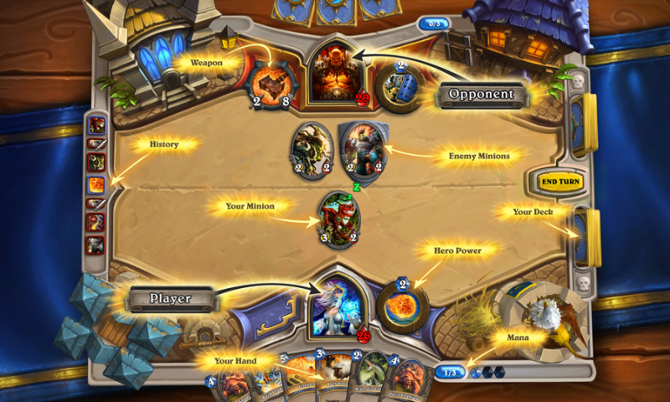
Gameplay
Turn by turn
Gain 1 mana crystal per turn(Max 10)
Unique hero powers
Draw 1 card at start of each turn
Goal is to bring opponent health to 0

Slide 13
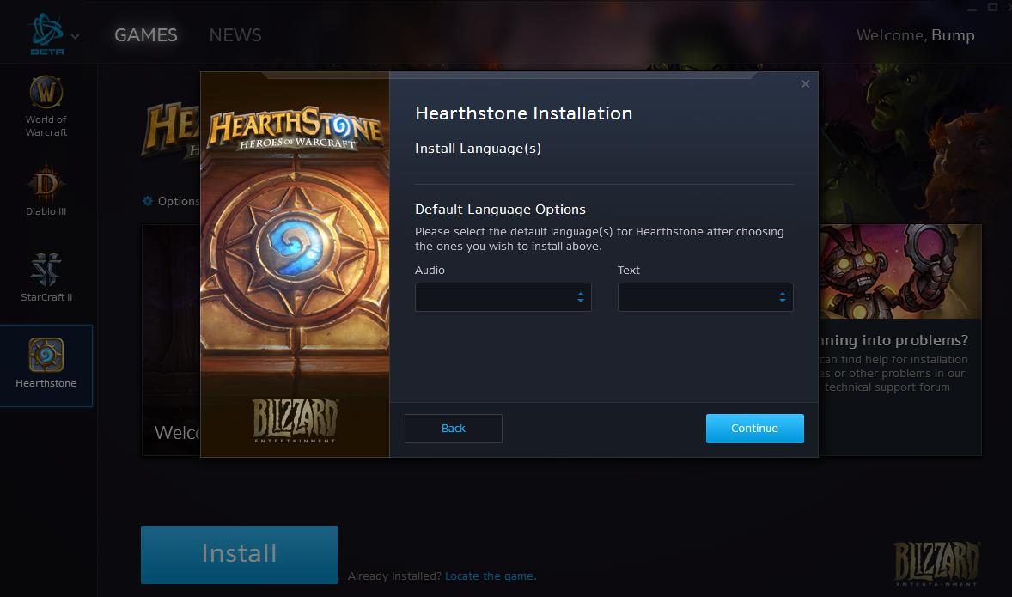
Game Installation
Battle.net

Slide 14
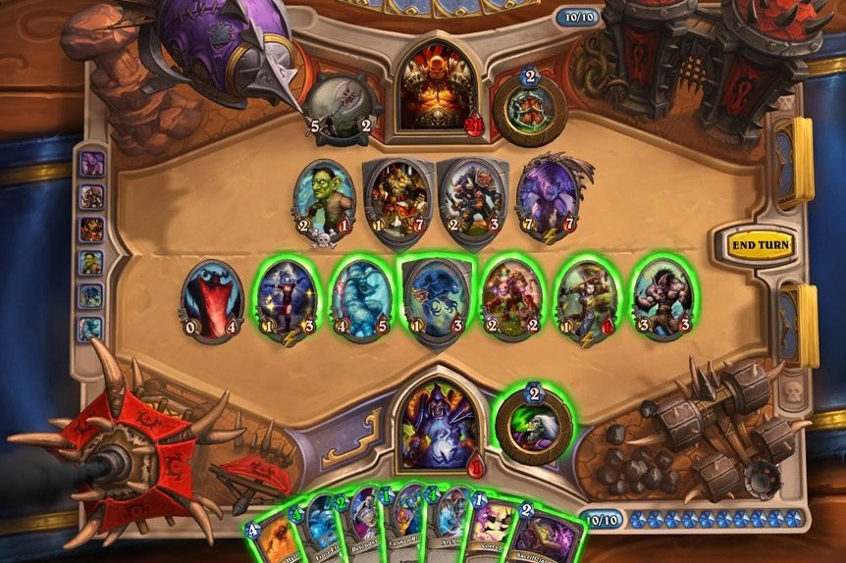
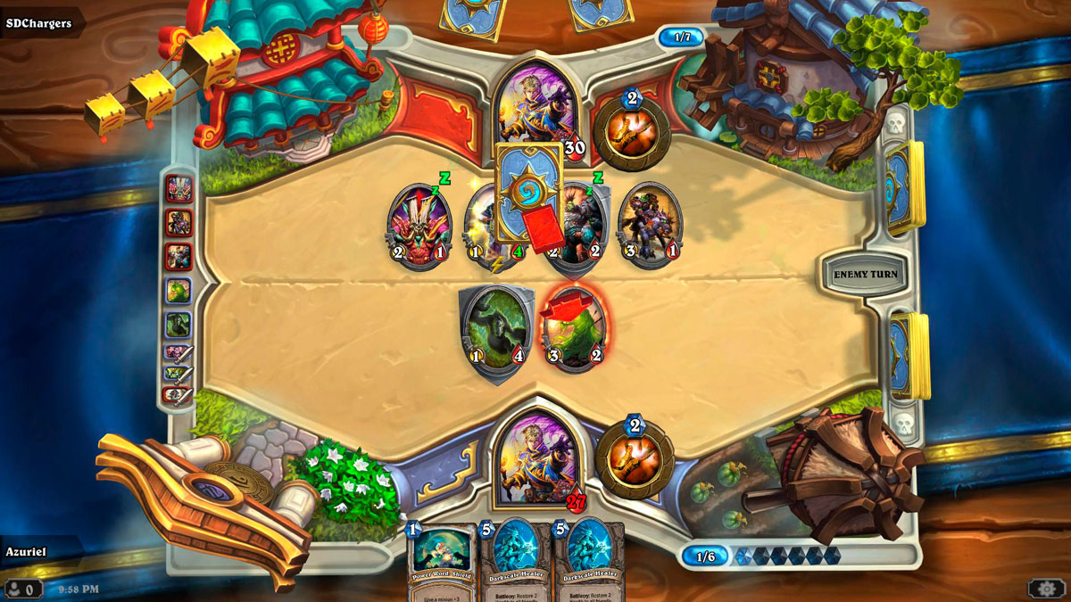
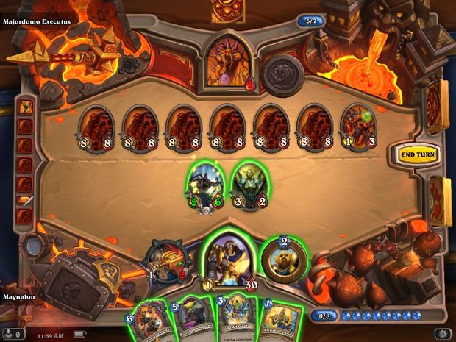
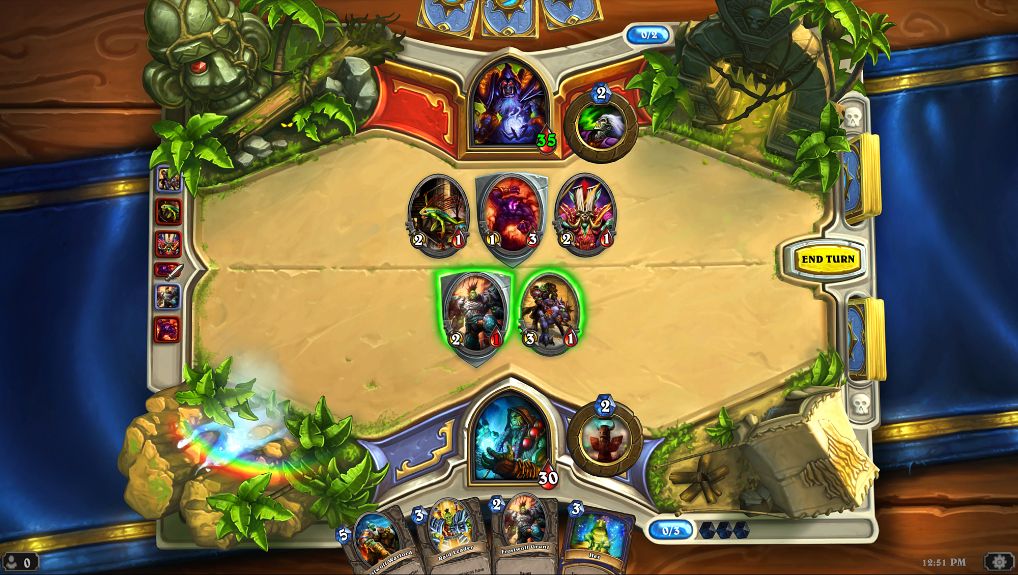
Game Artwork/sound
Battle.net

Slide 15
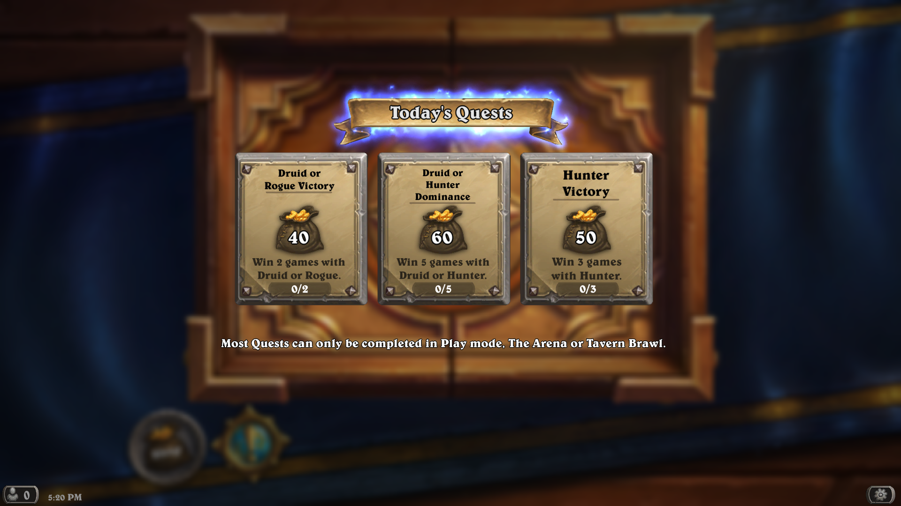
Game Review

Slide 16
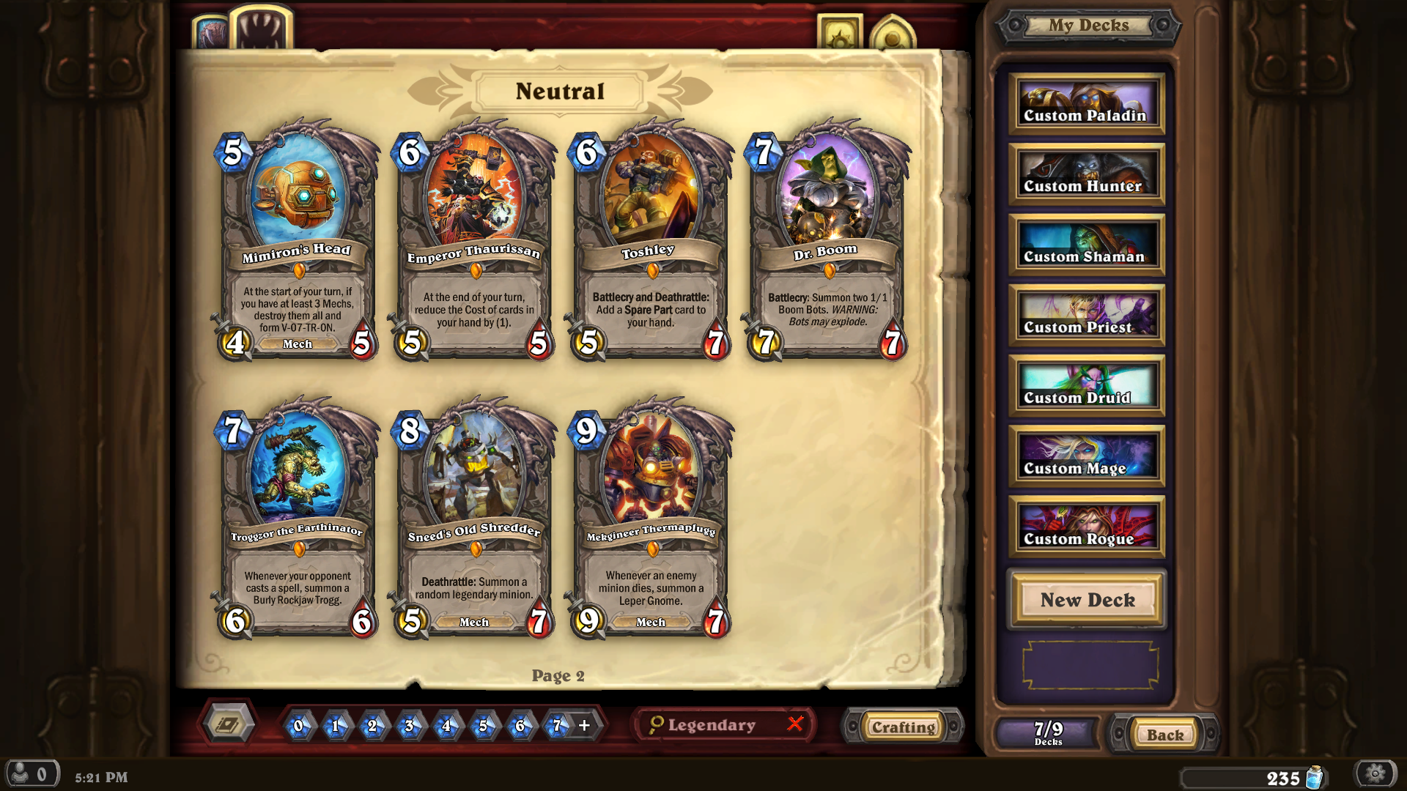
Game Review

Slide 17
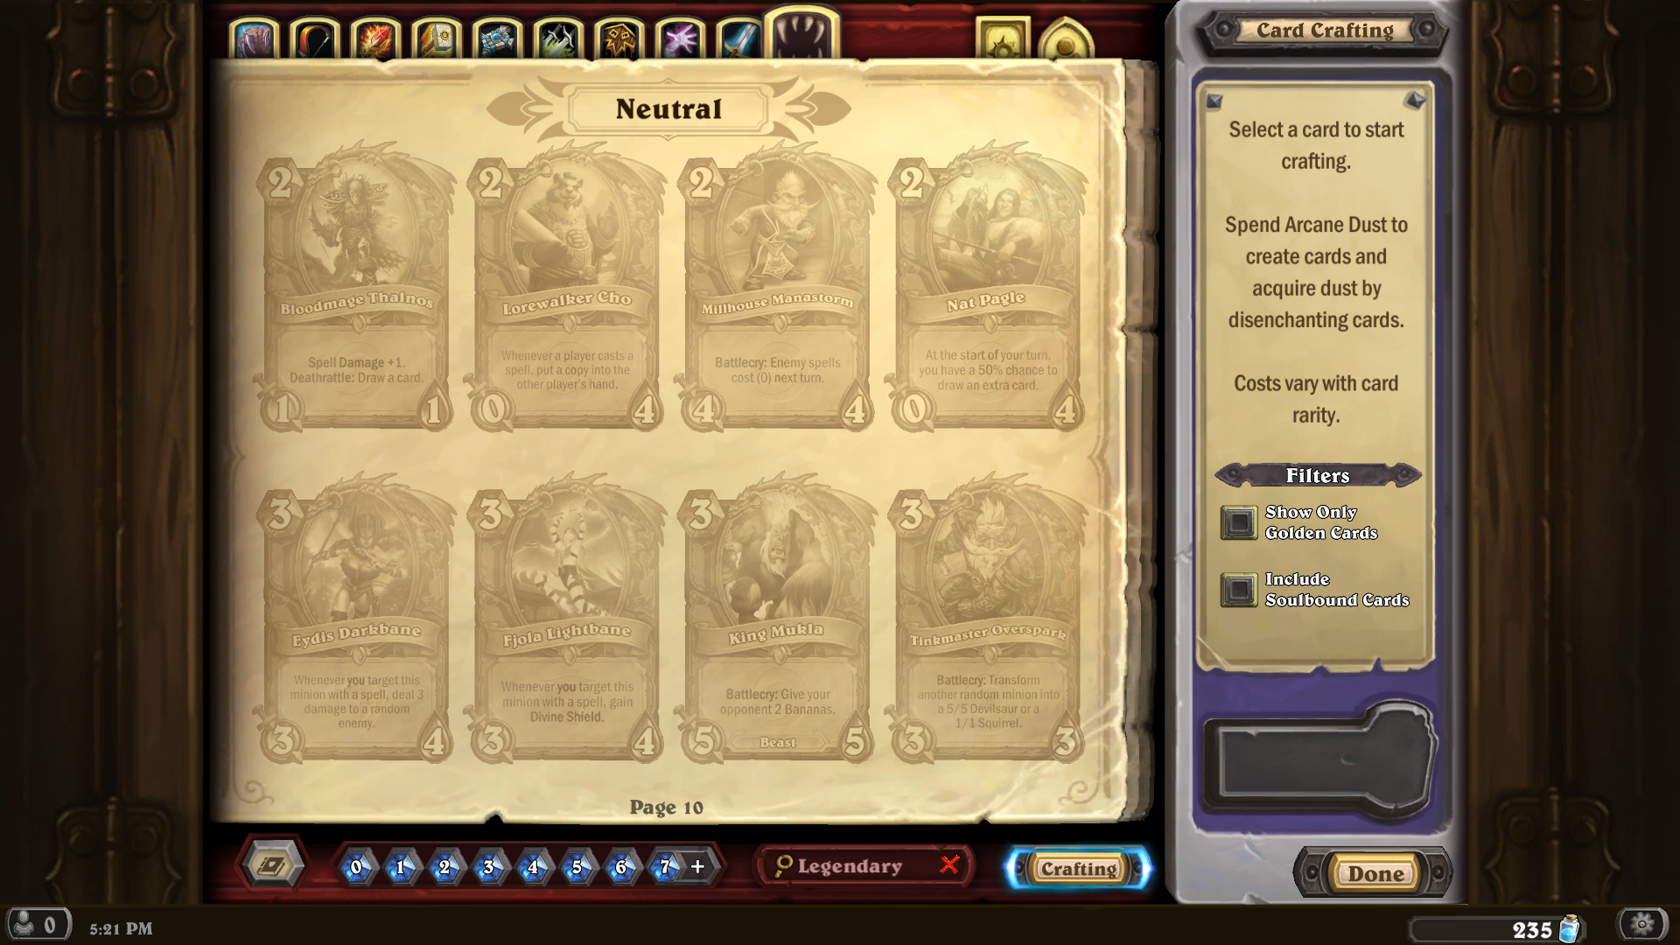
Game Review

Slide 18
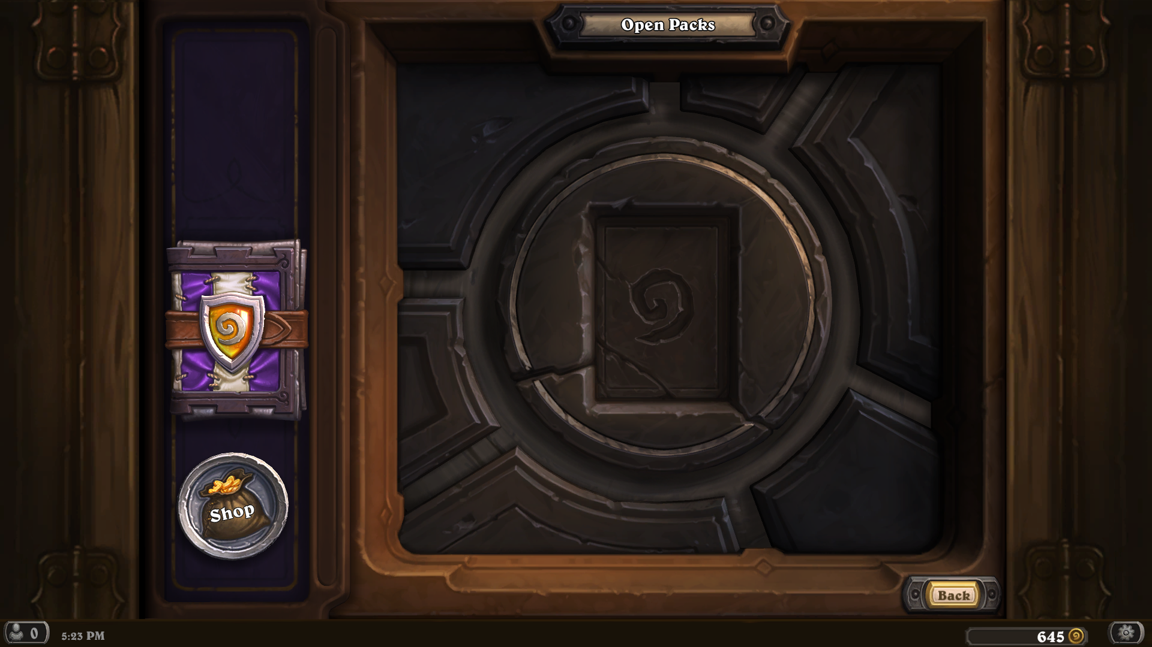
Game Review

Slide 19
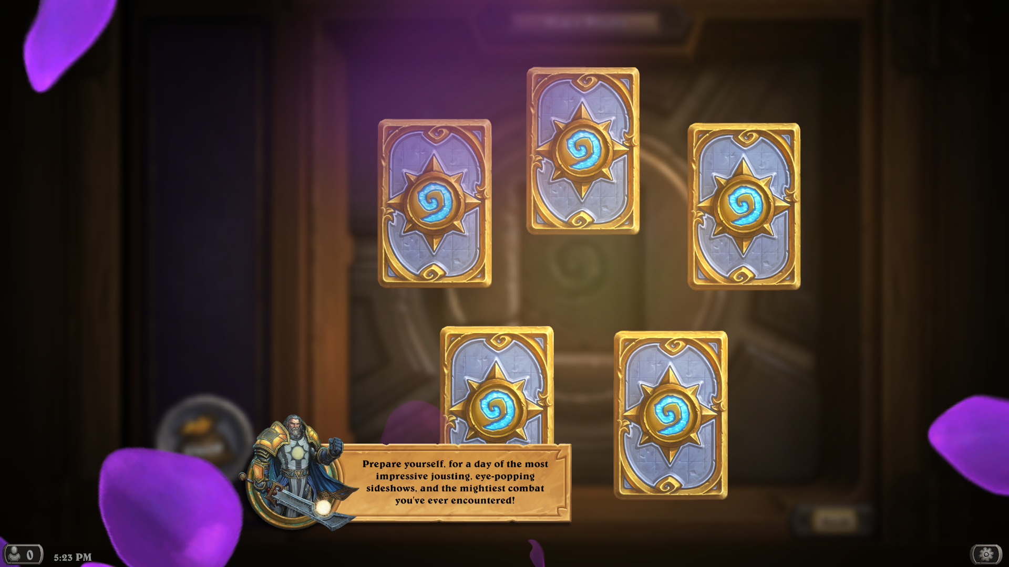
Game Review

Slide 20
Game Review
What is good?
What is bad?
Every match is unique
Quick matchmaking
Many different strategies
Build your own deck
Matches take 10-15 min
Daily quests
9 different Heroes
Crafting mode
Without spending money, it's time consuming to become competitive
It's expensive to get a great deck.
Packs are random and can get multiple copies of same cards over and over
Might face opponents that have much better decks than yours

Slide 21
Summary
Very addicting game
Can be played from anywhere
Rated T
Great graphics and sound
New content releases and balances
Many different playstyles
Ranking system
PvP and PvE
Free to play, can try it before deciding to spend any money.

Slide 22
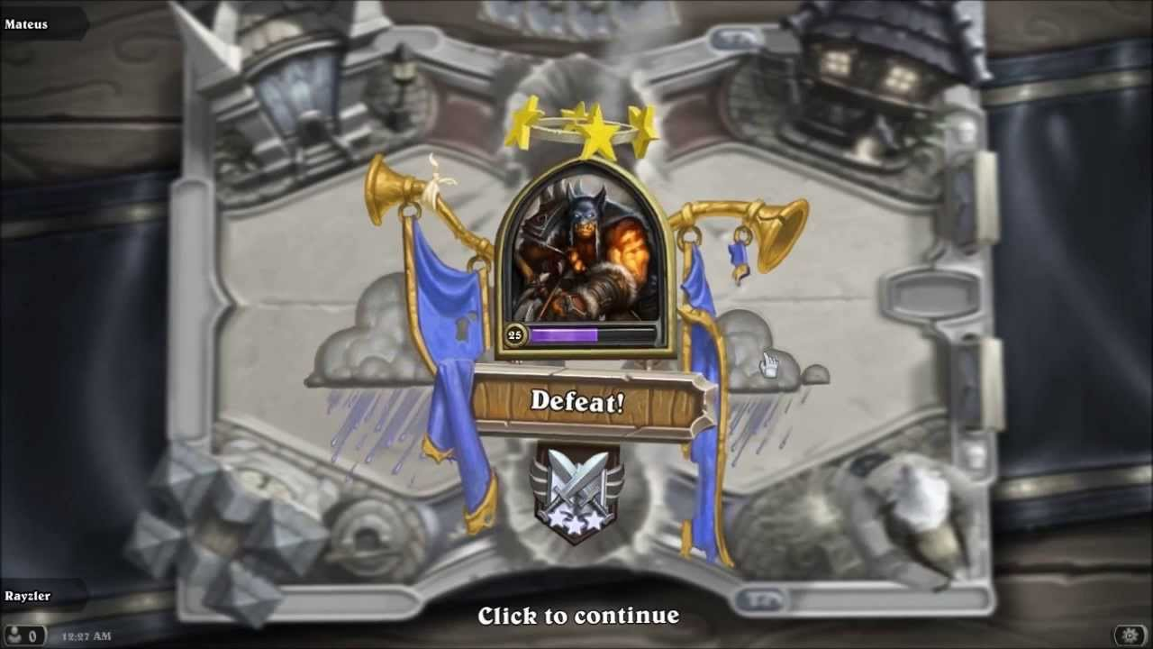
The End

