Slide 1
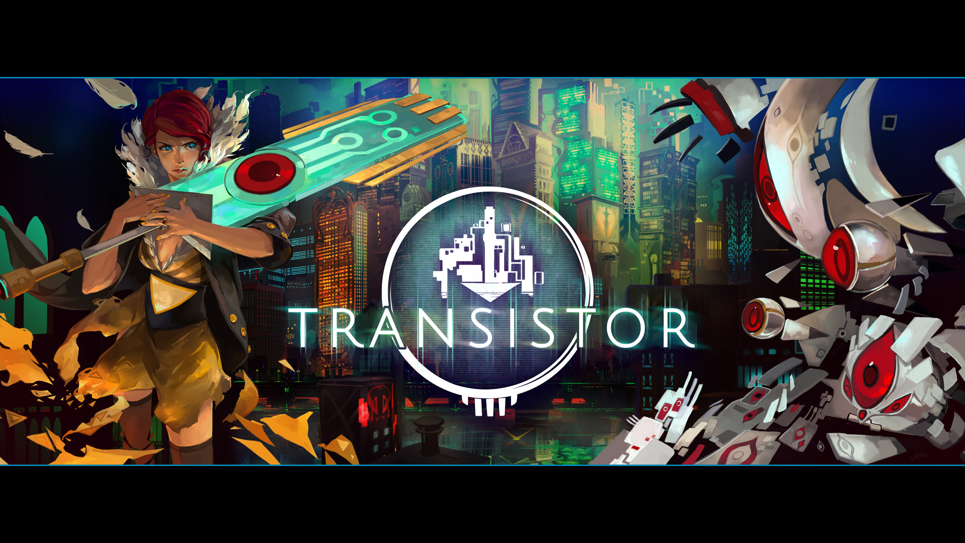
Transistor Game Review
By: Lauren Gaber
Transistor - Game Review
By: Lauren Gaber

Slide 2
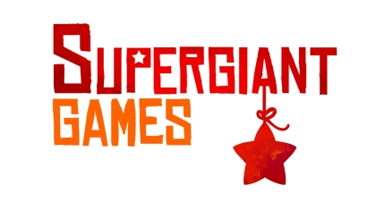
Basic Info
Game Title:
Transistor
Company & Author:
Supergiant Games
Type of game:
Single player Action RPG
Price:
$19.99 on Steam ($29.98 with soundtrack)

Slide 3
Basic Info (cont)
Minimum stated hardware requirements:
Runs on Windows, Mac OS X, and Steam OS + Linux
Minimum Windows Requirements:
OS: Windows 7 32-bit
Processor: Dual Core CPU - 2.6ghz
Memory: 4 GB RAM
Graphics: 1GB of VRAM: Intel HD 3000 GPU / AMD HD 5450 / Nvidia 9400 GT
Hard Drive: 3 GB available space

Slide 4
Basic Info (cont)
Actual hardware required:
I recommend to play on a computer with a stronger processor
Runs on laptop which is 3.0ghz, but it starts to work too hard after about an hour (laptop is 3 years old).

Slide 5
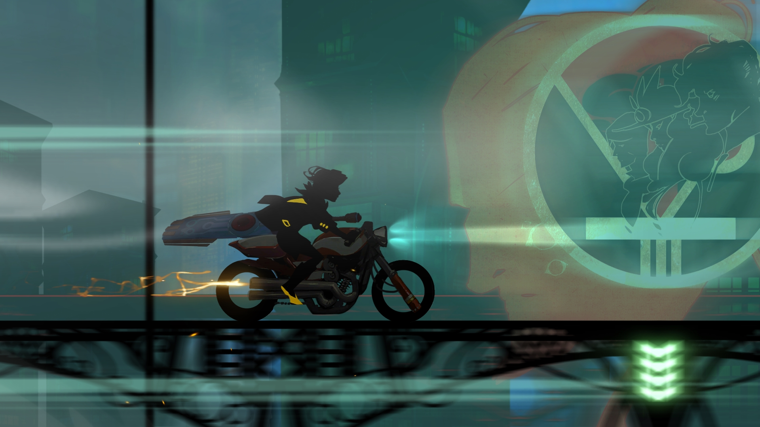
Game Summary

Slide 6
Game Summary
Quick overview:
Isomorphic layout, linear story, blends strategic planning and real time combat very well.
Story line:
(from Steam page): The Transistor is an extraordinary weapon of unknown origin which you use to fight through the stunning futuristic city of Cloudbank in pursuit of its former owners.
Player's role:
You play as Red, an influential singer, now voiceless and on the run wielding the Transistor. You fight to keep it out of enemy hands and to find answers about its origin.
Installation:
Purchase and download from Steam application

Slide 7
Game Summary (cont)
User Interface:
Menu for controls and settings can be called up at any time
Menu for programming and recharging Transistor is called up in-game by visiting periodic Access Points
Your game saves automatically when:
Access Point is used
New area entered

Slide 8
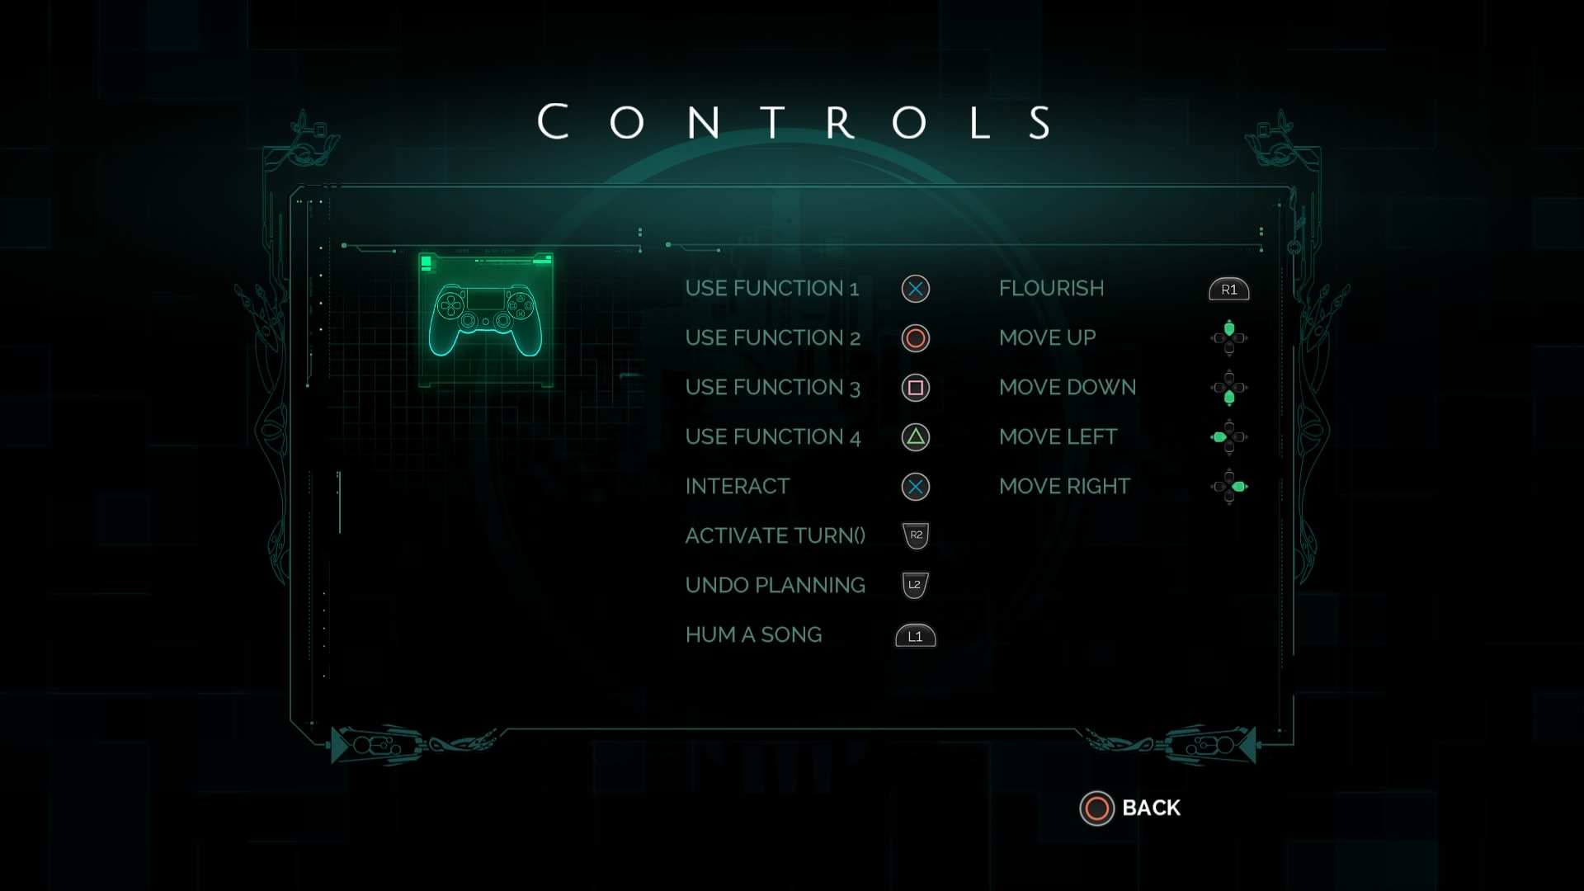
Customizable Control Menu (for Playstation Controller) Screenshot

Slide 9
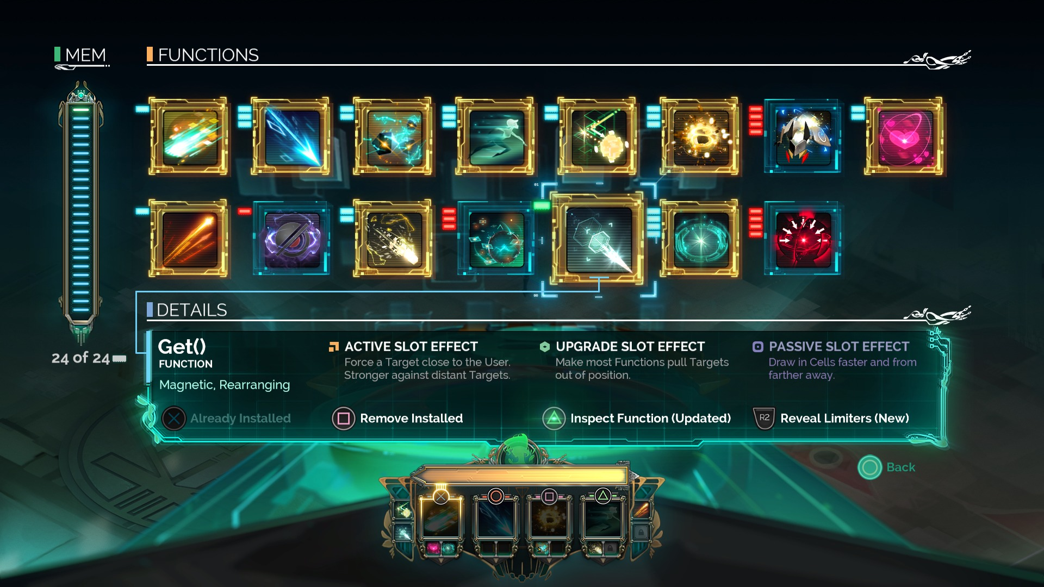
Function Inventory Menu (Functions used for Transistor programming)

Slide 10
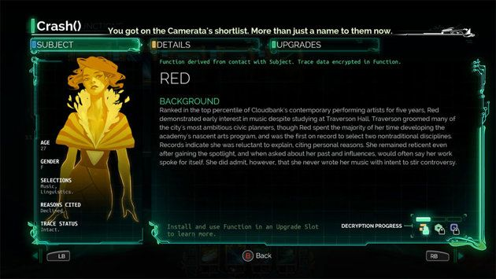
Functions (cont)
Functions are Transistor abilities. The Crash() Function belongs to Red, and if you examine it, it will tell you more about her and the ability’s origins.

Slide 11
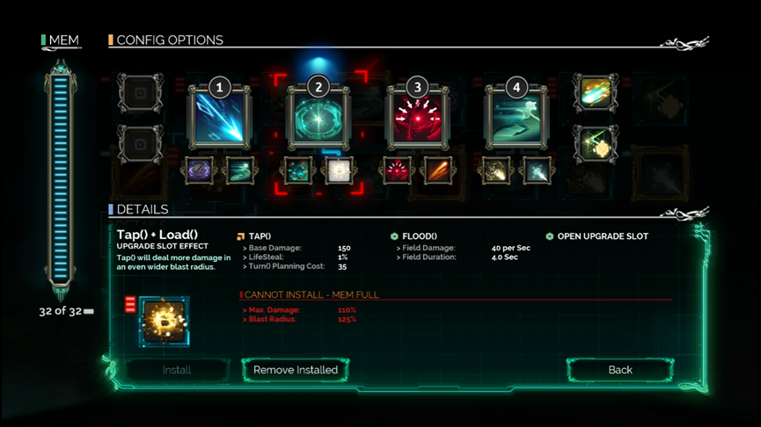
Transistor Function Config Menu (Transistor programming)

Slide 12
Game Summary (cont)
Game Play:
Player is chiefly guided through the world by the Transistor talking at Red and interacting with the environment.
Story unraveled through Transistor’s commentary, as well as by decrypting original owner Function information through usage.
Controls:
Movement: left mouse or W, A, S, D keys
Function choice: toggled through short keys (1,2,3,4) or selection with mouse
Attacks: right mouse
Interaction: E key, Humming: Tab key, Flourish: Q key, Undoing a planned move: R key
Controls are customizable.

Slide 13
Game Summary (cont)
Game Play (cont):
Combat:
Can be planned out in a Turn() or performed on demand
A Turn() has a recharge time, some functions disabled for real time attack while recharging.
You can only plan so many actions with one Turn(). The Functions expend different amounts of the Turn().
There are specific areas for fighting a battle that you’re locked into while they’re happening.

Slide 14
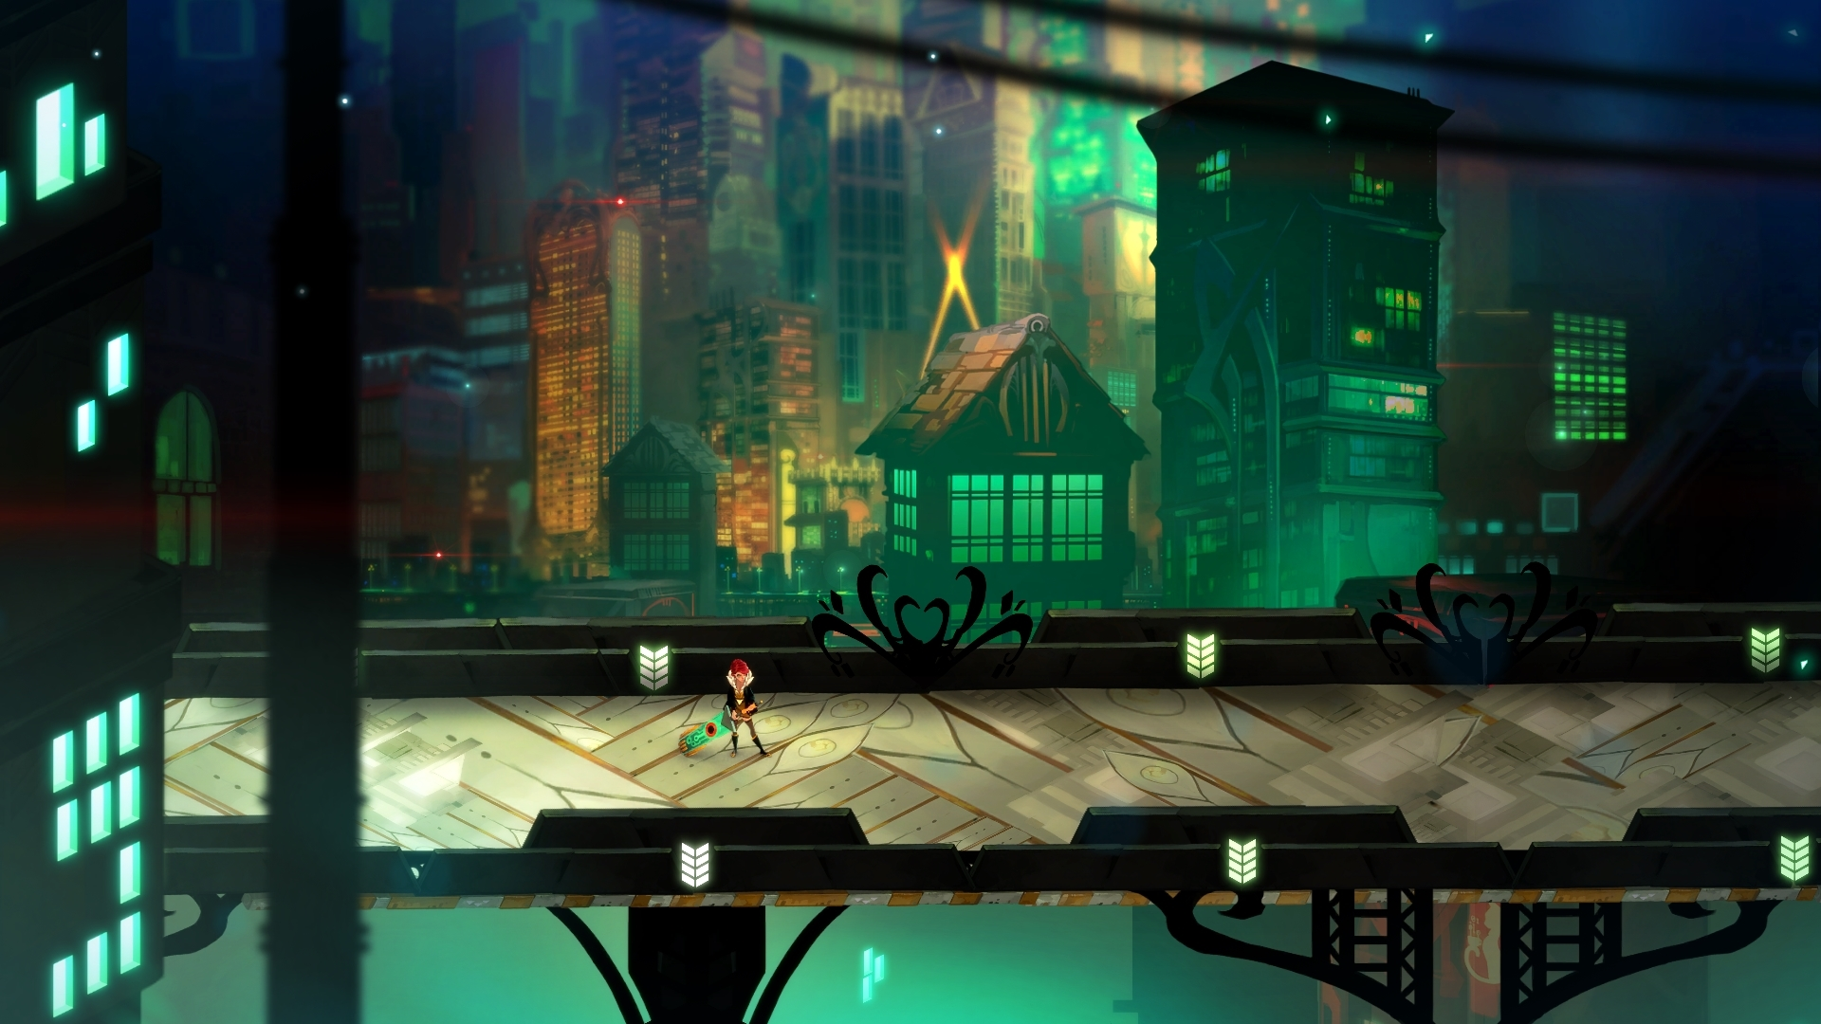
Walking around Cloudbank

Slide 15
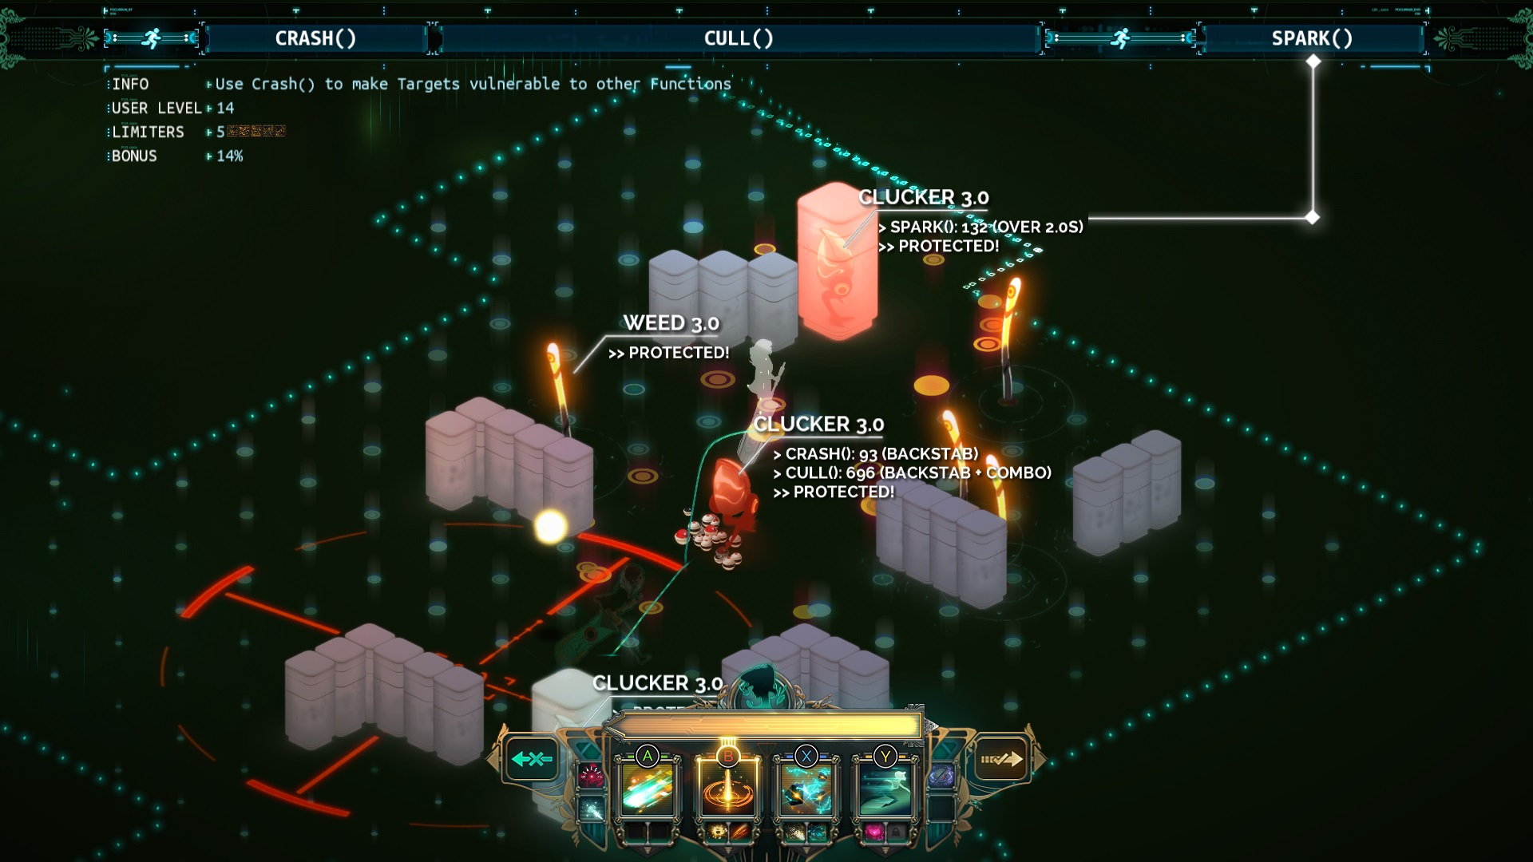
Planning stage of a Turn()

Slide 16
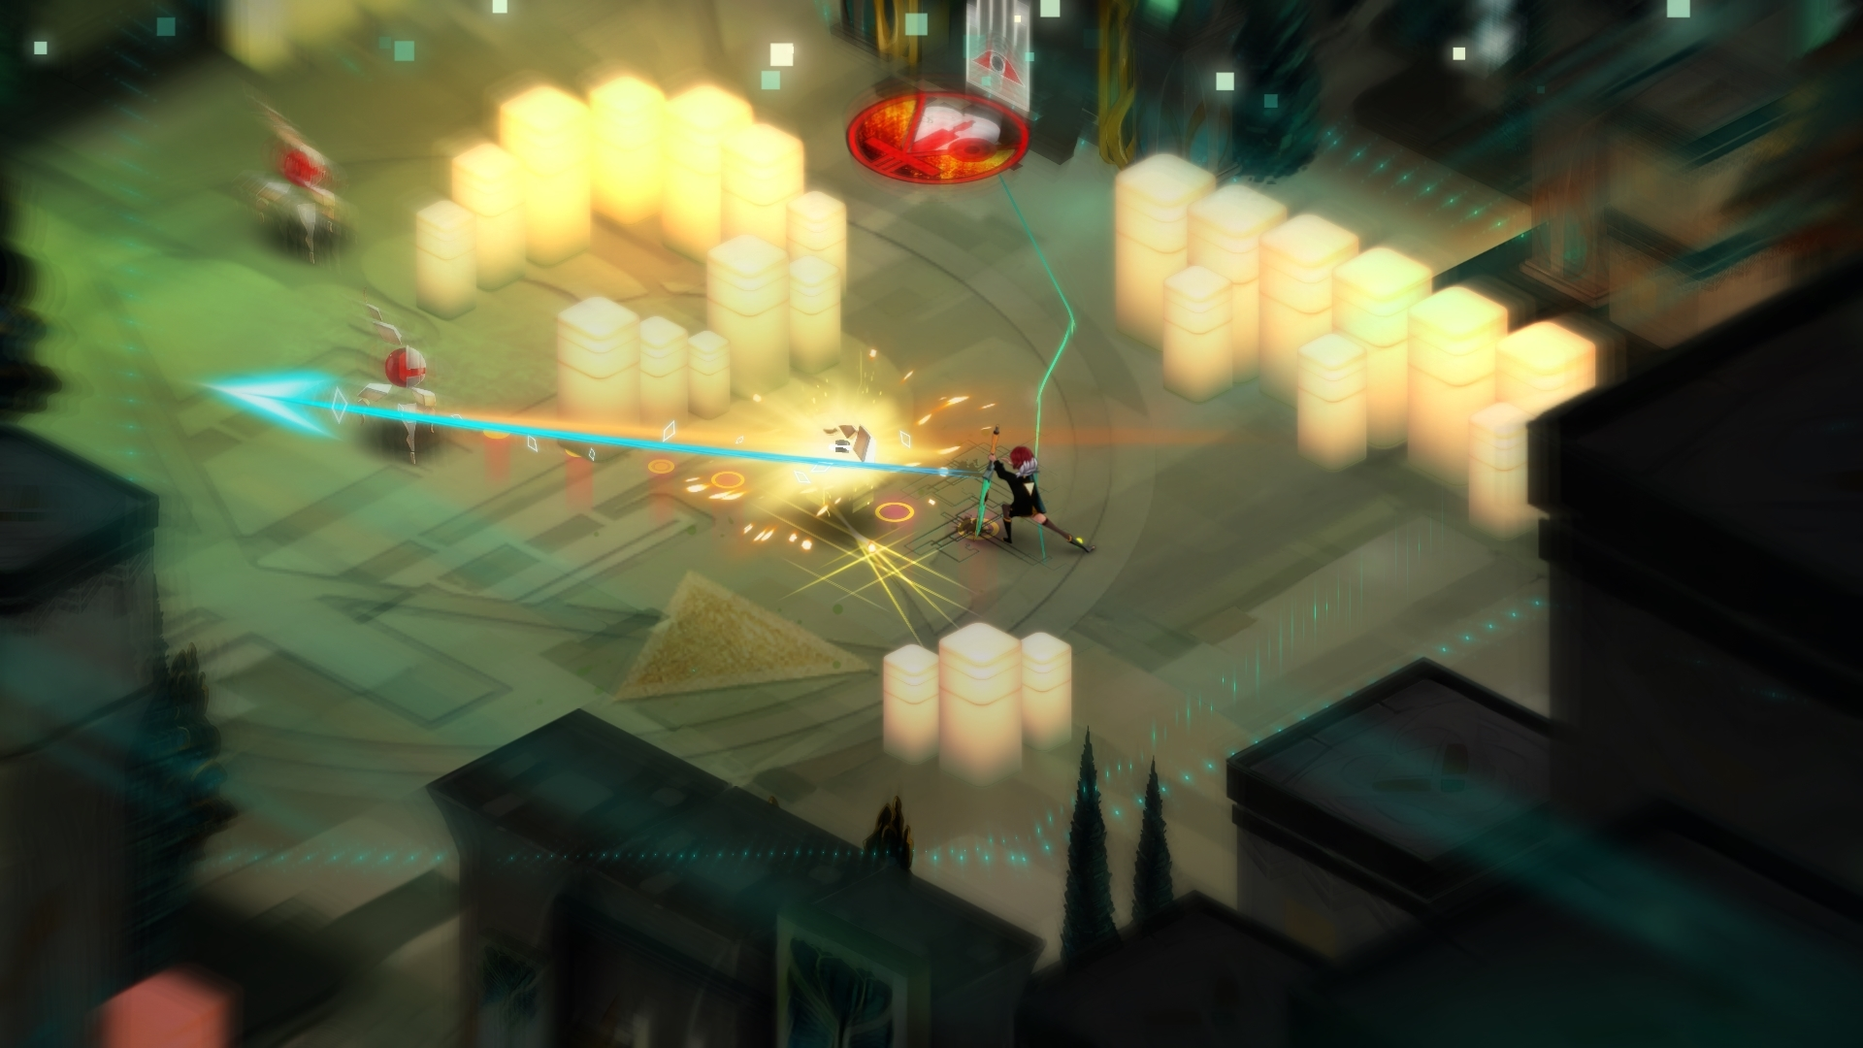
Execution of a Turn()

Slide 17
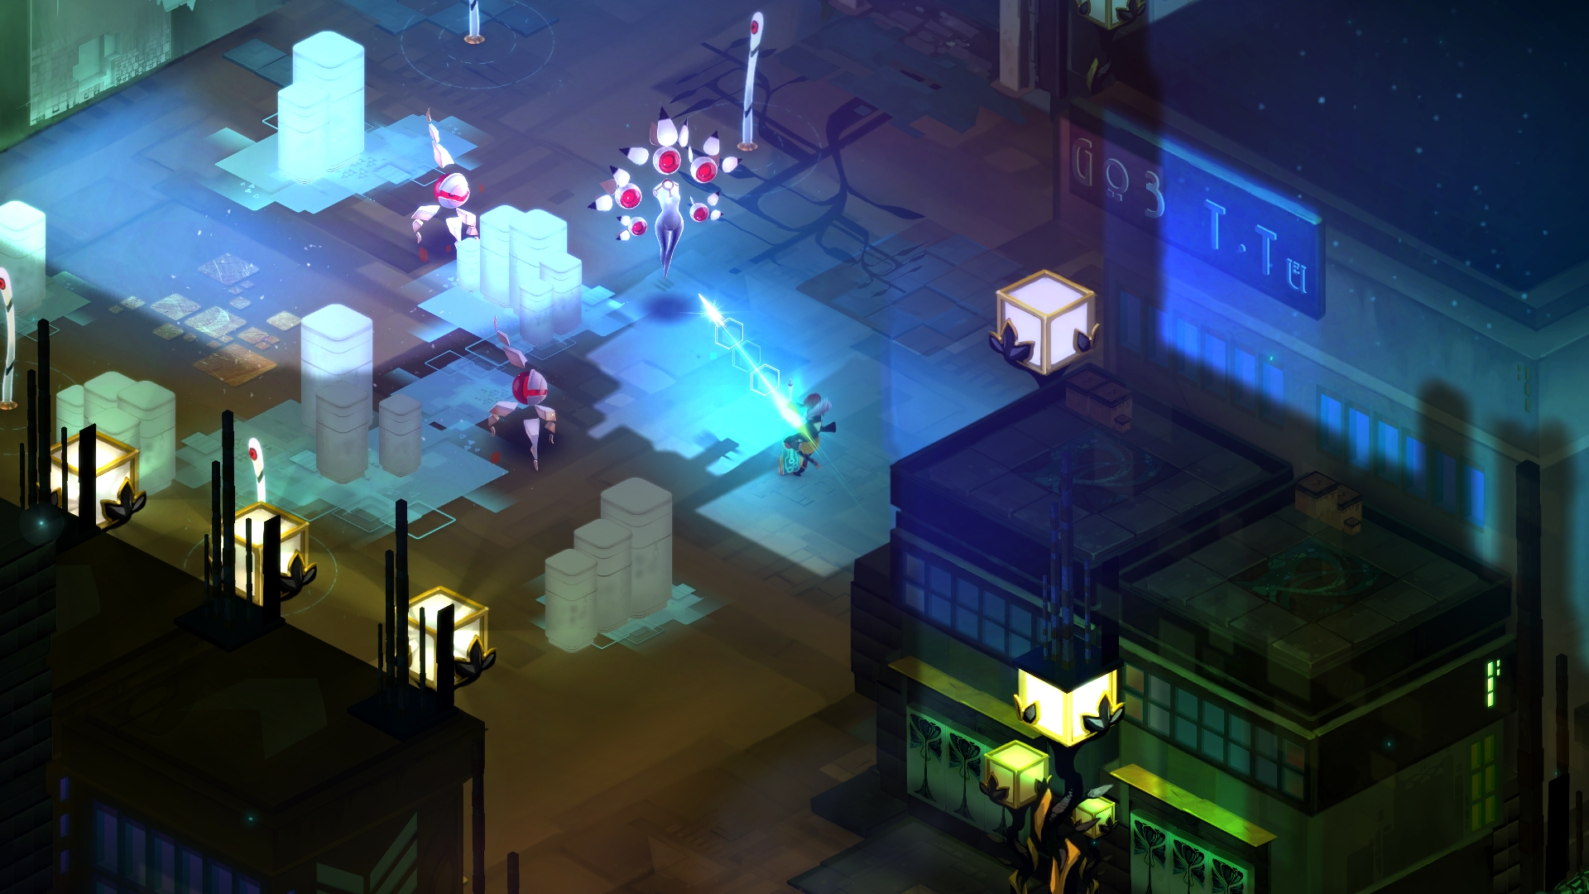
Real Time Attacks

Slide 18
Game Summary (cont)
Scoring:
You level up from battling and practicing, which unlocks more Functions and their original owner’s back stories.
Artwork:
Art direction by Jen Zee. The game is very beautiful, and projects the desired atmosphere of futuristic science fiction.
Sound and Music:
The music is also very beautiful and appropriately atmospheric, never too distracting. Music composed by Darren Korb; Some tracks include Red singing (courtesy of Ashley Lynn Barrett). Voice of Transistor is Logan Cunningham.

Slide 19
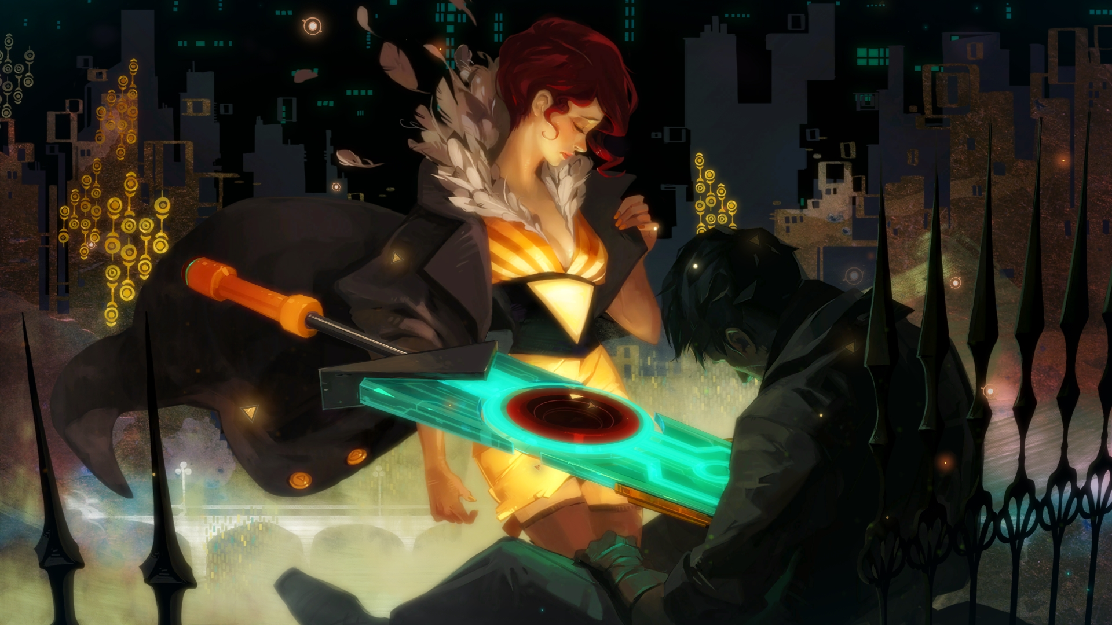
Artwork

Slide 20
Game Summary (cont)
Special features:
For purchase Soundtrack is the only listed DLC
Bugs:
Occasional awkward transitions or needing multiple clicks, likely due to lag
On first download and play it notified me of a graphics card problem which was incorrect and was solved through an advanced command and running the game as an administrator

Slide 21
Game Review – The Good
Art, music, sounds, and story. They formed a cohesive and consistent atmosphere and enriched the experience of game play.
Having the available mechanics of both planning and instant attacks was very satisfying, and made me better appreciate the benefits and drawbacks of both.
The ability to recombine different Functions in active, passive, and upgrade slots encouraged experimentation and strategy, while revealing more of the world’s backdrop and characters.
This game lets you explore the world pretty freely, but you never feel lost.

Slide 22
Game Review – The Bad
Didn’t like having to deal with that bug first thing
Large battles on low resources felt slightly desperate and repetitive and took a long time to complete. Indication of large battles wasn’t always clear, and full recovery could take a while.
Fewer defensive options to start out with were also occasionally frustrating, and it made battle feel draining more than fun at times. Can’t reuse access point for recovery
I would have liked to see maps of areas to get a better idea of the world layout and maybe hint if I was missing a visit to anything in particular like a practice side area.
The flourish animation is nice but appears awkward from most angles.

Slide 23
Game Review – Comparison to Existing Games in the Same Genre
Other Popular Action RPGs:
Bastion, Kingdom Hearts, Borderlands, Dark Souls, Fable, etc.
I don’t play many titles in this genre, but some common elements of the more successful ones have:
An emphasis on artistry and strong storylines
Take a medium-long amount of time to play completely through (6-30+ hours).
The way combat is designed blurs the lines between action RPGs and regular RPGs.

Slide 24
Game Review – Comparison to Existing Games (cont)
Transistor compared to its predecessor Bastion:
maintained the artistry and story aspects
Transistor has a better grasp of constructing game atmosphere (better sound design, more consistent styling of sprite)
Transistor compared to Kingdom Hearts:
Transistor has a clearer story and logical progression
Both have good combat systems
Controls for Kingdom Hearts were simpler, and I enjoyed the camera freedom.

Slide 25
Game Review – Appropriate Audience and Design Mistakes
Audience: Teen and Up
Reasoning:
Somewhat complicated keyboard controls
A decent attention span, reasoning/strategy skills, coordination and some patience make play much more enjoyable
More mature themes (murder, corruption, etc.)
Design mistakes:
Slow recovery times
Few defensive Functions
Lag

Slide 26
SUMMARY
Overall strengths:
It made me like some aspects of games that I usually don’t (isomorphism, turn taking/planning)
It is very gorgeous and well written, and has great aesthetics (and even pacing for the most part)
Overall Weaknesses:
Some rarer aspects of the battle system being difficult
The relatively quick overwork of computer processor

Slide 27
SUMMARY (cont)
Worth it?
Yes! Its worth it at full price but I also know it appears in Steam sales, which is how I only had to pay $6.79 for my copy. The soundtrack is worth purchasing too.
How it could be Improved:
Fix the graphics card notification
Improve the flourish animation
Refine format/intervals of battles and access points a bit more
Make it easier on the processor or require a stronger one for play

Slide 28
Link to Trailer on Steam (if time)
http://store.steampowered.com/app/237930

