Slide 1
Game Review
LeRoy Eberly

Slide 2
Hyperdimension Neptunia Re;Birth1
Game was originally in Japanese, I will be reviewing the International English Version
Developers:
Idea Factory, Idea Factory International, Compile Heart
Game Type: RolePlaying, Visual Novel, Turn Based Strategy, Comedy
Price: $29.99 (Steam, PlayStation Vita)

Slide 3
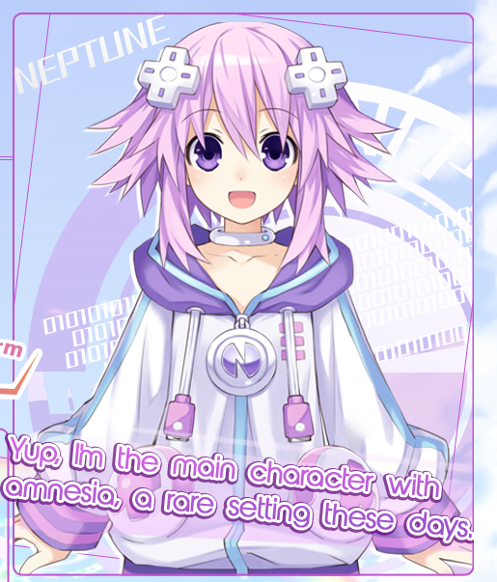

Slide 4
System Requirements
PlayStation Vita
Enough space for saved game data
Steam
Listed:
OS: Windows 7 (64bit, 32bit not supported)
CPU: Duo 2.66GHz
Graphics: DirectX 10.x or OpenGL 3.3 with 1GB of RAM
Hard drive: 7 GB

Slide 5
System Requirements
Steam
Actual Minimum
OS Windows 7 (32 bit)
Duo 2.33GHz
Memory: 3GB
Hard Drive: 7.3 GB
Graphics: Nvida 8600M

Slide 6
Game Summary
From Publishers Website:
A world protected by four goddesses, known as CPUs. These four CPUs are locked in a conflict with one another for world domination. Later, this battle would come to be known as the Console War. The land where humans reside has been overwhelmed by monsters released by someone known as Arfoire.

Slide 7
Game Summary
Summary
A world, known as Gameindustry, in which 4 CPU nations, Planetune (SEGA), LastStation (PlayStation/Sony), Leadbox (Xbox/Microsoft), and Lowee (Nintendo) fight to protect their shares and the world.

Slide 8
Game Summary
Main Characters (representation)
Neptune (canceled Sega Neptune)
Compa (Compile Heart, game developer)
IF (Idea Factory, game publisher)
Arfoire (R4, Nintendo DS game card that allows free downloads)
http://hyperdimensionneptunia.wikia.com/wiki/References

Slide 9
Game Summary
Installation
PS Vita: Simply insert the game disk or download from store
Steam: Simply download from steam and run
User Interface
There are three main interfaces
Story Interface
Combat Interface
Main Menu

Slide 10
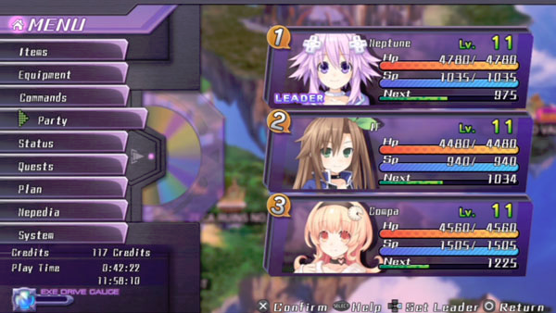
Game Summary
Menu Interface

Slide 11
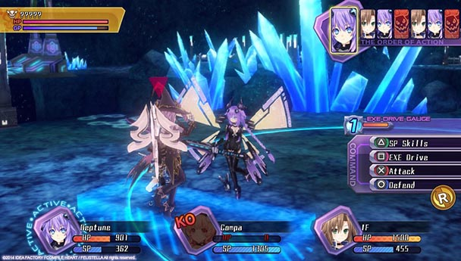
Game Summary
Combat Interface

Slide 12
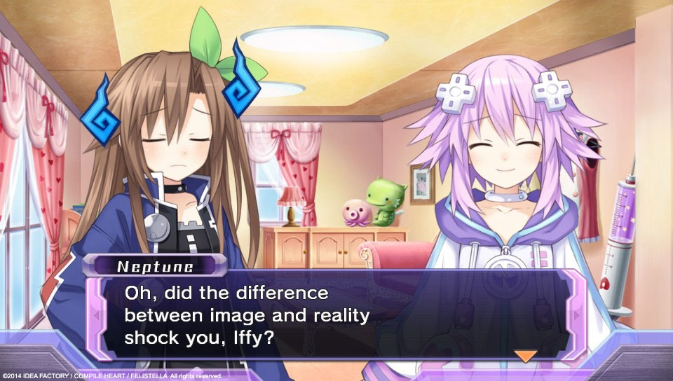
Game Summary
Story Interface

Slide 13
Game Summary
Scoring
Metacritic: 72/100
IGN: 6/10
Steam: 96% rated positive out of 3,700 reviews

Slide 14
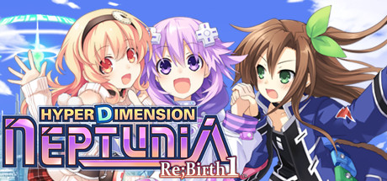
Game Summary
Artwork
The art is of what you’d expect in an Anime style game, very colorful.

Slide 15
Game Summary
Sound and Music
All music and sounds are original upbeat and fit well with the game
Voices come in two options:
Original Japanese Voice
English

Slide 16
Game Summary
Special Features
Turn based combat
NewGame+, start the game over keeping weapons and stats of previous game
Customize weapons, effects, and clothing of all playable characters
DLC gives more costume options
~50 hours of gameplay before NewGame+

Slide 17
Game Summary
Steam Manual: http://www.ideafintl.com/rebirth1/pc_manual/rebirth1_m.pdf
Gameplay: https://youtu.be/Uqj2iQ5DA3c?t=16m37s

Slide 18
Game Summary
Bugs
Random crash when moving through menus too quickly (happens more on older systems for Steam)
Black Screens
Audio for some actions do not play

Slide 19
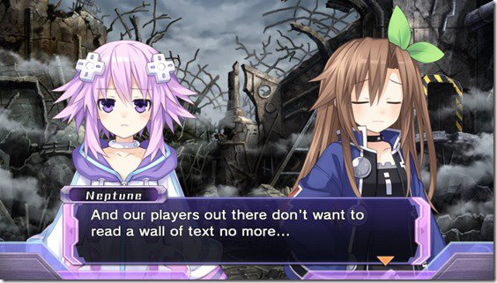
Game Review
What is Good?
The story
The story is based in a world where just about everything is based in some form on the gaming industry. The story also does not take itself seriously.

Slide 20
Game Review
What is Good?
Customization
From clothes to combat moves, the player gets to choose. I enjoy games where you can customize the looks of the characters and the abilities of the characters. There is a decent amount of freedom in regards to customizing.

Slide 21
Game Review
What is Bad?
The Grind
I don’t know what it is about asian games, but they enjoy their tiring grind. Unless you purchase certain DLC, prepare to spend at least a few minutes between chapters leveling up characters.

Slide 22
Game Review
What is Bad?
Replayability
The game lacks replayability severely. It is a very lengthy game to complete so it is well worth the money, but new game+ just tells the same story over again with leveled characters, which is great if you come back and pick up the game again after some time. Sure there are achievements to get you to continue to play, but they do not add much value to the game.

Slide 23
Game Review
How does it compare to other games?
The game is very unique compared to other games of the genre. This game offers an entertaining and fun alternative to other similar games. The comedy and all the plays on real companies or consoles makes this game stand out from the others.

Slide 24
Game Review
Is the game better or worse than similar games?
Setting the issue of replayability aside, this game is slightly better than similar games, but only if you enjoy a comedy game that does not take itself seriously and the Japanese anime styled art.

Slide 25
Game Review
What is the appropriate Audience?
I would say anyone ages 14-30 are the target audience for this game. Anyone who enjoys comedy and Anime will also find the game enjoyable.

Slide 26
Game Review
Are there any design mistakes?
Replayability
End Game

Slide 27
Summary
Strengths
Story, genre, art, physics
personality, comedy, DLC, soundtrack
Weakness
Replayability
Too many characters

Slide 28
Summary
Is the Game Worth Purchasing?
Yes, and even more so if you get it on sale.
How could the game be improved?
Adding a compelling game mode when the main story line is completed to keep the user playing and add replayability value.

Slide 29
