Slide 1
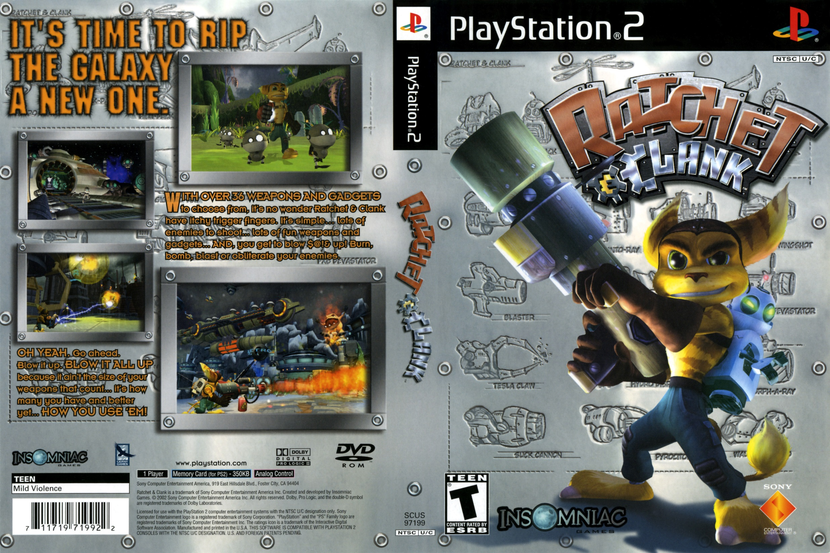
Game Evaluation of Ratchet & Clank
Andrew Berg
CIS 487 Game Design
Professor Bruce Maxim
September 23, 2015

Slide 2
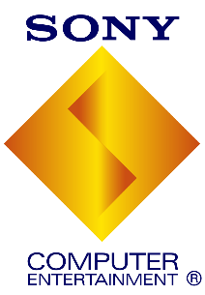
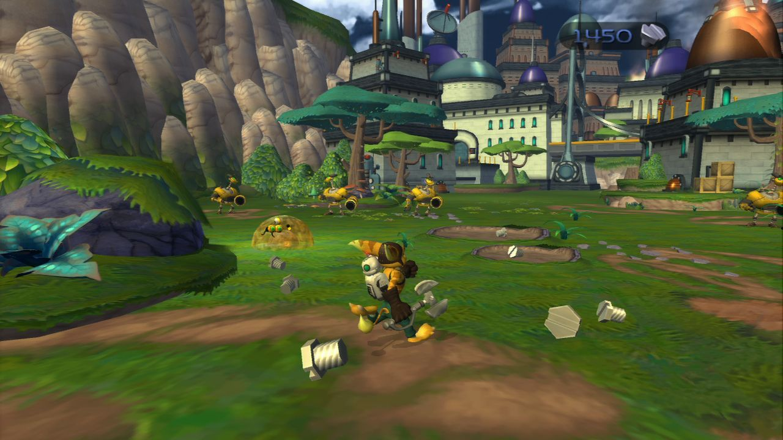
Development Team:
Price Range: $20 (at release)
$6 (at Destiny Games currently)
Publisher:
Type of Game: 3-D Platformer (PS2)
Screenshot at: http://www.destiny-games.com/products/ (Ratchet & Clank at search)

Slide 3
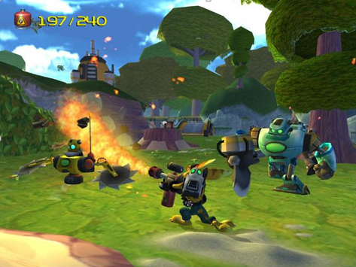
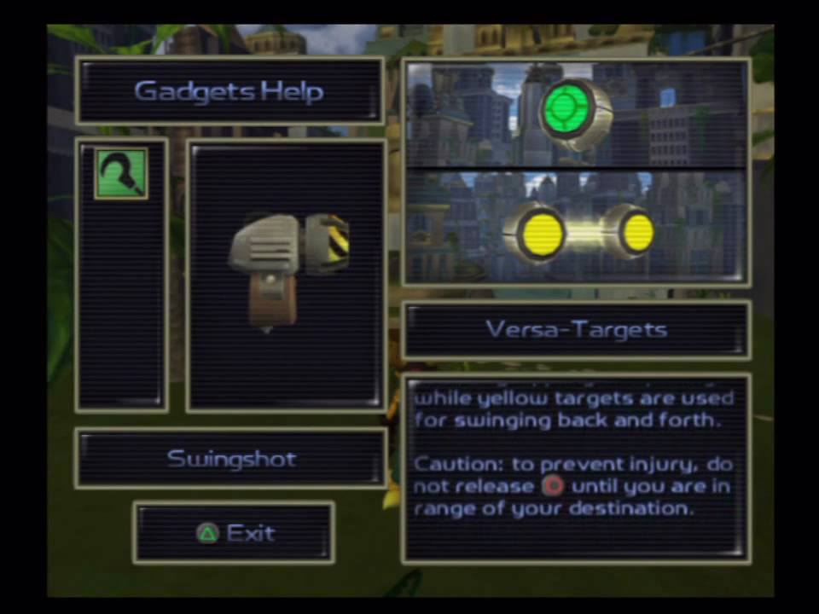
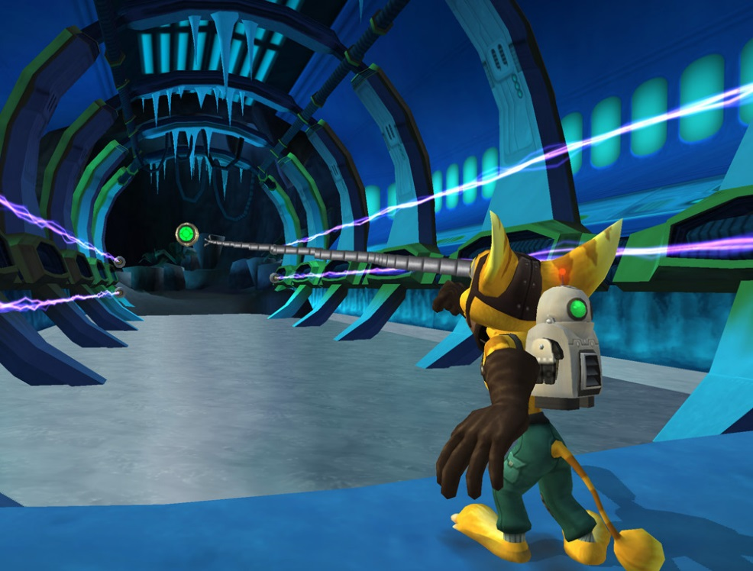
Quick Overview
-Run around in a 3-D environment
-Eliminate enemies with weapons
-Solve puzzles
-Purchase new weapons
-Rinse and repeat as you progress through the story

Slide 4
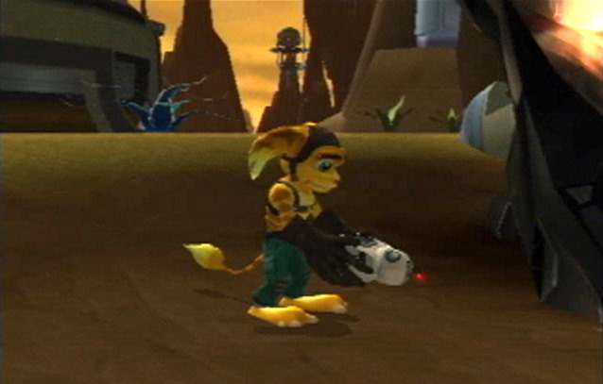
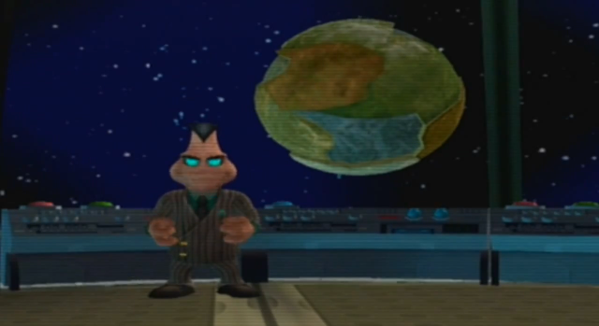
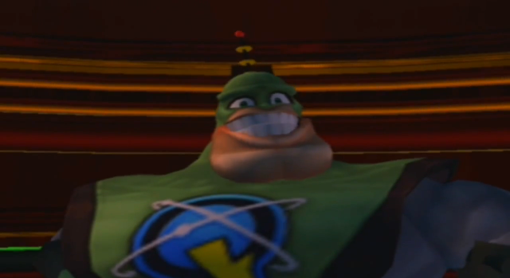
Storyline
Ratchet (of species lombax) is building a spaceship on his home planet when he discovers a nearby explosion . To his suspense he discovers a small robot who he eventually names Clank who is in sight to defeat the villainous Chairman Drek. Drek is a warmongering blarg who develops a plan to create a new world for his species given the pollution level of his home planet; Orxon. In conquest of this he is extracting portions of other planets, causing universal chaos. Clank convinces Ratchet to help him find proclaimed hero Captain Qwark to help stop Drek. From that point on the story begins…
Ratchet finds a mysterious robot…
Drek and his evil plan…
CAPTAIN QWWWWWWWWWWWWARK!!!

Slide 5
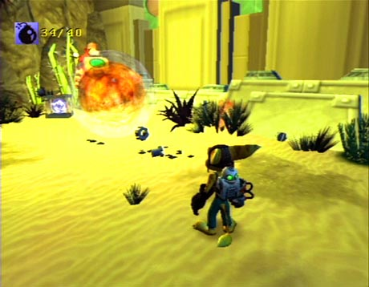
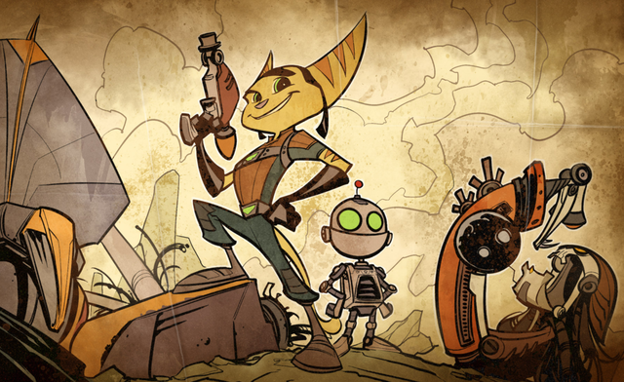
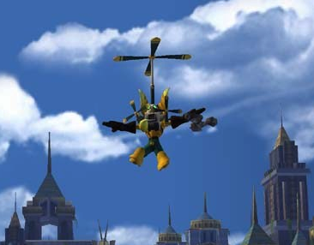
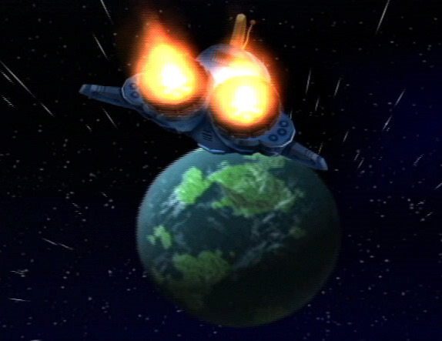
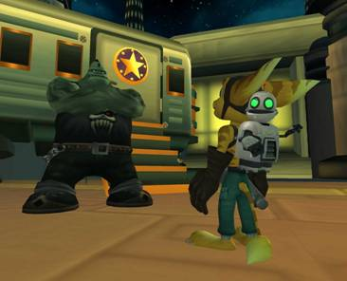
Your Role? Play the hero and save the universe!
And BLOW UP EVERYTHING in the process!

Slide 6
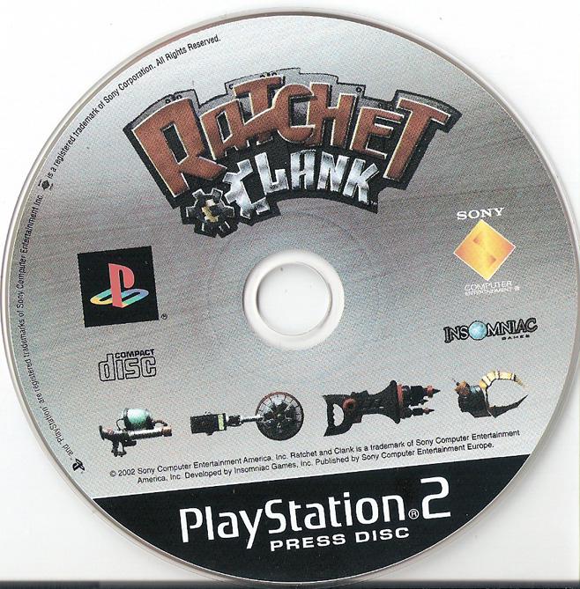
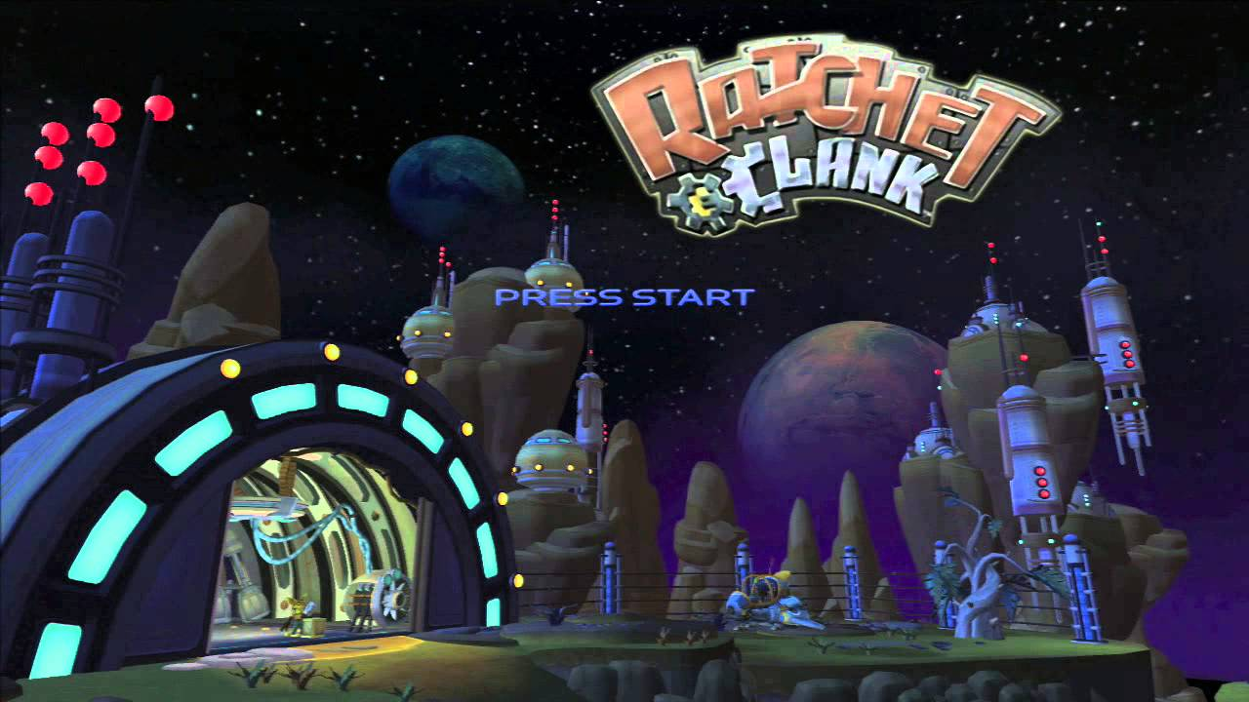
Installation
As simple as inserting the disc inside your Playstation 2!
Loading time is approximately 20-30 seconds of logos
System Requirements
A functional PS2 (with video/audio inputs and power cord of course)
A functional PS2 controller
A memory card with 350 KB space to save your progress

Slide 7
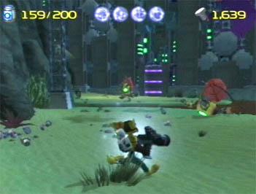
Ammunition
Nanotech level (Health)
Bolt counter (Currency)
User Interface
Third person mode throughout the game
Ammunition
Health
Bolt counter (currency)
Fairly simple to adjust to. Each resource appears on the screen when it changes (ie. Using your weapon brings up Ammunition, Taking damage brings up Nanotech level, etc)
Occasionally help messages will appear at the bottom of the screen.

Slide 8
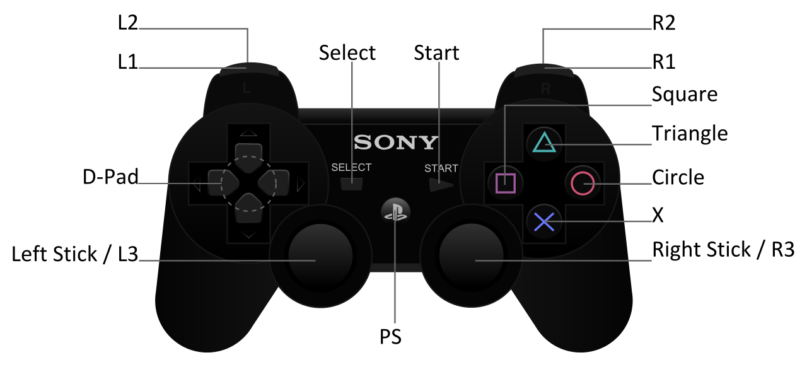
User Interface (continued)
-The basic controls are listed below as far as user input goes:
L1/L2 – First person targeting
R1/R2 – Crouch
Start – Menu
Select- Map
D-Pad – Walk/Run
Left Analog Stick- Walk/Run
Right Analog Stick- Camera
Triangle – Quick Select (Weapons/Gadgets)
Square – Swing Wrench
Circle – Fire Weapon/Use Gadget
X - Jump
*NOTE: The PS2 controller has an analog button instead of PS

Slide 9
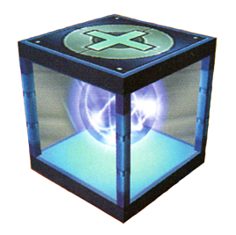
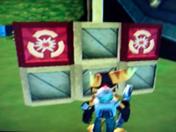
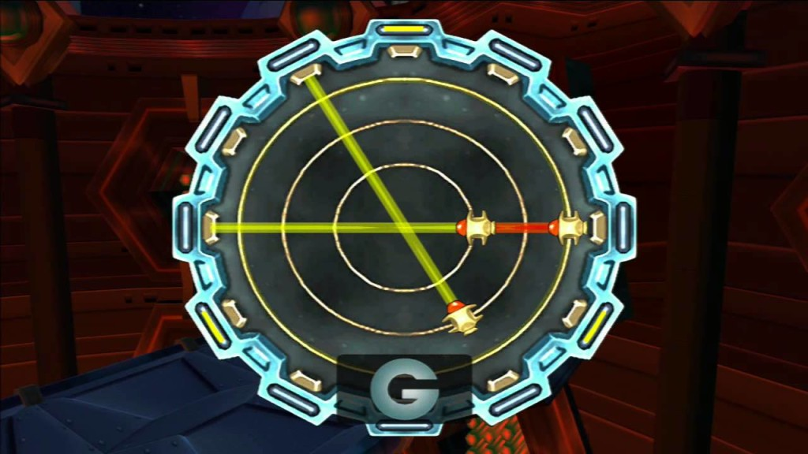
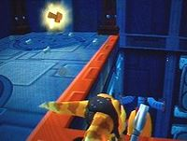
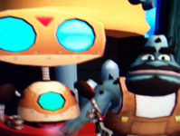
Gameplay
Eliminate enemies (and obstacles) with weapons
Collect lots of bolts (to buy weapons and ammunition)
Avoid losing all off your health (from enemies, explosive crates, falling off cliffs, etc. Collect nanotech crates)
Solve puzzles with gadgets (and sometimes weapons)
Collect ‘Info bots’ to explore through the story
Explore each environment thoroughly (Gold bolts are hidden throughout along with skill points to unlock bonus content)

Slide 10
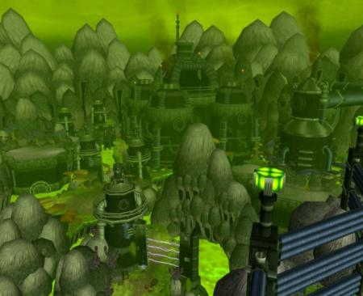
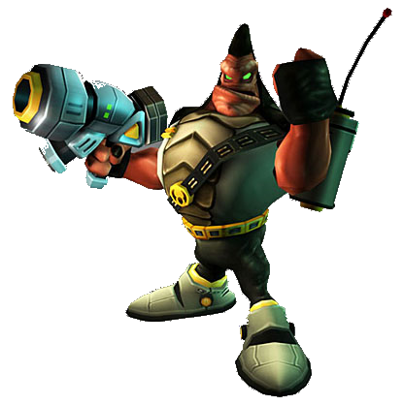
Artwork
3D inspired
Lots of humanoid creatures and robots
Weapon designs are often exaggerated
Each level has a worldly feel
Inspired by the science fiction genre

Slide 11
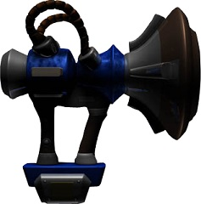
Sound and Music
Sound effects are exaggerated well to portray events
Ambient techno music brings outer space feel to the game
The links below are a few great examples:
https://www.youtube.com/watch?v=44kVXhimAGk
Aridia Outpost X11 theme
https://www.youtube.com/watch?v=trlhrKqoJAc
Oltanis Orbit – Gemlik Base theme

Slide 12
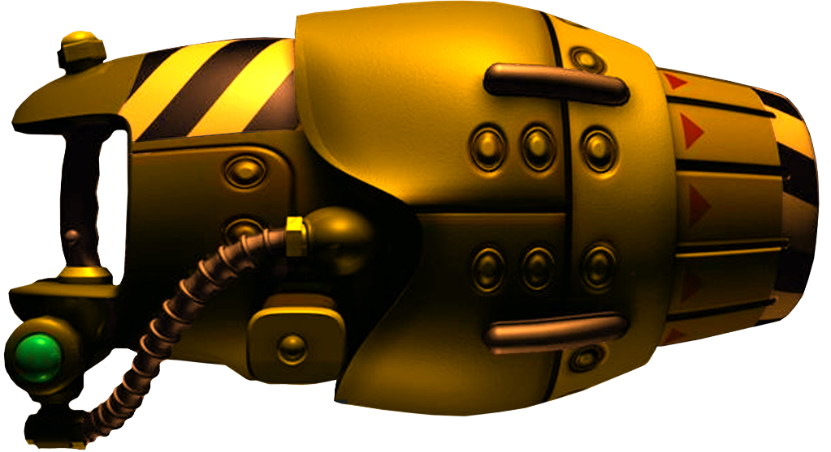
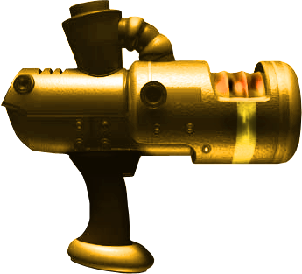
Special Features
When using the shop you are greeted by the Shop owner in a separate interface
Completing the game the first time allows you to play the game in challenge mode. In this mode, you can use the gold bolts you collected to purchase gold version of some of the weapons.
Instruction Manual
The instructions with the PS2 version came in the form of a map (or poster) rather than a booklet which is a bit unusual

Slide 13
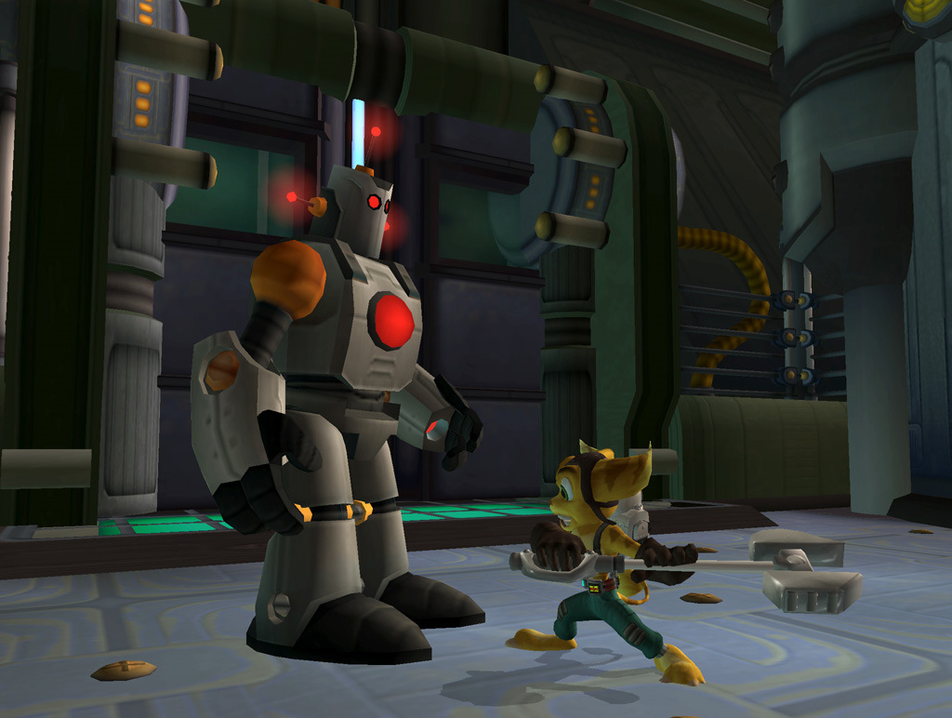
Bugs
- There are rare cases for bugs in the game; they are usually related to the game’s physics.

Slide 14
Game Review
What was good about the game?
Consistent use of controls (no useless controls)
Weapon strategies and approach
Map design
Solid learning curve for younger players
Compelling storyline (lots of action filled cut scenes)
How does it compare to games of its genre?
World size is smaller
Lots of moving sprites on screen at once
Why is it better or worse than similar games of this genre?
Better due to amount of protagonist/antagonist character development
Worse due to the lack multiplayer and how linear the game feels
What was bad about the game?
Lack of replay ability aside from buying gold weapons and getting skill points after beating the game
Camera controls
Bad transition from easy levels to hard ones
Are any design mistakes present?
The game could use more distractions and diversions outside of the story (mini games, arena, lore, etc.)
The camera could have been handled a bit better

Slide 15
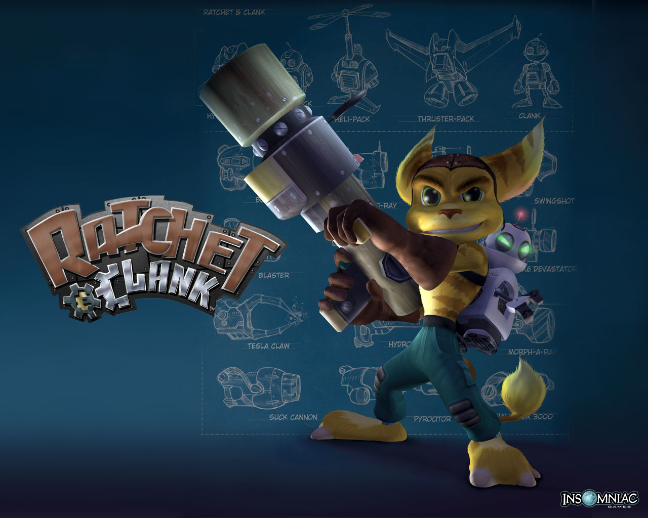
Is the game worth purchasing?
Short answer: Yes
Dust off your Playstation 2 :)
Game is undervalued at Destiny games in terms of content offered
Solid 3D platformer
How could it be improved? (as listed earlier)
More distractions and diversions
Co-op mode or multiplayer extension
A better Challenge mode after the game is completed the first time

