Slide 1
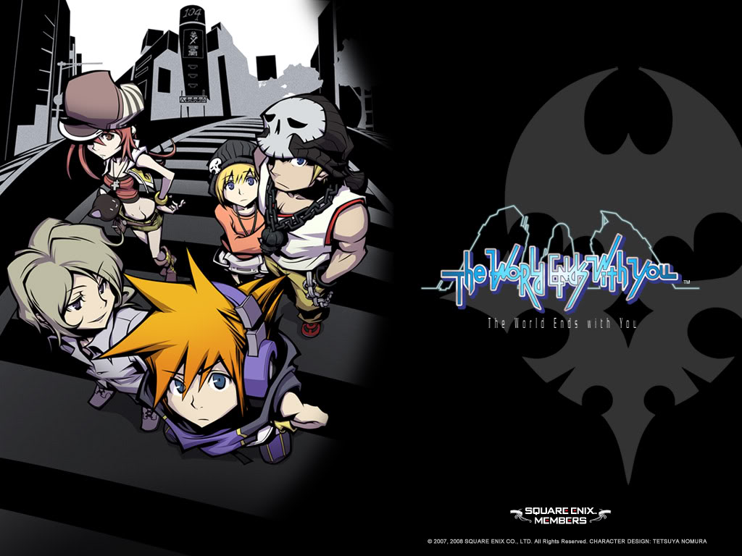
The World Ends with You (Game Evaluation)
Drew Allen
CIS 487 Prof. Maxim
9/23/15

Slide 2
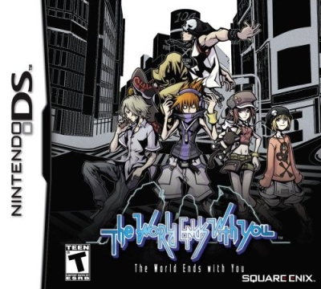
Basic Info
The World Ends with You
Created by: Square Enix & Jupiter
Pricing: $24.99 (Nintendo DS) or $17.99 (iOS/Android)
Genre: Action, adventure, Fantasy, Role-playing
Minimum Hardware Requirements: Nintendo 3DS
Actual Hardware Requirements: Nintendo 3DS

Slide 3
Game Review
The reason this game is fun is the dual-play style that challenges
the player to play with two set of characters at the same
time while fighting the same monsters.
The bad of the game where the difficulty to get certain items/
weapons (called Pins) and finding rare monsters to get
materials to upgrade as well as the cooperative functions.
The comparison of the game to other JRPGs are the design of
the main protagonist by being something outrageous and
complex.

Slide 4
Game Review cont’d
I believe it’s better than some assortment of Square Enix games
because it deals with actual realistic matters like fashion and
recognizable, famous area like Shibuya and Akirahabara which effects
the nature of the shops you go to and the ways people dress just by
battling and wearing their clothing.
I believe the appropriate audience for this game would be ages
12+ because of the concept of death and how things need to be
read in order to fulfill your mission objectives and juggle the
two characters together.
Some design flaws would definitely be the various battle styles and
learning their playstyles on a handheld device, the way to “evolve”
pins in the game and cooperative playing with other users.

Slide 5
Game Summary
Overview: “You have 7 days to live. Fail to oblige and face execution.”
The premise of the game is that you are forced into a death game where you risk your “life” in order to gain it back with various tasks from a Game Master and you have a week to complete it or be wiped from existence.
You have to work with another “Player” and form a pact in order to fight against these monsters called “Noise” that are only visible to you but can affect both the real world and the underground world created for the game to be in effect.
The installation is by having the cartridge game for the Nintendo 3DS or have about .8 GB of memory to play on the iOS/Android.
The UI is either on the phone or the handheld device with a stylus to use the touch functionality on the bottom screen.

Slide 6
Game Summary Cont’d
Gameplay: Using two characters to fend off monsters by executing different movements on the DS or phone and putting in directional inputs on the DS and switching between characters on the phone.
The game kept track of the scoring by how quickly the battles go with a ranking of letters from S-F (S is superb and F is failure and every letter in-between).
Some special features included were mini-games, special missions/end-game content, changing difficulty anytime in the game, replaying any day/week, and completion of the pin list.
There was a manual for the DS but not sure about the mobile devices.
The only bug I could find listed online was for the iOS/Android for when they did an update and couldn’t play on the old files so it was the way that the code was written where it couldn’t read them properly.

Slide 7
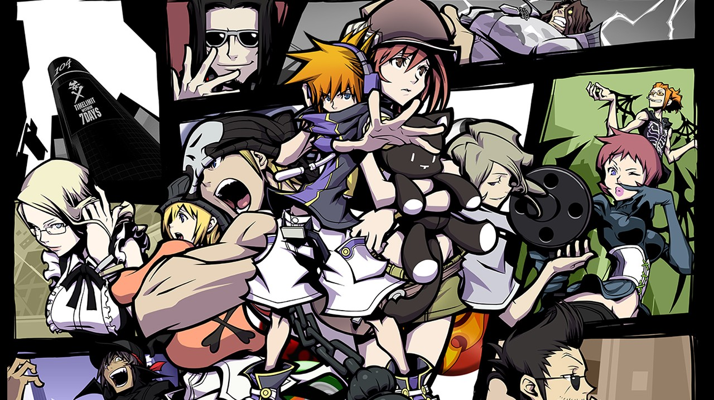
Artwork

Slide 8
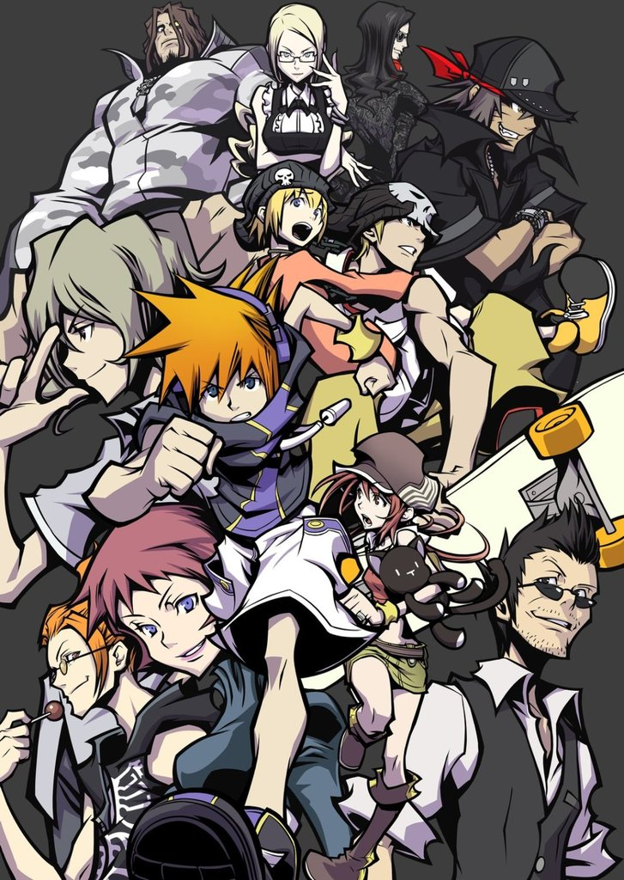
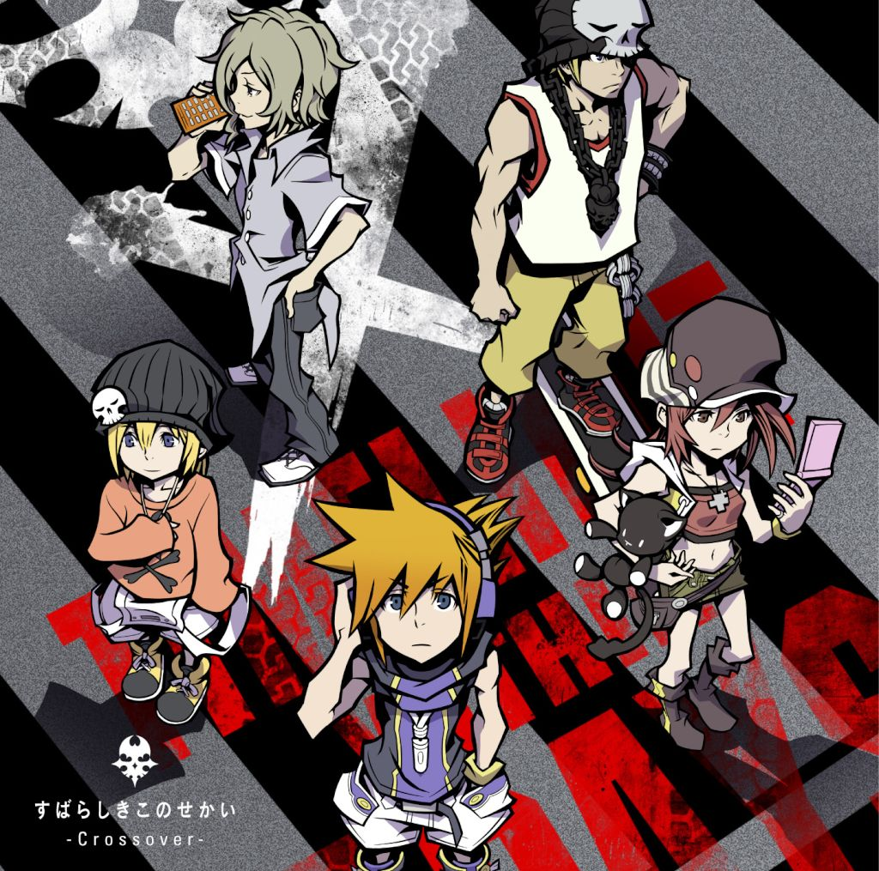
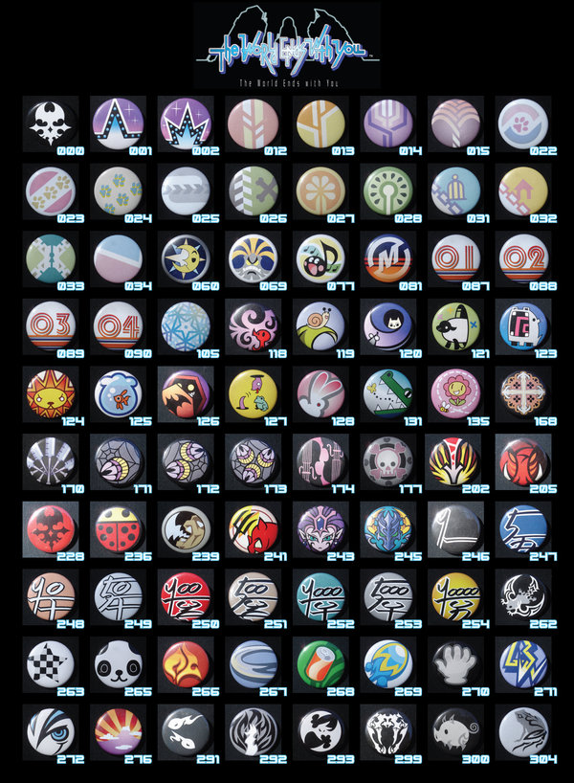
Artwork

Slide 9
Soundtrack & Trailer
https://www.youtube.com/watch?v=cPNGqg_LdXw
https://www.youtube.com/watch?v=UCgOVbk1pT0 (Example to show go to “imprinting” or 42:03)

Slide 10
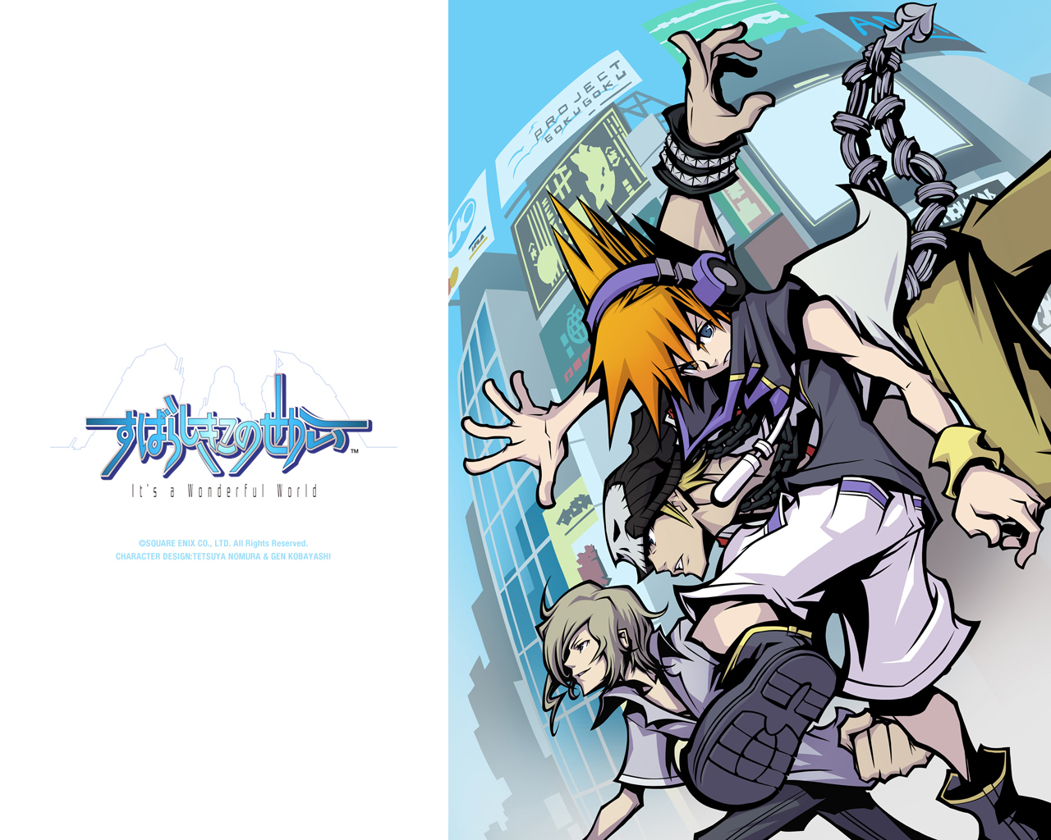
Overall Summary
Strengths: Game design is unique to each character and their personality, atmosphere of the game was fitting
to the plot.
Weaknesses: Battle system was challenging and hard to grasp
on DS, cooperative gaming wasn’t heavily influenced and upgrading weapons was difficult to do but wasn’t exactly terrible.
I would say it’s worth the purchase on either platform (a bit cheaper on the DS compared to original price) and you get to see how it varies from some of their Square Enix games both game mechanics wise, style and feel of the game.
The improvements were made more on the mobile devices but it was the dual battle play where switching between them was better designed and some fluidity among it and game controlling.

