Slide 1
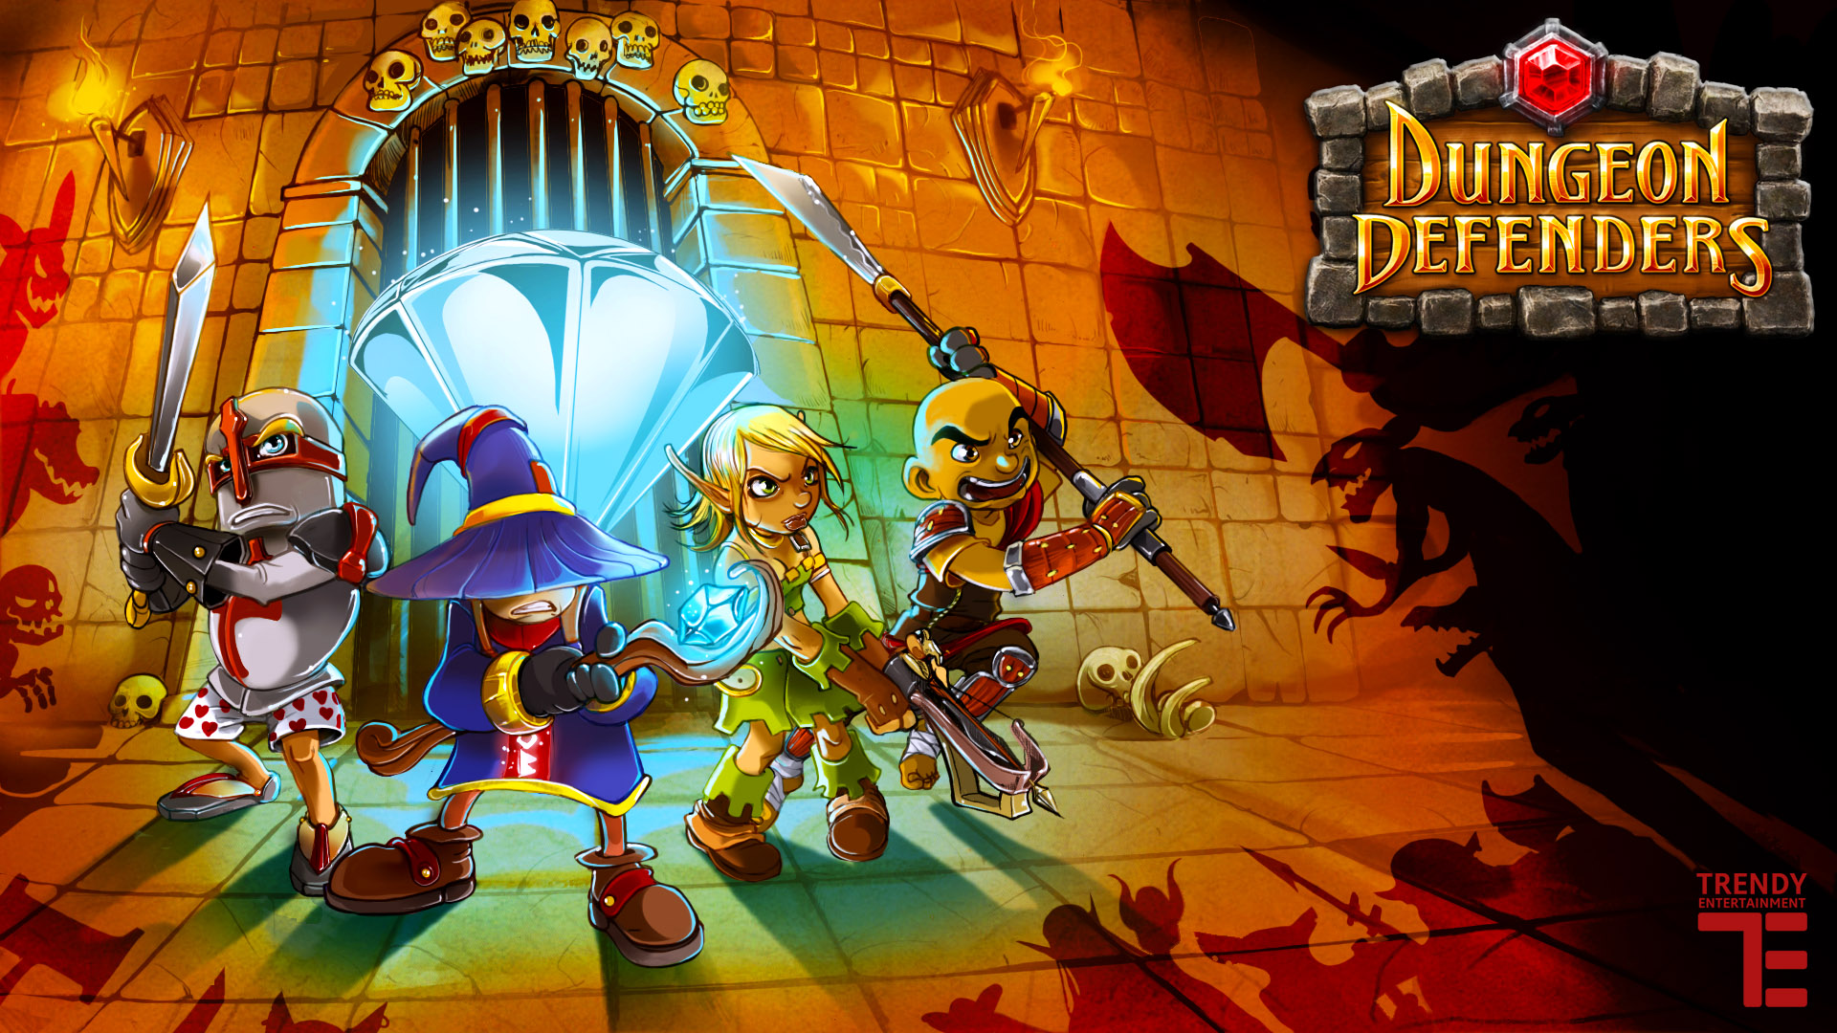
Game Review
By: Brandon Whyte

Slide 2
Dungeon Defenders: What is it?
Title: Dungeon Defenders (DD)
Developers: Trendy Entertainment
Type/Genre of Game: If forced down to one, Tower Defense. Heavy elements of rpg/arpg present.
Price: Dungeon Defenders Eternity (Original DD + all DLC + DD2 aspects being added) full price $14.99, but on steam sale for $5.99.
Required Specs: 1 GHz dual core, 1GB RAM, Windows XP or later, 256MB GPU, 2 GB HDD available, 128kbit/s connection.
Recommended Specs: With the graphics turned down, game runs surprisingly well on low-end machines. There are, however, pixel shader compatability issues that may be encountered with older graphics cards.
Installation: Steam Download.

Slide 3
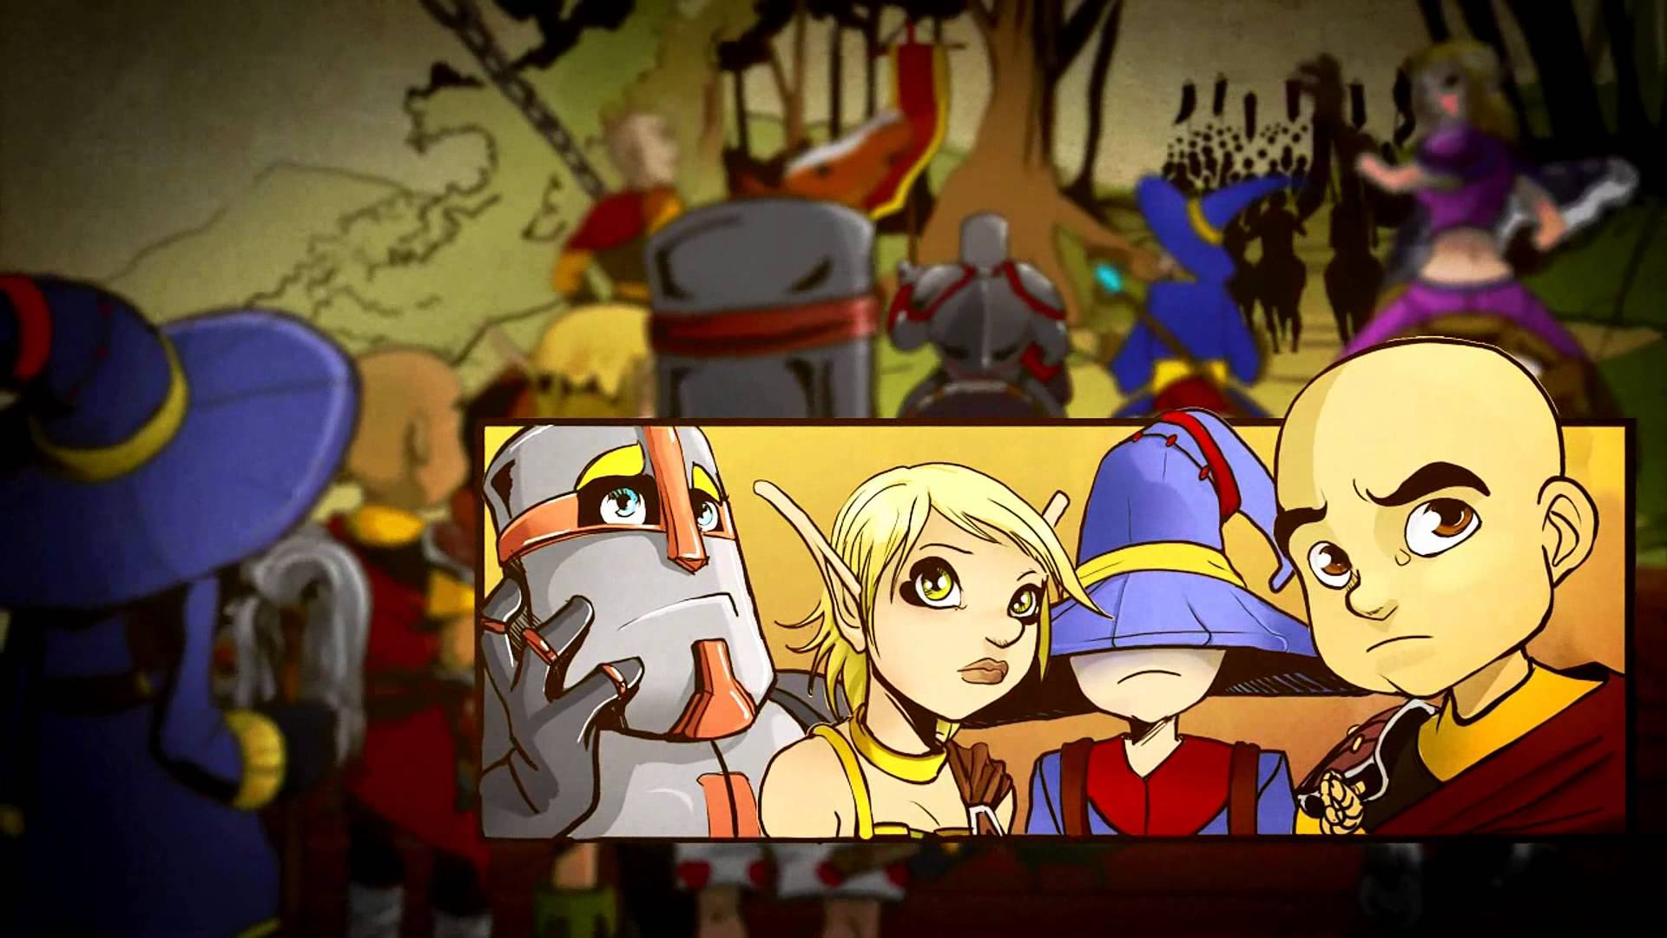
Dungeon Defenders: Game Summary
Quick Overview: Goal is to protect “Eternia Crystals”, immobile objects, on various levels. This can be accomplished using towers or heroes, likely some combination between the two.
Story Line: With the heroes of the realm called away on a long journey, an accident occurs that causes
dark forces to seek to unleash
an ancient evil sealed in the
“Eternia Crystals”. Only the
heroes’ protégées can put a
stop to the onslaught of
darkness that threatens to
free great evil!!

Slide 4
Game Summary Continued
Player Role: Player takes on the role of one of the heroes’ apprentices, and works to make the castle safe.
Game Play: Each level opens with an Eternia Crystal (or several), as well as various mob spawning locations, placed across the map. Game play is divided into two phases, Build and Combat. During the build phase, players build, upgrade, and repair towers. During the Combat Phase, players take advantage of their defenses, and use skills and attacks to attempt to keep the waves of various monsters away from the crystals. Gear, levels, pets, currency and stats gained are persistent between levels, allowing for progressive character development. Play may be offline or online, solo or cooperative (up to 4 players). Each player may alternate between all of their characters during any Build Phase.
Scoring: Scoring is a formula based on a variety of factors, including difficulty, wave number, clear time, and a variety of other “bonuses” that can change across missions. Scoring is reflected on community visible leaderboards.
Manual: All manuals and guides are available online, including both official and fan-created.

Slide 5
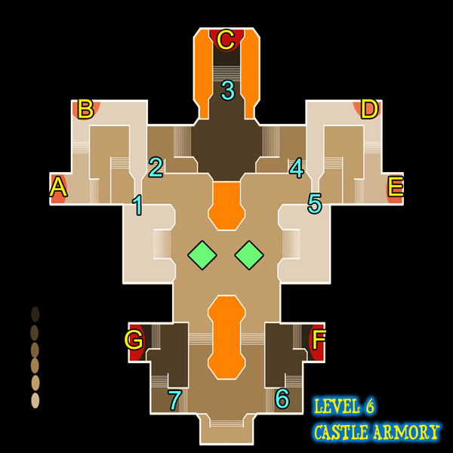
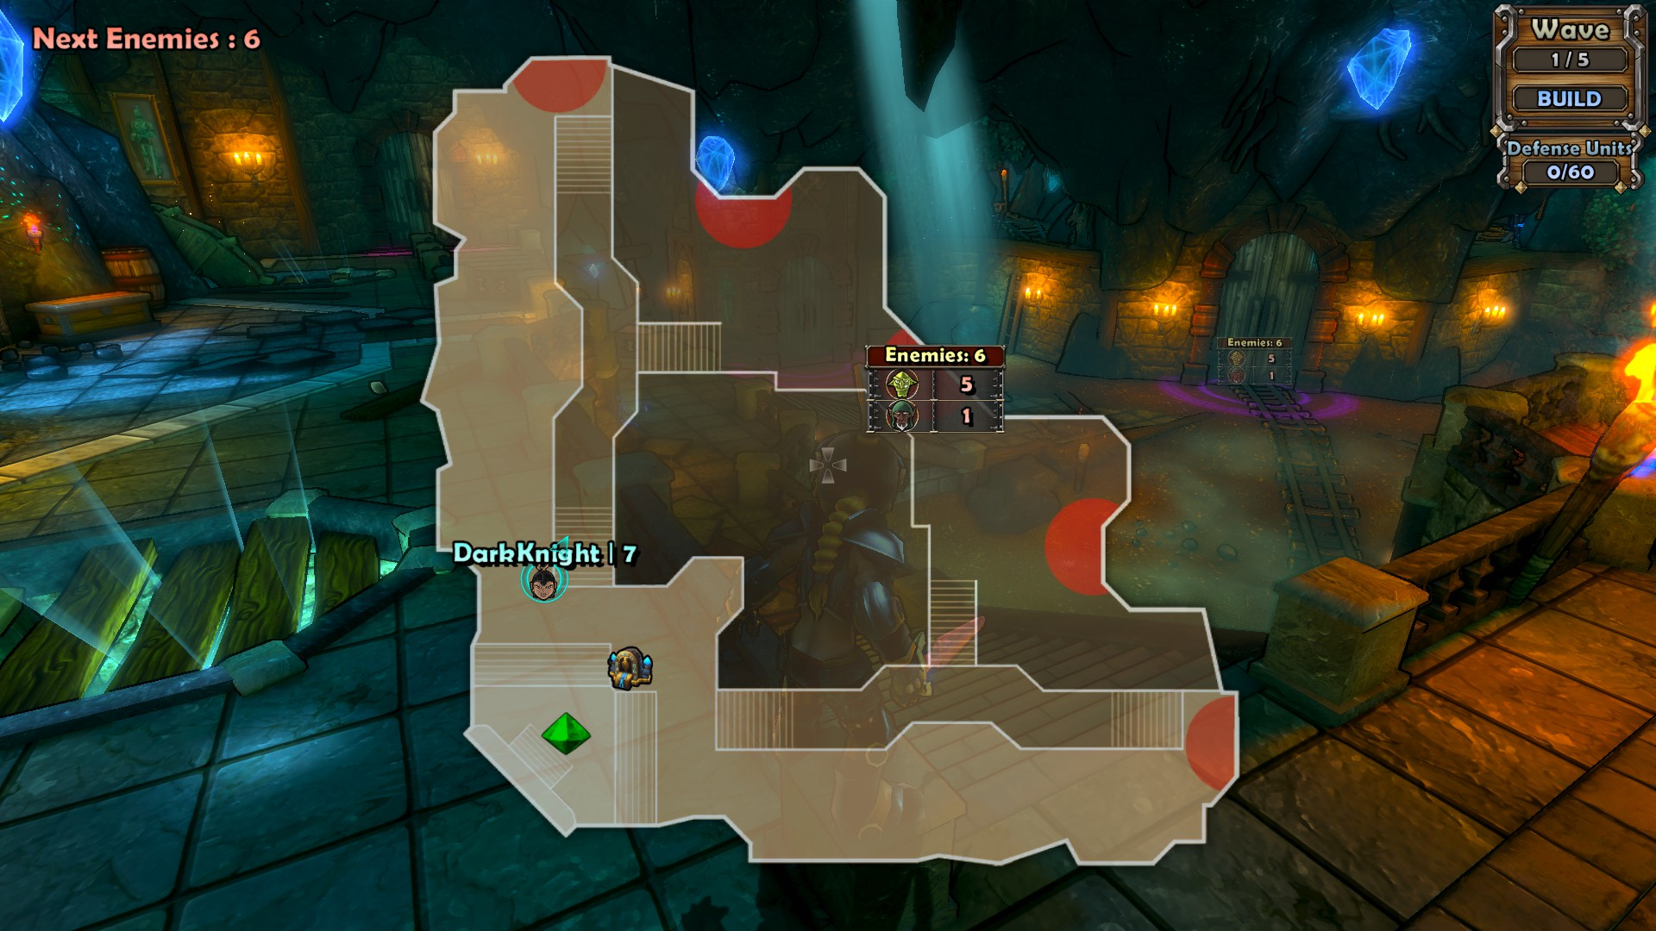
Level Layout Examples

Slide 6
Game Summary Continued
Sound and music: Very reflective of the art style, the music attempts to reflect various aspects of the game (Start of monster waves, Victory, Boss battles, etc.) while maintaining a light-hearted attitude.
Special Features: Although the majority of the attractiveness of DD lies in the variety of gameplay features, special features include skins, event levels, PvP events, and more.
Bugs: Being developed by a smaller studio, there were a wide variety of bugs and glitches, ranging from minor graphics glitches to gameplay bugs and exploits.
A few examples of issues:
The ability to upgrade gear multiple times for single cost with extremely rapid clicking.
Currency exploits (buy a level 1 weapon, if all upgrades go into a single stat, the level 30 upgrade makes the weapon worth many times what you spent on it, at which point you can sell it to an npc, buy a level 1 weapon, rinse and repeat.)

Slide 7
Game Summary: UI and Artwork
User Interface: The camera defaults to an over-the-shoulder third person view that follows the avatar. Health and Mana are displayed in the bottom left, along with other key binds (build tower, repair tower, skills, etc.) which can be changed, score, experience and level. The top right corner displays Wave Number, the current phase (Build/Combat), Defense Units Used, and monsters remaining.
Artwork: One of the game’s more unique features, the game’s art style is a brightly-colored, cartoony style that also handles special effects and weapon appearances in flashy, stylish ways.

Slide 8
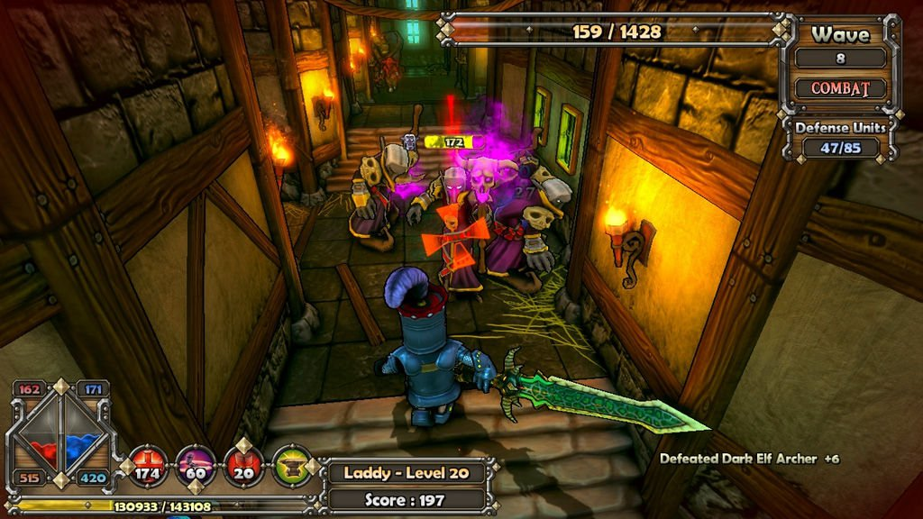
User Interface
Remaining monsters in wave
Wave Number
Phase
Defensive Units Used
Health, Mana, Experience
Hotkeys
Character
Score

Slide 9
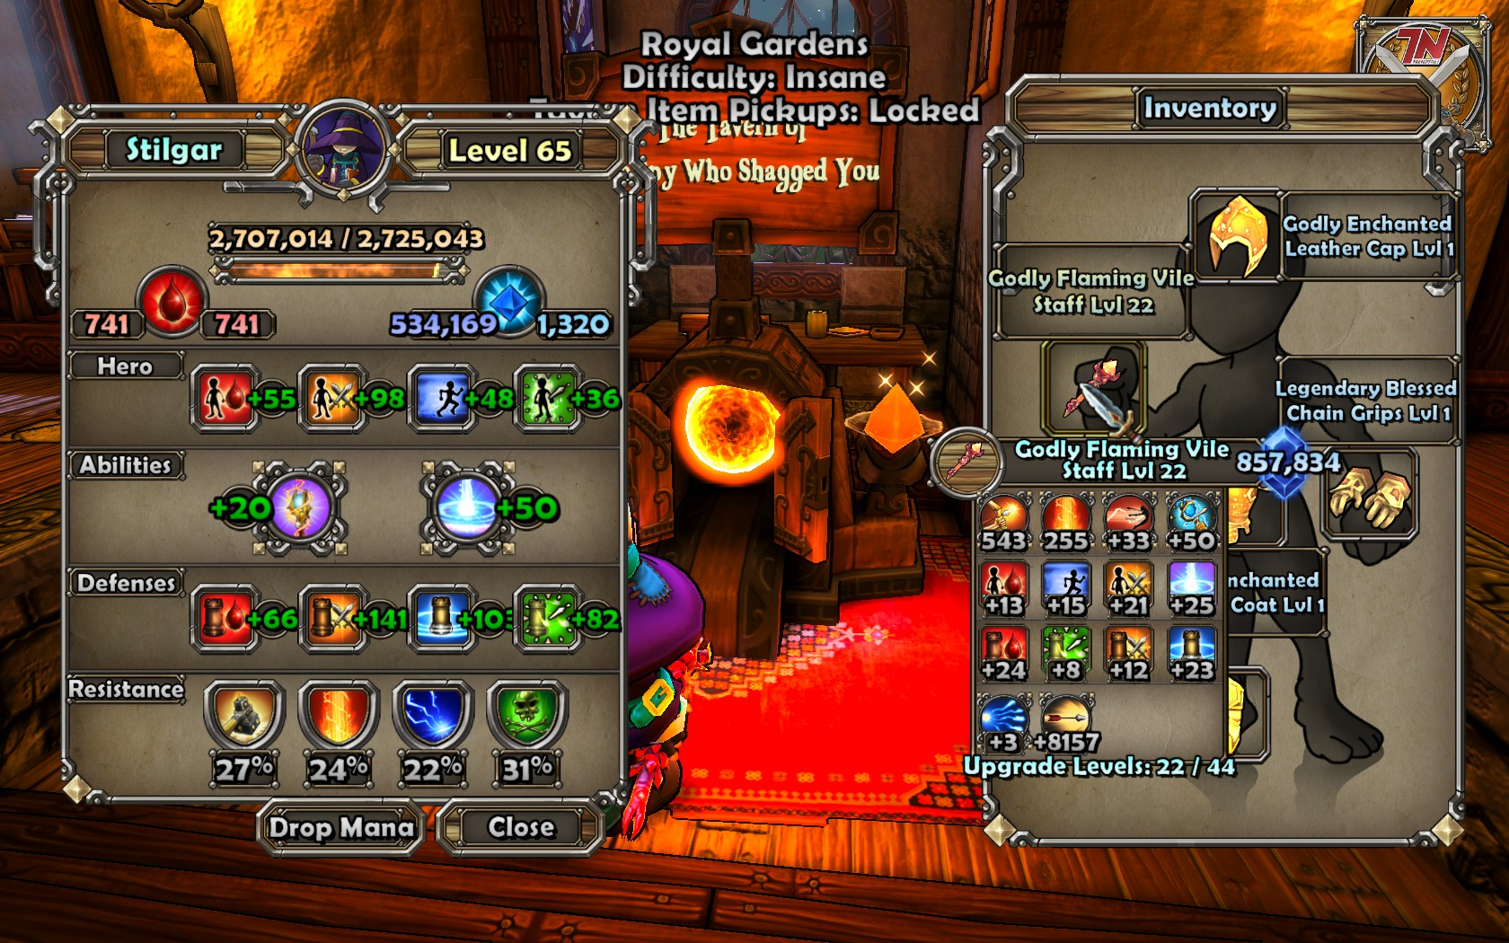
User Interface: Stats and Inventory

Slide 10
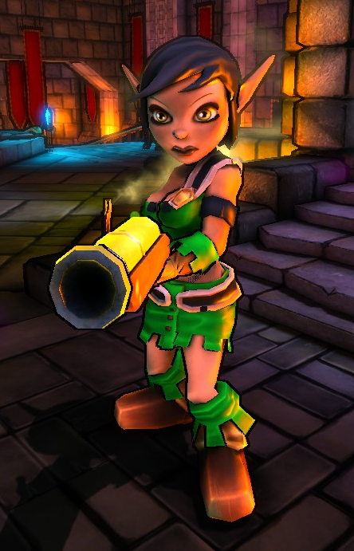
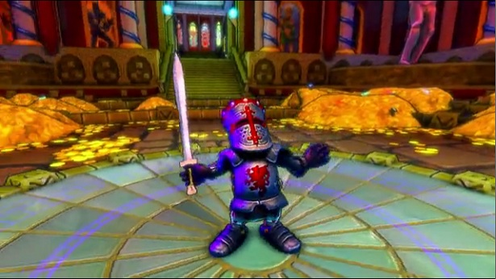
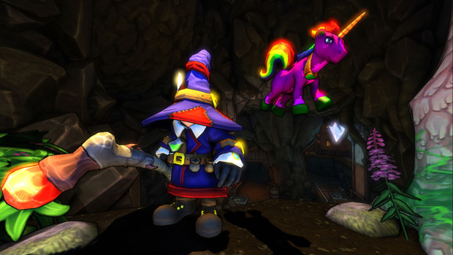
Artwork: Character Appearance

Slide 11
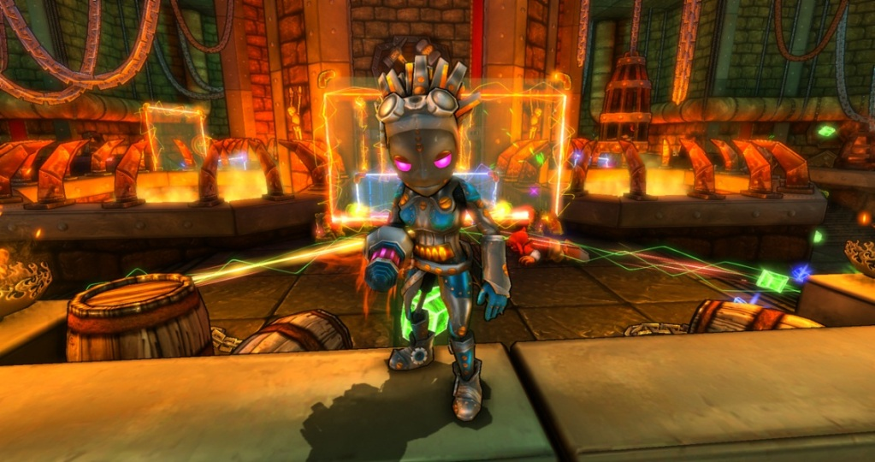
Artwork: Individualized Appearances

Slide 12
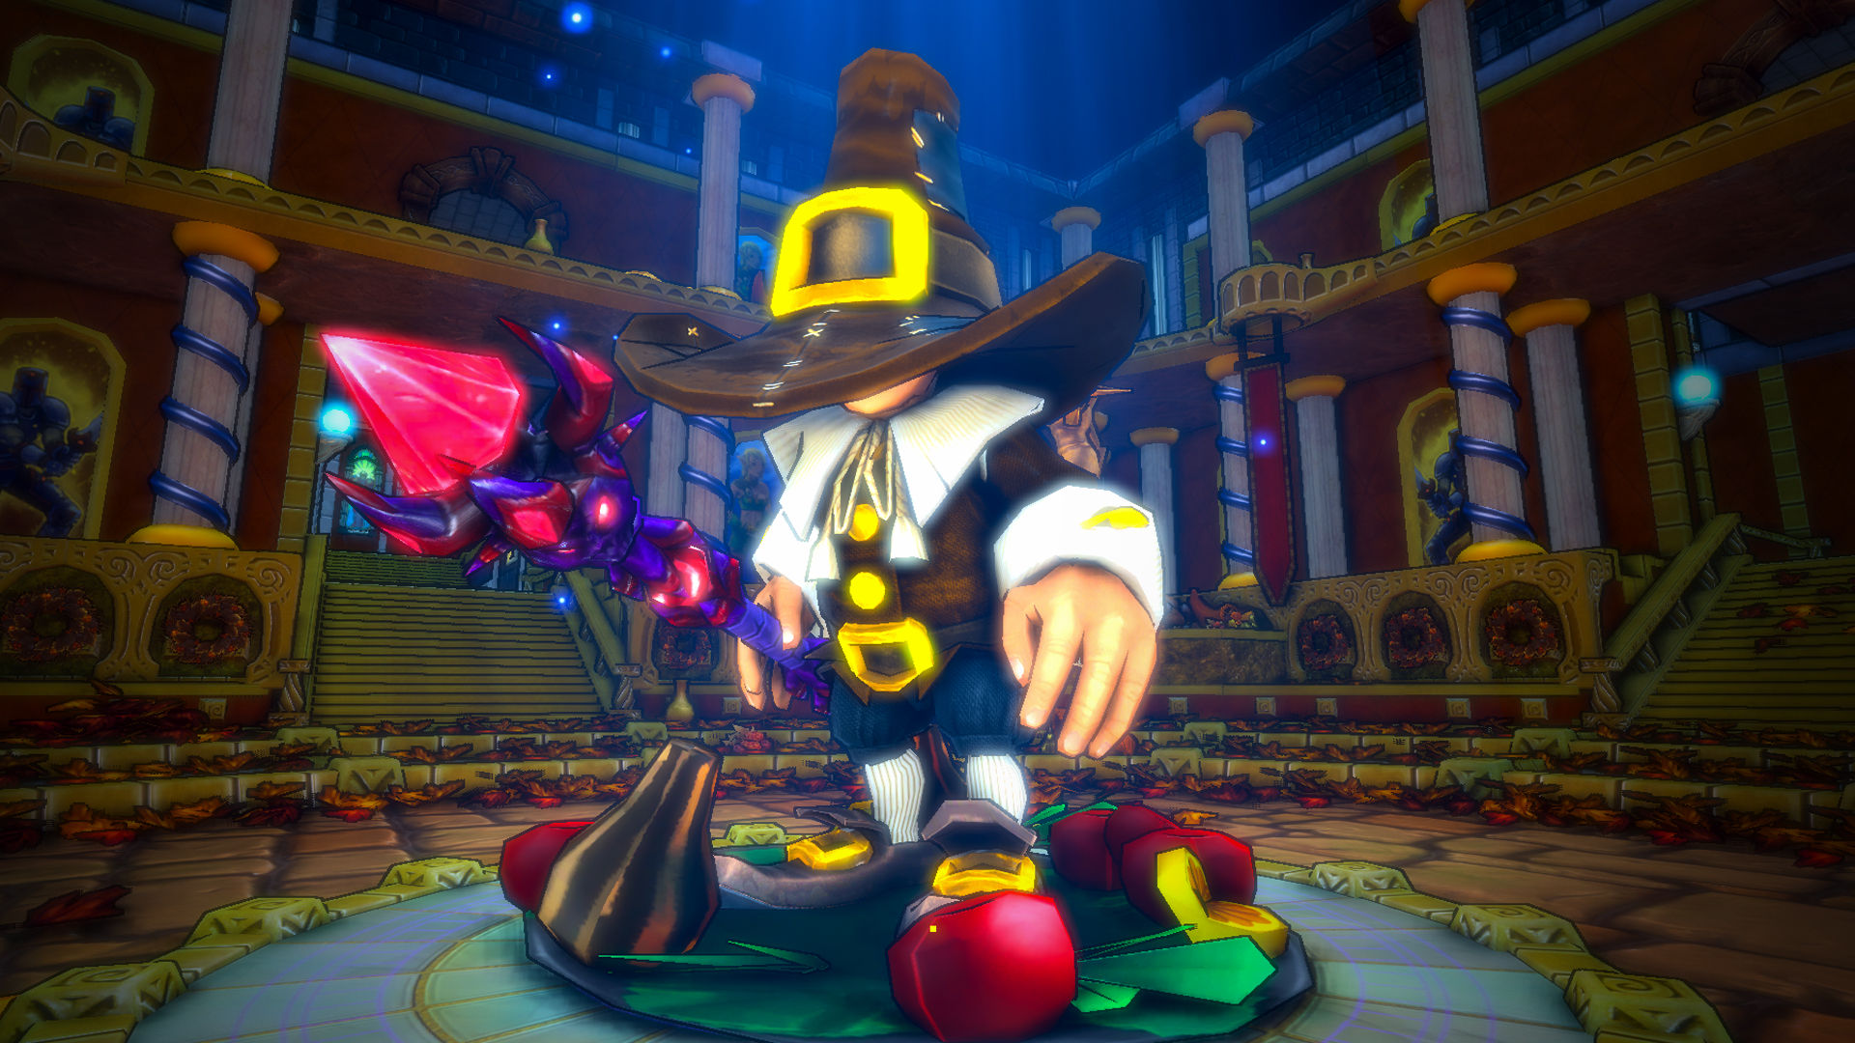
Artwork: Individualized Appearances

Slide 13
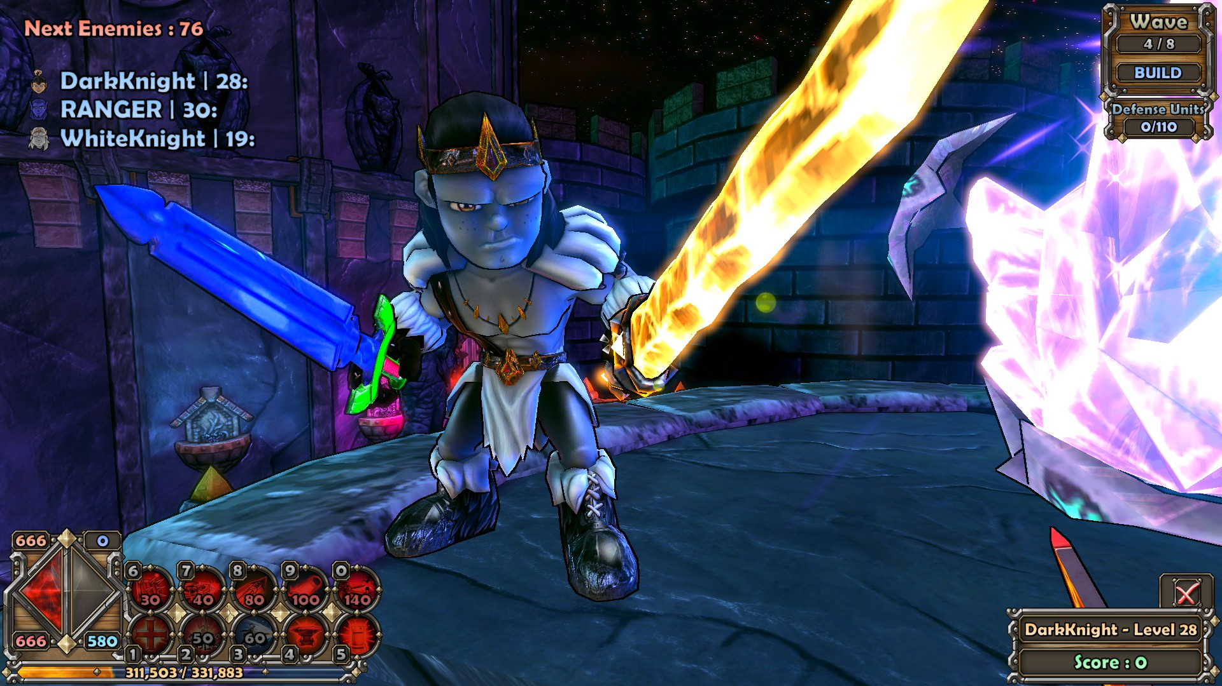
Artwork: Individualized Appearances

Slide 14
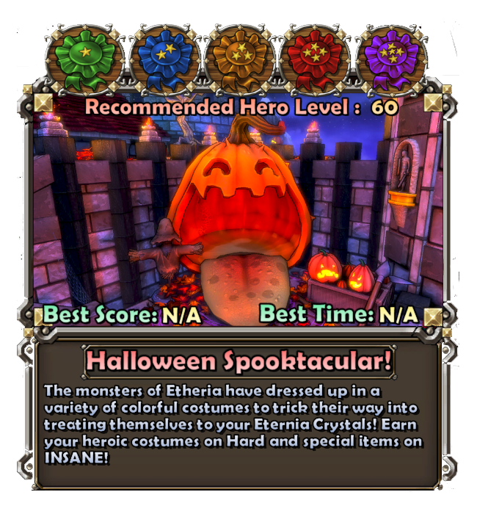
Game Review – What was fun?
What was fun about the game?
Combination of enjoyable aspects of TD, RPG, and ARPG genres, geared towards cooperative play.
Fun art style for levels, characters, gear, and skills.
Upgradeable, collectable and tradable gear.
Pet system.
Alternative game modes, including
Endless, Survival, PvP, Challenges,
Seasonal Events, and more!
Wide variety of strategies; Can utilize
towers and combat abilities of
different classes in both solo and
cooperative play.
Meaningful decisions; Stat points,
types of gear, etc. all reflect on the
way your character plays.

Slide 15
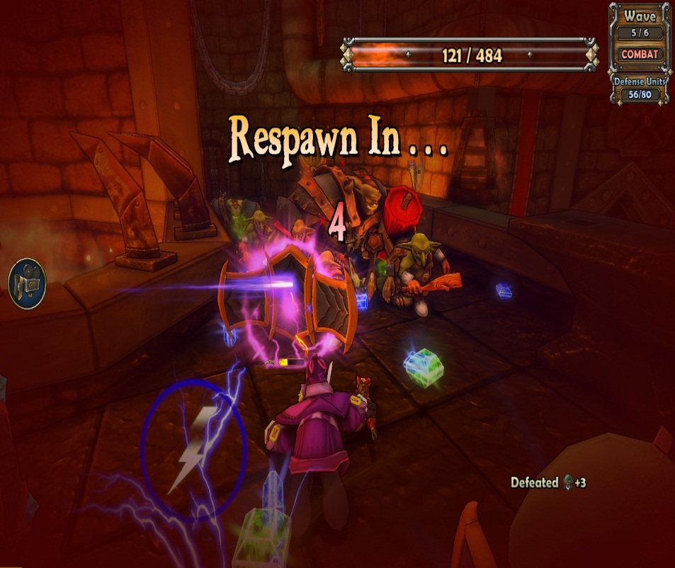
Game Review – What wasn’t fun?
What wasn’t fun about the game?
Losing!!! Having to restart a level often means repeating the early waves utilizing the same strategy to try and win with something different at the end.
Guess and test: When first encountering a level, some paths that monsters take aren’t always clear. Though most of the times it is easily
deduced, it only takes one
group of monsters to destroy
a crystal.
Focus seemed to switch to
additional DLC (for profit)
after first while.

Slide 16
Game Review – Genre Comparison
How does it compare to games in the same genre?
DD took a classic, mazing style Tower Defense and brought in enjoyable elements from other genres, creating a familiar yet unique and enjoyable experience. (A.K.A. it’s better)
By adding the additional elements, the variety of player goals, particularly in the end game, were greatly increased.
Cooperative mode was a huge plus, and is something that is not always present in TD games.

Slide 17
Game Review – Target Audience and Design Flaws
Target Audience - Options for advanced tactics and builds make it appealing to more “Hardcore” gamers, while simple UI and graphics style keep it approachable to more casual and/or younger gamers.
Design Flaws – Although there were many different design issues (First major game of a small studio), two of note would be:
Game Balance: While some people enjoyed being able to utilize multiple characters, others argued that a game which has competitive aspects (scores with leaderboards, PvP, etc.) shouldn’t require multiple characters to achieve an “optimum” result.
The game was designed so that further content could be added (at a cost to the user). This presented not only a potentially frustrating experience of being “nickeled and dimed”, but also left gaps in the original release in both terms of gameplay and content.

Slide 18
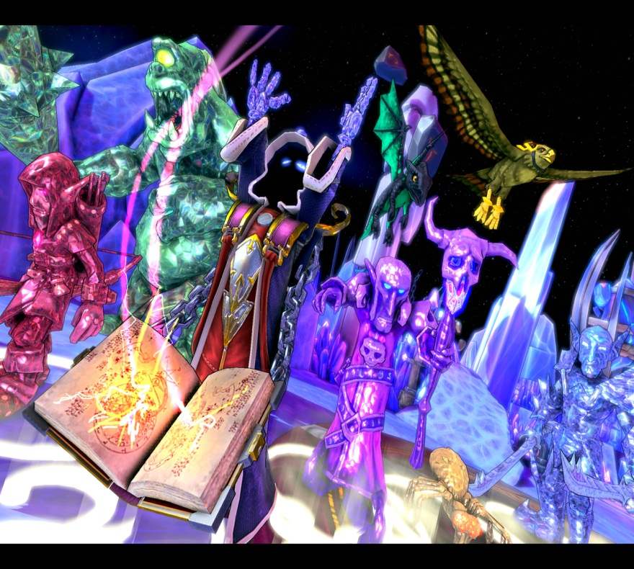
Summary – Overall Strengths and Weakness
Overall Strengths:
Unique gameplay elements.
Cooperative aspect available.
Stylistic, fun art style.
Unique boss encounters.
Variety of age, style, and
seriousness of player appeal.
Variety of end-game goals, with
players deciding which they want
to aim for.
Overall Weaknesses:
Design and implementation issues, scaling from minor to major.
Gameplay is hard to define; much easier understood from experience than word of mouth.

Slide 19
Final Thoughts
Improvements?
Though many options, several things that make for more enjoyable gameplay:
Player strategy more interactive with each other.
Interactions available with environments instead of just player added things such as towers.
Additional testing before releasing patches and updates to prevent bugs/exploits from going live.
Is it worth buying?
From an hours played and entertainment derived perspective, the game offers far more than a good chunk of AAA titles. At fifteen bucks max, absolutely.

Slide 20
Questions/Comments?

