Slide 1
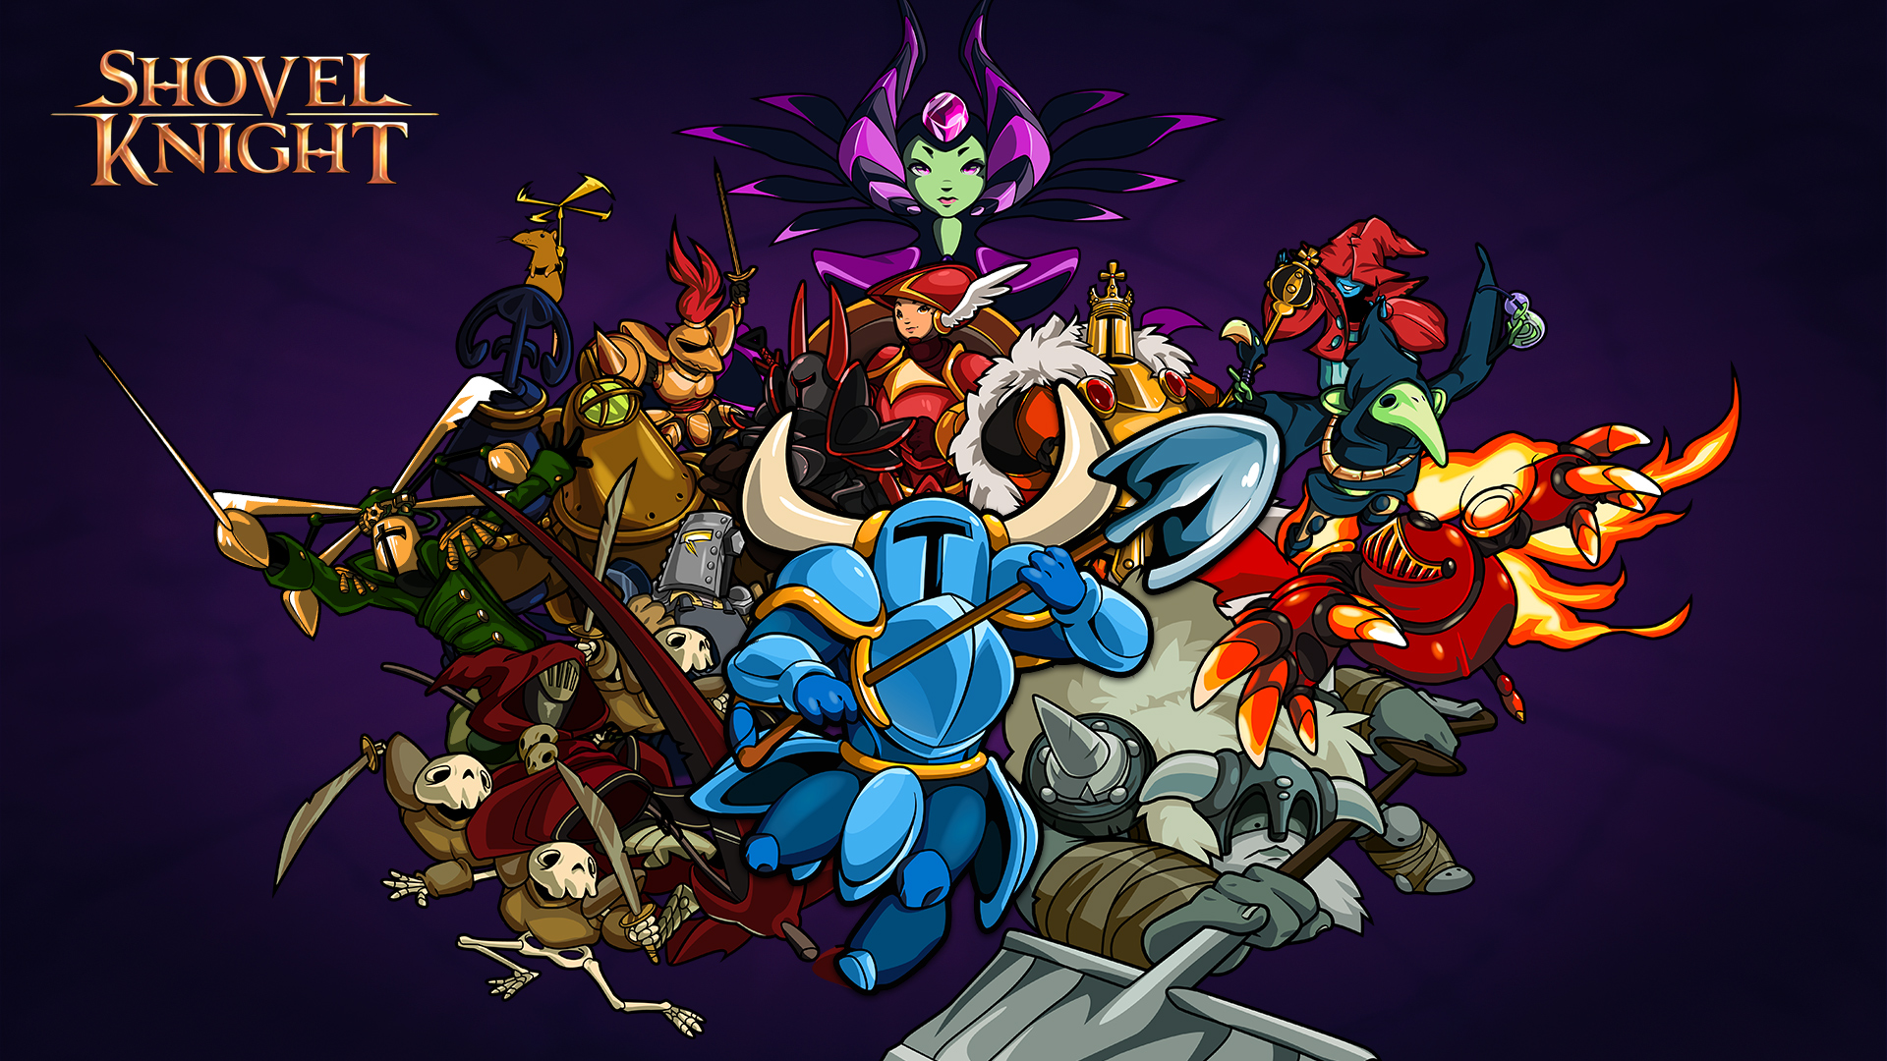
Jose Torres CIS 487

Slide 2
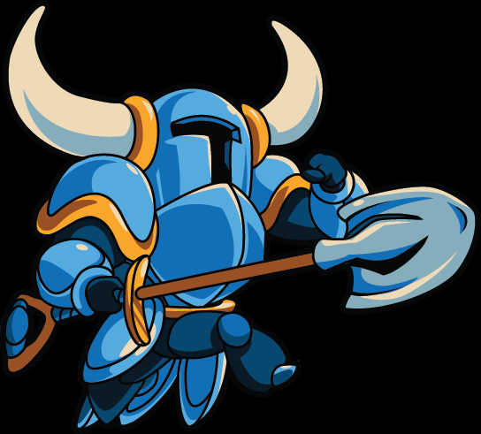
Overview
Basic Information
Game Summary
Game Analysis
Final Summary

Slide 3
Basic Information
Shovel Knight is a 2D action platformer that was developed and published by independent developer Yacht Club Games
It was released in North America for the 3DS and Wii U on June 26, 2014. Also available on PC and recently on Mac.
Price: $14.99
Available on Steam and Nintendo eShop.

Slide 4
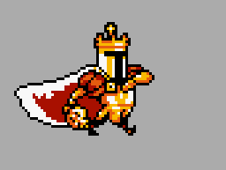
Basic Information (cont.)
Minimum System Requirements
PC
Windows XP SP2 or later
2.1Ghz dual core processor
2GB ram
DX 9
250 MB available space
MAC
OS X 10.6 or later
2.0 dual core processor
2 GB ram
250 MB available space

Slide 5
Game Summary
Story
Legendary adventurers Shovel Knight and Shield Knight roam the land until Shield Knight was sealed away in the Tower of Fate. After Shovel Knight receded into solitude, the land was seized by The Enchantress and her Order of No Quarter. Now, Shovel must travel the landscape defeating the 8 evil knights, defeat the evil Enchantress, and quest for his lost beloved Shield Knight with his Shovel Blade.

Slide 6
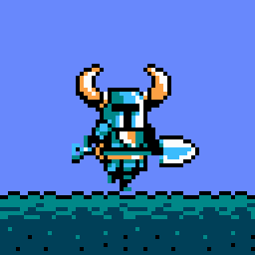
Game Summary (cont.)
Player’s Role
Take control of Shovel Knight wielding the Shovel Blade using it to attack enemies, destroy obstacles, and dig up treasures.
Installation
3DS/Wii U = eShop
PC/Mac = Steam
User Interface
Basic
Controller-based
Not Difficult

Slide 7
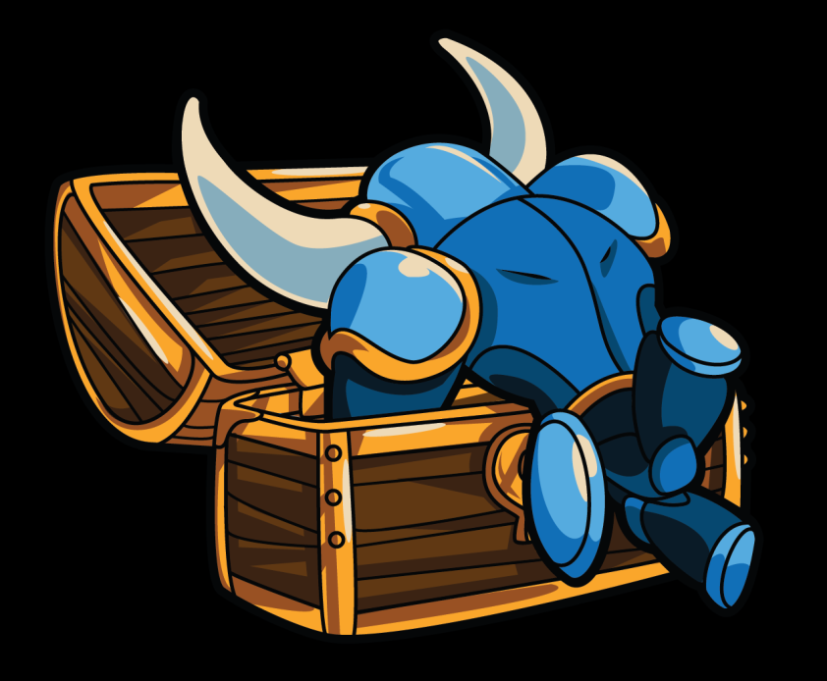
Game Summary (cont.)
Gameplay
2D side-scrolling platform game
Retro 8-bit graphics that adhere to classical games
Megaman, Super Mario Bros. 3, Castlevania, Ducktales, etc.
Color palette matches appropriately to NES capabilities
Linear
Controller-based/Keyboard-based
Chiptune soundtrack

Slide 8
Game Summary (cont.)
Special Features
Achievements
New Game+
Wii U
Different controller options
3DS
Stereoscopic 3D
Streetpass Arena

Slide 9
Game Review
The Good
Artwork is amazing
Soundtrack is very appropriate to the environments
Learning curve is balanced by boss/level difficulty
Combines the best control mechanics from previous NES games
Treasure is NECESSARY
Recovery and equipment
Equipment has tradeoffs which enhances experience

Slide 10
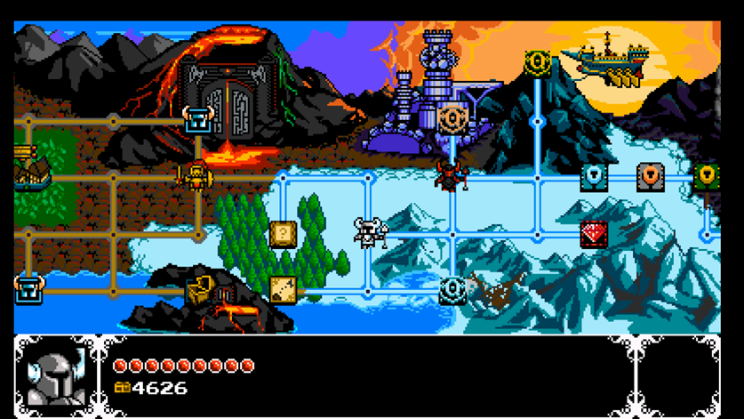
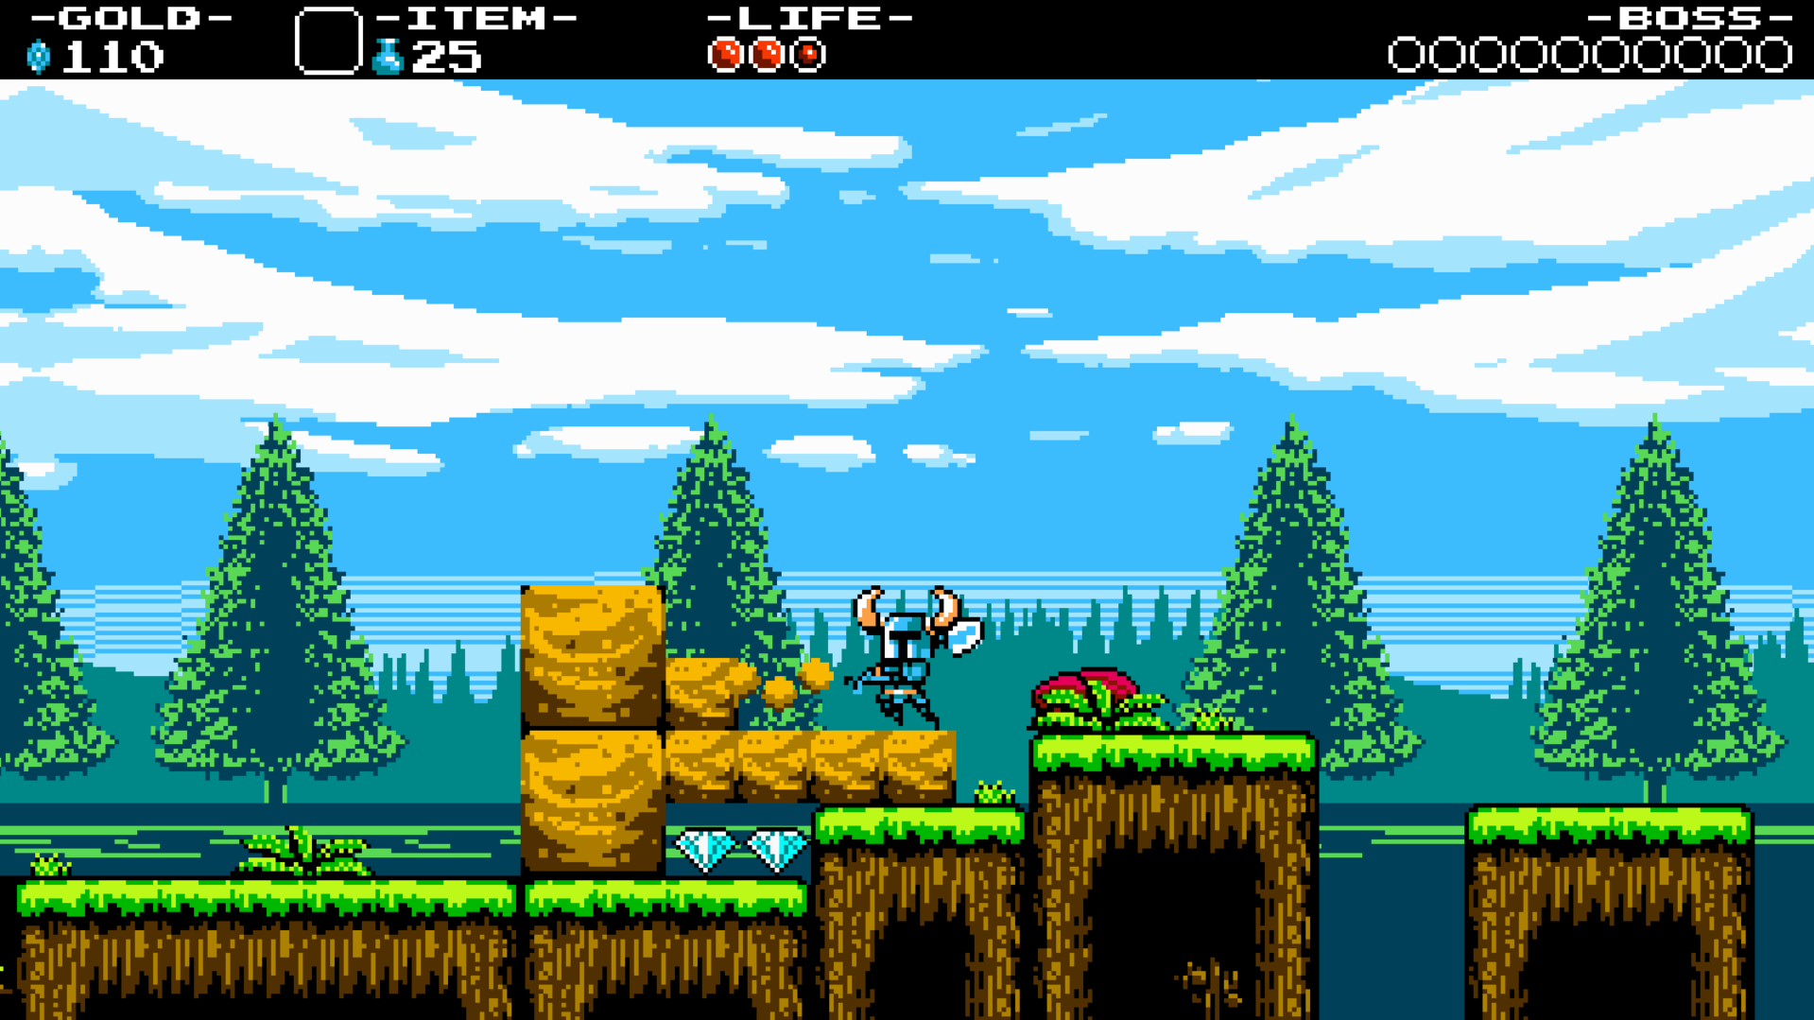
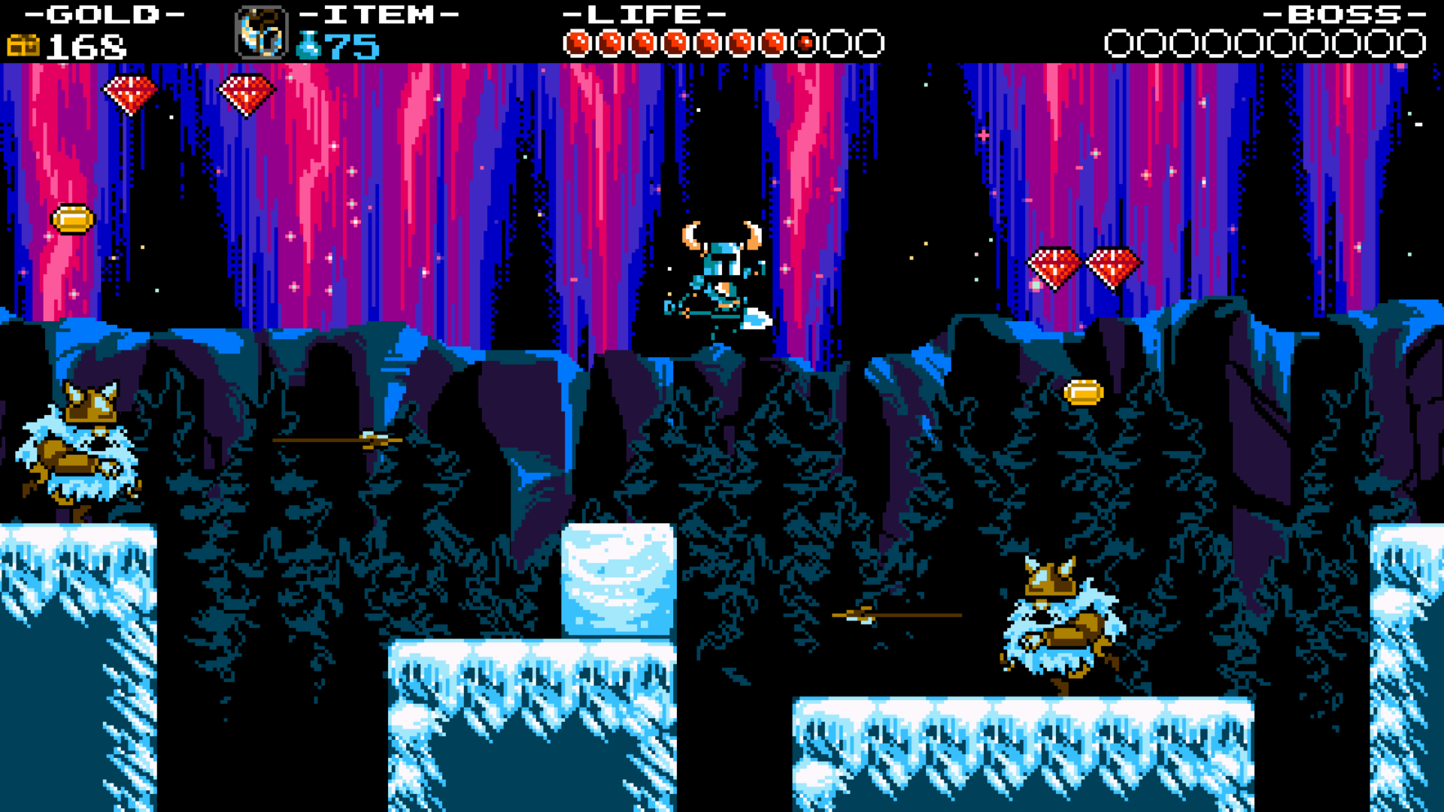
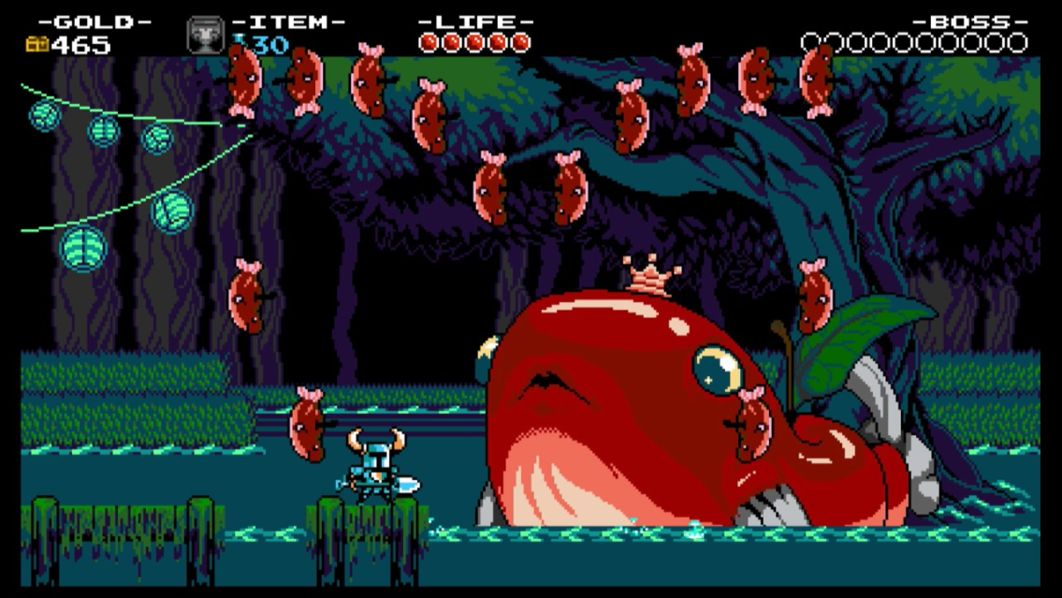

Slide 11
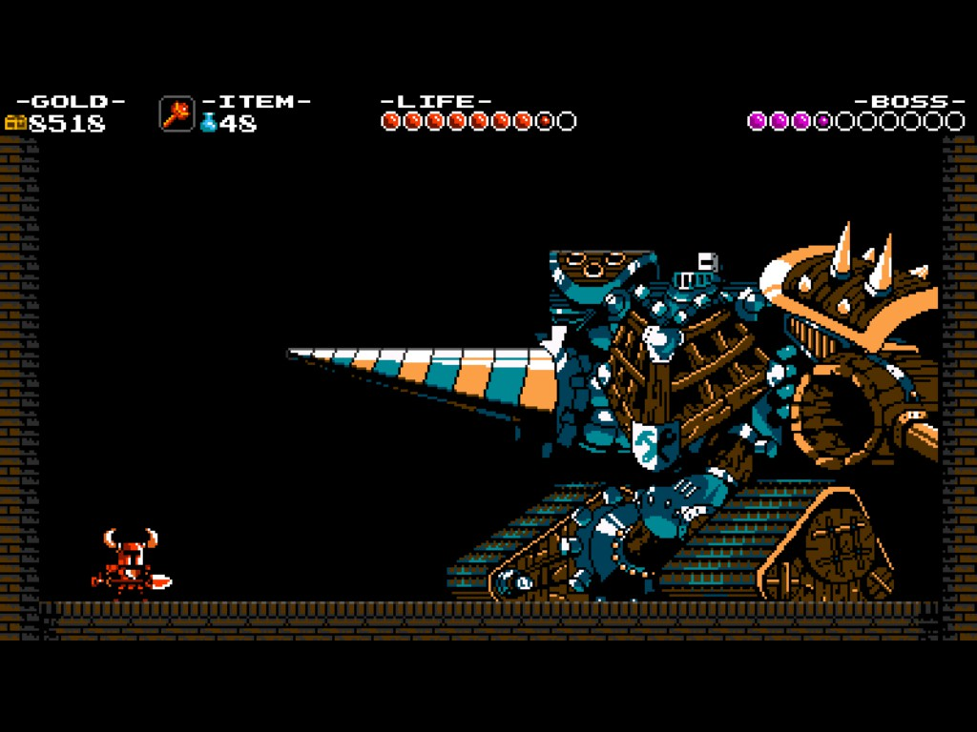
Game Review (cont.)
The Bad
Secrets were easily obtainable
Mini bosses proved to be a bit more difficult
Technically could have been nonlinear
Not enough side quests
Some secondary weaponry were rarely used

Slide 12
Game Review (cont.)
This game can be virtually enjoyed by anyone (basically if you like Super Mario Bros.)
There are some animations that are a bit faulty, but I believe those were intentional for nostalgic purposes.

Slide 13
Final Summary
Strengths
Tight controls mechanics
Pleasant level design complemented by great soundtrack
Fresh experience compared to relevant games
Weaknesses
Inadequate use of secondary equipment
Not enough side quests
Improvement
MORE activities
Make game progression more nonlinear

Slide 14
Worth it?
Hell yeah!

