Slide 1
Watch Dogs Game Review
A review for the X-Box One Variant by Tim Stolzenfeld

Slide 2
Basic Information
Game Title: Watch Dogs
Developer: Ubisoft Montreal
Publisher: Ubisoft
Game Type: Action Adventure
Price: $59.99
Console Type: XBOX One

Slide 3
Game Summary

Slide 4
Overview
Player character: Aiden Pearce
Perspective: 3rd Person Shooter
Setting: Chicago, IL
Year: Current day, with some “imaginative” hacking twists
Goal: Bring vigilante justice to villainous hackers

Slide 5
Story Line
The Northeast blackout that occurred in 2003 has prompted cities to create cTOS (CenTral Operating System) which connects all personal information and city infrastructure
In this game, the blackout was caused by an ill-minded hacker
These hackers led to the death of Aiden’s niece
Left vengeful, you (Aiden) are on a mission to bring justice to these mischievous hackers

Slide 6
Installation
Physical Copy
Insert disc, the game will begin installing
Digital Copy
Purchase the digital copy on the XBOX one store, the game will download and install

Slide 7
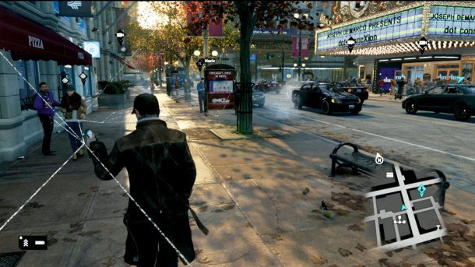
User Interface
The interface is generally clean and dynamic. There is only as much interface is as needed at any point in time. Through playing the game, I have found the user interface to be not distracting.

Slide 8
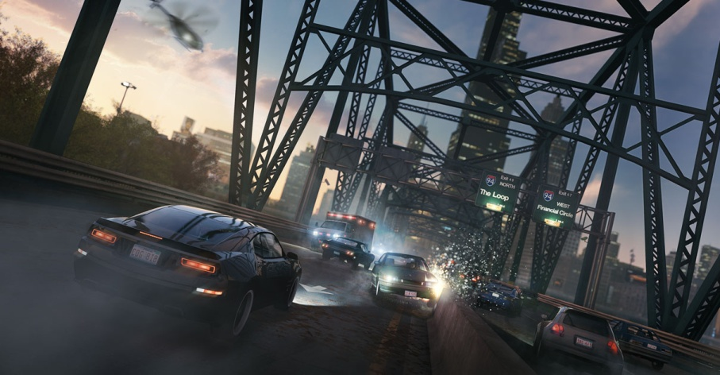
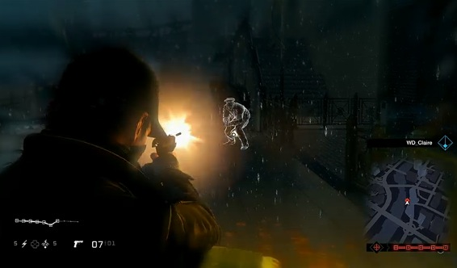
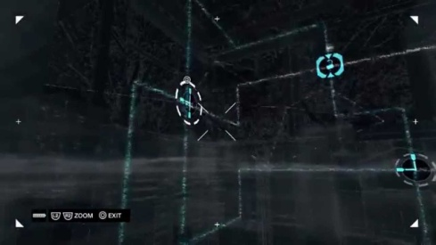
Game Play
The game play is a combination of reckless driving, intense gun fights, and hacking puzzles. This diversity of player objectives keeps the game fresh and interesting throughout the duration of the story.

Slide 9
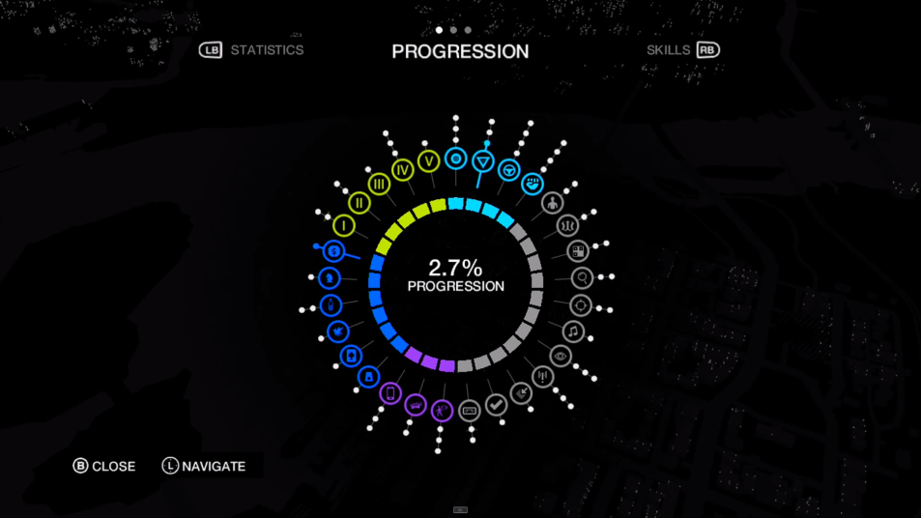
Scoring
Missions
There are 4 acts in this game, each with a number of missions
Side Objectives
As you play the game, side objectives become available such as “king pin” take downs, gangster hide-out busts, and city games such as poker, slots and chess
All of the above (and others) are considered in a progression pie-chart. You can see how you have progressed with respect to each part of the game

Slide 10
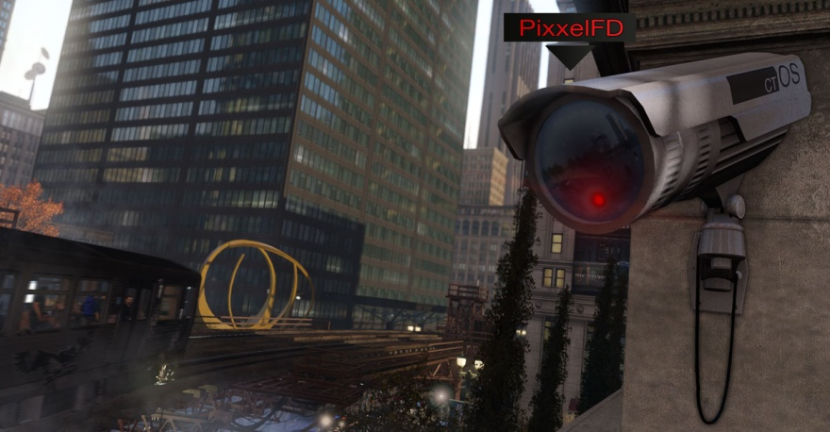
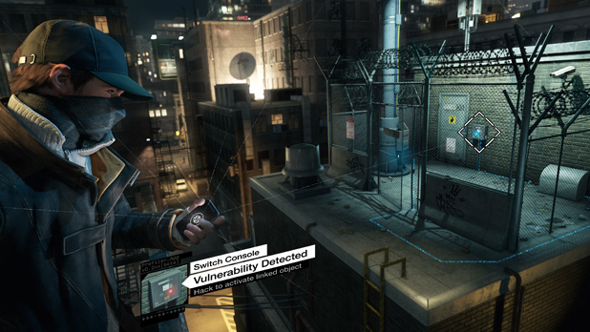
Art Work

Slide 11
Sound and Music
As Aiden travels through the city, the citizens respond to Aiden
Music changes with the context of a situation (i.e. pre action, during action, post action)
Sounds are supported during hacking, driving and shooting
There is great city ambience

Slide 12
Game Manual
Maybe the days of true physical “Game Manuals” are behind us…
I did find this online, however:
VG24/7 Watch Dogs Game Walkthrough

Slide 13
Bugs
The game is very clean but…
A couple of things I noticed:
“Elite” enemies can be easily defeated by positioning Aiden behind a barrier in such a way that these enemies remain still and shoot at Aiden, never hitting him but easily allowing the player to continuously shoot the enemy
City citizen AI could be improved, as they tend to walk into things (walls, Aiden, other NPC’s) and do not properly change their animation states or actions

Slide 14
Game Review

Slide 15
The Good
There lots of different things to do, such as drive, shoot and hack
The world is large with plenty to explore and do on the side
Artwork, sounds and animations are well done

Slide 16
The Bad
Most of the world is the same (city), with only a small portion being very different (country)
The story is a bit too “tech fantasy” – I feel like this is the kind of game somebody would stumble across in 20 years and laugh at
Hacking seems boring compared to the rest of the game (like shooting and driving)

Slide 17
Compared to GTA…
Can’t fly planes
Can’t drive trains
Story is not as good, GTA seems somewhat realistic (at least possible)
Less environment diversity

Slide 18
Intended Audience
There is excessive language in this game, but I think that this would be appropriate for today’s 15+ audience
At this age, the players would understand the game concepts although the material could be a bit mature for them still

Slide 19
Design Mistakes
Focusing too much on hacking as a game play mechanic
Little entertainment in this compared to other game mechanics
Repetition in the story line missions
Shoot something mission, drive something mission, hack something mission, repeat…

Slide 20
Review Summary

Slide 21
Strengths & Weaknesses
Strengths
Diversity of game-play
Long story to play through
Multiplayer features
Weaknesses
Story revolves too much around “hacking”
The hacking game play mechanic is dry

Slide 22
Potential Improvements
Expand multi-player capabilities
Diversify the city environment
Reduce the hacking influence on the game’s story
Increase capabilities when driving (like allow shooting)

Slide 23
Worth Purchasing?
Yes
Personally, this was the first game that came out for Xbox One that I played through
The story is fun to play through, with plenty to do in-between to keep the game fresh and allow the player to do what they want (side games, shoot things, drive things, break things, hack things)

