Slide 1
By James Polisuk

Slide 2
Creators
Created by BioWare Studio
Produced by Electronic Arts
Composer was Inon Zur
Released in the USA March 8, 2011

Slide 3
Price
When released it was at $59.99
Now it is $19.99 on Origin.
An online game market and library for EA games

Slide 4
Requirements
Playable on the Xbox 360, PlayStation 3, Microsoft Windows and Mac OS X

Slide 5
PC Minimum
CPU: Intel Core 2 Duo / AMD Athlon 64 X2 (or equivalent) running at 1.8 GHz or greater
RAM: 1 GB (1.5 GB Vista and Windows 7)
OS: Windows XP with SP3, Windows Vista with SP2, Windows 7
Video Card: NVIDIA GeForce 7900 GS 256 MB / Radeon HD 2600 Pro 256 MB or greater\
Sound Card: Yes
Free Disk Space: 7 GB

Slide 6
PC Recommended
CPU: Intel Core 2 Quad 2.4 GHz Processor / AMD Phenom II X3 Triple core 2.8 GHz or equivalent
RAM: 2 GB (4 GB Vista and Windows 7)
OS: Windows XP with SP3, Windows Vista with SP2, Windows 7
Video Card: NVIDIA GeForce 8800 GTS 512 MB / ATI Radeon HD 3850 512 MB or greater
Sound Card: Yes
DirectX 11 Video: ATI 5850 or greater; NVIDIA 460 or greater
Free Disk Space: 7 GB

Slide 7
Mac Minimum
OS: OS X 10.6.6 Snow Leopard or greater
CPU: 1.86 GHz Intel Core 2 Duo or better
RAM: 2 GB or greater
Video: ATI HD2600, NVIDIA 9400 or better card with at least 256 MB of dedicated VRAM
Hard Drive: 9 GB space

Slide 8
Game Play/Setting
This is an action adventure role playing game, RPG.
You begin the game by creating the main character, a man or woman trying to get away from the Blight.
Classes: Rogue, Warrior, Mage
What is the Blight? Kirkwall?

Slide 9
Main Characters
Hawke
Bethany/Carver
Aveline
Varric
Fenris
Merrill
Isabela
Anders

Slide 11
Life in Kirkwall
Working off a debt
Deep Roads Expedition
Qunari, Battle of Kirkwall
Champion
Mage/Templar Conflict

Slide 12
Combat/Game Play

Slide 13
Progressing the Story

Slide 14
Features
Downloadable content for the game is available. With some of it free, but most of it cost money.
The DLC extends to new story arches and add new playable characters to your squad.

Slide 15
BUGS
The only bug I came across through my play through was that I couldn’t progress to the cut scene in this one area for the story. I had to restart the game from my last save, which fixed the problem.

Slide 16
Review
Game had an amazing combat system. It was fast pace and smooth. Also had a pause function to issue complex commands to your team.
Bad side of the game was that I felt like the exploration was weak. For most of the game you stayed in the city of Kirkwall and its country side. The games predecessor was more vast in exploration.

Slide 17
Comparison
Has exploration, a story driven game, and loot system, as all role playing games do.
Game is better then other role playing games because it has many characters with progressing stories that you want to know about and has a strong party combat system.
Downside is that the game has a lack luster loot system, also exploration is weak.

Slide 18
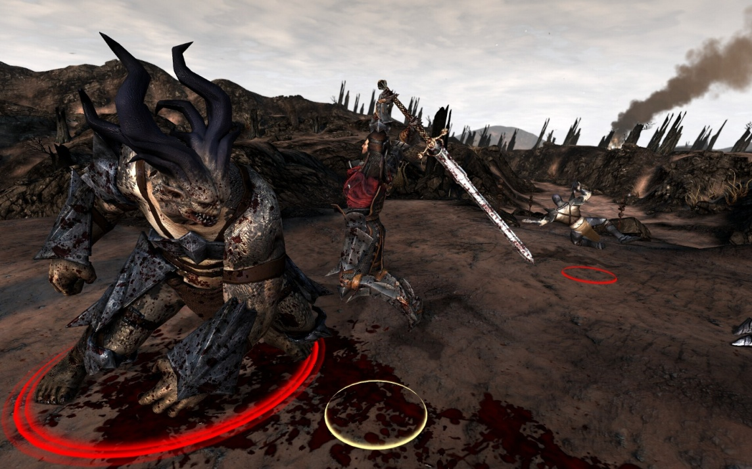
Who would play this?
Mature audience
People who love story
Fantasy Role Player fans

Slide 19
Summary
Strengths
Weaknesses
Strong story
Exciting combat
Likeable characters
Villains with motives
Make your own story choices
Lackluster loot
Small exploration
A lot of choices you make really don’t matter in the end

Slide 20
Is it for you?
Fan of the Dragon Age series
Fan of Fantasy Role Playing
Like party combat
Enjoy making story driven choices

Slide 21
The End

