Slide 1
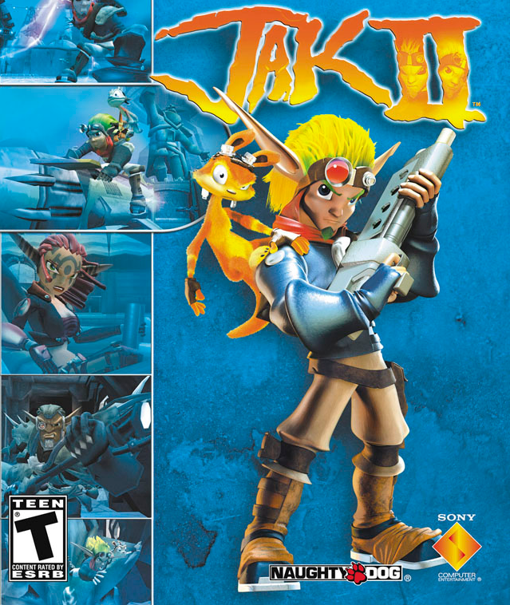
Game Evaluation by Victor Nitos

Slide 2
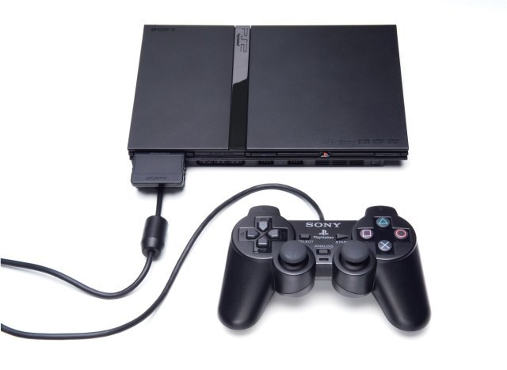
Basic Information
Jak II is a 3D platform game from Sony and developed by Naughty Dog.
It was released in 2003 as a PS2 exclusive. Retail price at release was $50. Now, you can search online or at small game stores for $5-15.

Slide 3
Requirements
Minimum Requirements: Playstation 2 console, 1 Playstation controller.
Actual Requirements:Playstation 2 console, 1 Playstation controller.
Recommended: Unless you plan on playing for 10-12 hours straight, I’d suggest a memory card.

Slide 4
Story Line
Jak II picks up after the events in the prequel Jak & Daxter: The Precursor Legacy
After exploring their land more, they, Jak, Daxter, Samos, and Keira, find and put together a strange precursor machine that launches them into the distance future where a large city is in place of their tiny village and darkness and evil has fallen over the land.

Slide 5
Story (cont.)
Immediately upon arrival, Jak is taken away as prisoner for two years for unknown reasons by the leader/dictator of the city, Baron Praxus and is subject to strange and painful tests with Dark Eco.
With the help of Daxter, Jak escapes and together they work together to battle Baron Praxus and his oppresive forces, the much more threatening metal heads with the Underground, a resistance group against the Baron and Metal Heads alike, and maybe find a way home.

Slide 6
Quick Overview
The game is focused around Haven City, a very large city with a slum, industrial, market, rich, palace, farm, water, and port districts. From the city you can also go into the sewer system as well as out side through air-lock doors to water pump station, mining quarry, precurser forest, and Old Haven City, all of which are in metal head territory. All of which is in an open world, non-linear environment.

Slide 7
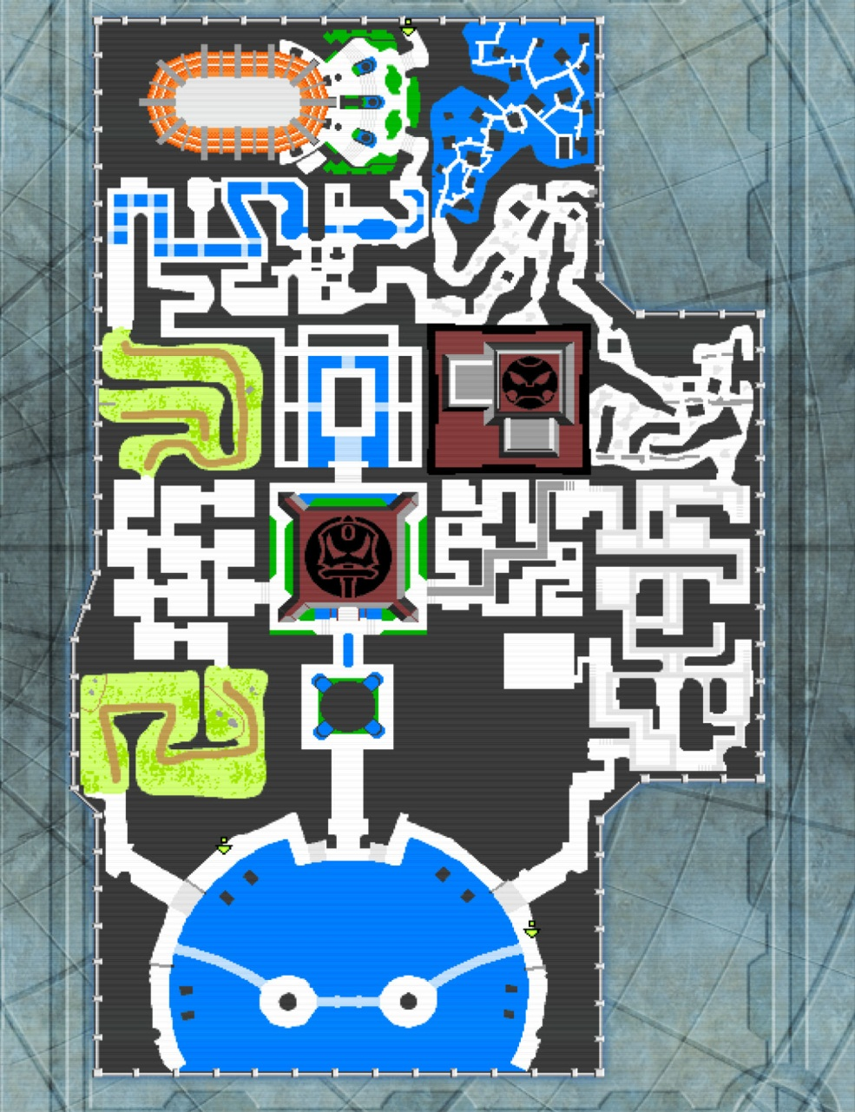
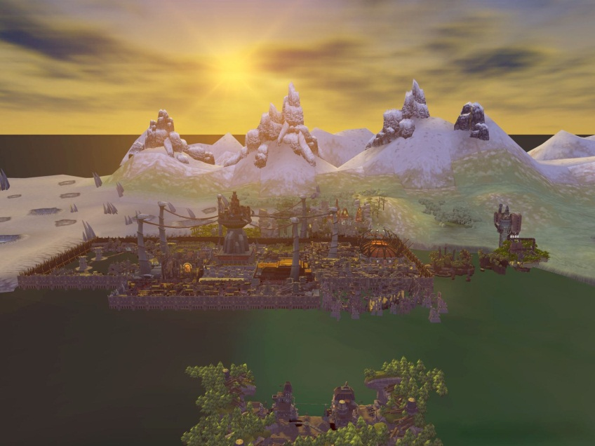
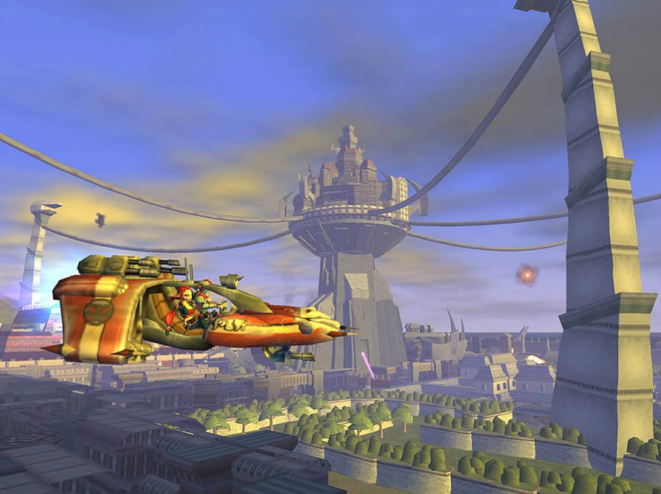
Quick Overview (cont.)

Slide 8
Quick Overview (cont.)
The player’s role is to control Jak and sometimes Daxter to defeat Baron Praxus’ forces, the Metal Heads, and recover ancient precurser artifacts.
The goal of the game is to free the city from the Baron’s rule and Metal Head threat and return home.
You control Jak to negotiate obstacles and paths, fight/shoot enemies, race, and play mini-games to reach your objectives.

Slide 9
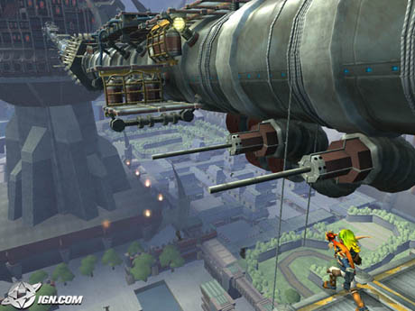
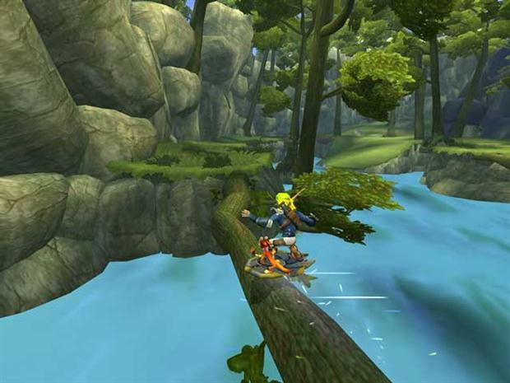
Gameplay
Jak II adds additional gameplay features from its predecessor by adding weapons and vehicles.
Jak is very mobile character, able to double jump, high jump, and roll jump as well as grab onto certain poles and ledges to maneuver across treacherous terrain as a platform styled game should allow.
Later, Jak receives a hover board, which allows him to hover across any terrain and grind across ledges, rails, and logs normally difficult to cross by foot or hovering.

Slide 10
Hand Combat
Jak still has his basic hand combat from the original, a swift, focused, single punch and a spinning kick, which also serves a dual purpose of extending air time after jumping.
Hitting the single punch in mid air allows for a diving kick directly below Jak.
These attacks are very effective against most lone enemies and in small groups, which is useful for conserving ammo for boss battles.

Slide 11
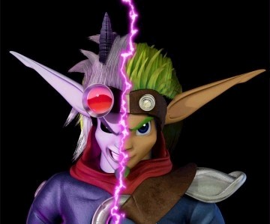
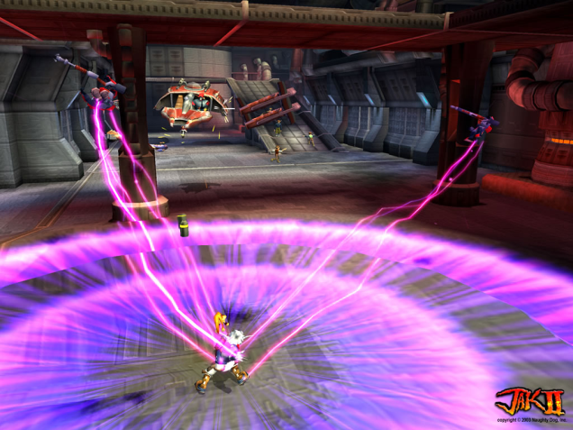
Dark Jak Hand Combat
Due to Jak’s torture and experimentation from Baron Praxus to create his “Dark Warrior Army” using normally highly toxic Dark Eco. Jak is cursed with a dark form.
It insanely increases his attack speed to the point where he’s too fast for enemies to hit and gives new attack abilities such as the Dark Bomb.

Slide 12
Weapons
New as Jak II took the series into a much darker and more mature direction.
Four new weapons are progressively awarded to Jak after completion of jobs for Krew, Haven City’s criminal underworld leader. Jak is given the scattergun (shotgun), pulse rifle (assault rifle), vulcan cannon (mini gun), and peacemaker (can of whoop-ass firing bazooka)

Slide 13
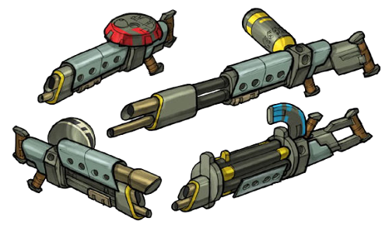
Weapons (cont.)

Slide 14
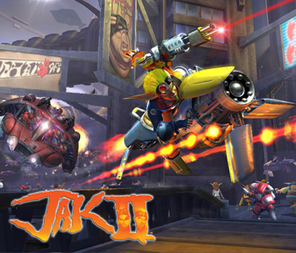
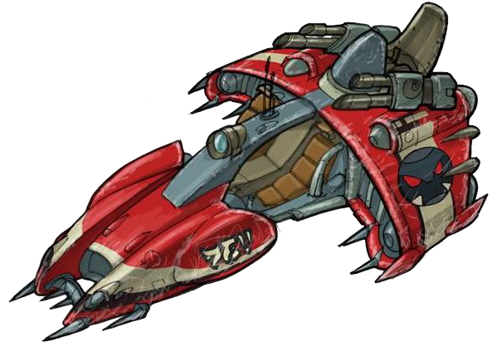
Vehicles and Vehicle Combat
Vehicles come in 2 types: civilian and guard vehicles and 2 classes: hover bike and car.
The civilian vehicles are faster, more maneuverable, and more collision resistant while the guard vehicles are more bullet resistant and have mounted machine guns.
Jak can fire from any vehicle though thanks to Daxter volunteering as gunner.

Slide 15
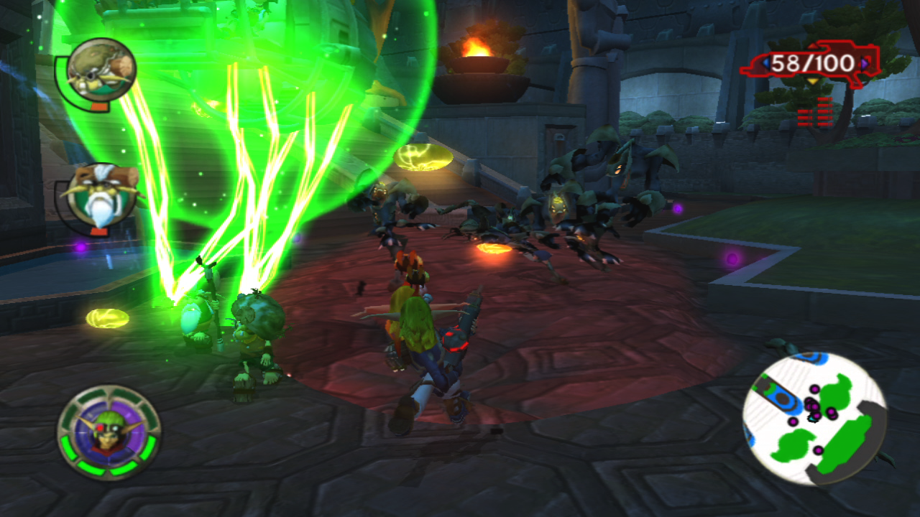
User Interface

Slide 16
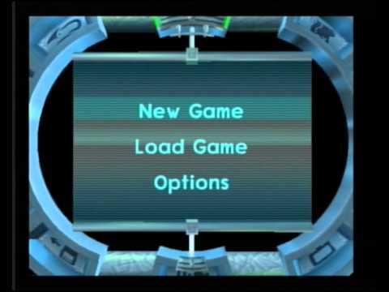
Menu
Unfortunately, best picture I could find

Slide 17
Scoring
A few mini-games kept a scoring system to pass, but throughout the game, the only “score” kept was amount of Metal Head skulls and Precurser orbs collected.
Metal Head skulls could be given to a talking Precurser idol for additional Dark Jak powers.
Precurser orbs could be exchanged in the menu for “special features” such as “large head world” and “mirror world”

Slide 18
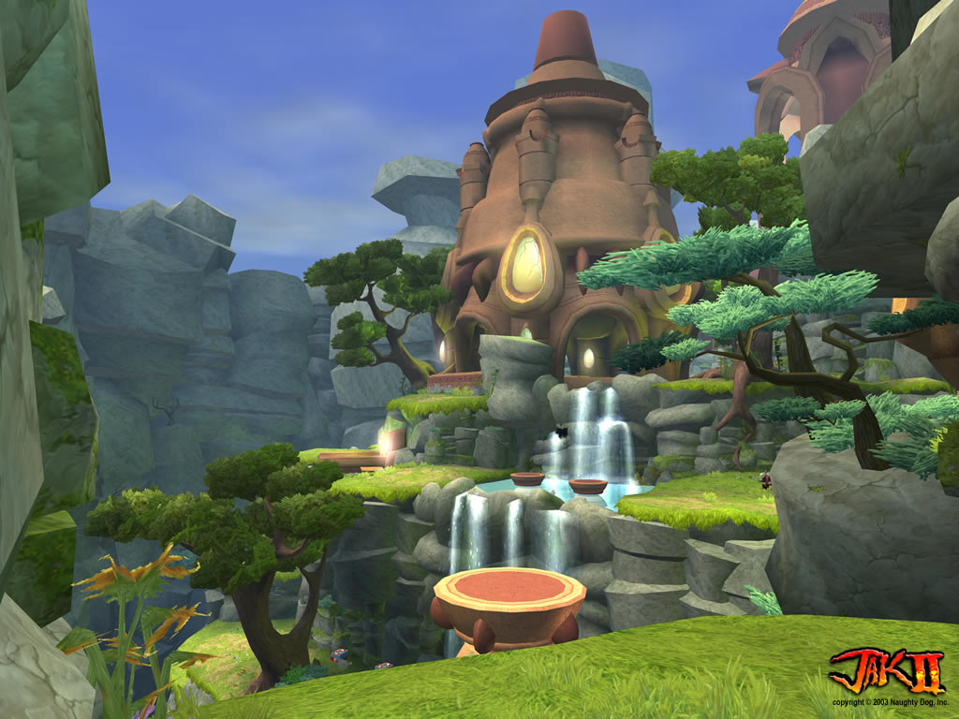
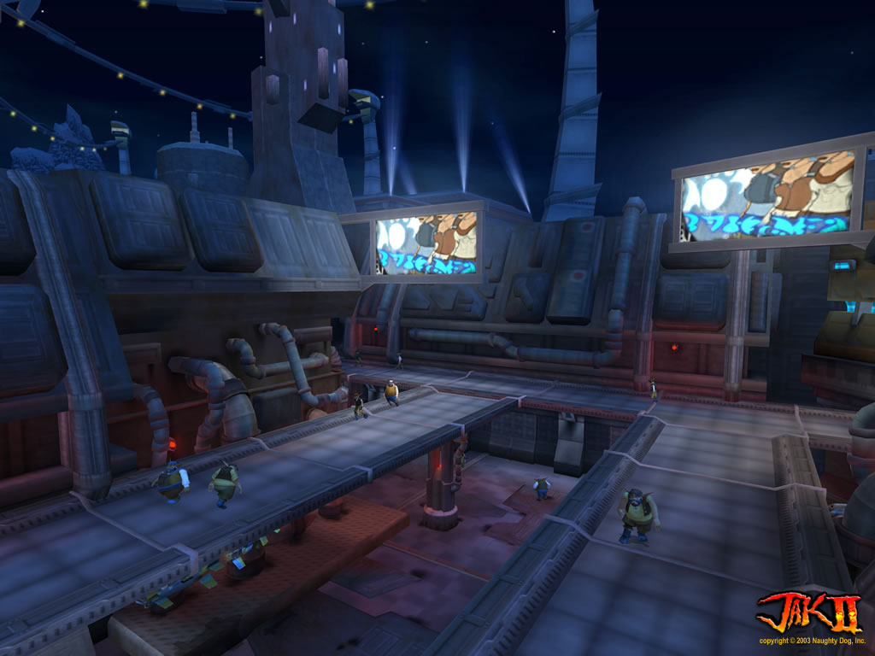
Artwork
Jak II was a beautiful game at release. Even today, it doesn’t look half bad.
The amount of detail put in every corner and crevice of the city and surrounding areas is amazing. The developers didn’t slack anywhere or cut corners, even in parts of the city where you will only walk by once or twice.
The forest is most beautiful of all. A sharp contrast from the violent and dark city. It’s just so tranquil aside from the occasional Metal Head. So much to the point where when the Krimzon Guard invades, I, as a player, felt morally obligated to defend the peace and tranquility of that forest.

Slide 19
Music and Sound
Music and sound didn’t stand out (except maybe the combat music), but it was good enough to get the job done.
The combat music activated as soon as an enemy locked onto you. If an enemy sneaks up behind you, the music will activate and get you on your toes.
Voice acting was superb and kept me immersed in the story.

Slide 20
Special Features
Precurser orbs could be exchanged for extra features as well as cheats such as:
Special Features
5 - Toggle Jak's Goatee 15 - Mirror World 30 - Big Head Mode 45 - Small Head Mode 55 - Scrap Book 1 65 - Scene Player Act 1 75 - Vulcan Fury Course 85 - Scrap Book 2 95 - Scene Player Act 2 105 - Peace Maker Gun Course 115 - Scrap Book 3 125 - Scene Player Act 3 135 - Reverse Races 145 - Level Select 155 - Unlimited Ammo 165 - Unlimited Dark Jak 175 - Invulnerability 200 - Hero Mode
http://www.youtube.com/watch?v=C2eNpVUoRNI
http://youtu.be/uCzwoswg7BA?t=14s

Slide 21
Review: The Good
Jak II stayed true to the great platform style game that came before it while incorporating weapons, vehicles, and new experiences into the game.
It properly used those elements above to add to the gameplay rather than take away from what originally made Jak & Daxter series good (platform style).
The open world gave the player the freedom to accomplish the mission when he/she wanted to, and gave the player the choice of which mission to complete first.
Giving Jak a voice (was a mute in the prequel) made his character more likeable and interesting.
The Story overall was very immersive. Going from the innocent and bright Jak & Daxter to the corrupted, violent, dark Jak II was a shocker to the player, even more so when they discovered their old home in ruins. Personally, that impacted me greatly.

Slide 22
Review: The Bad
Areas were huge, and if you missed one switch, or overlooked a small path, you’ll end up searching the area a couple times over before you find what you need, and that was really time consuming.
NPCs would repeat commands verbatim if you didn’t do it immediately and if you were stuck or fell off a platform just before the command was completed, you would have to listen to the NPC repeat the same command over and over and over.
If you died during a major battle or boss battle, you would respawn at the last checkpoint without the ammo you just spent. Naughty Dog tried compensating by adding ammo crates near these tough spots, but there were usually not enough to compensate.

Slide 23
Similar Games
Ratchet and Clank: Ratchet and Clank used a very similar gameplay system as it was a platform style game with an arsenal of weapons to use.
What set Jak II apart was it’s immersive story with a more serious and dark tone. Though Daxter was there every step of the way to provide comic relief, all along the way a sense of realism was there as you were in the middle of a struggle against a tyrant and an army of monsters.

Slide 24
Intended Audience
The game was rated T for teen by the ESRB and I would agree for the most part. Jak II had violence (though no blood or gore), scantly clad characters, and mild language.
Anyone from the teen age group all the way up to full grown adults can enjoy this game.

Slide 25
Design Bugs
If you pull out a weapon on foot, crawl, put the gun away while continuously crawling, Jak will hold an invisible gun. If you stand up or stop crawling, the invisible gun will go away.
Once or twice I would get stuck because I can’t find one enemy or a switch/button and spend a good half hour/hour trying to find it just to continue.
Other than that, Jak II was an excellentlymade game.

Slide 26
Summary
Jak II is a very immersive game with an immersive story and addictive gameplay and open world environment to enjoy.
I would highly recommend this game to anyone with a PS2.
If you don’t have a PS2, there are emulators you can find.
I would highly recommend playing the prequel and sequel to Jak II in order. A complete HD version is available on the PS3.

