Slide 2
Basic Game Info.
Game Title: Mass Effect 3
Developer: Bioware
Publisher: Electronic Arts (EA)
Directed By: Casey Hudson
Written By: Marc Walters
Music By: Clint Mansell
Type of Game: Role Playing Game Action Shooter (RPG)
Price:
Original: $59.99
Current: $19.99
Can be played on the Playstation 3, Xbox 360, Wii or PC
Minimum Hardware Requirements:
Pentium Dual Core E2160 1.80 GHz
GeForce 405 or Equivalent
RAM: 1 GB
OS: Win XP 32
Direct X: DX 9
HDD Space: 15 GB
Recommended Hardware Requirements:
Pentium Core 2 Duo E6600 2.4 GHz
GeForce 9800 GT or Equivalent
RAM: 4 GB
OS: Win XP 32
Direct X: DX 9
HDD Space: 15 GB

Slide 3
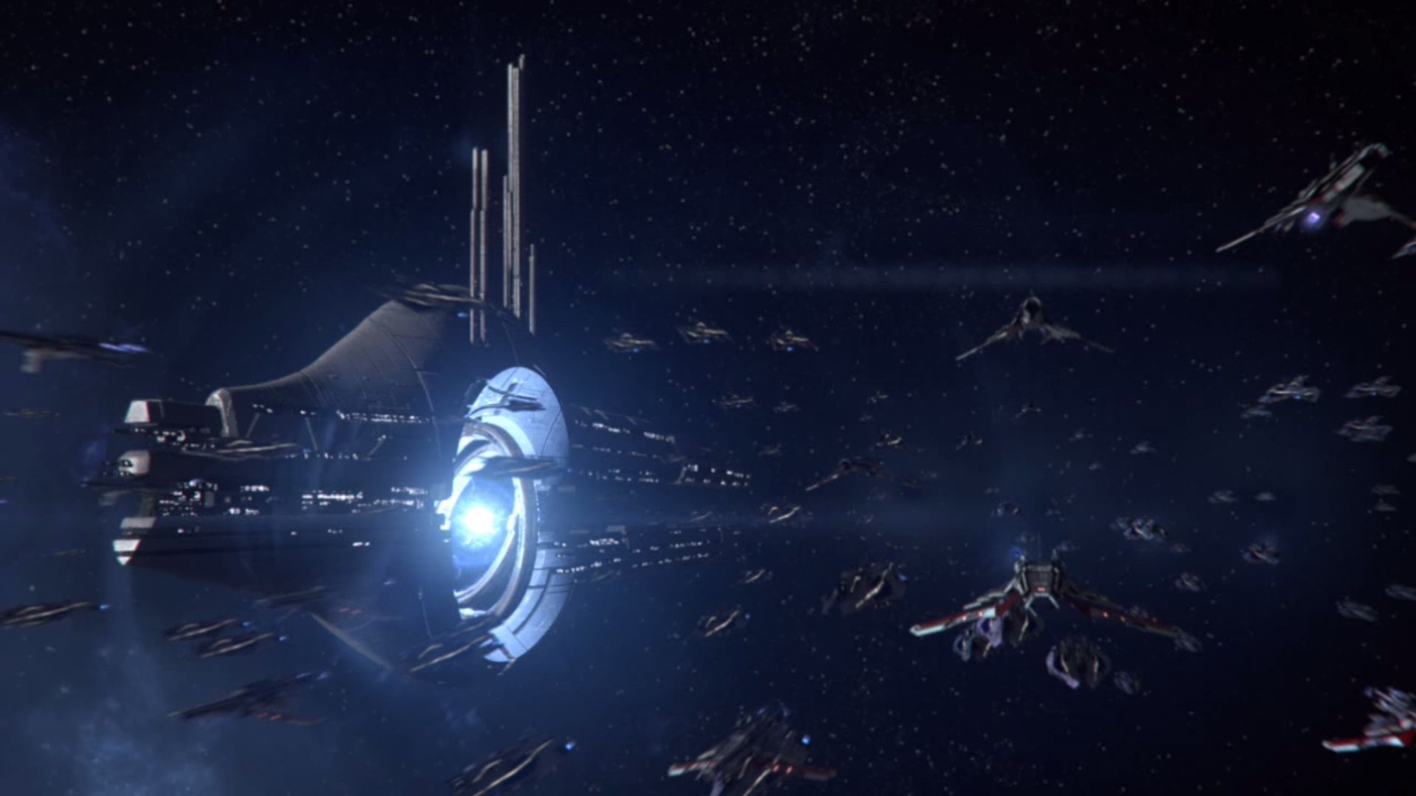
Game Summary

Slide 4
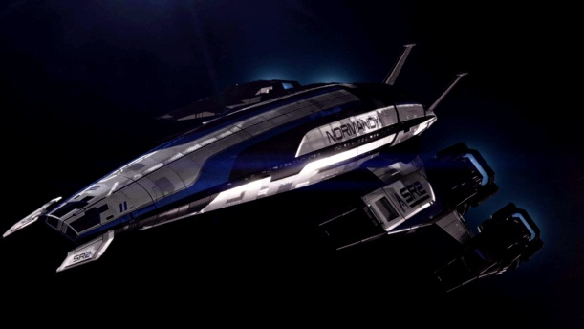
Quick Overview
Third game in the Mass Effect Trilogy
This game is a Sci-Fi RPG, taking place in the near future (about 150 years from now).
The primary gameplay portion is implemented as a squad based third person (mostly) shooter.
The player visits several locations including:
Space Stations
Alien Planets
Mars
Earth
Primary mode of transport is a starship called the SSV Normandy

Slide 5
Main Storyline
The story of the game takes place in the future, in the 2180s. Following the discovery of an alien repository on Mars, humanity discovers that Pluto’s moon, Charon, is in fact an ancient device capable of hurling correctly designed ships thousands of light years across space. It is known to the races of the galaxy as a Mass Relay, powered by the Mass Effect.
Mass Effect 3 tells the conclusion of the story that began in Mass Effect and continued into Mass Effect 2. The Reapers (a race of machines with an extremely advanced Artificial Intelligence) have invaded the galaxy, intent on destroying all sufficiently advanced organic life. This game tells the story of a squad of people, led by you playing its leader, Commander Shepard, who attempt to stop the Reapers from destroying the Earth by any means necessary.
To even have a chance, your squad must unite the races of the galaxy into the largest fighting force ever seen. You must gather resources and armies in order to build the only weapon that even stands a chance of stopping the Reapers… the Catalyst.

Slide 6
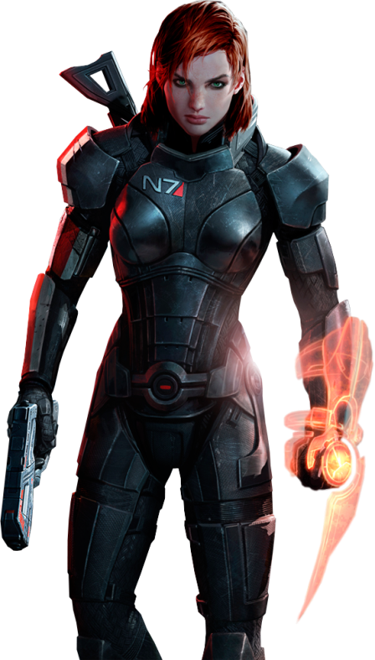
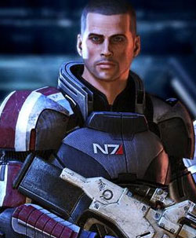
Player’s Role
As a player, you are Commander Shepard, a human commander in the Alliance Military.
Can be either male or female
Can choose from six different classes:
Soldier
Adept (Uses Biotics)
Engineer
Vangaurd (Soldier/Adept)
Sentinel (Engineer/Adept)
Infiltrator (Soldier/Engineer)
If you created a character in Mass Effect 1, you may use the same character through all three games
Your character is fully voiced acted by either Mark Meer (male Shep) or Jennifer Hale (female Shep)
Your moral choices throughout the game allow you to be either a Paragon or a Renegade (think light vs. dark side of the Force)
The player also has control over his/her squadmates in combat

Slide 7
Other information
Installation
For the PC, around 15 Gigs of HD space is required.
No CD required afterwards
For consoles, some installation of game files is required
All three setups have loading times
Artwork
Space based realism
Artwork is beautiful
Sound and Music
The combat sounds are fantastic
Enemy noises/screams are appropriately terrifying
Reapers have their own unique sound
Music of the game does an excellent job of setting the tone
Manual
Online version of the manual
On my copy, there was no manual in the box
Tutorial in the game showed how to play and what to do
Scoring
Mostly done via XP (Experience Points)
Gained by defeating enemies and completing objectives
Basis for how roleplaying games work
Allows the player to improve their character by chosing different skills and abilities that make the player character more formidable
Also can gain Credits to buy and upgrade weapons and armor

Slide 8
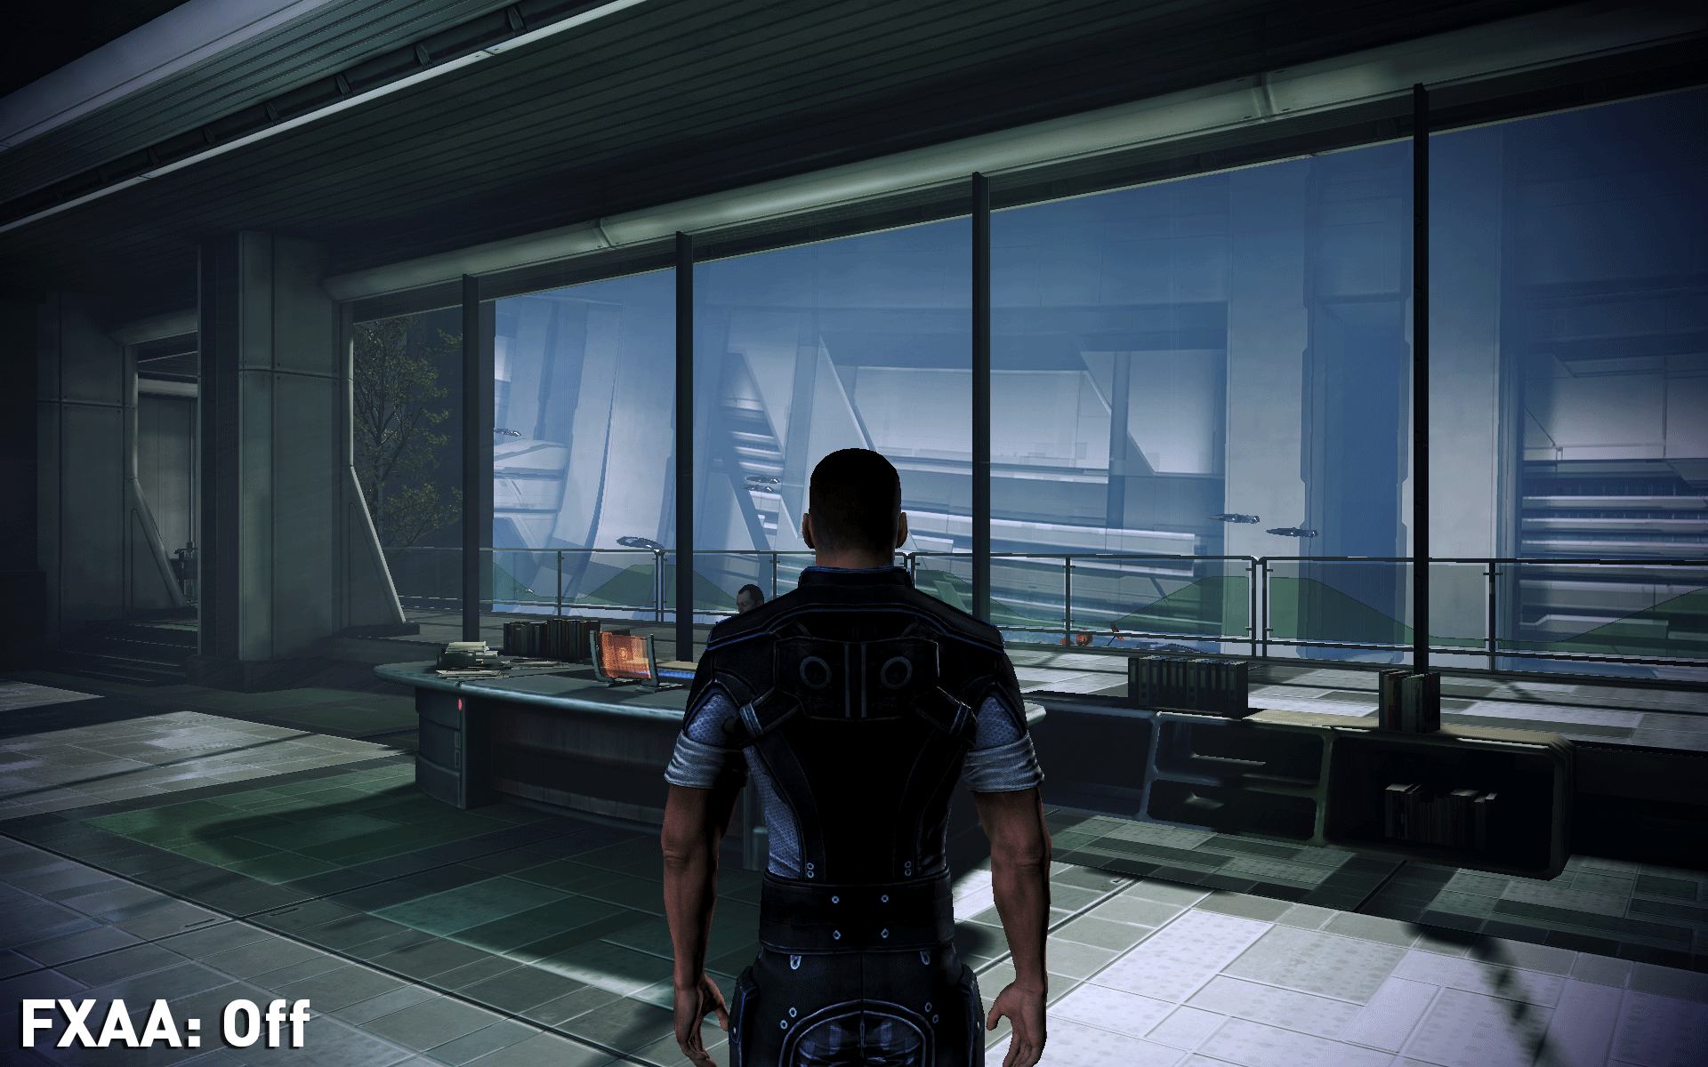
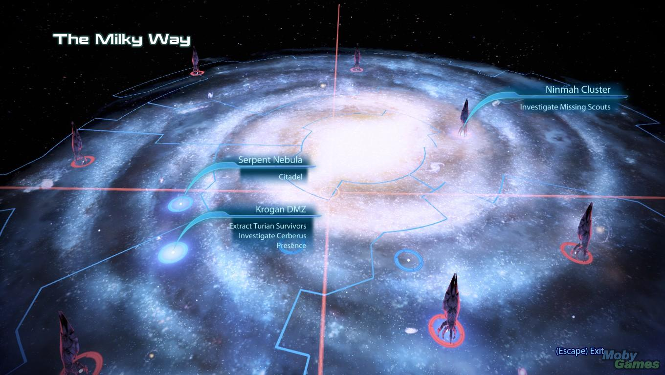
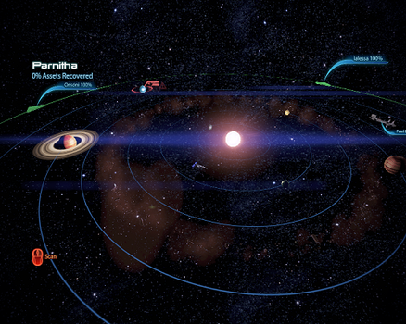
gameplay
Gameplay in Mass Effect 3 has 3 unique categories:
Exploration
This can take place both in and out of Combat
You move Shepard and the team around an area. This is where a large part of the roleplaying (other than decisions making) comes in to play
Discover missions
Talk to NPCs
Space Exploration
Both System and Galaxy Exploration
Discover resources
Fly to planets to execute missions
Combat
Where most of the gameplay is for this game
Will have an entire slide on this

Slide 9
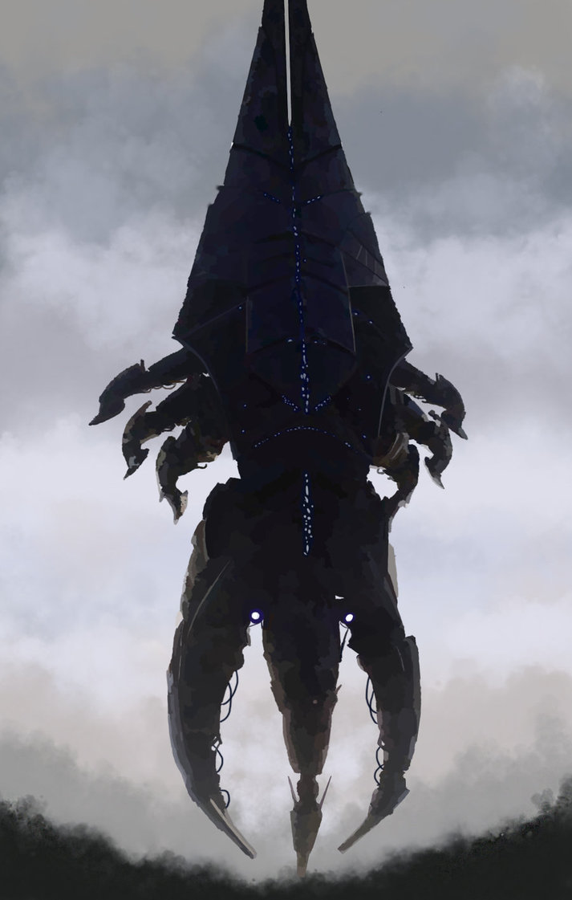
Combat and User Interface
The combat and the User Interface for this game are very closely intertwined. The biggest amount of gameplay takes place during combat.
In Mass Effect 3 3rd Person Shooter combat is the default mode.
Combat is against the Reapers and their minions. It takes place in many locations of the game including:
Earth
The Citadel
Omega
Eden Prime (where the 1st game began)
Tuchanka (the Krogan Homeworld)
Rannoch (the Quarian Homeworld)
And many more

Slide 10
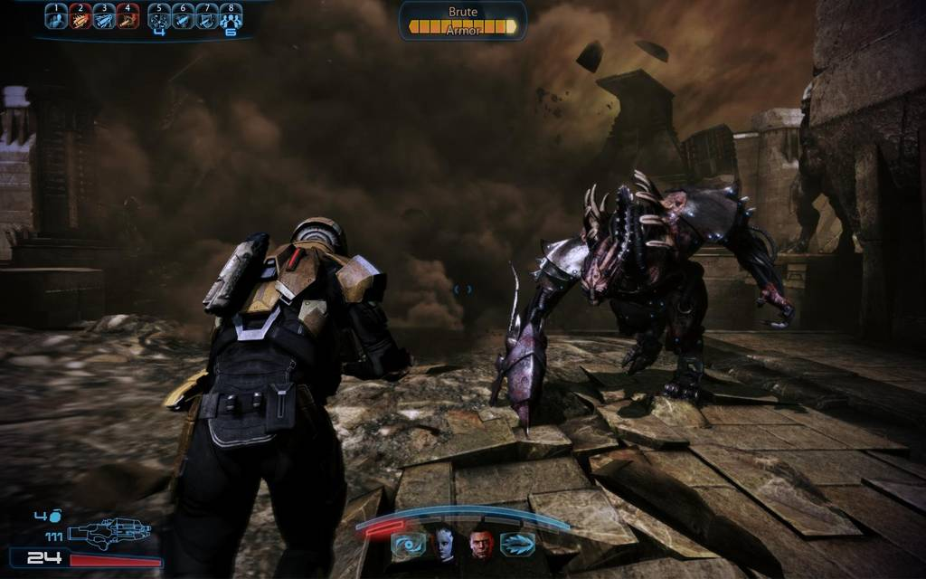
User Interface: Combat

Slide 11
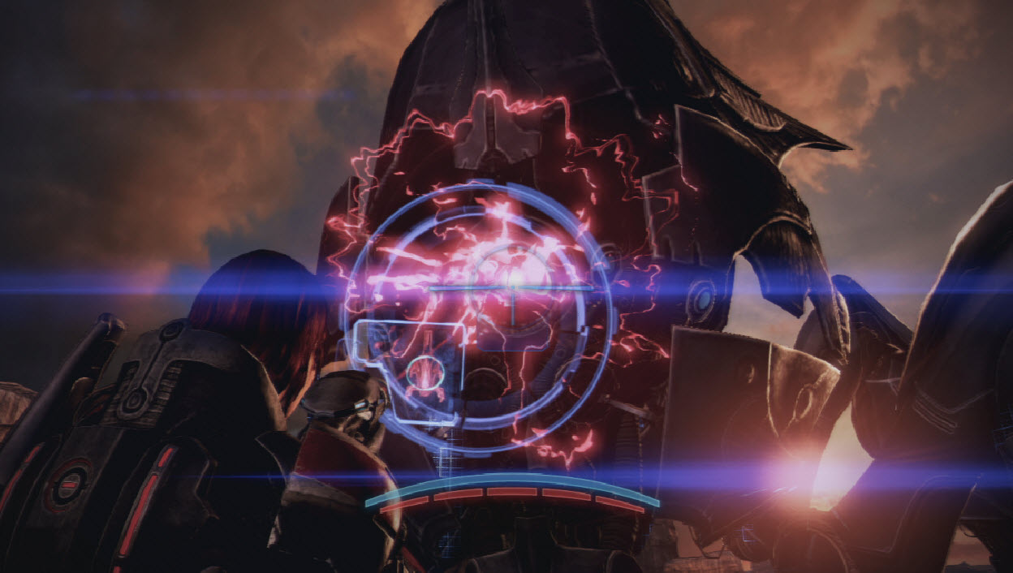
User Interface: Combat

Slide 12
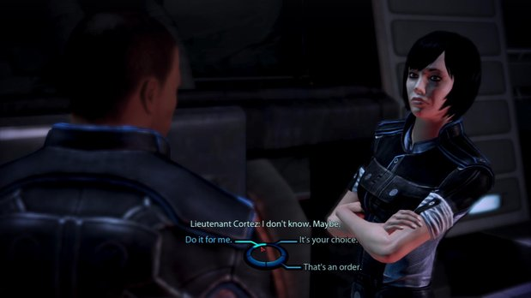
User Interface: Conversations/Choices

Slide 13
Special Features
The Mass Effect trilogy allows for a character created in the first game to be played throughout all three installments.
Choices made in the first two installments can carry over into the final chapter
Essentially makes the trilogy into one long 100+ hour storyline.
Each game can be played separately, however, and does not require data from earlier games to work
Bioware’s innovative conversation wheel allows for the player to make conversation choices
The Paragon (Heroic)/Renegade (Hostile) systems allows a player to customize Shepard’s personality and story choices
Different Interrupts during conversations become available depending upon your Paragon or Renegade Status
Multiplayer mode available
Team-based multiplayer mode against Reaper (computer) or human opponents
Requires an internet connection
Certain characters in the game, including Shepard depending on his/her chosen class, has access to Biotics
Biotics are similar to Star Wars’ Force Powers
Can be combined for interesting effects including levitating an enemy (Pull) and then slamming them into the ground or wall (Slam).
Can Warp (damage) enemy armor and personal shields with Biotics

Slide 14
Known Bugs
During a mission to the planet Tuchanka (the homeworld of the Krogan), it has been reported that despite having the proper save information available, a certain character still dies. As of today, there is still no official fix.
At times, on the main mission select screen, certain locations (star systems/nebulas) will flash as if they have missions to complete when they actually do not.
During cutscenes, characters are not equipped with the same weapon that they had in the mission
There are certain times during the game that this can lead to disastrous consequences because the game literally swapped Shepard’s weapon out for a different one. So suddenly when you pick back up, you are pretty significantly de-powered.
There are quite a few reports of strange body part clipping
Shepard’s head turns 180 degrees to follow something but his body does not, so his head looks like it is on backwards.
Arms sometimes bend to odd, impossible angles.
The Shepard character looks like their head is following/looking at a character that should be on screen but that character is no where to be seen. The missing character will then sometimes snap back into location, following the path that Shepard’s head was following, ending up where they should be.
There is also an infinite fall location at the Citadel Presidium Commons, at the Café.
Shepard can sometimes get stuck in the Normandy cockpit in a chair or under the floor after a dialogue with Joker (the pilot). The only known fix is to restore your last save.

Slide 15
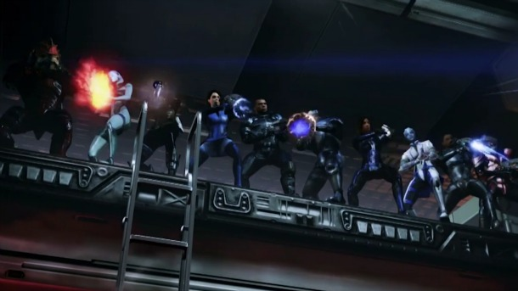
Game review

Slide 16
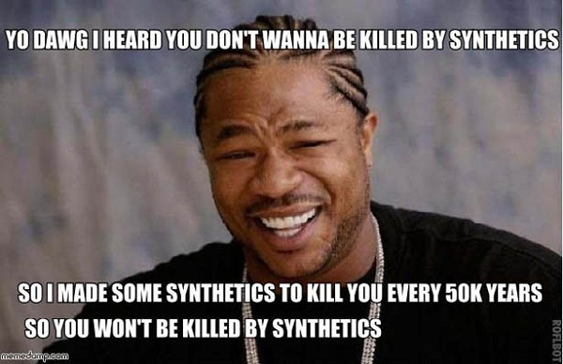
Game Review: The Good and the bad
The Good:
If you are a story lover, the storyline stretches over three different games giving a great space-based RPG experience
Combat is fast paced and well balanced through most of the game
Excellent graphics and cutscenes
The ability to make Shepard YOUR Shepard gives you a connection to the characters and world and that is unparalleled
Shepard is able to romance different NPCs in the game
The Paragon/Renegade systems allows Shepard to react differently depending on how you played him/her
Deep and well realized NPCs (non-player characters) give the universe a very ‘real’ feeling
Extremely fun DLCs add some great content to the game
The Bad:
The ending of the Mass Effect 3, and hence the trilogy, was SEVERELY lacking
Was very poorly executed
Didn’t make sense to most people that had played the entire trilogy
Did not live up to expectations
Did not do or have what Bioware had claimed
Bioware did a DLC to try to help fix this issue, but most players are of the opinion that the ending is still poor. It did not CHANGE the ending, just clarified some poorly explained plot points.

Slide 17
Game Review (Cont.)
I really enjoyed this game. I have rarely seen a space based RPG, let alone one that had this kind of depth. Xenosaga could be considered one, and so could The Knights of the Old Republic (also by Bioware and is a Star Wars based game). These three games established a rich back story and mythology, had interesting gameplay, and really allowed you to make the main character yours.
The few things that make it better than similar games are:
You can make Shepard your personal character, from the way he/she looks to how she interacts with the world.
The world is extremely deep and well realized. It feels like you are playing a movie that you are in control of, as far as the choices of the main character go.
The graphics and cutscenes are quite good and well done.
As for the appropriate audience, I agree with the ‘M for Mature’ rating that the game was given. The romances, if you cultivate them, do have a chance to culminate in a love making scene between Shepard and your chosen mate. It should also be noted that in these romances, you can date a man if you are a man and a female can date a female. Along with this reason, there is a lot of death and killing, as well as some fairly brutal acts that Shepard can commit (more likely if you follow the Renegade path).
Being as the game was fun, interactive, wasn’t impossible and it allowed for me to play how I wished, I really don’t see any major game design sins. If I had to pick one, it would be that the writers should have talked more to keep the storyline, particularly the ending, more consistent. In my playthrough, the entire reasoning behind the Reaper attack made zero sense because of something my Shepard had accomplished.

Slide 18
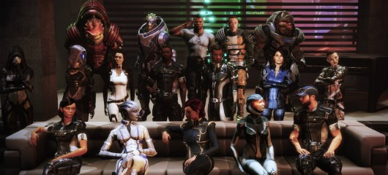
Summary

Slide 19
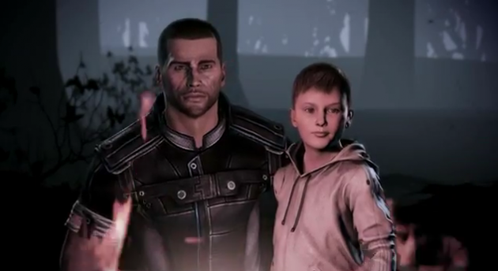
Summary
All in all, this is one of the best games that I have ever played. I have, personally, called it a nearly perfect game, with the exception of the ending.
Its strengths lie in the fact that it allows you to make the character you want and react to the situation how you want him/her to. The storyline is fantastic. The combat is fun, engaging, and well paced and balanced. It doesn’t overshadow the other parts of the game.
Its main weakness, however, is also the story. Because you have worked to make Shepard yours through 3 games, the ending feels flat and uninteresting. It also feels rushed, disjointed, and it doesn’t make sense.
I definitely think that this game is worth purchasing. The entire Trilogy can be purchased, and that is how I recommend playing the game.
The only way that I could see substantial improvement coming to this game is in a rewrite of the ending.

Slide 20
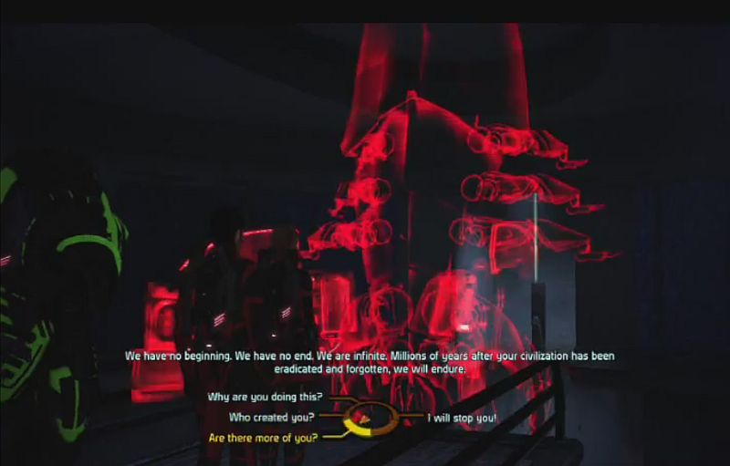
Questions?

