Slide 1
N Game - v2.0
Alfred Kishek

Slide 3
Overview
A Ninja who navigates through different levels avoiding hazards, collecting tokens and eventually reaching the exit door for the level.
Player’s Role - You are the ninja! You need to get to the end before the time ends.
Audience - Everyone
Can be used by casual gamers or experts!
I played it in middle school. My roommate still plays it now.

Slide 4
N Game Basic Information
N is a freeware game released in 2005
Metanet Software - Independent game development company, founded in 2001 by Mare Sheppard and Raigan Burns
Based in Toronto
Type/Genre: Platform Game
Hardware Requirements/Actual Hardware Required:
Flash game (Must have flash and a browser)
No installation required!
Additional Platforms
XBox, Nintendo DS, PSP

Slide 5
Story
You have god-like speed, dexterity, jumping power and reflexes that are all the result of your “amazingly fast metabolism.” Sadly, your lifetime is 1.5 minutes
Like all ninjas, you crave gold and a natural propensity for exploration
N standing for “the way of the ninja” is a highly advanced system of spiritual, cognitive, and physical training.
The ninja needs to traverse a series of 5 rooms before the end of their episode.
In accordance with the teachings of N, it is your profound hope that you will develop the skill and intelligence to necessary to achieve mastery of all 100 episodes.

Slide 6
User Interface

Slide 7
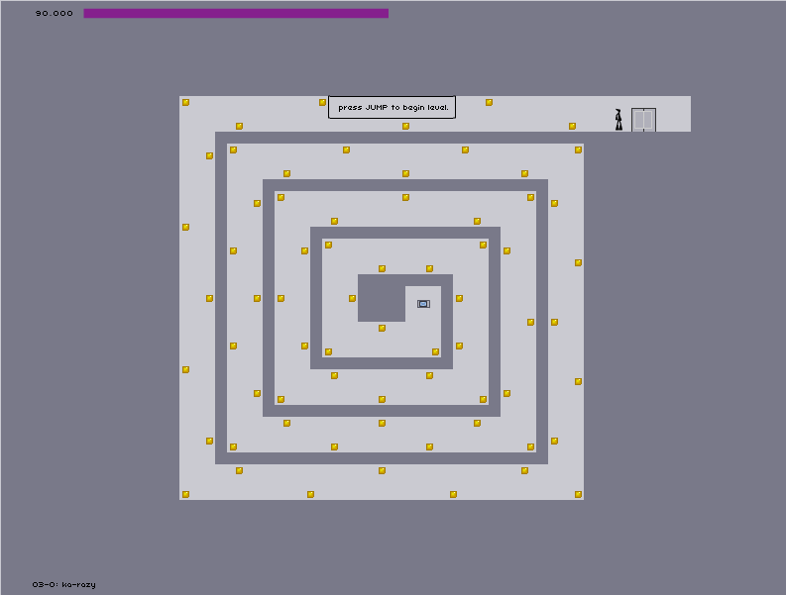
User Interface
Time
Instructions
Player
Exit

Slide 8
User Interface Overview
2D Game with over 500 maps!
Design Mistakes - Visually it could be improved by moving features around.
Time bar placement
could be improved
Artwork is very simple and focused on creating difficult, yet achievable levels.
Controls are simple
Left, right, jump, suicide (K)
Sound and music
Helpful to have enabled
Addicting and rewarding when collecting coins

Slide 9
Game Play
The objective of the game is to traverse through the platforms and reach the end of all 500 maps.
Scoring
Time-based
Gold tokens allow you to gain 2 seconds of time. Collecting tokens, however, takes time!
Demo

Slide 10
Special Features/Game Components
Hazards
Rocket Turrets
Homing Missiles
Laser Drones
Target you for a few seconds, then fire a straight laser path
Zap Drones
Once they spot you they chase you in a straight path. If they catch you, you will die
Thwumps
Square blocks that accelerate towards you once spotted
Chain Guns
Fires a stream of inaccurate bullets at the target ninja
Stationary Mines
Land mines
Falling!

Slide 11
Additional Features
Overclock mode
change the speed of your game
Same color as the environment
Same color as background rendering you practically invisible
Customizable RGB colors

Slide 12
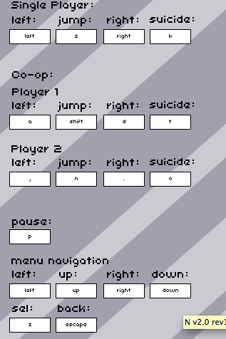
Configurable Settings and Features
You can remap keys!
Co-op mode and player
themes
No game manual - just a
small tutorial

Slide 13
Bugs
The game overall is very
smooth. But every game
has bugs!
One of the most addicting features is how smooth the game-flow is and it is generally towards the players advantage.

Slide 14
Game Review

Slide 15
What is good?
Very low latency for controls; everything is very responsive.
It becomes extremely difficult and frustrating as you progress through the levels.
Sense of strategy and control of your outcome.
You want to become the best ninja ever!
Dynamic elements that change your environment.
Meaningful Decisions - Should you collect coins?

Slide 16
Dynamic features
Gold
Adds time to the clock
Launch pads
propel the ninja at greater speeds
Bounce Blocks
Bounces you higher
One way platforms
Allows you to go in one direction, but not the other.

Slide 17
What’s bad?
Story line is very plain
Becomes way too challenging
Old, graphics could be improved
Not enough change in the earlier levels (becomes very redundant early on)
Lacks probability, every level is exactly the same every time you play it.

Slide 18
Similar Games
The game is inspired by:
Lode Runner - old commodore 64 game
Soldat - means soldier
The concept is very general and not new as a platform game, however, it is a very unique game and hard to compare to others.
Better or worse: I would say both, as a platform game, it really tackled the ability to become dynamic and allows users to create their own maps!

Slide 19
Summary

Slide 20
Strengths and Weaknesses
Strengths
Very addictive
Dynamic Features
Outcome is controlled by the user
Weaknesses
Could use a storyline
Poor visual design

Slide 21
Is it worth it?
For the price of $0.00, YES!
Possible Improvements:
More hazards
Visual design
Collectables <Stars, etc..>
Overall, I love it!

