Slide 1
Reviewed by Woo Kang

Slide 2
Basic Information
Diablo 3 Reaper of Souls (expansion of D3)
Action RPG
Blizzard Entertainment
Price : $34.99(PC, additional to D3)
Price : $39.99(Consoles, including D3)
Can run on Xbox360, Playstation 3, Mac, and PC

Slide 3
Minimum Requirements
Windows XP, Vista, 7, 8
Intel® Pentium® D or AMD Athlon™ 64 X2
NVIDIA® GeForce® 7800GT or ATI Radeon™ X1950 Pro
2 GB RAM
25 GB available HD space
1024X768 minimum display resolution

Slide 4
Game Summary
Diablo has been killed in Diablo 3
Addition of Act 5(originally 1 – 4) and the new bad dude, “Malthael”
Fight through Malthael’s enslaved army and renegade angels to punch his face
When he learns his lessons you can play in the new Adventure Mode

Slide 5
New Class: Crusader

Slide 6
What else is new?
Adventure Mode – move freely around all acts and waypoints
Bounties – Variety of quests in adventure mode with rewards
Nephalem Rifts – Randomly generated maps, mobs, and mob density with higher chance of item drops and a rewarding boss at the end
Greater Rifts – timed rift with difficulty levels for leaderboard rankings
Seasons
More customization of items and looks

Slide 7
Game Play on a PC

Slide 8
Game play on Xbox One

Slide 9
What makes this game fun?
Finding Legendary Items
Team play/ Clans
Progression compared to Diablo 3 is smoother
Action is great

Slide 10
What is bad about the game?
Usually only one or two strongest “builds” and equipment settings
Doesn’t require much skill to be competitive, just time
PC game designed around consoles to maximize profit

Slide 11
Most Similar Game to Diablo: Path of Exile

Slide 12
Path of Exile skill tree

Slide 13
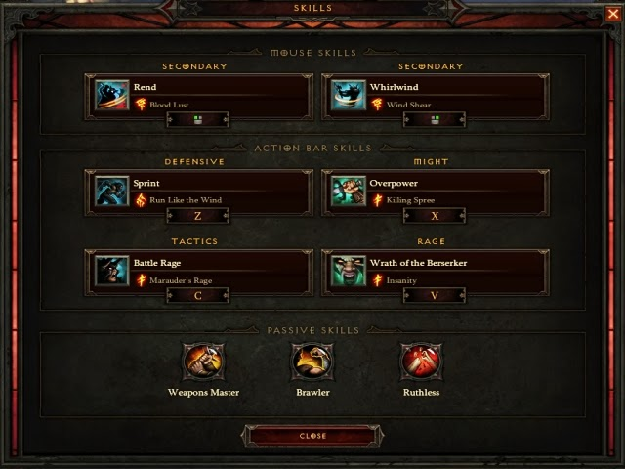
D3(RoS) vs PoE
D3 – more casual
PoE – more variety/uniqueness

Slide 14
Summary
Got Diablo 3? Reaper of Souls is worth buying
Overall a fun, casual, monster killing, action RPG game
Not enough variety in skill/item builds to keep trying out new things
This game could improve if console devices weren’t a constraint

