Slide 1
Game Evaluation EarthBound (Mother 2)
Lindsay Insco
CIS 487
September 24, 2014

Slide 2
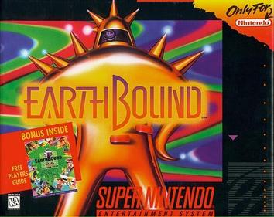
Basic Information
EarthBound (Also known as Mother 2)
Developed by HAL Laboratories / APE and published for the Super NES (Super Famicom in Japan), and recently re-released on the Wii U
Released June 05, 1995 in the US
Genre : RPG

Slide 3
Overview/Installation/Requirements
Japanese-style turned-based RPG
For the Super Nintendo and recently re-released on the Wii U as a downloadable game.
Installation – Insert cartridge into SNES or purchase and download on the Wii U Marketplace (Automatic installation from there)
Requirements :
SNES or a Wii U

Slide 4
Summary
“Adventure…Excitement…Trout Yogurt!
Immerse yourself in a truly original, funny game with quirky characters, dozens of places to explore, and an intelligent combat system featuring yo-yos and dirty socks” (earthbound.nintendo.com)
The game begins as the main character, a young boy named Ness (Or whatever you choose to name him) investigates a meteorite crash with his neighbor, Pokey. During this investigation, he is told by Buzz Buzz (a creature from the future) that the evil Giygas has turned animals, objects, and humans into angry, hateful creatures and you must collect 8 melodies from special sanctuaries to stop the force. You are joined by 3 other special characters, Paula – a psychic girl, Jeff – a nerdy, eccentric inventor, and Poo – a monk child. You will visit interesting towns, fight zombies, evil sign posts, and even some angry hippies.

Slide 5
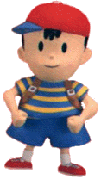
Ness and Paula
Ness
Paula

Slide 6
Jeff and Poo
Jeff
Poo

Slide 7
User Interface and Gameplay
The interface is simple :
Directional pad (Up, Down, Left, Right) for motion
You will travel around towns and in stereotypical dungeons to explore for items, fight enemies, and gather sounds
Turn-based RPG system
Old-style, turn-based RPG system, where you will pick a command (Be it attack, use a skill, an item, block, or run away), and the turns will roll out. You will strike, potentially another character that you control in your party will take their turn as well, and the enemy will have a turn.
Depending on how you approach an enemy, which is freely walking around the town, path, or dungeon you are in, or how the enemy approaches you determines who gets the first turn.

Slide 8
Scoring
You will gain experience points for each battle, and work on a basic level system.
Start at level 1 – The more experience you gain, the higher your level becomes
Increasing your level may increase your attack, defense, hit points, psychic points (Magic points), etc. Basic statistics, and you will learn new skills such as supporting psychic powers (Healing), or offensive psychic powers (Such as PSI Rockin’)
You will use various clothing items (Such as hats, bracelets, etc) to increase your defense and protect against status ailments
You will have a variety of weapons to choose from over time (from yo-yo’s, to baseball bats, to frying pans even!)
Each battle will also award you so much money, that your father will deposit into an ATM automatically. You must find an ATM to withdrawal or deposit your money, and you may check your balance by calling your father or stopping by an ATM
Saving is also done by calling your father
Status ailments will decrease your strength in battle, such as being homesick (If you do not call your mother every now and then, you will become so)

Slide 9
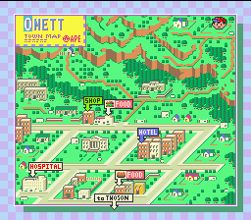
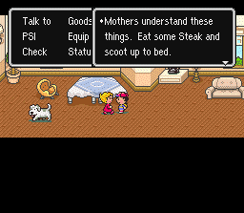
Onett

Slide 10
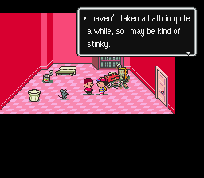
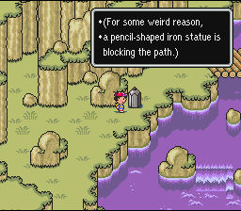
Twoson

Slide 11
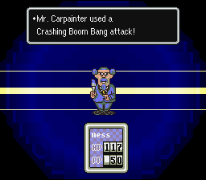
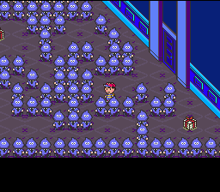
Peaceful Rest Valley / Happy Happy Village

Slide 12
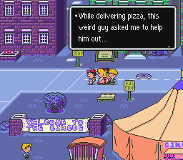
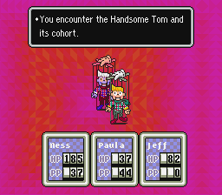
Threed

Slide 13
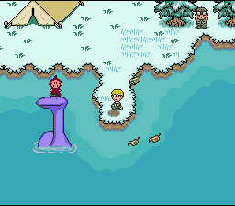
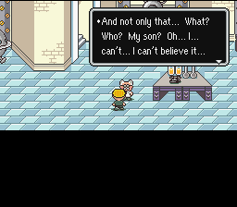
Winters

Slide 14
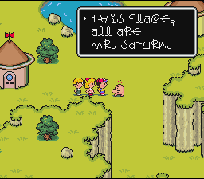
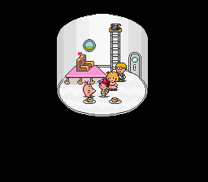
Saturn Valley / Belch’s Factory

Slide 15
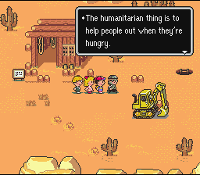
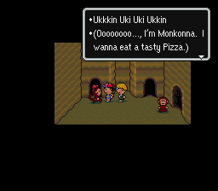
Dusty Dunes Desert

Slide 16
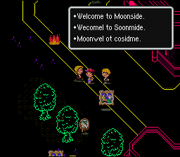
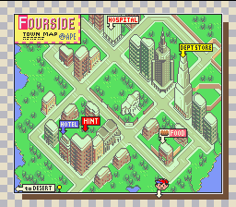
Fourside/Moonside

Slide 17
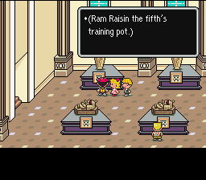
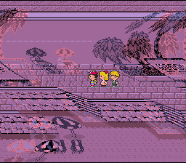
Summers

Slide 18
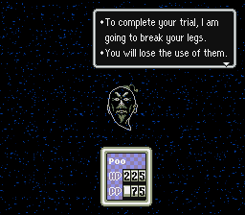
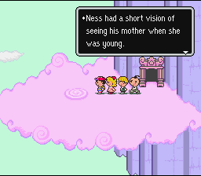
Dalaam

Slide 19
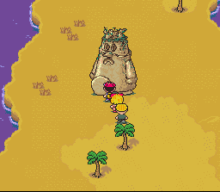
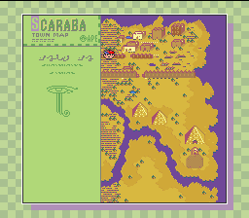
Scaraba / Tenda Village

Slide 20
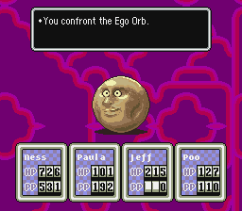
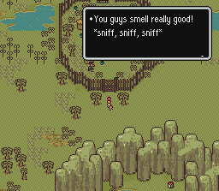
Lost Underworld

Slide 21
Sound and Music
Music is by
Keiichi Suzuki
Hirokazu Tanaka
Much like the game, there is a lot of pop-culture reference
Heavily influenced by The Beach Boys
Randy Newman
John Lennon
Beatles references often as well

Slide 22
Special Features
Pop culture references
Example : ‘XXXsterday’ quiz in Onnett
There is a yellow submarine in Brick Road

Slide 23
Bugs
If you poison the final boss Giygas, and he dies from the poison, the game fades out with the background still Giygas’ lair, but Ness’ family is in position as if they were in their home in the ending.
If you use an Exit mouse in the final room where Giygas resides, everyone in Ness’ party are no longer robots (This makes sense if you play the game, obviously)

Slide 24
What’s fun?
The game is very original and quirky
Interesting characters
One is named Poo…
You battle raging hippies, stop signs, and pieces of artwork!
Interesting story
Very different from Final Fantasy, for example, more light-hearted in some ways.
Has become a classic
One of the most requested games to be re-released
Cult-like following
Classic turn-based RPG with smooth game play
Very similar to many other battle systems at the time (Again, think of the original Final Fantasy games and such)

Slide 25
Not So Fun
There is a 10-minute wait in one portion of the game (That I will not spoil), and this does get cumbersome
The game will remind you to take a break very frequently (with a call from your father suggesting you take a break). Useful for health reasons, but rather annoying
Levels have an inconsistent jump in difficulty. One new town will be nearly impossible to get through, while the town after it will be a breeze, etc.
The battle system is repetitive, and it is not anything groundbreaking, even for its time

Slide 26
Appropriate Audience
Despite its light hearted nature, the audience seems to be geared towards teenagers and even adults
Rated ESRB E for Everyone originally, yet the Wii U has it rated T for Teens due to fantasy violence, mild blood, suggestive themes, and crude humor

Slide 27
Worth it?
I feel like every gamer should really have a go at it.
Turn-based RPGs aren’t so popular anymore, but this game really is a classic, and there isn’t anything like it
There’s a cult-like following, even.

