Slide 1
Chrono Trigger Review
The Best RPG of all time
By: Nathan Bustamante

Slide 2
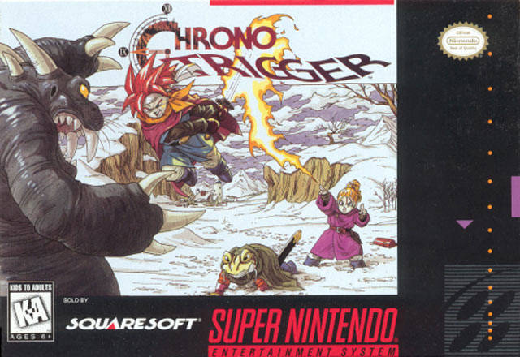
Basic Information
Game Title: Chrono Trigger
Company & Author: Squaresoft (now Square Enix)
Type of Game: Role-Playing Game
Price: Free if you download emulator (Original cartridge can cost, at a minimum, $80)
Minimum stated hardware requirements: Any computer that can run a super nintendo emulator or an actual super nintendo.
Actual hardware required: Almost any computer as long as its not super old. You can even turn a raspberry pi into a little emulator.

Slide 3
Storyline
In 1000 AD, you play as Crono. Lucca and her father are showcasing their new invention, a teleporter, at the Millennial Fair. Crono runs into Marle who eventually becomes a volunteer out of the audience to try the teleporter. Marle’s special pendant reacts with the teleporter and she is mysteriously transported elsewhere. Crono recreates the process and chases after Marle soon discovering that they’ve traveled back in time to 600 AD. Marle is mistaken for her missing ancestor, the queen, therefore stopping the search party. This has repercussions for Marle, namely, she ceases to exist. Marle, now mistaken for the queen disappears and the stranger Crono is blamed. Crono, Lucca and a servant of the queen, Frog, restore history to normal by recovering the queen, however, Crono is imprisoned for her kidnapping and sentenced to death. Crono, Lucca and Marle escape through another portal leading them to 2300 AD. Here they discover that the entire world was wiped out by a creature named Lavos in 1999 AD. Shortly after, the party finds Gaspar at the End of Time, where an ancient art of magic is taught to them and the epic journey to save the world from Lavos begins.

Slide 4
Scoring
- Gain experience to level up
- Spend money to get new equipment
- But you have to find the best equipment

Slide 5
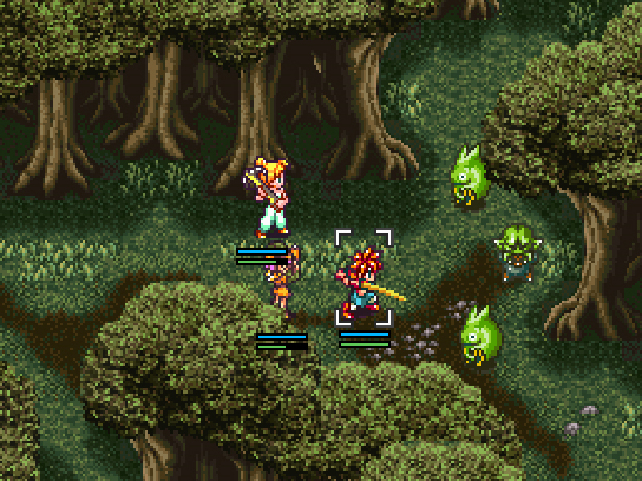
Gameplay
The Gameplay is like most traditional RPGs however they do a few things differently than most other RPGs at that time. For example battles are not random. You can always see your enemy. If you run into them, then a battle sequence begins and the menu combat starts. You are allowed three people in your party. If you have more than three people in your party, any time you jump through a portal to go to a different era, you will end up at The End of Time. It’s a clever way of restricting the number of party members. Another element to the fighting system is the active or wait option, which you choose at the beginning of the game. Active means that the enemy will not wait for you to select what you want to do. Wait means that the enemy will wait for your turn to end. I personally prefer active. It’s more challenging, and it makes you have to react much faster.
The story actually provides some very interesting gameplay as well. Because of all the time travel, things you do in the past have an affect on things in the future. This does not just pertain to the storyline either. There are some special items you cannot get, if you go to the past and first remove the item from that same chest because the upgraded version of it will not be there in that very same chest in the future.

Slide 6
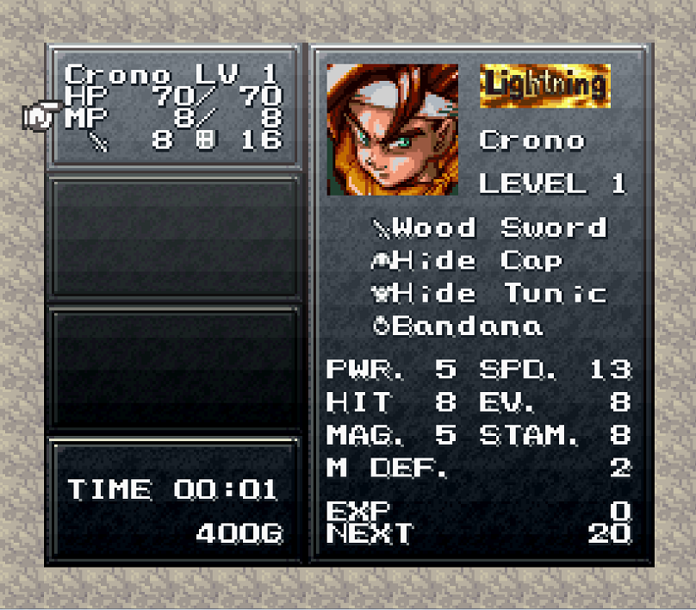
Equipment
There are four equipment slots. Weapon, armor, helmet and accessory. The first three are pretty straight forward, new weapons make you stronger, armor and helmet give you defense. However, these can have special effects, such as a status immunity or plus to a certain stat. Weapons can have awesome effects such as 4x critical hit damage. Accessories are extremely important. These can give stats, but their effects are much better than most anything you can get for other pieces of equipment. Some accessory effects include: Critical hit rate and Counter rate increased by 50%, 50% MP cost, increased damage, etc.

Slide 7
Techs
Each Character gets their own techs. They cost MP to use. An example of one of Crono’s techs would be his ‘Cyclone’. He spins his sword around hitting people in an area. An example of a tech Marle has would be ‘Aura’. She is able to heal an ally with ‘Aura’. What’s interesting about these is that this two techs can be combined into a dual tech in which Marle uses ‘Aura’ on Crono while he is using ‘Cyclone’ and it heals the whole party. In fact, its the only way you can heal the whole party at once for a while. This combining of techs remains prominent throughout the game and eventually leads to some of the most powerful attacks called triple techs. Triple techs involve the whole party.
All Triple Techs - https://www.youtube.com/watch?v=XCmXL9uiEKc

Slide 8
Music and Artwork
Something that is very nostalgic for me is the music. Just hearing it makes me want to play the game again. It’s such great music that orchestras have performed these songs before. In fact, I heard a Chrono Trigger orchestrated song on the radio the other day! Here’s a snippet of one of my favorites. It sets the tone for new areas amd eras.
https://www.youtube.com/watch?v=i_QxGtXSa9E
The Artwork was done by the same guy who did Dragon Ball Z (DBZ), Akira Toriyama. It’s pretty easy to tell once you look at the pictures and it suits this game very well.

Slide 9
Bugs
-There's only one significant bug I could find.
-At a save point in The End of Time it is possible to get stuck in the wall if you save while moving.
Side note: Dont play PlayStation version. It takes a couole seconds to pull up the menu and thats very frustrating considering its instant on SNES.

Slide 10
Worth Buying?
As much as I love this game its not worth 80 dollars for the original. However, you can buy newer versions (Nintendo DS) for pretty cheap.
Just get the emulator and play it. Very worth playing, especially for free.

Slide 11
The Good The Bad
- Just about everything
- story, characters, music, battle system, leveling, equipment, New Game+
-Not hard enough
-very rarely do I feel challenged
-possibly graphics

Slide 12
Conclusion
This game is a masterpiece. It is timeless. It’s always ranked very high on best RPGs of all time list. The amount of money the cartridge goes for on Ebay now is pretty outrageous, but it’s a testament to the popularity of the game. I would say the graphics could be improved, however, I’m not sure in what way they could improve the graphics and retain the same charm the game currently possesses. If you are a fan at all of RPGs, Chrono Trigger is an absolute must play. The story, the battle system, the equipment, the characters and their backstories, and the music are all phenomenal. It also has replay value with New Game+ after you have completed the game. Although everything is absurdly easy, you can go defeat the last boss at different points in the game and at different points in history to get different endings to the story. There are something like 13 different endings. My only criticism, and I say this a lot about modern video games, it needs to be harder. Video games, in my opinion, are not hard enough which is why some of my favorites consist of Darks Souls and Ninja Gaiden.

