Slide 1
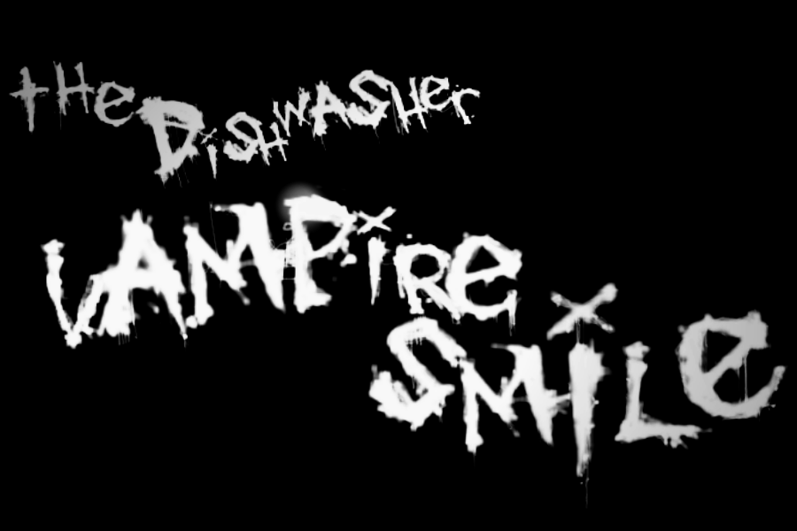
Review By: Skyler Basta

Slide 2
Basic Info
Developer: Ska Studios
Designer: James Silva
Artwork: Michelle Juett Silva
Genre: Side Scrolling Hack and Slash
Price: $9.99
Hardware: Xbox 360
151.70 MB Download

Slide 3
Style
Vampire Smile is an Xbox Live Arcade game that came out in 2011. It has a rather grim-dark style as well as moments of humor. The game was created entirely by a brother-sister team and is the sequel to another Dishwasher game, Dead Samurai.

Slide 4
Story
Vampire Smile takes place on the moon after the destruction of an AI controlled earth. Yuki and the Dishwasher are the main protagonists and siblings who have gained vampire powers seek vengeance on those responsible for what has happened to them and the planet. They must fight their way through swarms of enemies to finally battle with the Fallen Engineer. The story is dynamic and changes depending on which character you play as well as a different story for co-op.

Slide 5
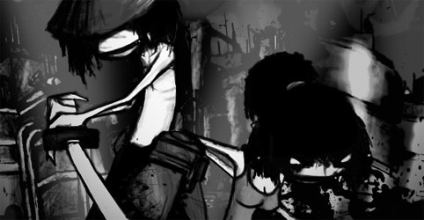
In the game the story mode the player takes control of either Yuki or the Dishwasher or both for co-op play. As you play you can explore to find collectibles, play a guitar hero-esque minigame for currency and battle through several different stages and bosses while upgrading stats and weapons.

Slide 6
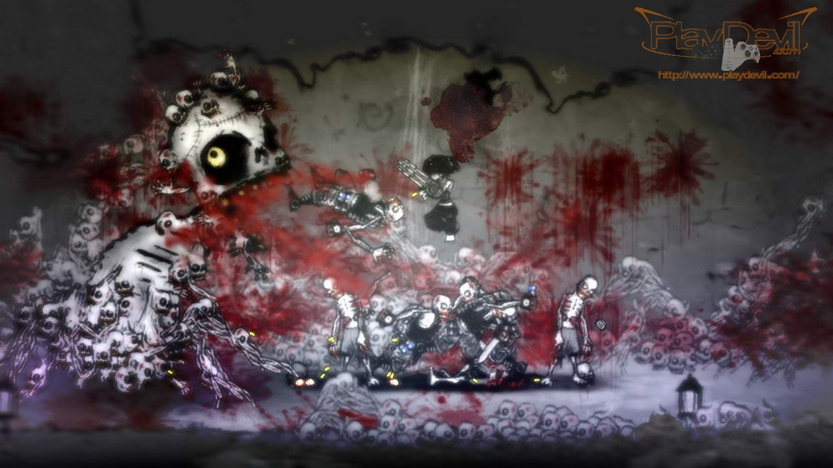
Gameplay
Vampire Smile has a very hectic combat style that often leads to furious button mashing as you attempt to fight through more and more challenging enemies especially on the hardest difficult. It does require skill though to know when to use an ability and what weapons are best for certain scenarios.

Slide 7
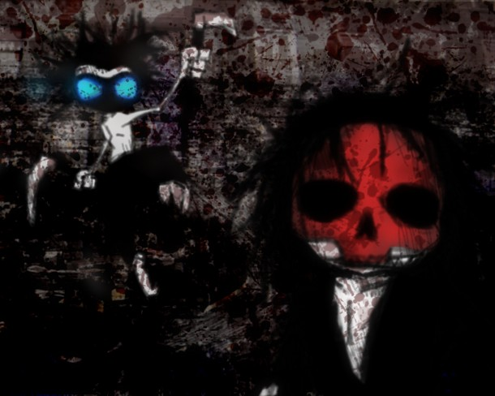
While the story mode does not have relevant scoring there is an arcade mode where you play as various characters with the same play-styles as the story characters and complete various challenges to achieve high scores.

Slide 8
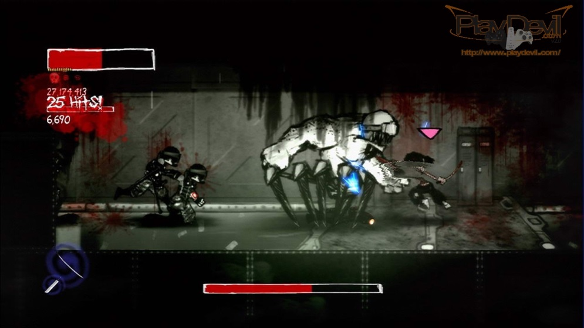
GUI
Health bar, skull count (for magic) and score in top left corner for player one and top right for player two.
Current weapon shown in bottom left for first player and right for second.
Boss health bar in the bottom middle.

Slide 9
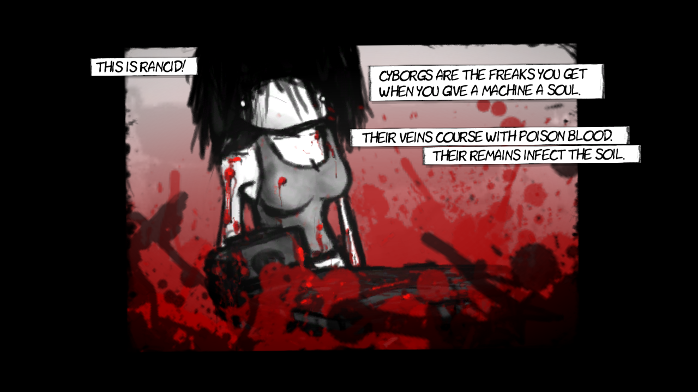
Artwork
All artwork was done by Michelle in a gritty hand drawn comic style. This style carries over into the “cutscenes” as well which are replaced with comic strips.

Slide 10
Music
The music of Vampire Smile was written and performed by James. It has a dark punk rock theme throughout and gives the players a chance to perform some songs through the rhythm mini-games hidden throughout the game.

Slide 11
Special Features
The game is capable of being played co-op over Xbox Live and like the first game has a unique co-op mechanic when more than two players are in the game. The third and fourth player take control of Yuki and the Dishwasher’s pets as a supportive twin stick shooter cat or raven. The game also supports a special difficulty called “Pretty Pretty Princess” that is unlocked by dying a certain amount of times.

Slide 12
Bugs
From personal experience the game had no bugs. On launch the only major bugs involved not being able to unlock certain achievements or not being able to connect to other players over Xbox Live. These issues have since been patched.

Slide 13
The Good
Addicting, hectic combat and interesting gameplay mechanics.
Great game to play with friends at a party.
Quick and entertaining storyline.
Cheap price for the quality.
Synergy between style, gameplay and music.
Replay value is high with new difficulties.

Slide 14
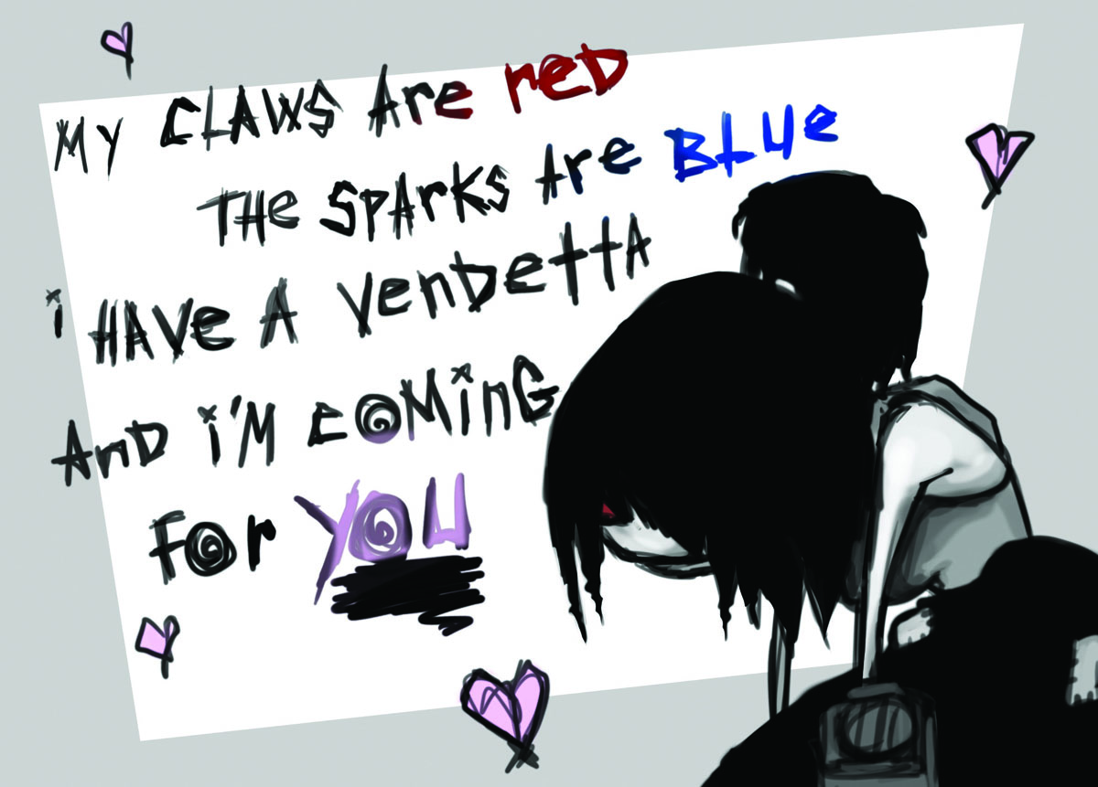
The Bad
Personally I can’t think of anything but some game reviewers believed the level design was repetitive and that the story wasn’t very in-depth or wasn’t interesting enough. Too much happening on screen making it difficult to track the player.

Slide 15
Comparisons
Vampire Smile is different from other side scrolling hack and slash games mostly in terms of artistic style. The art for the game is very unique as well as the high quality music adding to the overall enjoyment of the game. In my personal opinion the combat is more entertaining and fast paced than other games of the same genre. I believe Vampire Smile is one of the best games of its genre because of its overall quality.

Slide 16
Audience
Due to the amount of gore and violence present in the game I believe players should be 17 or older. The type of players would be those who enjoy fast paced action and grim-dark humor.
The biggest possible design flaw is repetition in level design though I believe there is a good level of variety present.

Slide 17
Summary
Strengths: Combat, distractions, soundtrack.
Weaknesses: Repetition, story.
Is the game worth purchasing?: Absolutely. The game has quite a large amount of content for $10, the combat is addictive and it is a blast to play with friends.
Improvements: Adding plat forming puzzles, vary the bosses a bit more, more playable characters.

Slide 18
Trailer
http://www.youtube.com/watch?v=AQWp5IXQCfg

