Slide 1
The Basics
Title: Guitar Hero III Legends of Rock
Company: Neversoft and Activision
Type: Music Rhythm
Price: (New) $59.99
Minimum Requirments: *Console and guitar controller
Actual Requirments: *Console and a normal controller
*Console consists of: Xbox 360, PS2, PS3, or Wii

Slide 2
Game Summary
Overview
In this game instead of using a traditional controller it is recommended you use a controller in the shape of the guitar in order to emulate playing the songs that are in the game.
Story Line
In the game you pick a character whom you start a band with and tour the country/world. You play different gigs trying to become the biggest band. But to be honest no one really cares about the story line of the game.

Slide 3
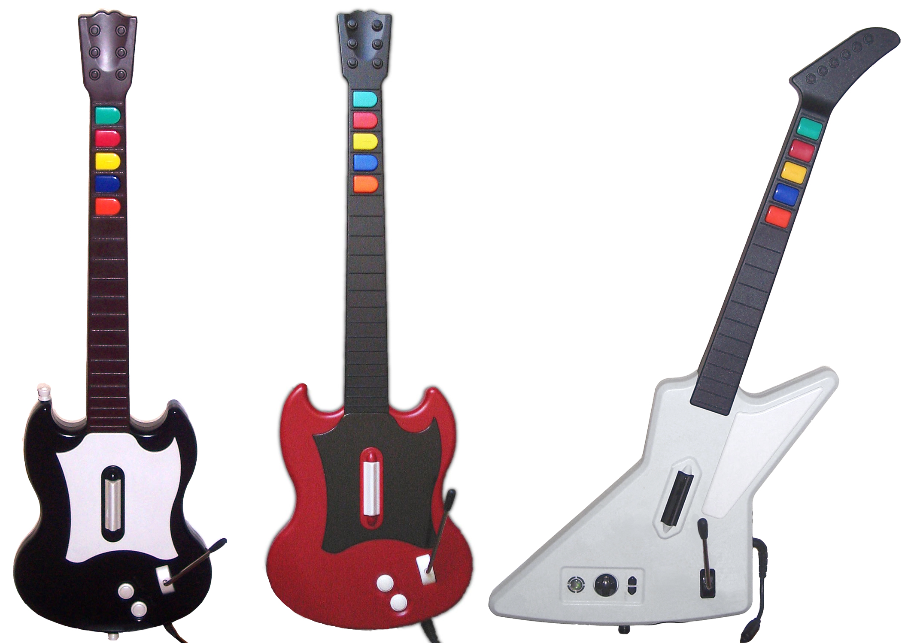
Game Summary (cont.)
Players Role/Gameplay
As the player you pick a song to play and then notes will scroll across the screen. As the notes scroll across the screen you strum the bar of the guitar while simultaneously pressing the note in sync as it passes a certain part of the screen.

Slide 4
Game Summary (cont.)
Scoring
Score is determined by hitting multiple notes in a row and by keeping your “rock meter” from failing (i.e. out of the red).
The game is scored by successively hitting multiple notes in a row (combo) and for every 10 hit you get a multiplier (x2, x4, x8) and (x4, x8, x16) with star power. The multiplier stays for as long as you hit successive notes, but once you miss it goes back to the original multiplier and you have to build up another streak.

Slide 5
Game Summary (cont.)
User Interface
There are four main parts to the user interface:
Strum Line: This is the spot that when the notes pass the player has to hold the note and strum the guitar.
Rock Meter: This is where you will build up your star power which will double your points for a limited time and boost your rock meter as well so you do not go into red.
Score Board: This shows you your score and inside of the score is our last item.
Score Multiplier: This will show you the total multiplier that you have at any current time.

Slide 6
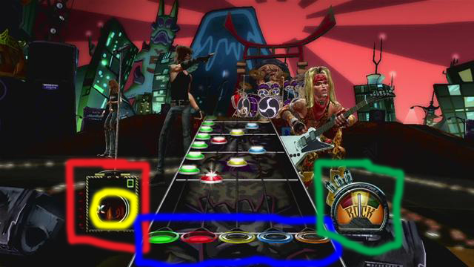
Game Summary (cont.)
User Interface (cont.):
http://www.youtube.com/watch?v=Nc-hn3Z_yiE
http://www.youtube.com/watch?v=4Sfg2RG0kTw

Slide 7
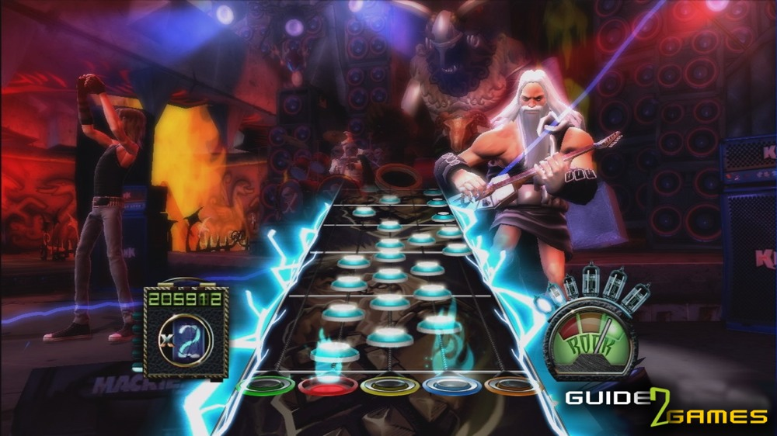
Game Summary (cont.)
User Interface (cont.):

Slide 8
Game Summary (cont.)
Special Features:
-Downloadable content
-Cheats
-Unlockables
Bugs:
- Calibration with sound and video on LCD, Plasma, or HD TV’s was an issue.
- The game would only output mono sound, not Pro Logic II or stereo for the Wii

Slide 9
Game Review
The Good:
Many difficulties for all skill levels
Downloadable content to continue challenging you
Coop play and competitive versus mode
The Bad:
Calibration with sound and video on LCD, Plasma, or HD TV’s was an issue.

Slide 10
Game Review (cont.)
Comparison:
Guitar Hero 3 was the best selling game in 2007 period so it was better than all other previous and future releases of the series.
Guitar Hero 3 was better than the others because it had the perfect hit box combination for the hammer-on’s and pull-off’s. In the previous versions it was too hard and in the later ones they dumbed it down.
Rockband was arguably better due to the more variety of instruments you could play and the larger set lists.

Slide 11
Game Review (cont.)
Design Mistakes:
One of the biggest is the scrolling background. I have a friend that is color blind and there are only 1 or two characters that have backgrounds that he can see.
Hardware in their guitar controllers to active star power is inaccurate and doesn’t always work with the motion sensor.

Slide 12
Overall Summary
Strengths:
Endless replay ability
Coop play
Good for all ages including difficulties
Good music
Weaknesses:
Guitars break on high skill levels
Sticky keys, broken whammy bars
It has caused wrist, shoulder, forearm, and tendon injuries.
Poor story line and limited songs to play, especially at high skill levels

Slide 13
Overall Summary (cont.)
Conclusion:
For endless hours of fun and frustration I would suggest purchasing this game, especially if you like a challenge. Just be careful not to play too much and injure yourself.
Improvements:
Better hardware
Color blind mode
More tracks provide a challenge at higher difficulties

