Slide 1
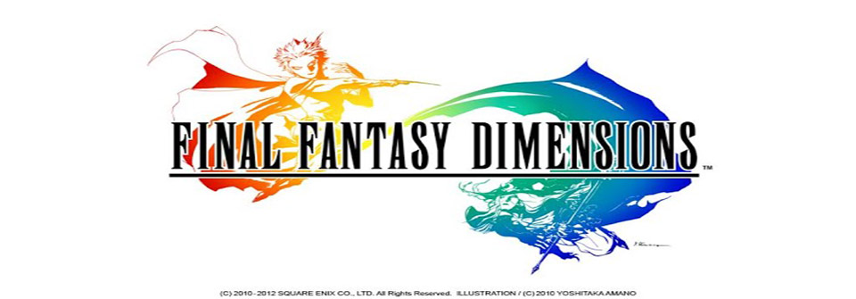

Slide 2
Basic Information
Seller: Square Enix Co., Ltd.
Version: 1.1.1
Size: 197 MB
Compatibility: iOS 4.0 or later. Compatible with iPhone 3GS, iPhone 4, iPhone 4s, iPhone 5, iPhone 5c, iPhone 5s, iPad, iPod Touch. This app is optimized for iPhone 5.

Slide 3
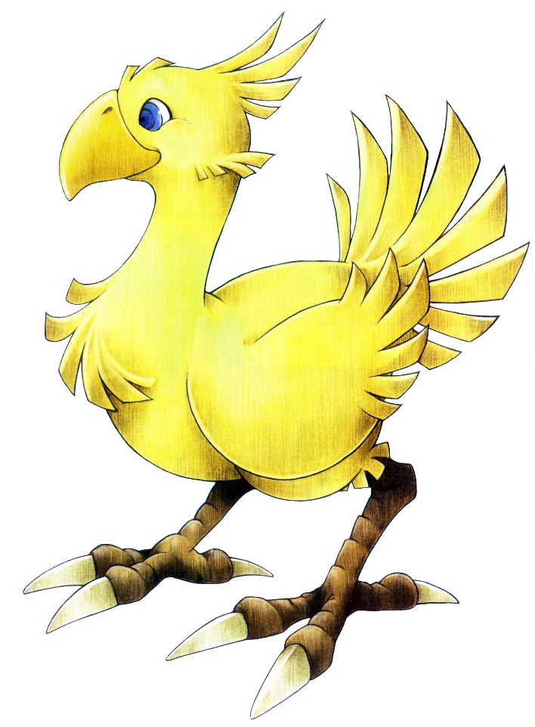
Is It Worth the Gil?
Initial download in the App Store is free, but to continue playing after the prologue you must purchase the rest of the games chapters.
Total Price for entire game: Roughly $30
Steep price for an Android/iOS download.

Slide 4
A Few Things About the Gameplay
Likes
Dislikes
Bosses and the customizable job system makes for a the game a challenging experience for new and old fans of the series.
30+ hours worth of gameplay for a mobile app makes the $30 price tag less painful.
Awesome soundtrack
Touchscreen controls difficult to use (for someone with large fingers…like myself)
Repetitive gameplay and story elements (for non Final Fantasy Fans)

Slide 5
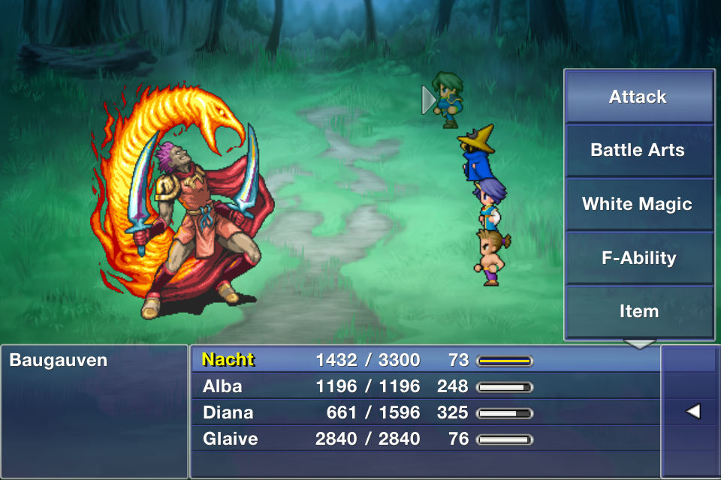
Gameplay Continued…
Traditional 8-bit retro style graphics much like Final Fantasy2, 3, and 4 give fans of the series a trip down memory lane.
Traditional Final Fantasy story. Warriors battling a evil empire to ultimately save the world from its grim fate.

Slide 6
Summary
Overall a very solid purchase
Games free prologue makes the game at least worth checking out (if you want more, buy it; if not, hey it was free)
Game would definitely run better on a iPad’s larger screen(i.e control issues)
Score: 8/10 Definitely a buy for fans.

