Slide 1
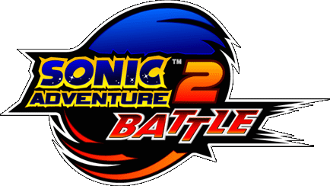
Game Evaluation By: Mario Konja

Slide 2
Basic Information
Company: SEGA
Author: Sonic Team
Type of game: Platformer
Price:$40-$50
Min Requirements: Nintendo Game Cube, 1 Game Cube Controller.
Recommended Requirements: All Min Requirements, and a Game Cube Memory Card.

Slide 3
Brief Overview
Accomplish different types of missions with certain characters.
2 sides to the story: Hero or Villain.
Types of missions include races/runaways, emerald hunting, and robot suit courses, and battles.

Slide 4
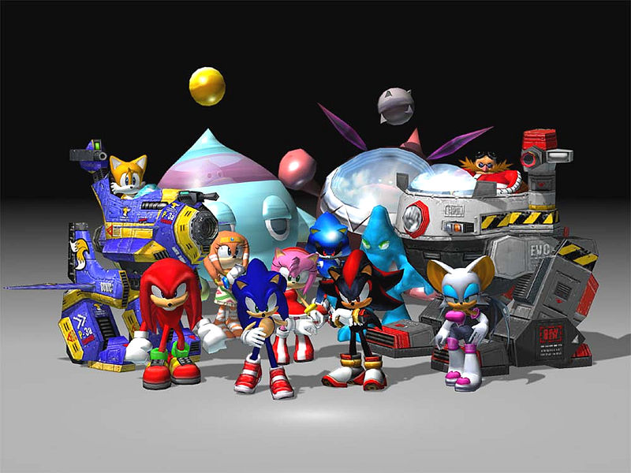

Slide 5
Story Line
Sonic Adventure 2 features the world-famous blue hedgehog in a hyper-fast adventure where players can either save the world or conquer it in an action-packed showdown between Hero and Dark characters! You play as Sonic, Tails, or Knuckles and attempt to save the world -- or play as Shadow, Dr. Robotnik, or Rouge and triumph over all who stand in your way. Mistaken for a villain and kidnapped by a military squad, Sonic must escape his captors and discover who is responsible for all his trouble. Jump into the action and check out Sonic's new moves as he grinds rails, swings from poles, and somersaults past the bad guys

Slide 6
Player’s Role
The players control the character for that level.
As you progress you learn of new characters and gain items that help in levels ahead (such as Sonic’s speed shoes)
Complete the mission at hand to move on to the next part of the story.

Slide 7
User Interface
The game is all in a third-person point of view.
Rings are used as life, as long as you have 1 ring you can survive 1 hit, but having 100 rings works the same, only 1 hit.
No blood.
Few buttons to press and remember.
Game is saved after every mission completed.

Slide 8
Gameplay
Not a very free roaming game.
You are stuck to a straight path how ever there are multiple routes to completing the missions.
Each character can move differently
EX: Knuckles and Rough and fly/glide the others cannot.
Defeating bad guys comes in a verity of ways:
Jump attacks, punching, summersaulting, and even shooting.

Slide 9
Scoring
A level is beaten when the main task is completed.
There is a grading system to how well you completed the task.
Things such as speed, enemies killed, and rings collected help improve the grade you earn.

Slide 10
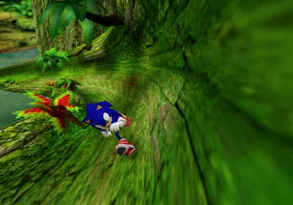
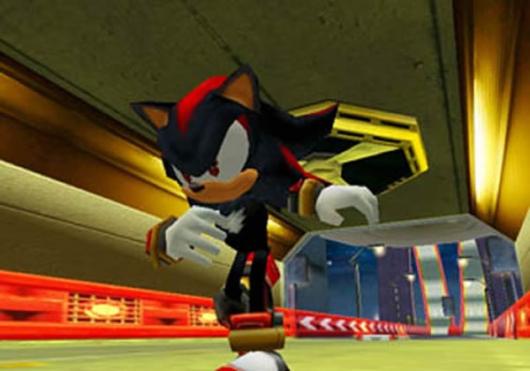
Artwork
For a game developed in 2001-2002 the artwork was fairly average, nothing flashy, but not bad to be noticeable.

Slide 11
Sound and Music
The sounds in the game have an arcade feel to them.
When robots die or shoot they make typical sounds of blowing up or laser shots.
The characters make noises too as you play, grunts when jumping and even talk when you are AFK or hit.
The background music fits each level, with intense levels playing high paced music and slower levels playing relaxed music.

Slide 12
Review

Slide 13
Pros & Cons
Pros:
Multiple routes to play the game, when both routes are completed, a final one is unlocked to finish the story. Fun story mode and easy to finish, not too short as well. Multiplayer for frineds.
Cons:
Not a free environment, strict path. If stuck cannot skip missions. Multiplayer may be fun, but very repetitive.

Slide 14
Similar Games
Other similar games are obviously the other sonic games, where you must reach point A to point B with out dying.
Another similar game is Super Mario. As Mario you walk across a 2 world to the finish while fighting enemies.

Slide 15
Audience
Anybody can play this game, but it was really targeted to kids in the ages of 10-14.
Children younger may have a hard time playing this game as it may be too difficult.
It did get an E rating but did have some disclaimers such as Mild Lyrics and Violence.

Slide 16
Mistakes
All bad guys are about the same difficulty, instead of having you fight harder guys as the game progresses they instead have you fight more of them at one time.
When emerald hunting the emeralds are sometimes too hidden, even with the help of hints.

Slide 17
Summary
Great game with many different ways of playing it. An option of 2 story lines plus a third when both have been completed is fun, showing you how they intertwine.
If you own a Gamecube and love your typical Sonic games I would advise buying it, but only for a very cheap price, There is more to do such as the chao garden and mini games in there.

Slide 18
Credits/Sources & Demo Vid
http://www.ign.com/games/sonic-adventure-2/gcn-16893
http://en.wikipedia.org/wiki/Sonic_Adventure_2
Demo: http://www.youtube.com/watch?v=1dE0KL_01OA

