Slide 1
Space Cadet Defender HD CIS 587 Game Evaluation – Ruth Johnson

Slide 2
Basic Information
Game Title: Space Cadet Defender HD
Company: SixHourSoft LLC
Type of Game: Arcade / Action Space Shooter
Price: Free with offers for In-App Purchases
Hardware Requirements: Requires iOS 4.3 or later. Compatible with iPhone, iPad, and iPod Touch. Optimized for iPhone 5. Recommended for Retina Display.

Slide 3
Game Summary - Story
Overview: Defend Earth from the Alien Horde
These are troubling times. Earth’s very existence is threatened. Alien invaders from space have been sent to destroy our planet. You have been called up to repel their attack. You must plan your battle strategy well and upgrade your fighter ship to defeat the increasingly advanced aliens. Beware, their powerful overlords are watching and will join the fight to help the alien forces destroy us. We’re counting on you. Earth is counting on you. Suit up Space Cadet!

Slide 4
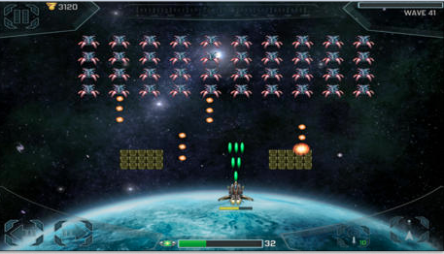
Player’s Role
The player is a space cadet and must destroy aliens to save Earth.

Slide 5
Installation
Apple App Store
Available for iPhone, iPad, and iPod Touch
Search for Space Cadet Defender HD
Click installation button labeled “Free”

Slide 6
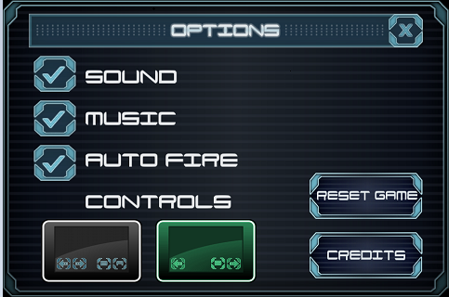
User Interface
Two options for user controls
Choose auto fire then both options are available
Choose user controlled firing then one control interface available

Slide 7
Game Play
Destroy aliens on each level (100+ levels)
Boss levels with Alien Overlords
Killing some aliens will cause medals to float down
Collect medals (or buy)
Use medals to purchase ship upgrades
Upgrades
Weapons – speed, power, multi shot
Defenses – shield strength, ship speed
Energy – regeneration, level
Special (Unlocked at various levels)
Seeking missle
Scatter gun
Destroyer

Slide 8
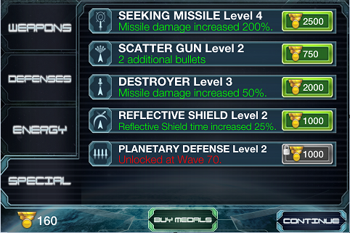
Upgrades

Slide 9
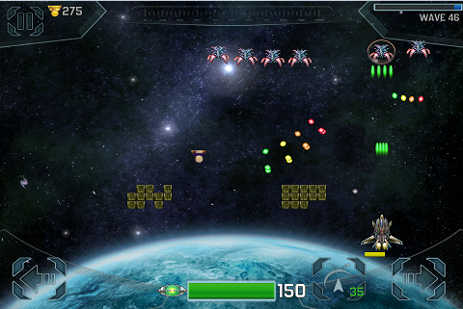
Scoring
Collect medals
Bronze 5 pts, Silver 10 pts, Gold 20 pts

Slide 10
Artwork
Nice graphics: HD, background, aliens, and space cadet

Slide 11
Sound and Music
Electronic music
Sounds for:
Shooting
Aliens dying
Space Cadet dying
Special weapon

Slide 12
Special Features
Upgrade system

Slide 13
Manual and Bugs
No manual
YouTube Demo
http://www.youtube.com/watch?v=6PUSrP9qhtU
Versions
First version 1.0
Currently on version 1.5
Bugs
Haven’t found any so far.

Slide 14
Game Review – Good (Fun)
Familiar space shooter type game
Blast Aliens
Auto fire removes the boredom of button mashing
Boss Levels
Buying Upgrades – different combinations
Can purchase more medals with $$
Earn bonus medals upon level completion
Nice music
Easy on the eyes
Addictive – High replay value
Quick games – you can play this anywhere

Slide 15
Game Review – Bad (not fun)
Cannot replay previous levels
Collecting needed medals can sometimes take a while
Killing bosses can be too difficult
Lose all medals when game is reset

Slide 16
Comparisons
Better than most games in genre
More options for user controls than most
Bullet speed is faster
Shoot more bullets on screen
Music is more complex
Artwork is high quality
Worse than games in genre
Cannot go back and play previous levels

Slide 17
Game Audience
Nearly any age (6+)
People with short attention spans
People wanting:
A quick game
Something to do while waiting in line
Kill lots of enemies fast
A game to play many times

Slide 18
Design Mistakes
Cannot replay previous levels
Lose items bought with real money if game is reset

Slide 19
Summary
Strengths
Easy to pick up and start playing
Fast fun
Great time killer
Free
Weaknesses
Cannot play previous levels
Some levels can take time to get past

Slide 20
Summary - continued
Worth purchasing medals?
Yes, if you want to upgrade faster
No, if you want to reset the game ever
Game improvement ideas:
Create a paid version
Allow users to play previous levels
Add more levels

