Slide 1
Matt Gildner
CIS 487 Game Review
9/20/2013

Slide 2
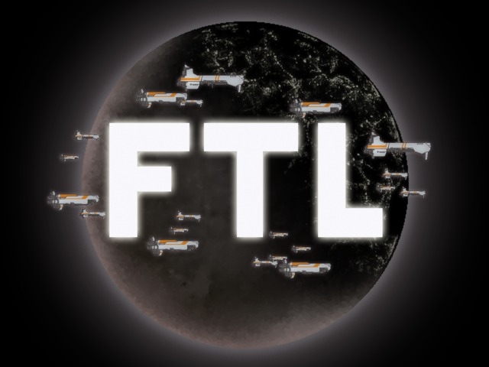

Slide 3
Basic Information
Game title:
FTL: Faster Than Light
Developer: Subset Games
Type of game:
Price: $9.99 for PC
Minimum System Requirements:
OS: Windows® XP / Vista / 7 or Mac OS X 10.5.8 or above
Linux (x86 or x86_64)
Processor: 2GHz
Memory: 1 GB RAM
Hard Disk Space: 175 MB or more
Video: OpenGL 2.0, minimum resolution of 1280×720

Slide 4
Quick Overview
You are the captain of a ship and must flee from a rebel fleet while managing your crew and ship systems.
High quality graphics and an excellent soundtrack.
Systems are easy to manage
You will die

Slide 5
Storyline & Players Role
The Player is the captain of a ship of their choosing
Must deliver critical information to allied fleet several sectors away while being pursued by a rebel fleet
Each sector is filled with many planetary systems and events that are procedurally generated.

Slide 6
Purchase/Install
Purchase from ftlgame.com or Steam store
Normal installation procedures
168.5 MB on disk

Slide 7
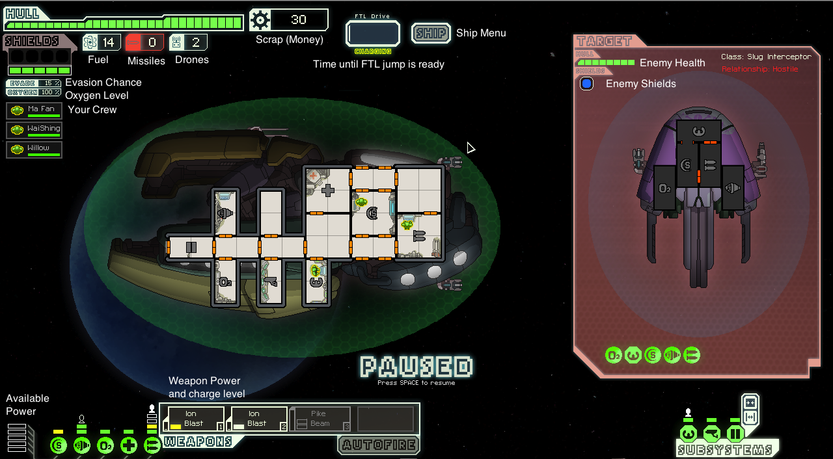
User Interface

Slide 8
Gameplay
9 Ship types each with 2 variants
Kestrel: Basic ship you start with
Engi Cruiser: Designed for use with ion weapons and drones
Rock Cruiser: Uses brute force and resilience to overpower enemies
Stealth Cruiser: Uses speed and cloaking to avoid enemy fire
Federation Cruiser: Advanced version of Kestrel, features upgraded weapons and diverse crew
Zoltan Cruiser: Unique shields prevent enemies from boarding and missiles from getting direct hits
Mantis Cruiser: Combines conventional weapons with boarding parties to overwhelm enemies
Slug Cruiser: Designed to cripple enemy systems, hull breaches self-repair
Crystal Cruiser: Unique crew and shield piercing weapons, deals massive damage from conventional weapons or boarding

Slide 9
Gameplay
Combat
Defeat enemy ship before you take too much damage, some enemies may try to surrender
Micromanage crew to boost main systems, repair system damage, close hull breaches, and put out fires
Kill crew to loot ship or destroy them to salvage from their wreckage.

Slide 10
Gameplay
Quests provide opportunities to make scrap, repair damage, get new items, and even unlock new ships. Some quests are traps!
Must travel from beacon to beacon in each sector to get to the exit and progress to the next sector. You choose which sector you want to go to next.

Slide 11
Scoring
The formula for the score is: Score = (s+10*b+20*d)*D
s = Scrap collected (scrap gained by selling does not count)
b = beacons visited
d = Ships defeated by eliminating the crew or destroying the ship
D = difficulty modifier, 1 on easy and 1.25 on normal

Slide 12
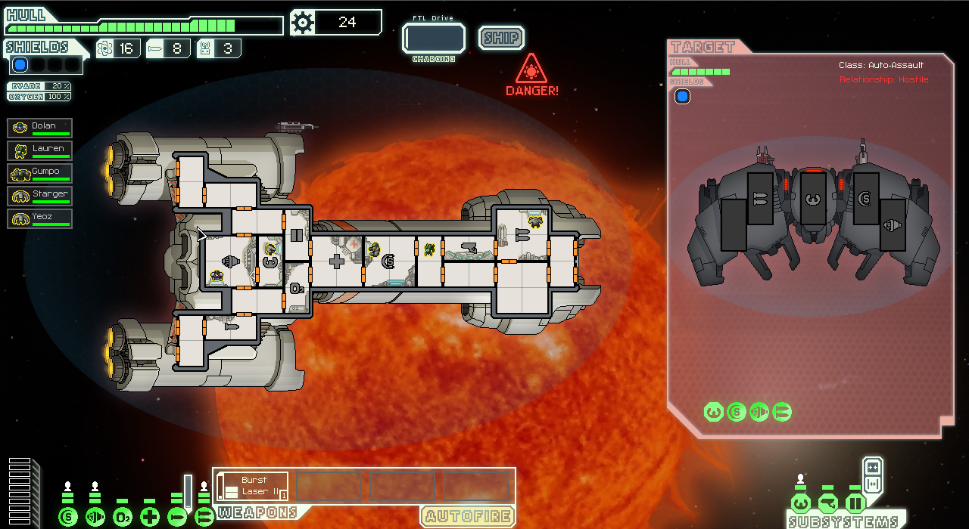
Artwork
Stylized 2D art gives FTL a very different feel from most space games

Slide 13
Music
Composer: Ben Prunty
Combines scifi motifs such as synth bells and adventure themes
Tracks create a variety of emotions from eerie tension to excitement
Different tracks for each sector and for different situations

Slide 14
Game Review
What’s good?
Combat is straight forward with many potential strategies
Both simple and advanced strategies are feasible
Difficult, but not frustrating
Random maps, high difficulty, and challenging achievements provide high replayability
Permadeath makes every battle count

Slide 15
Game Review
What’s bad?
Simple story provides setup for game, but not much else
Random aspect means some games relentlessly punish you until failure
Some ships can only be unlocked when a series of random events proc in a specific order
Combat encounters lack variety

Slide 16
How does it stack up to other roguelike games?
One of the highest rated roguelikes in recent history. (84 on metacritic)
Similar games include Rogue Legacy (85) and The Binding of Isaac (84)
Other roguelikes have a long or continuing stories, FTL has a short story built on being replayed
Combat is focused on strategy instead of skill
Squad based instead of hero based

Slide 17
Appropriate Audience
People who enjoy strategy or roguelike games will enjoy FTL
Due to the violence and high difficulty, I would not recommend this game for anyone under the age of 13.

Slide 18
Overall
Strengths
Difficult, but not frustrating
Good strategy is rewarded
Makes you feel like the captain of a starship
Weaknesses
Enemy encounters can be repetitive
Randomness can create impossible scenarios

Slide 19
How can it be improved?
Additional campaigns with new enemies, weapons, random encounters, and environmental hazards reduce the repetitiveness and force players to adopt new strategies

Slide 20
Is it worth the purchase?
Yes
For $10 this game is a must have. Challenging combat and high replayability means you can easily lose 30 – 40 hours or more in FTL without realizing it.

Slide 21
