Slide 1
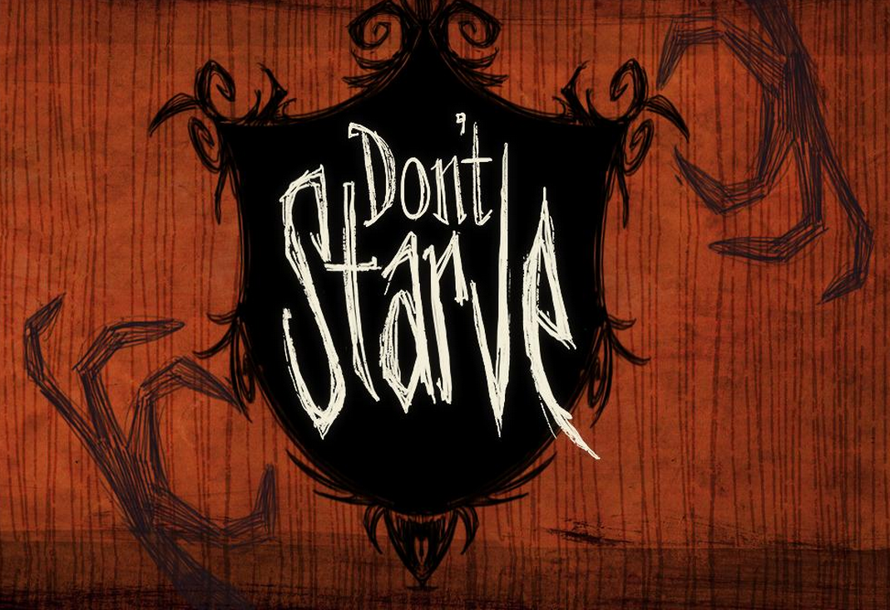
Game Review
By: Garrett Boren

Slide 2
Basic Information
Name: Don’t Starve
Developer: Klei Entertainment
Released: April 23, 2013
Price: $14.99
Genre: Open World
Survival-Adventure
Distribution: Steam
POV: Isometric
Minimum System Requirements:
OS: Windows XP/OSX 10.7/Unbutu 12.10
CPU: 1.7 GHz
Memory: 1gb
Graphics: Radeon HD5450 or dedicated 256 MB
DirectX®: 9.0c
Hard Drive: 500 MB HD space
Sound: DirectX 9.0c
Installation:
Purchase on Steam, accept the EULA and then install

Slide 3
Summary
In order to begin playing, the player must select his/her character and if they wish they may customize the generation of the world. After the world is generated, the player is free to do as they please in order to survive. When the player eventually meets their ultimate demise (be that by the denizens of the world or by starvation) they are awarded experience based upon how well they did in that particular save, which goes towards unlocking new characters to play with and the cycle continues.

Slide 4
Story Line
Don’t Starve is primarily an exploration based adventure game so it has little real guiding story, the player wakes up on an (relatively) uninhabited island and is left to his or her own devices in order to fulfill the title of the game and not starve. Through exploration and the so called Adventure Mode, the player can discover some of the backstory as to why he/she is on the island and who is orchestrating their fate.

Slide 5
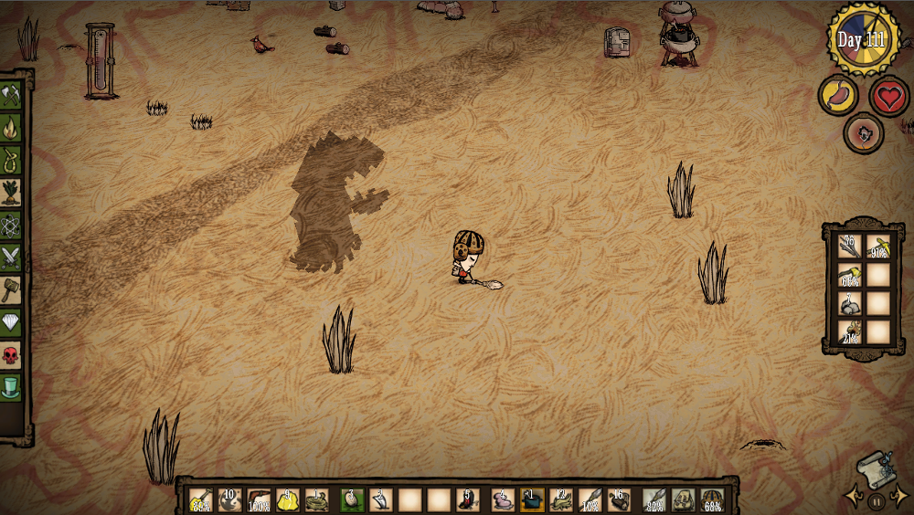
User Interface
Time and Day Counter
WASD to move
Spacebar to interact
Health Hunger and Sanity
Crafting Menu
Backpack contents
Tool Armor/Backpack Headwear
Inventory contents

Slide 6
Characters
In Don’t Starve there are 9 playable characters, most of which are unlocked just by simply playing the game. They are as follows.
Wilson- The first character that the player will experience, Wilson is the most well rounded character. He simply grows a beard which keeps him warm.
Willow- The first character unlocked by the player with experience. Willow is the resident pyro of all the characters, she has a lighter that never runs out and is immune to damage by fire.
Wolfgang- Taking the form of the stereotypical circus strongman, Wolfgang has the biggest stomach and hits the hardest of all the characters, he is the tank character in Don’t Starve and this is balanced out by the fact that he is afraid of the dark and also consumes more food.

Slide 7
Characters(cont)
Wendy- Wendy is the weakest physically of all the characters, her attacks with weapons are the weakest, but she makes up for this by being able so summon her dead sister in the form of a ghost to fight for her.
WX-78- A bipedal robot who hates humanity, WX is one of the more unique characters in Don’t Starve. Being electronic, the rain actually hurts him and he can be supercharged by a lightning bolt, making him faster. He can also consume gears to gain more health and increase the size of his stomach.
Wickerbottom- A stereotypical old librarian lady, Wicker is more suited to prototyping items and therefor has a bonus in researching. She can also craft books to do various things to help her.
Woodie- He is a lumberjack… with a unbreakable talking axe and he like to chop wood. But beware, he is cursed and you shouldn’t indulge him too much or else.

Slide 8
Characters(cont)
Wes- He’s a mime, he cannot talk, also he is very weak, he likes to avoid combat. On the bright side he has unlimited balloons to blow up for him to enjoy. Basically he is the hard mode for Don’t Starve.
Maxwell- I won’t go into much detail about Maxwell, only that he is technically the villain of Don’t Starve, but playing as him definitely has it perks.

Slide 9
Gameplay
The primary goal of the player is to collect enough food each day in order to survive and then to avoid the darkness of night because in the darkness lurks a monster that will kill you. This can be done in a multitude of ways, at the beginning the play will probably be picking carrots out of the ground and picking berry bushes, from there they can then collect some flint, make an axe and chop some trees to get a fire going. As the player progresses however, more and more tools become available to them, so they can do things like hunt rabbits or buffalo like creatures called beefalo, or they could use the manure produced by the beefalo to fertilize farms in order to grow food. Since the game is very open ended, it is really up to the play what they want to do, some people settle down in one area and build up a base, whereas others choose to be more nomadic and explore what the world has to offer, both above ground and down in the caves, a completely separate level tied to the world that is in perpetual darkness.

Slide 10
Sound and Music
The sounds for all of the creatures and actions the play can preform in the world are excellent. They really drive the atmosphere of loneliness that the game projects onto the player, even the players lack a real voice, as all their dialogue lines are accompanied by a unique instrument rather than some kind of voice actor. So there is no actual heard dialogue in Don’t Starve, its all text based with sound effects to bolster the environment.
The music of the game gives off a steampunk kind of sound and it really lends to the fantasy magic and technology theme that the game has running through it. The music incorporates a lot of brass and percussion instruments which help to give it a somewhat sinister sound to it, further lending to the survival feel of the game.
http://www.youtube.com/watch?v=1BdztHsnxiw

Slide 11
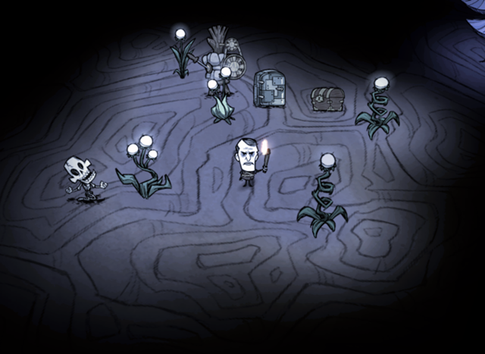
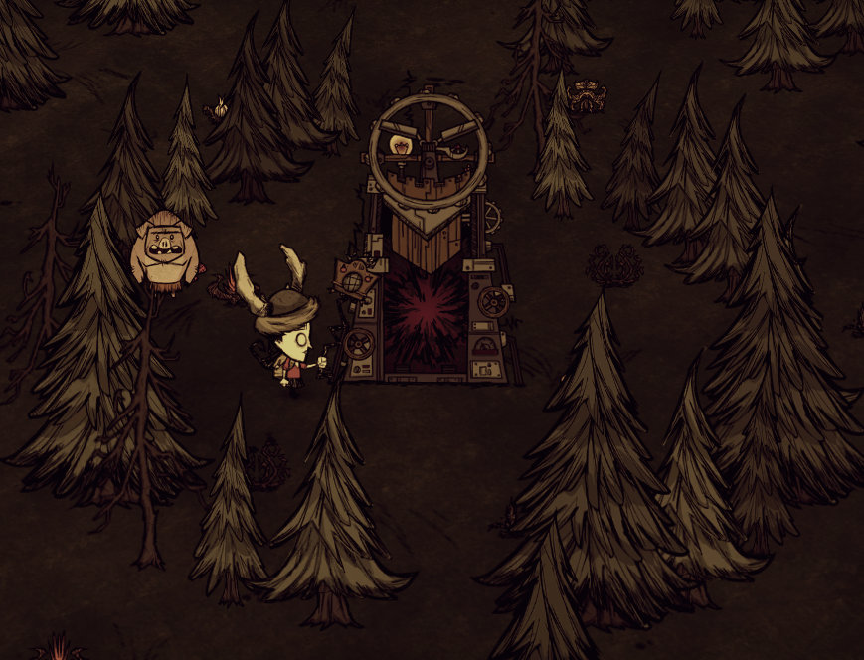
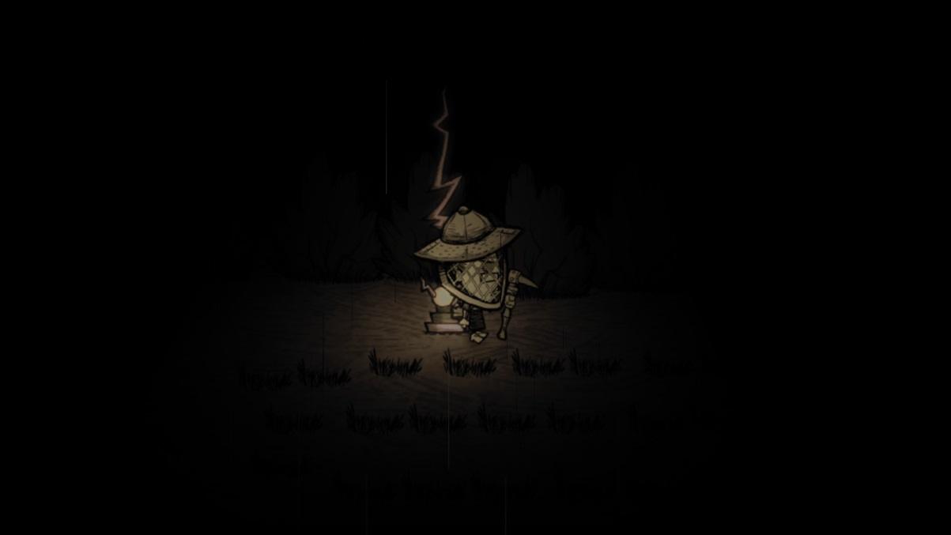
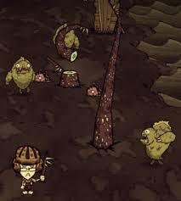
Artwork
The Artwork styling of Don’t Starve is very animated feeling. Its dark and roughly drawn outlines and primarily cool color scheme really brings the player into the survival aspect and it also server as a backdrop to the steampunk fantasy feel of the world which is very fitting. The other really atmospheric thing Klei did was the fact that the game is seen from an isometric point of view using completely flat set pieces serves to create a game environment that is unlike any other. The way the player characters are drawn as compared to the other NPCs in the world really seal in the fact that the player does not belong in this world because they look nothing like its natural inhabitants.

Slide 12
Bugs and other Oddities
There aren’t many bug in Don’t Starve as it is still in development and Klei has kept on top of any bugs that have come up. The downside to that is the fact that some content is unfinished and feels slightly unpolished. An example of this is the caves, currently as Klei is still finishing up the balance within the caves if the player dies there they don’t die forever, they are just put at the entrance of the cave and only lose the stuff they had on them. As Don’t Starve uses the threat of imminent death as a tension builder this completely throws that out the window. Also since they are still in development, the player can loot the caves and then use a option to regenerate the caves and get a whole bunch more loot, and since the scarcity of resources is what drives the player it can be very exploitive.

Slide 13
Review
Pros:
-Very engaging and seamless environment.
-Fun to play
-Very easy to pick up, does not take a lot of skill to play
-For a game with as much content, its pretty cheap
Cons:
-Without a defined story some people tend to get lost and bored
-The art and music style isn’t for everyone
-There are some immersion breaks with unfinished features
-Can be time consuming
-There is no in game instructions, the player is left to figure out almost everything

Slide 14
Target Audience
Don’t Starve has not been formally rated for a target audience, but as there is some violence, albeit completely gore-less, this game is best suited to teenagers and older. Also the inbuilt difficulty would make it a game unsuited for someone too young because they would not really be able to experience the game. I think that for the audience it is intended for, Don’t Starve is a wonderful game.

Slide 15
Is it worth it?
Most certainly, the shear amount of time a person could invest in a game like Don’t Starve is enormous, that coupled with the fact that it is only $15 makes it an excellent game as far as enjoyment vs cost goes. This is fortunately the kind of game that can be play both very frequently and quite casually, picking it up and putting it down are both very easy, that is if you can convince yourself to stop actually playing.

