Slide 1
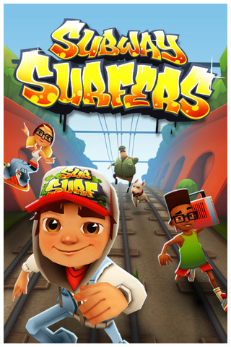
Subway Surfers Game Review

Slide 2
Basic Information
Company Name: Kiloo Games and Sybo Games
Type of Game: Action (Endless Runner)
Price: Free
Release Date: May 24th, 2012
Size: 36.0 MB
Rating: 9+
Requirements: Compatible with iPhone 3GS, iPhone 4, iPhone 4S, iPhone 5, iPod touch (3rd generation), iPod touch (4th generation), iPod touch (5th generation) and iPad. Requires iOS 4.3 or later. It’s also available on mobile devices with android 2.2 and up.

Slide 3
Story Line
The game features endless chases that includes the player, who is caught painting trains and must run away from the police or inspector.

Slide 4
User Interface
Controls are easy and responsive.
Swipe finger left to move to left lane, and swipe right to move to right lane.
Swipe finger up to jump and down to tuck and roll.

Slide 5
Gameplay
The player has to run along a set of subway tracks and is always moving forward.
The player collects coins and other power-ups on his/her path while avoiding series of obstacles.

Slide 6
Gameplay
Obstacles includes trains, tunnels, light posts, and more.
The game end if the player crashes into any obstacle.

Slide 7
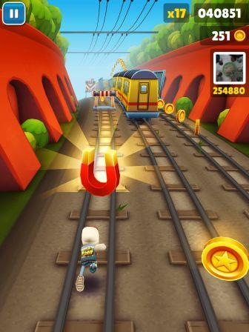
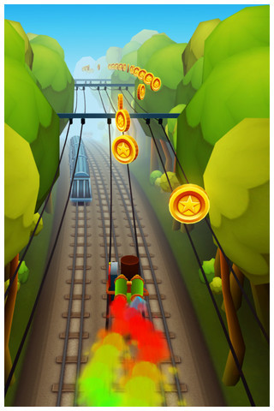
Gameplay (cont.)
Power-ups add variety of formula that improves your score.
Two power-ups that contribute greatly to collecting coins are Jetpack and coin magnet.

Slide 8
Gameplay (cont.)
With coins you collect, several items can be upgraded to help the score and prolong the game.
Hover-board is one of the items that can be purchased with coins, which gives the player one more chance per one hover-board.

Slide 9
Positives
Subway surfers seems to cover wide range of audience.
Audio of the game is fun to listen and add to the overall experience of the game.
Although the graphics are repeated in advance levels of the game, the game environments are colorful and bright and animation are also fluid.
The game is easy to use, entertaining, and addictive.
There several characters to choose from.

Slide 10
Negatives
You can’t customize controls which forces you to use 2 hands for the most part.
There are no defined levels. So, you can’t save progress. As a result, beginning of the game becomes always slow and redundant for advance users.
As you advance in the game, the only thing that changes is pace of the game. But, the graphics don’t change from what is seen in early stages of the game.

Slide 11
In-Comparison
Subway surfers can be compared to Temple Run Game.
Temple Run seem to be provide better overall atmosphere than Subway surfers. The scenes changes as you advance in Temple Run as compared to Subway surfers.
Subway surfers is better with the use of the power ups to maximize overall fun experience.
Temple Run has sharp turns which gives the player disadvantage to make advance decisions. On the other and, Subway Surfers gives the player far view all the time with enough time to make advance decisions.

Slide 12
Summary
Subway Surfers game is free and is definitely worth trying.
The game is designed to be fun for wide range of users. Adults can certainly enjoy Subway Surfers game
Improvements:
Levels can be added to allow progress to be saved.
Add different scenes than the repetitive subway scenes.
The game crashes rarely, but this is something that can be improved too.

