Slide 1
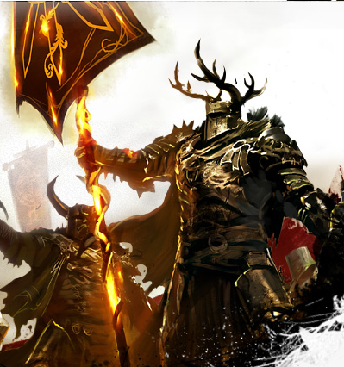
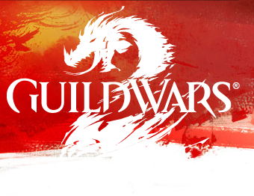
Game Evaluation – Guild Wars 2
Eric Sidwell
CIS 487

Slide 2

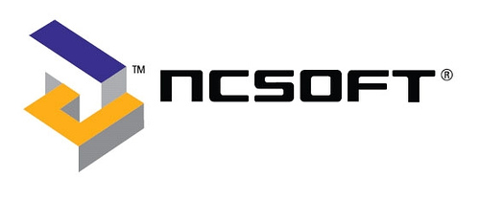

Basic Game Information
Game title: Guild Wars 2
Company: NCSOFT
Author: ARENANET
Type of game: MMORPG
Price: $59.99

Slide 3
Minimum Hardware Requirements
Minimum Windows stated hardware requirements:
  Windows® XP Service Pack 2 or better
  Intel® Core™ 2 Duo 2.0 GHz, Core i3, AMD Athlon™ 64 X2 or better
  2 GB RAM
  NVIDIA® GeForce® 7800, ATI Radeon™ X1800, Intel HD 3000 or better (256MB of video RAM and shader model 3.0 or better)
  25 GB available HDD space
  Broadband Internet connection
  Keyboard and mouse
Minimum Mac Beta stated hardware requirements:
  Mac OS®X 10.7.X or later
  Intel® Core™ 2 Duo 2.0 GHz, Core i3, AMD Athlon™ 64 X2 or better
  4 GB RAM or better
  NVIDIA® GeForce® 320m, ATI Radeon™ HD 6630M,
  Intel HD 3000 or better
  25 GB available HDD space
  Broadband Internet connection
  Keyboard and mouse/equivalent

Slide 4
Actual Hardware Requirements
My System:
  Windows® 7 Professional 64-bit Service Pack 1
  Intel® Core™ i7-2600K @ 3.4 GHz
  8 GB RAM
  NVIDIA® GeForce® GTX 580
  Stored on a 120 GB SSD
  Broadband Internet connection
With this system I am able to run the game a max settings with slow down only from internet latency

Slide 5
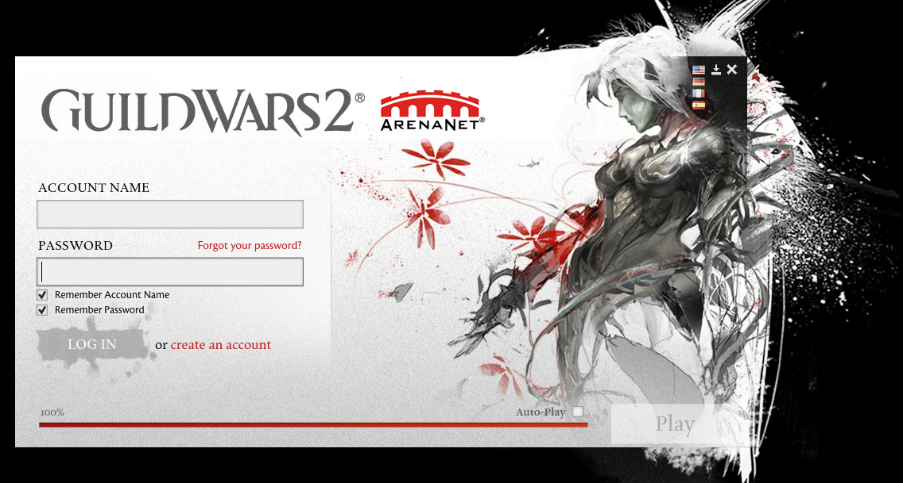
Installation
Installation of the game is very simple using digital download
After purchasing the game, and applying your game code to your new account, you are directed to a site for a small download
After downloading the 21.7MB file you open it and the downloader/launcher appears
The game will automatically install itself at this point and all you have to do is wait
Unfortunately the game is 25GB in size so this is not a fast download by and means.

Slide 6
Overview
Guild Wars 2 is a Massive Multiplayer Online Role Playing Game set in the fantasy world of Tyria.
The game consists of 5 races, 8 classes (professions), 8 crafting disciplines and 80 levels of character advancement.
The game boasts of an “Ever-Changing World” in the form of dynamic events.
Action-Oriented combat that is fast-paced and allows for both interaction with the environment and other players.
A personal story for your character that you get to decide
Competitive play for new players and hardcore alike with Player versus Player as well as World versus World matches.

Slide 7
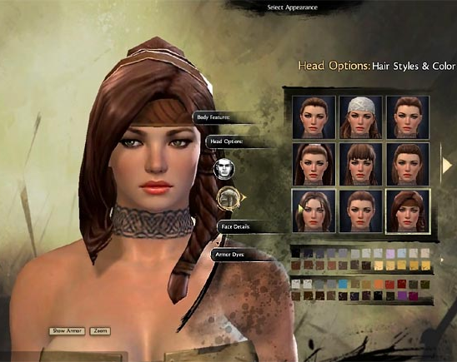
Character Creation
Like many MMORPGs these days, character creation is a bit of a lengthy process in Guild Wars 2, a 10 step process.
You start with selecting your race then gender, and lastly class.
After completing those preliminaries you move to the details of your avatar’s looks which has a wide range of choices.

Slide 8
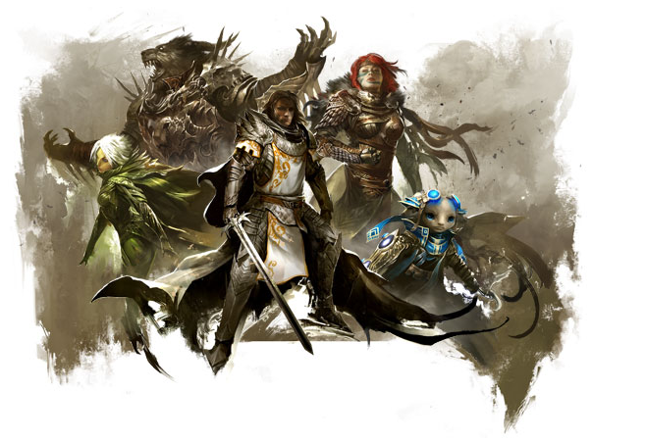
The Races
The five races (from left to right) :
  Sylvari
  Charr
  Human
  Norn
  Asura

Slide 9
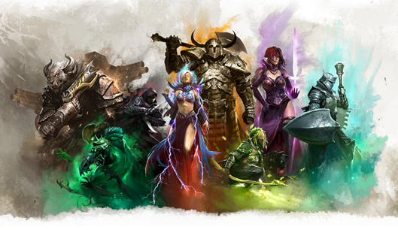
The Classes
The eight classes (from left to right):
  Engineer
  Necromancer
  Thief
  Elementalist
  Warrior
  Ranger
  Mesmer
  Guardian

Slide 10
The Story
The choices that you make during character creation seem to have some effect on the start of your story.
No matter what you start your character as, you will be the Hero. It is important to note that you are not the only Hero that exists, but instead one of greater skill than most.
Each Player has their own story and choices that can be made to direct their story. For instance, there is a point early on in each players story that allows them to direct how they accomplish a primary goal. Either way you complete the goal but in different ways.
  Do the choices really matter?
  Does this actually add to the game?

Slide 11
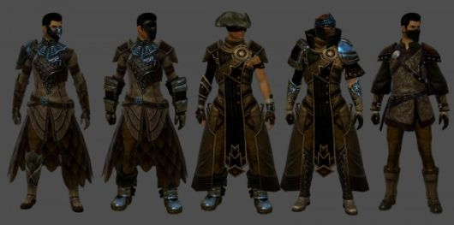
The Beginning
Each starting area begins with an introduction to your character’s race and a cut scene that meshes together all your choices from character creation.
No matter what you choose, the game starts you in a dire situation that leads you to a battle with a large boss
The game is intended to be played solo or multiplayer and as such enemies scale to accommodate the number of players involved

Slide 12
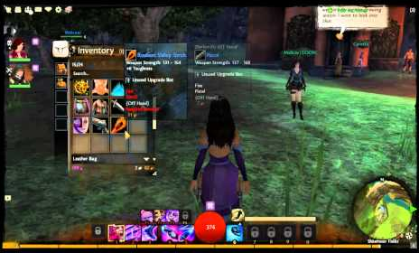
User Interface
The user interface in Guild Wars 2 is simple and effective
It has a feel that is very similar to most MMORPGs today and is not particularly remarkable

Slide 13
Game Play & Scoring
As promised the game is definitely engaging
In comparison to other MMORPGs, the game does an excellent job of not making you grind away at gaining levels. In fact it is almost forbidden!
As for scoring, this game doesn’t have any form of traditional scoring system
The closet the game comes to scoring is the level of your character

Slide 14
Artwork
NCSOFT and ARENANET went to great lengths in the creation of this game to pay very close attention to the way the artwork is done
They have intentionally attempted to blur the line between hyper realistic graphics and cartoonish graphics
They accomplish this by giving everything a painted feel as if you are viewing an extremely detailed oil painting
This is an excellent choice as it reduces the players expectations of the game being extremely real and lessens the “kiddie” factor of being to cartoon like
This in turn prevents the usual gripes that come with it not being perfectly detailed or childish

Slide 15
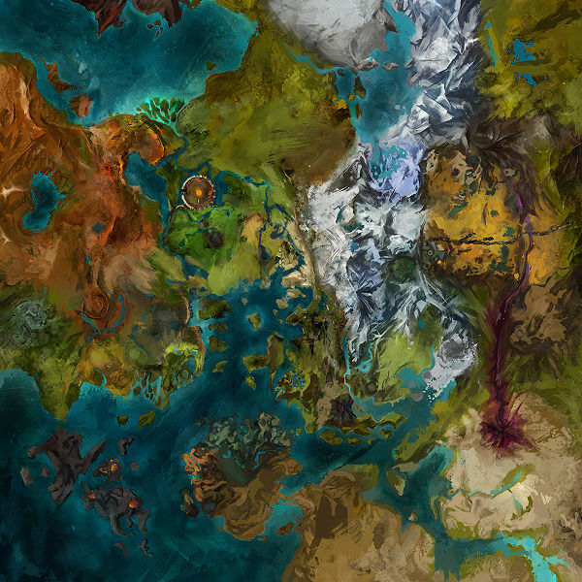

Slide 16
Sound and Music
I have played the game to level 20, and I can tell you that the sounds are adequate
I don’t find myself engrossed in a particular area because I’m enthralled by the sounds or the music
On the other hand, I can’t say I have come across any sounds that are particularly jarring either that otherwise repulse me
Overall, I think the sounds and music are just a addition to the game and seem to be of little note in the games overall experience

Slide 17
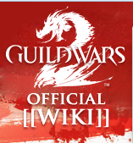
Game Manual
Since I purchased the digital copy, there is no game manual
However, the game does have a Wiki page that explains in great detail almost every aspect of the game a player could need
On top of this resource, the game does a excellent job of keeping you informed throughout the beginning tutorials and I suspect that even a novice computer user would be able to pick this game up with little to no issues

Slide 18
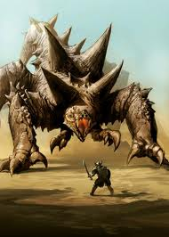
Bugs
So far, I have not run into any bugs
There was an incident within the first week of release that several players exploited and as such was resolved with a hot patch and the players removed from the game
EULA is very specific about not taking advantage of the game and players lost their rights to play for 6 months

Slide 19
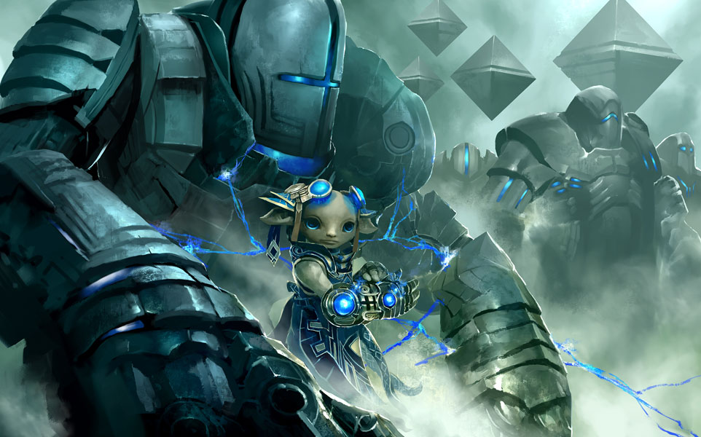
Game Review – The Good
I am really enjoying myself
The game has no down time in between things to do, there is always something to go do
Exploration is encouraged and rewarded which creates a nice break from adventuring
You don’t have to go out of your way to travel anywhere
You don’t have to go to town all the time
There is no push to gain levels to get to the top a fast as possible to start the “end game”

Slide 20
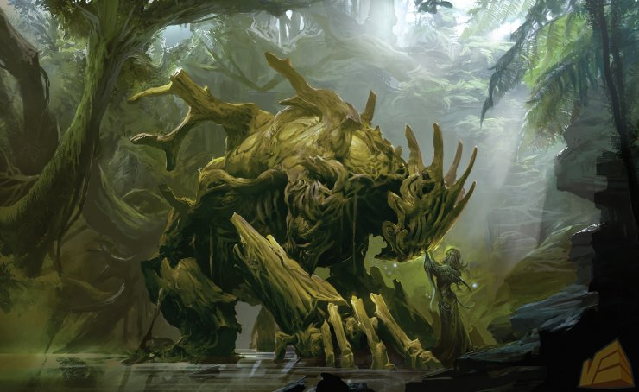
Game Review – The Bad
Due to there being no push to gain levels the game seems less directed than other MMORPGs which feels a little strange
Character leveling is not as rewarding as it is not tied very closely to commonly use skills
The game has a lot to take in right from the beginning that could detract some players from really getting into it
Too many choices

Slide 21
How does it compare?
Ever since World of Warcraft became the largest MMORPG in the world, MMORPGs having been using a lot of its design philosophies.
Guild Wars 2 in similar in control and the user interface, however that is really its only similarities
Combat is faster and more engaging do to the interactive nature of the battle system
Character building uses for simple stats that break into multiple sub-stats that define the character
Characters don’t buy skills, instead you learn them through level gaining or combat
So despite the similarities, that arguably could be attributed to most MMORPGs these days, the game is definitely unique in its own right

Slide 22
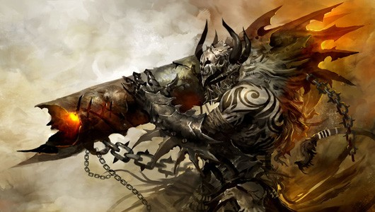
Better or Worse?
Having played to level 20 of 80 I have only scratched the surface of this game and very much enjoy spending a couple hours at a time playing the game.
The game is better than many MMORPGs in a lot of ways, most notable is the lack of time commitment that the genre is notorious for
So far I have no reason to note this game as being worse in any particular way than any other MMORPG

Slide 23
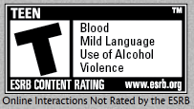
Who should play this game?
This game is definitely meant for a for an older child to an adult and the ESRB content rating is Teen
There is no blood that occurs in the game, however it is very violent and slashing effects make blood like streaks across enemies
There is no bad language that I have come across other than the occasional cursing of players which is filtered by default
I think anyone that enjoys a long RPG would like the personal story of this game as well as the social functions of an MMO

Slide 24
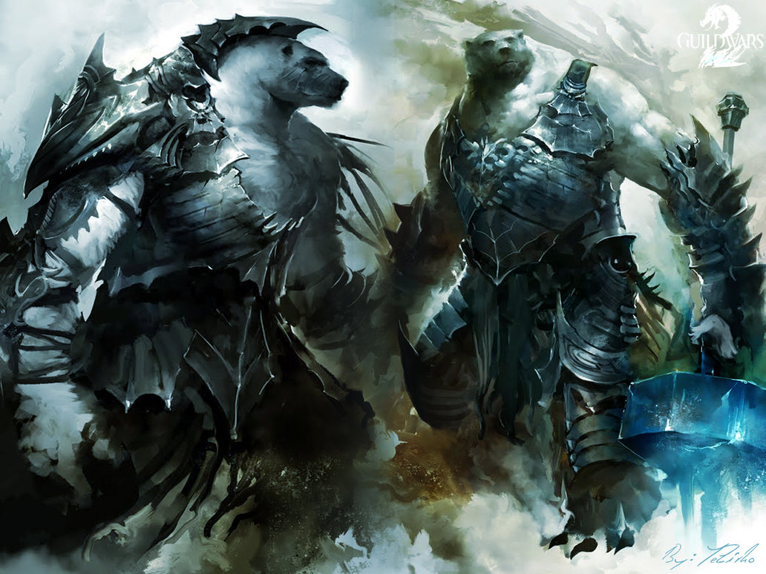
Overall – Strengths and Weaknesses
Strengths
  Fun to play
  Easy to learn, hard to master
  No grinding
  Innovative way of including story in an MMO
Weaknesses
  Maybe to much to handle for new comers
  Can seem to open and undirected
  Lack of skill importance may lead to a lack of interest

Slide 25
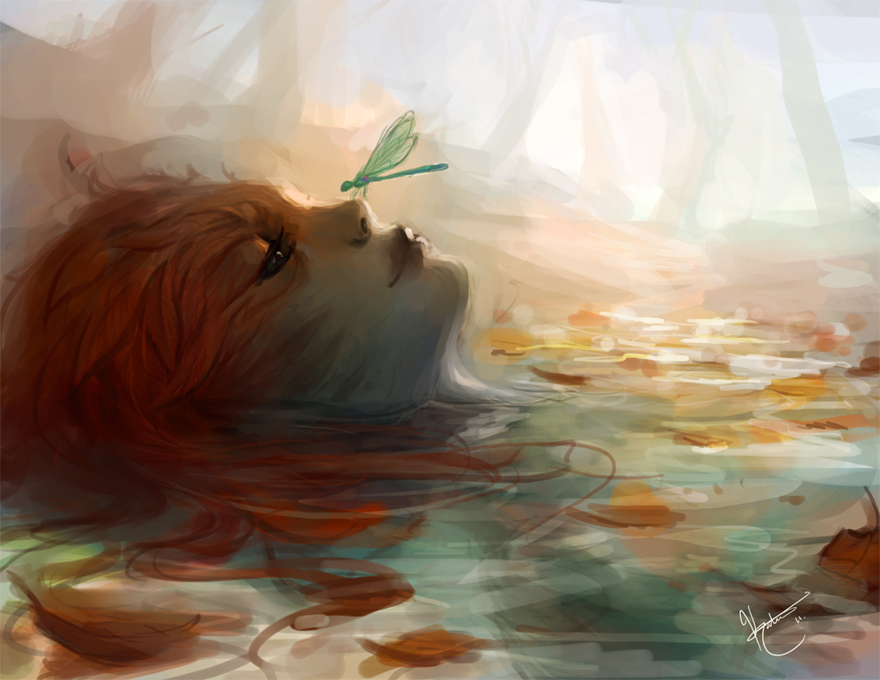
Is it worth it?
I highly recommend purchasing this game
The best part about this MMORPG in comparison to all others… no monthly fee (yeah I saved it for last). With this in mind, you are no more committed to it than any other game and as such you can come back to it later if necessary without paying an arm and a leg

Slide 26
How can it be improved?
The game needs to be more engaging
Without the music to really draw you in it feels like a game at all times. I never find myself getting lost in the music or the colors of the environment
Not once have I come across something in the game and been shocked enough to simply look at it for a while or stop to listen to a song

Slide 27
