Slide 1
Reviewed By: Joe Shunia

Slide 2
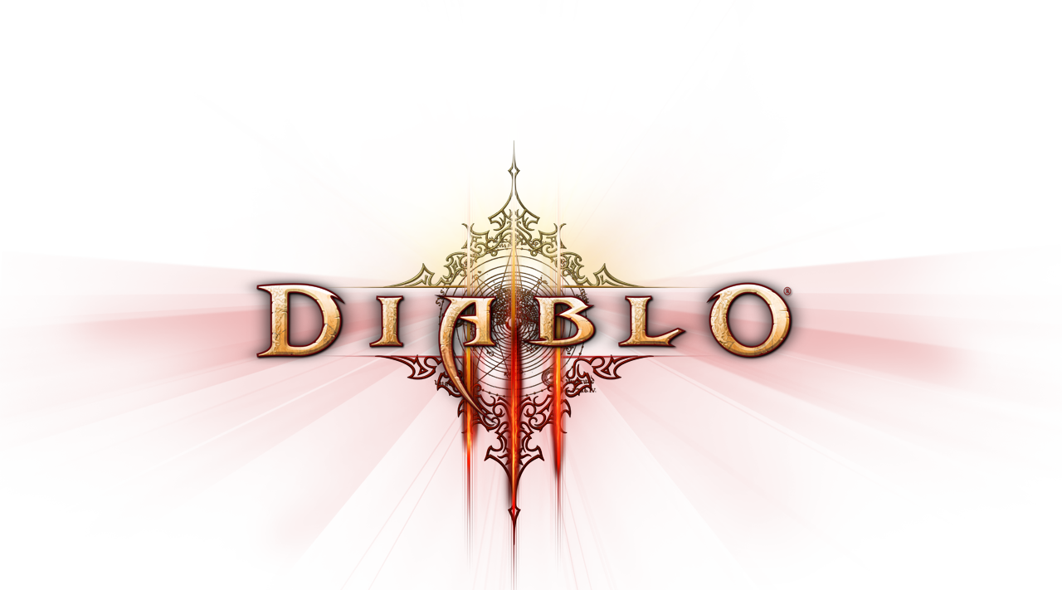
Basic Info:
Name: Diablo III
Developer: Blizzard Entertainment
Genre: Action RPG
Price: $59.99
Model: Online Only
Platform: PC/Mac
System Requirements:
OS: Windows Vista/7 or Mac OS X 10.7+
Processor: Intel® Core 2 Duo 2.4 GHz or AMD Athlon™ 64 X2 5600+ 2.8 GHz
Memory: 2GB
Graphics: NVIDIA® GeForce® 260 or ATI Radeon™ HD 4870 or better
HD Space: 12GB available

Slide 3
Game Summary
“Diablo III is an action role-playing game that takes place throughout the dark fantasy world of Sanctuary. You play a hero who engages in fast-paced combat that tests your reflexes and rewards tactical decisions. As you slay hordes of monsters and challenging bosses, you grow in experience and ability, learning new skills and acquiring items of incredible power.” – Diablo3.com

Slide 4
Game Summary cont.
You play as a hero class with unique abilities. You level up (1-60) from experience gained by killing monsters and completing quests. Leveling up grants you new abilities and power. Much of your power is derived from items you equip to your hero.
There are four difficulties to complete: Normal, Nightmare, Hell, and Inferno. Difficulties are unlocked in sequential order. You level from 1-30 in normal, 30-50 in Nightmare, and 50-60 in Hell. Inferno is a difficulty for level 60 characters only.
They recently added a system called Paragon Levels - unlocked at level 60 - which are a new set of levels 1-100 that give bonuses to your character and you gain them through killing monsters.

Slide 5
Storyline
A meteor has fallen on the city of Tristram and your hero travels to the city to investigate. Upon arrival you discover that the meteor has awoken demons and that you must save the town. Once you accomplish your task you set out into the world of Sanctuary to eradicate the Prime Evils — the Lords of Hell who command the demons.

Slide 6
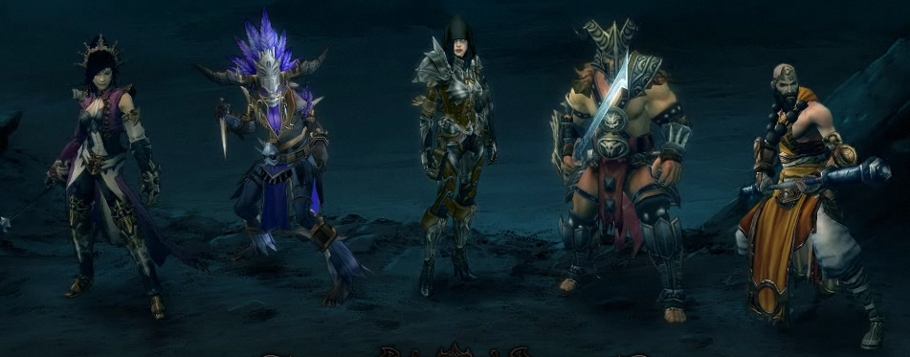
Hero Classes
Your hero class determines your skills, abilities, and item choice. There are 5 classes to choose from: Barbarian, Demon Hunter, Monk, Witch Doctor, and Wizard. All classes can be either male or female.

Slide 7
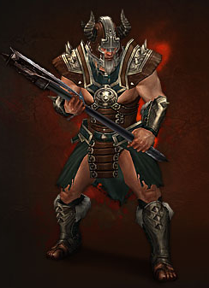
Barbarian
The Barbarian is a heavily armored melee class that hails from Mount Arreat. Fights with melee weapons and builds up Fury while in battle which is used to preform powerful attacks.
*This is the class I play.

Slide 8
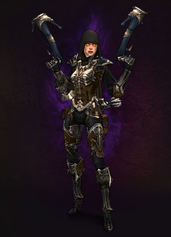
Demon hunter
The Demon Hunter is a ranged class that uses bows, crossbows and relies upon evasion and the careful placement of traps for survival. She uses Hatred for her offensive abilities - which regenerates quickly, and uses Discipline for her defensive abilities
- which regenerates slowly.

Slide 9
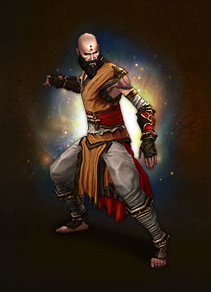
Monk
The Monk is a holy warrior whose who relies upon quick melee strikes and uses fist weapons or daggers to deal damage. Generates Spirit through combat - an inner strength that fuels the his skills and mobility.

Slide 10
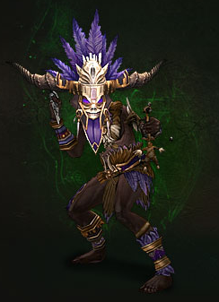
Witch Doctor
The Witch Doctor is a ranged class that summons undead pets and utilizes poison, acid, and fire attacks. Spells are powered by Mana, a slowly regenerating resource.

Slide 11
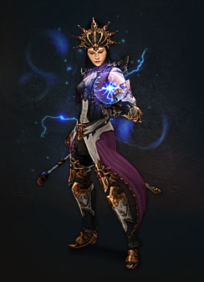
Wizard
The Wizard is an ranged class who commands the elements to deal damage. Casts spells with Arcane Power, a quickly-regenerating reservoir of power.

Slide 12
Skills
Primary source of damage and survivability, unique to each class.
Can have 6 active at one time, 2 on mouse and 4 on skill bar.
Each skill has 6 variants that can be selected from, called runes.
Skills and their runes are unlocked at certain character levels.

Slide 13
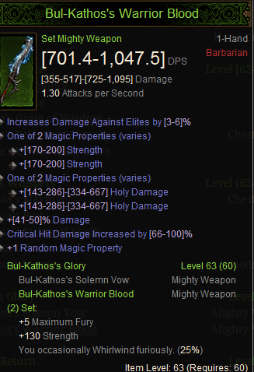
Items
Items are found by killing monsters and have random stat affixes that give your hero power.
Items can be are used as gear for your character and give you power.
There are 5 gear qualities: Common, Magic, Rare, Set, Legendary

Slide 14
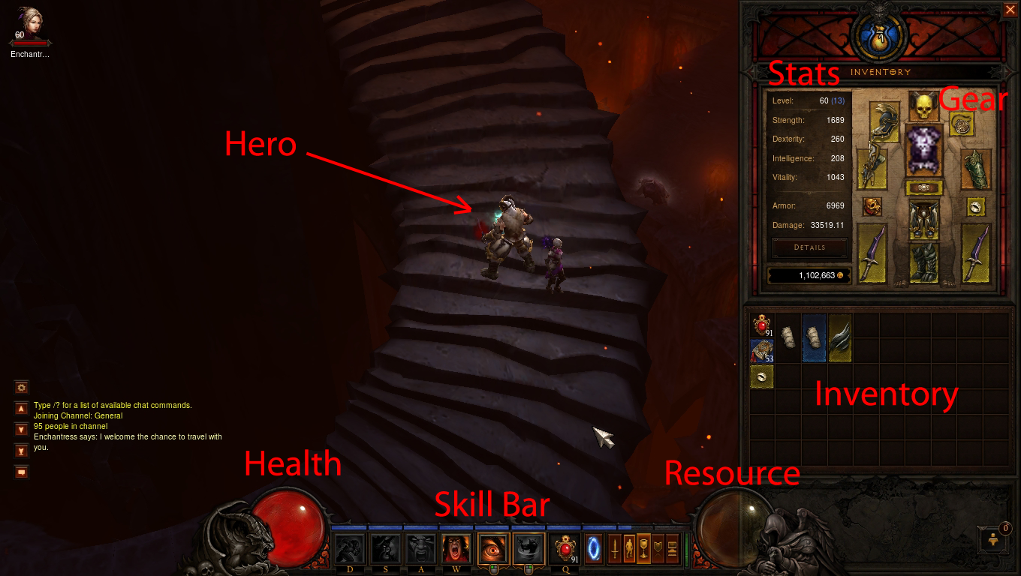
User interface

Slide 15
Gameplay

Slide 16
Gameplay
I removed the video for upload to VLT because it was about 70MB. Let me know if you need it.

Slide 17
Review: Pros/Cons
Pros: Gameplay, Skill System, Hero Classes, Graphics, Sound, Music
Cons: Storyline, Itemization, No PvP, Replayability, Matchmaking System

Slide 18
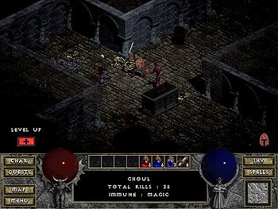
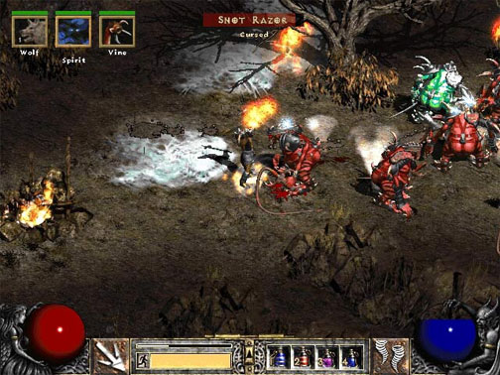
Previous Titles
Diablo I (1996)
Diablo II (2000)
Lord of Destruction Expansion (2001)

Slide 19
Rating
Gameplay: 10/10
Graphics: 8.5/10
Sound: 10/10
Story: 7/10
Server Stability: 8/10 (Has improved lately)
Replayability: 7/10 (More content is being added)
Overall: 9/10

Slide 20
Summary
Does not quite live up to it’s predecessors right now, but it is continually being updated and improved. Definitely worth a buy if you enjoy Action RPGs or were a fan of the previous titles.

