Slide 1
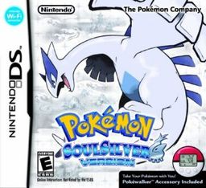
Pokémon Soul Silver Review
Genre: Role-Playing
Tyler Odom

Slide 2
Developed by :
Publishers:
Director(s) : Shigeki Morimoto

Slide 3
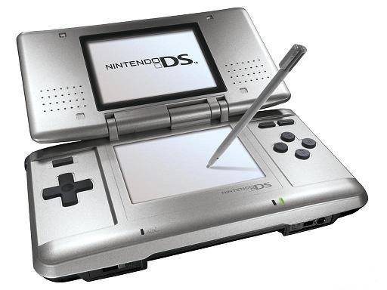
Price : $39.99
Requirements (one of the following):
DS
DS lite
DSi
DS XL
3DS
3DS XL

Slide 4
Overview
To be the very best, like no one ever was.
Got to Catch them All!

Slide 5
Storyline
Your trainer journey begins in New Bark Town, where you select one of three starter Pokémon from Professor Elm.

Slide 6
After completing a task for the Professor, he lets you keep the Pokémon you chose at the start.
Your trainer then is set off in to Johto region, travelling city to city catching Pokémon and collecting badges.
After collecting badges, you then face the Elite Four
While travelling, you are faced with battles from other trainers in the world.

Slide 7
Throughout your game, you have two Opponents
Team Rocket Rival

Slide 8
Player’s Role
Your role in the game is to catch and train Pokémon to be able to win battles against Team Rocket, Rival, and the Elite Four.
Installation
Insert the game into your DS system

Slide 9
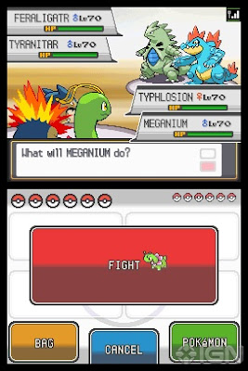
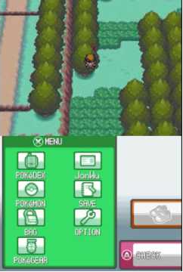
User Interface

Slide 10
Gameplay
Open World
Lots of Puzzles
Storyline follows a general path throughout the game, exception in some areas
Experience System
Winning Battles increases experience towards Pokémon that were part of the battle
Pokémon has 4 slots for moves that are chosen by the trainer
Moves availability by leveling, breeding, direct training
Health Bar Management of the Pokemon

Slide 11
Artwork
Digital Sprites / Cartoon
Each Pokémon is different / 493!

Slide 12
Sound and Music
Music is constant throughout game.
Every town has their unique music.
Battles have music based on Importance of battle
Each Pokémon has their unique call

Slide 13
Special Features
Pokewalker, a pedometer that
resembles a Poke Ball.
Level up a pokemon by walking
Access “Routes” that can catch certain pokemon
Able to catch Rare Pokemon
Pokemon follows you in game
All other games, all pokemon stayed in their poke ball.
Exception of Yellow:Pikachu was only one able to follow

Slide 14
Manual
Instructions on Controls
How to select
Instructions on Pokewalker
How to connect
How to use
Troubleshooting

Slide 15
Bugs
“After receiving the Rising Badge from Clair in Dragon’s Den, players do not receive TM59 from Clair on their way out as they normally would, if they use Dig Teleport or an Escape Rope to leave. “
-bulbapedia.

Slide 16
Game Review
GOOD
Music/Sound was best between previous games
Replay-ability
Most out of previous games
Kept true to the original
Best graphics compared to previous games
Able to transfer from past games to keep favorite Pokémon continue with you.
Longest Story

Slide 17
Game Review
BAD
Still hard to level to 100
Every Pokémon game so not bad
If no access to internet/other players, you will miss out on catching Pokemon/access to events

Slide 18
Compare
Soul Silver is a remake of the original for the Gameboy Color
Updates on Battle style, Abilities, and more from the previous games
Has both Johto and Kanto regions.

Slide 19
Better or Worse?
Soul Silver is a major improvement from the previous games.
Has lots more to offer
Leveling is not as annoying
More Replay value then past versions

Slide 20
Appropriate Audience
8+.
Lots of young adults continue to play
No blood, cursing, or violent experiences.
Pokemon ‘faint’, not killed
None I found
Design Mistakes

Slide 21
Strength/Weakness
Strengths
Best Replay value compared to past versions
Music is major improvement/enjoyable
New additions with the Pokewalker
Weaknesses
Still annoying to level to 100

Slide 22
Improvements
Still needs to be a faster way to level to 100.
Pokewalker is easily lost in clothes, washed, and then won’t work

Slide 23
Game worth it?
The game is a buy. If you like Pokemon, or want a new Role Playing game.

