Slide 1
CIS 487 Game Review
Nicholas Mullins

Slide 2
Madden 13

Slide 3
TITLE: Madden 13
PUBLISHER: EA Sports
GENRE: Sports
PRICE: $59.99 (Xbox 360, PS3), $49.99 (Wii),
$34.99 (PS Vita), $49.99 (Wii U – Pre-
order)
REQUIRED HARDWARE: PS3, Xbox 360, Wii, Wii U, PS Vita
VERSION USED: PS3

Slide 4
Overview

Slide 5
NFL Football Simulation
All 32 NFL Teams
Current and Hall of Fame Player
Current and Hall of Fame Coaches
Allows Online and/or Offline Play
Create-a-Player
Control Individual Player or Entire Team
Play Single Game or Control a Team for up to 30 seasons

Slide 6
Player’s Role:
Quick Play
Choose from one of 32 teams and play against the computer opponent
Connected Careers
Choose between Current/Former Player, Coach/GM, or Created Player
As Current/Former Player
Build on the Career of the player and only control that one player
As Coach/GM
Control almost all aspects of an NFL team
Draft Players
Practice
Negotiate Contracts
Make Trades
Choose what plays to run during football games

Slide 7
Player’s Role (cont.):
As Created Player
Create a player
Get player drafted by an NFL team
Practice and improve the created player’s skills
Move your player up or down the depth chart depending on how they do in a football game
Ability to Demand a Trade/Release
If player is good enough they may get picked up by another team, if not then they are forced into retirement
Ability to Retire your created player and start again

Slide 8
Installation

Slide 9
Installation is typical of most console games
Insert disc into console
Start game
Game will prompt to update before being able to play
Once update is complete the game will start
Game will install some files onto the console HDD
After game has started
Will prompt to look for updated Roster files
Seems to update Rosters approximately once a week

Slide 10
Game Play

Slide 11
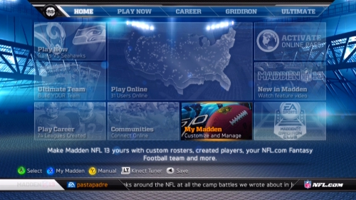
Opening Menu:
Play Now
Career
Gridiron
Ultimate

Slide 12
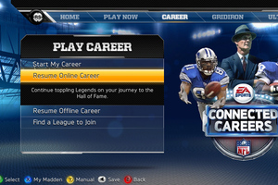
Play Now: Quick play – play a game with default settings and
rosters
Career: Connected Careers – Play as Player or Coach

Slide 14
Controls:
Uses standard console controller (or the PS Vita on-board controls)
Right-Stick (or D-Pad) moves between title menus
Left-Stick (or D-Pad) moves between options of the selected title menu
“X” button selects choice
“Square” brings up the “My Madden” screen
“Triangle” brings up the manual
“O” goes back
“R2” brings up Madden news
“Select” saves files

Slide 15
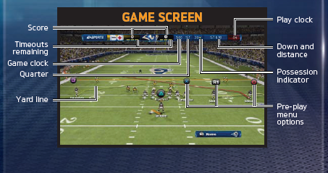
In-Game Controls:

Slide 16
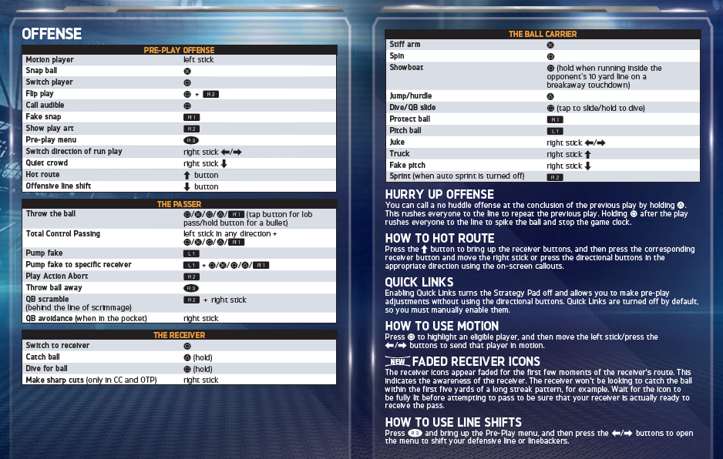
Offense Control:

Slide 17
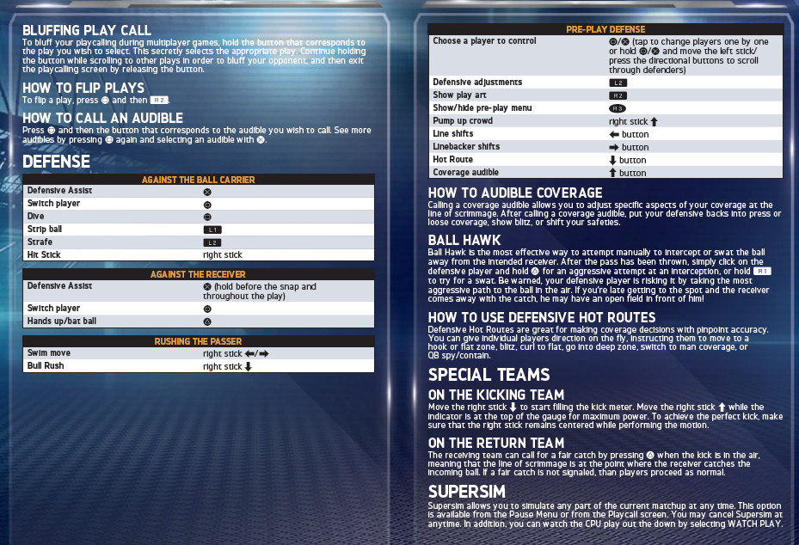
Defense Control:

Slide 18
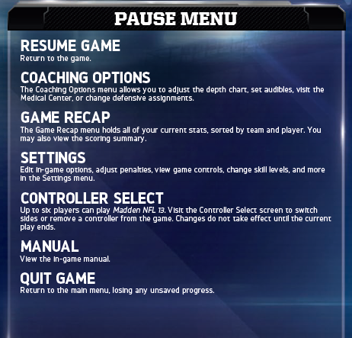
Pause Menu:

Slide 19
Difficulty:
Rookie – Easiest Difficulty setting
Pro – What most Madden gamers choose
All Madden – Most difficult, almost impossible to win games
All of the difficulty settings can be tweaked using the “sliders”
Penalty call frequency can be adjusted from never to every penalty called
You can adjust the accuracy of the QB, the ability of the O-Line and D-Line, rate of interceptions and fumbles, and the strength and accuracy of the kickers and punters
Separate sliders for User controlled team and Computer controlled team

Slide 20
Artwork

Slide 21
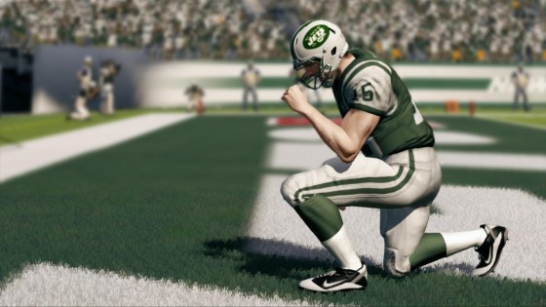
The creators of the game seemed to do a very good job on the likeness of the real athletes and coaches
Players do their real life celebrations
Ex. Tim Tebow “Tebowing”
Stadiums are very authentic
The crowd is somewhat a blur of colors unless they are the focus of the “camera”
Uniforms get dirty as the game goes on

Slide 22
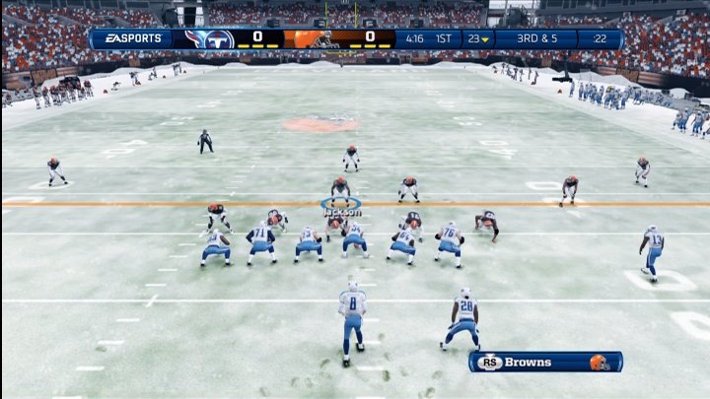
Weather conditions are accurately portrayed
Ex. During a game at Ford Field (completely enclosed stadium), the “camera” cut to a shot outside of stadium and it showed it raining in downtown Detroit
Open stadiums have rain, snow, wind, and temperature fluctuations

Slide 23
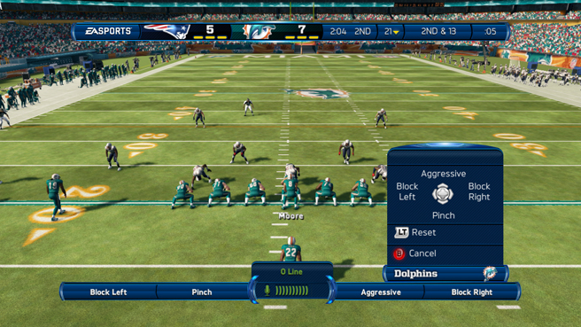

Slide 24
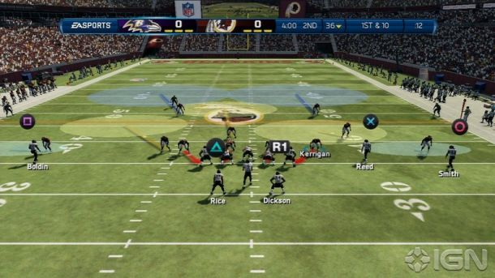

Slide 25
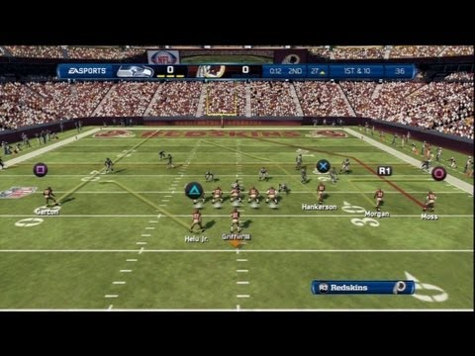

Slide 26
Audio

Slide 27
Audio is used very well in the game
Music that is played when you are in Menu sections has a very NFL feel to it
Sounds like something that would be in an NFL films clip
In-game sound effects are quite accurate to what is happening in the game
Player collisions (crunching sound)
Quarterback “barking” out commands at the line of scrimmage
Crowd noises
Booing when the opponent makes a good play
Cheering when the home team makes a good play
Cheers pick up as a drive continues longer and when in the redzone
Jim Nantz and Phil Simms are the in-game commentators
Sounds much like it would watching a real-life game on TV
Make some mistakes (I will discuss more in the “Bugs” section
Some of the things they say do not seem correct (not really a bug, but more like a bad call)
Ex. I was losing by 6 points with 1:30 left to play. I had the ball at the 20 yard line (80 yards to go) and the announcers said that there was not a chance to win the game. (In case you were wondering…I did drive the length of the field, score a TD and win.)

Slide 28
Special Features

Slide 29
The ability to play as NFL legends and coaches is a great new feature
We can now see what would happen if Barry Sanders did not abruptly retire (set the ALL-TIME rushing title, Emmit Smith would be second even though he had a quality offensive line)
Play as Bo Jackson before he had his career ending knee injury (Bo knows Football)
Communities section – communicate with other Madden gamers
Madden Moments Live – Play in real-life scenarios that occur throughout the NFL season
Twitter feed in Career Mode – NFL insiders make fictitious Twitter postings throughout the season based on how the game season is going
News feed at the bottom of screen in career menus – keeps you up to date on happenings around the NFL (real-life). Similar to what ESPN does during everything they air

Slide 30
Game Manual

Slide 31
Game manual is available in the game or online at:
Madden 13 Manual

Slide 32
Bugs

Slide 33
Every Bug I encountered did not affect the game play or outcome
Bug #1
During a replay of a receiver making a catch, they zoom in on the receiver and when the ball is coming towards the receiver the rotation on the ball is correct (at least if the QB is right handed, I have not tried it with a lefty) but just before the receiver catches the ball, the rotation goes in the opposite direction
Bug #2
After a play is over, players trip over other players constantly. This is good during a play as the players are moving quickly and cannot always get out of the way of other players, but after a play when the players are just walking around it looks really sloppy. It would not happen in real-life.
Bug #3 – Collision Detection
Most of the collision detection in the game is great. There are gang tackles and players usually fall like they should.
Sometimes a player will not look like they make contact with another player, but the tackle animation still happens. This is common on every Madden game I have played (as well as all other football titles that have been around).
Sometimes the players and/or ball go through other objects

Slide 34
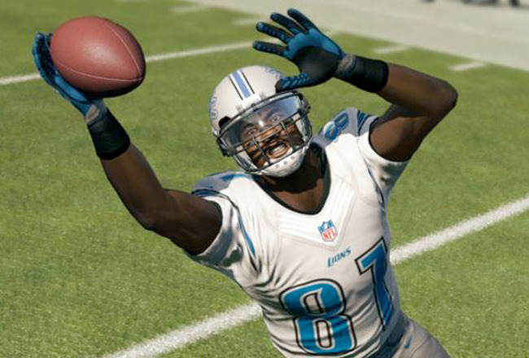
Magical multi-rotational football!

Slide 35
Review

Slide 36
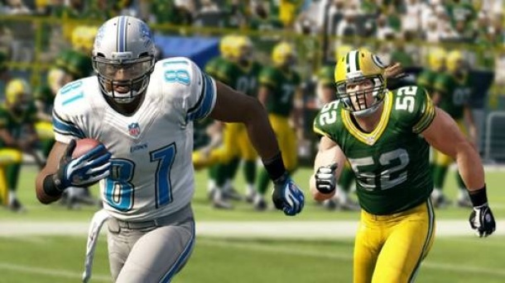
The Good:
Life like in appearance and game play
Ex. The Lions have a horrible running game and the secondary has more holes than Swiss cheese.
Allows me (or other players) to replay what happens during the NFL season (avenge the loss to the 49ers)
Best chance to see the Lions win a Super Bowl anytime soon
Ability to control your favorite team or player
Very high replay value
The NFL legends is a great addition to the game this year
Game Face – allows you to use a picture of your face on a player that you create

Slide 37
The Bad:
The mistakes by the announcers tend to get annoying after a short while
The Combined Careers mode
Combined the former Super Star and Franchise mode
Lost some of the details in Franchise mode
A lot of menus to go through when playing Combined Careers mode
Not available for the PC
Some PC gamers have resorted to using Madden 08 on their PC and creating custom rosters based on the current NFL rosters

Slide 38
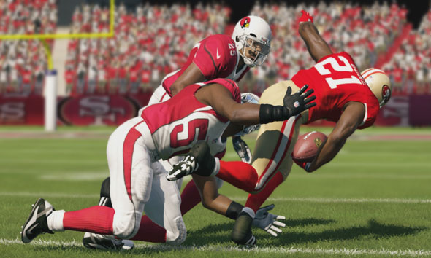
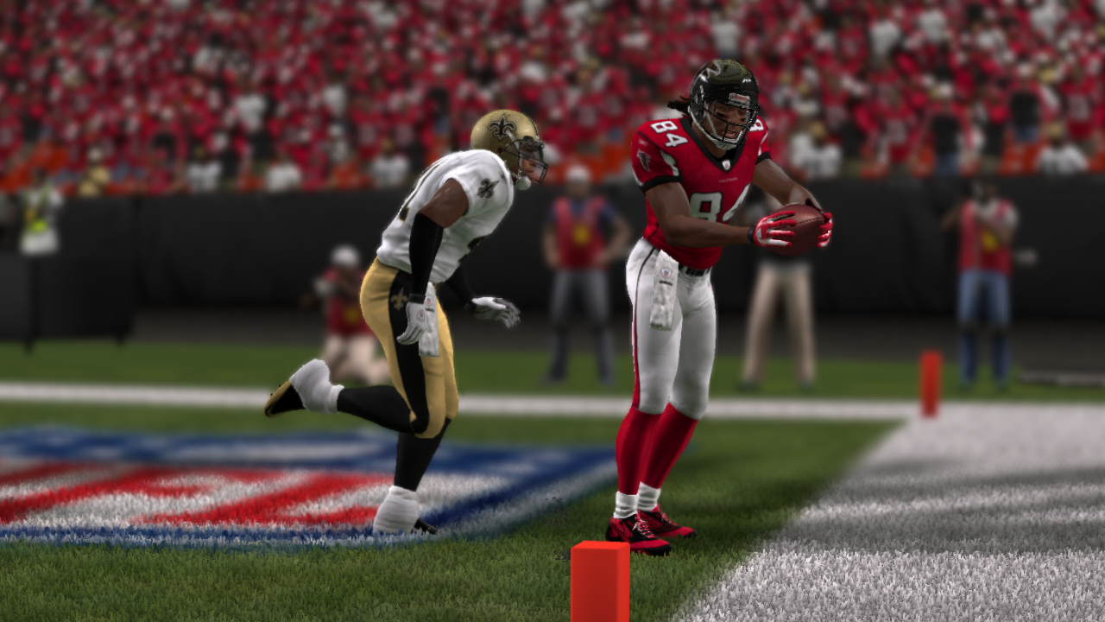

Slide 39
The Ugly:
Cannot import rosters from NCAA 13 to Madden 13 any more
Was nice being able to import the real-life college players into the NFL
Because of the exclusive rights to the NFL that EA has there are not competitors available
Game might be much better if customers had another option and the creators had to compete for gamers
EA does not seem to listen to the fans of the Madden franchise
They seem to tweak the game just for the sake of saying they made changes
Instead of the Combined Careers, they could have focused on the in-game play – better announcers, better collision detection, etc.

Slide 40
Summary

Slide 41
Strengths:
The NFL is arguably the most profitable professional league in the world and EA has exclusive rights to the NFL so if people want an NFL simulation game then the Madden franchise is their only choice
Excellent representation of the real-life player counterparts
Weaknesses:
Having exclusive rights to the NFL allows EA to worry less about keeping current gamers. It is the only option available
The constant tweaking that happens every year
In my opinion the game is worth purchasing. It has a high replay value and is the only way to play a real-life NFL simulation. I will keep purchasing the Madden games until a better option comes along or they retire the franchise.
Madden 13 will not bring in gamers that are not interested in football. If you are not a fan of the NFL then you will probably not enjoy the game.

