Slide 1
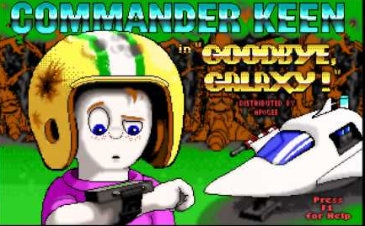

Slide 2
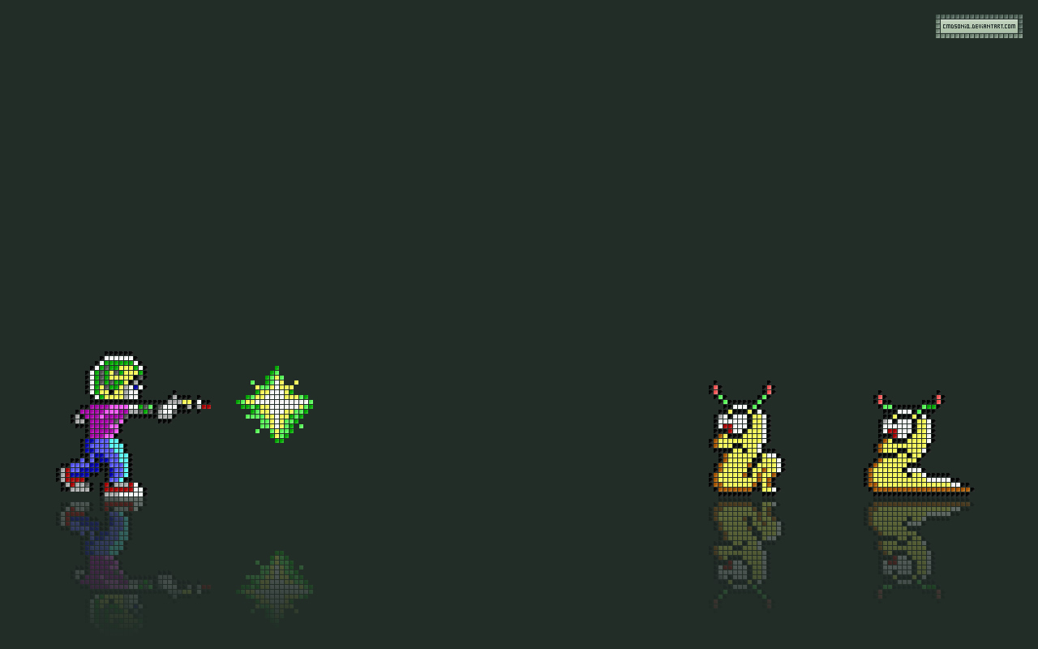
Basic Info
Title: Commander Keen 4: Secret of the Oracle
Publisher: Apogee Software
Developer: Tom Hall & iD Software
Release Date: November 22, 1991
Type Of Game: 2D Dos Game
Price: $4.99/free
Hardware Required: Any computer or cell phone with a dos emulator

Slide 3
Game Summary
Player: You are Billy Blaze a.k.a. Commander Keen an 8 year old genius
Story: Keen learns that there is a plot by the Shikadi to destroy the galaxy. Keen goes to the planet Gnosticus IV to consult the leaders of the Oracle. He discovers they have all been kidnapped. Keen’s job is to find and rescue the eight elders while making his way through large levels with many obstacles.
Installation: game was installed and run through a dos box emulator

Slide 4
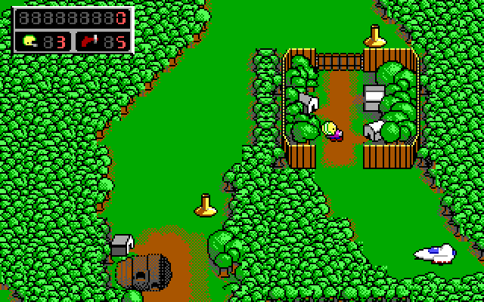
Interface – Map

Slide 5
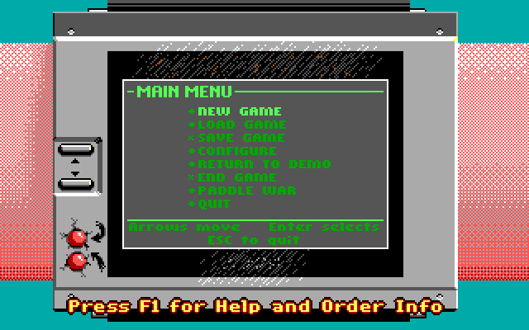
Interface – Main Menu

Slide 6
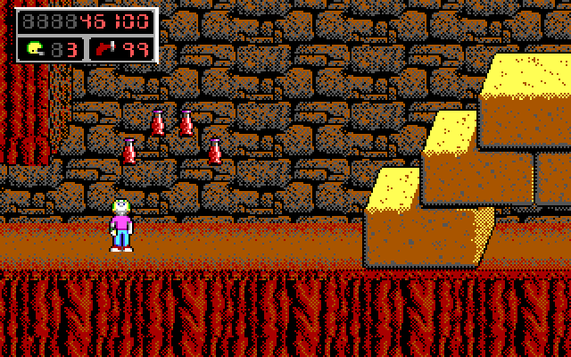
Interface – Game View

Slide 7
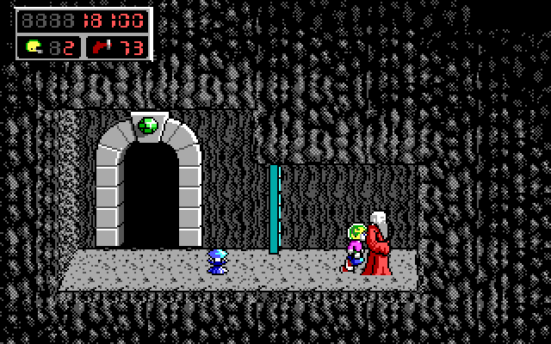
Interface – Game View

Slide 8
Game Play: left and right control with the ability to jump, along with special features like a neural stunner, wet suit, and a pogo stick. If you collect 100 rain drops you earn an extra life. Gems are used to open doors. Elders are hidden through out the levels
Scoring: points are earned by collecting various food items

Slide 9
Enemies & Hazards

Slide 10
Sound & Music: Various sound effects and subtle background music by Robert Prince
Special Features: a mini-game called “paddle war”, hidden level, an Easter egg hunt and some various comical entertainment

Slide 11
Bugs: No bugs were found while playing the game through a dos emulator.
According to Google:
Disappearing rain drops
Invisible pole climbing
Score disappearing

Slide 12
Game Review
Fun:
Large levels with many possibilities
Challenging levels and enemies
Good story line

Slide 13
Game Review
Bad:
Can get boring
Limited number of levels and things to do
Old School
Can easily be beaten in one day

Slide 14
Comparison
Unique game unlike any other games
Any side scrolling adventure games would be similar
Not many other games had the game play style that commander keen did

Slide 15
Audience: Any age or skill level is fine. Graphics and content are suitable for everyone
Design Mistakes: None present

Slide 16
Summary
Unique one of kind game
Good story and game play
Was one of the first very successful side scrolling Super Mario styles games in DOS

Slide 17
Summary
Could become boring eventually but a definite value for $4.99, you can have the whole Commander Keen collection

Slide 18
Improvements
More levels
More Features
New weapons and challenges
More enemies/harder

Slide 19
Game
http://www.sababagamesonline.com/CommanderKeen4.php

