Slide 1
CIS 487 Presentation
Dragon Age
Nader Khraizat

Slide 2
Company: EA and designed by BioWare
Executive Producers: Mark Darrah
Project Directors: Dan Tudge
Lead Designers: Brent Knowles, Mike Laidlaw, James Ohlen
Art Director: Dean Andersen
Lead Programmer: Ross Gardner

Slide 3
It is a single-player third-person role-playing fantasy game
Costs $19.99

Slide 4
Windows Minimum Specifications
CPU: Intel Core 2 (or equivalent) running at 1.6Ghz or greater
AMD X2 (or equivalent) running at 2.2GHZ or greater
RAM: 1.5 GB or more
Video: ATI Radeon X1550 256MB or greater
NVIDIA GeForce 7600 GT 256MB or greater
20 GB HD space

Slide 5
Recommended Specifications
CPU: Intel Core 2 Quad 2.4Ghz Processor or equivalent
RAM: 4 GB (Vista) or 2 GB (XP)
Video: ATI 3850 512 MB or greater
NVIDIA 8800GTS 512 MB or greater
20 GB HD space

Slide 6
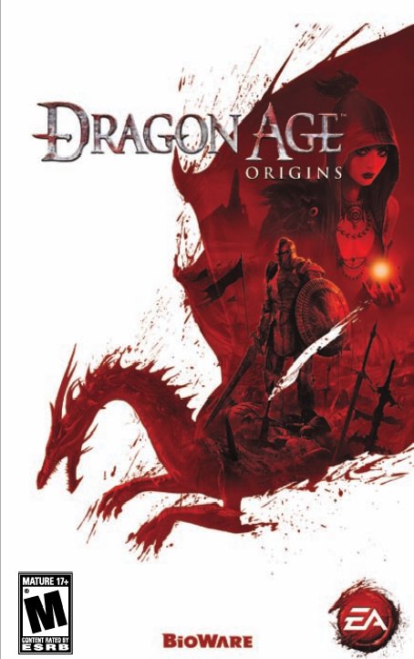

Slide 7
Storyline/Official game description
You are a Grey Warden, one of the last of a legendary order of guardians. With the return of an ancient foe and the kingdom engulfed in civil war, you have been chosen by fate to unite the shattered lands and slay an archdemon once and for all. Start your adventure by picking your race as a Human, Elf, or Dwarf, then your class as a Warrior, Mage, or Rogue. Then after that, it is all up to you. The choices you make guide the path you take through the Ninth Age: The Dragon Age.

Slide 8
"Men and women from every race; warriors and mages, barbarians and kings... the Grey Wardens sacrificed everything to stem the tide of darkness... and prevailed." —Duncan, head of the Grey Wardens in Ferelden

Slide 9
Installation
Either with a DVD ROM and install by following istructions.
Xbox
PS3
Or online copy off Origin

Slide 10
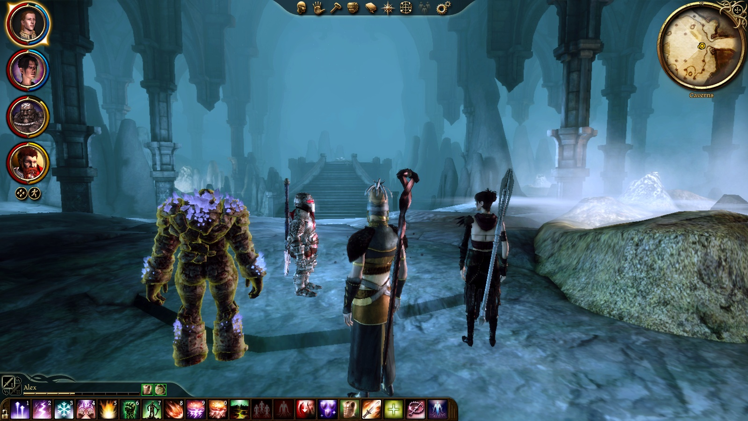
Game play

Slide 11
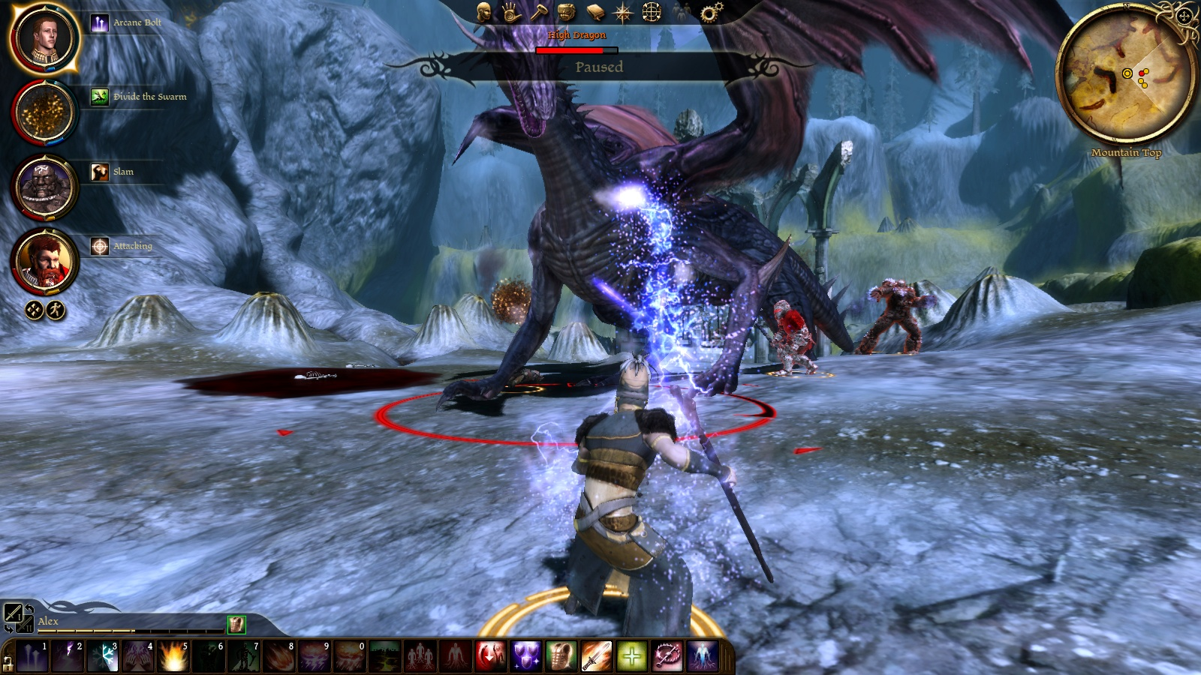

Slide 12
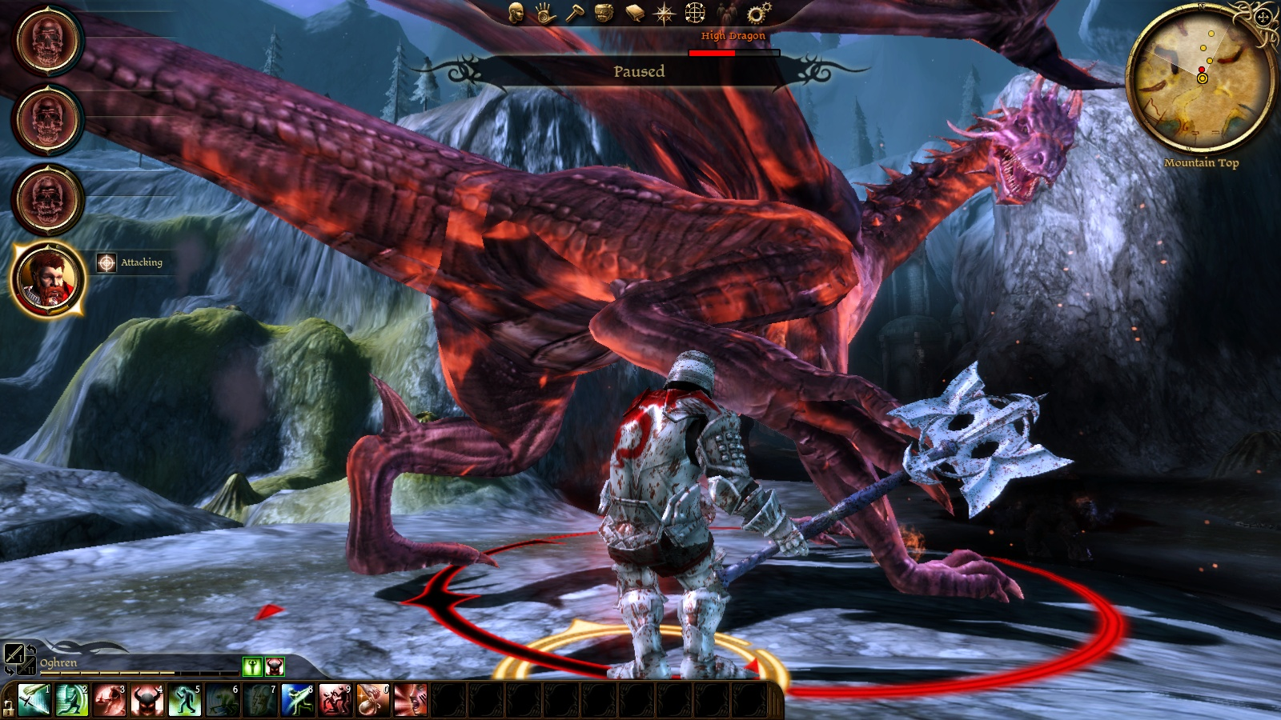

Slide 13
Sound and videos

Slide 14
Special features

Slide 15
Bugs
Aiming: sometime you have to press on a certain spot on the character in order to attach.

Slide 16
FUN
More than 18 different game play
Fusion spells
Challenging
Great storyline
When in city characters talk among themselves, insult or crack jokes
Each species have different enemies, each enemy has different units, each unit has different skills example rogue werewolf, blight werewolf, alfa werewolf… then the leader.
When you go from one city to another on world map while your on your way you might be attacked by wild animals or
Ambushes happens all the time for different reasons in cities forests even in main camp

Slide 17
NOT FUN
Sometimes they talk too much and about things that are not important and you can only skip one sentence at a time and not what their whole part
Sometime you fight way too powerful opponents too early in the game.

Slide 18
How does it compare to similar games in the same genre?
The character gains points to spend on skills, experience, and abilities as he/she levels up.
Why is it better or worse than similar games?
Better, it is long, has variety, and good storyline

Slide 19
Appropriate audience
Rated M for Mature:
Blood
Intense Violence
Language
Partial Nudity
Sexual Content

Slide 20
Design mistakes
Walking while staying in same position (one location)
Sometime u have to place the mouse on specific area on the box to open it or enemy to attack.

Slide 21
Strengths
Different opponents: I fought over 40 different enemies each with different ability, strength defense, and level. (I think I am almost %50 there)
Variety of opponents in one unit (mages arches, ogres, warriors, abominations and the leader of group)
Wide variety of graphics in different towns, cities, camps, fade, ruins, ruins after cities you visited are destroyed, temples, underground caves, forest, towers, and many more

Slide 22
Weaknesses
Too much talk sometimes.
If going deep into a level for a few hours you cannot go back to heal and buy potions.
My character cannot open LOCKED BOXES!!!

Slide 23
Is the game worth purchasing?
YES!!!
Rated 8.9
How could it be improved?
I thought it was great but could do with less talking in only a couple places and could add a skill to unlock locked boxes for all players and more potions which I heard they did in second part.

Slide 24
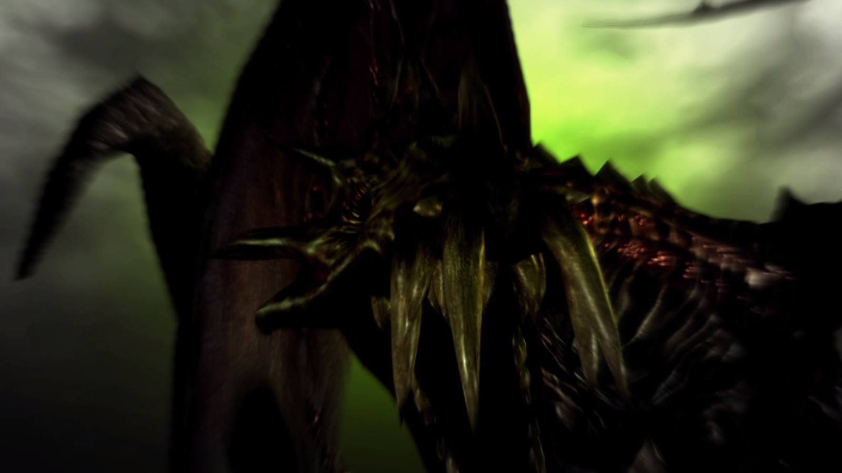
THE END!!!

