Slide 1
Waverace: Blue Storm
A Videogame Review by
Michael Ingrody

Slide 2
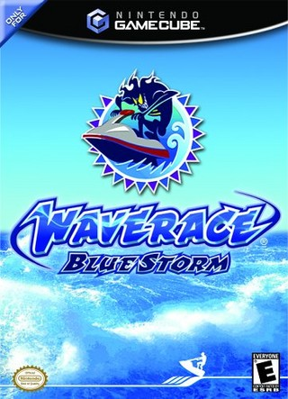
Game Information
Nintendo Gamecube
Nintendo Software Technology
2001
Jet-Ski Racing
3rd and Last in Series

Slide 3
Game Modes
Circuit – 5,6, or 7 Courses, 3 Laps, Buoy System, 8 Racers
Time Attack – Any Course, Any Weather
Stunt – Ramps & Point Rings, Stunts, Combos
Multiplayer – 4 Player Racing
Free Roam – Open Course, Practice

Slide 4
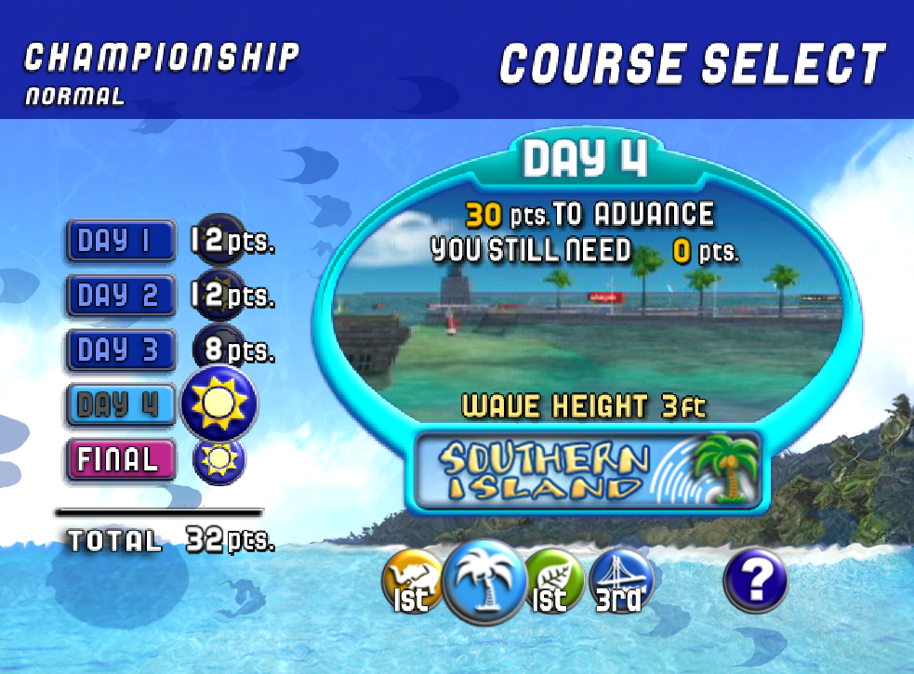
Circuit Mode

Slide 5
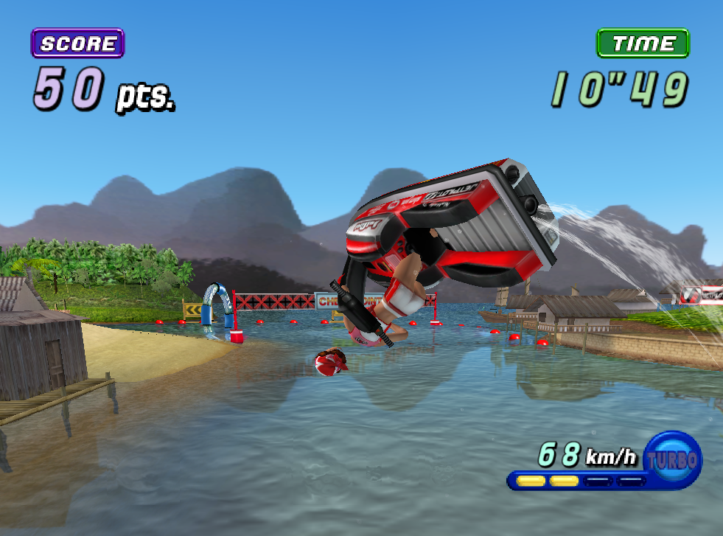
Stunt Mode

Slide 6
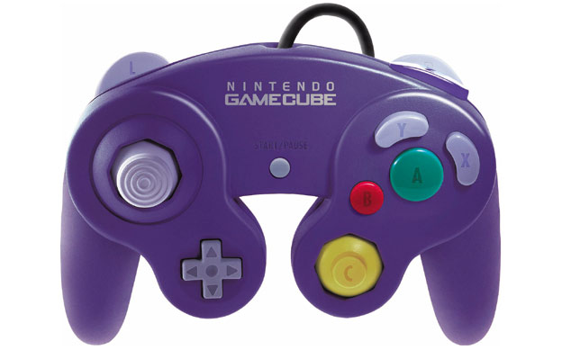
Controls
Lean
Lean
Turbo
Crouch/
Stunt
Steer (L/R)
Shift Center of Gravity (U/D)
Turbo
Throttle
Pause Menu
Camera
Toggle Map (Free Roam)

Slide 7
Water
Prized for Water Physics
Unique Maneuverability (Steer From Rear, Jet Thrust)
Varying Wave Heights Within a Course
Varying Water Levels Within a Course
Waves Affect Vehicle Control, Especially on Turns
Each Jet-Ski Produces Wake, Riding in Wake Compromises Steering Ability

Slide 8
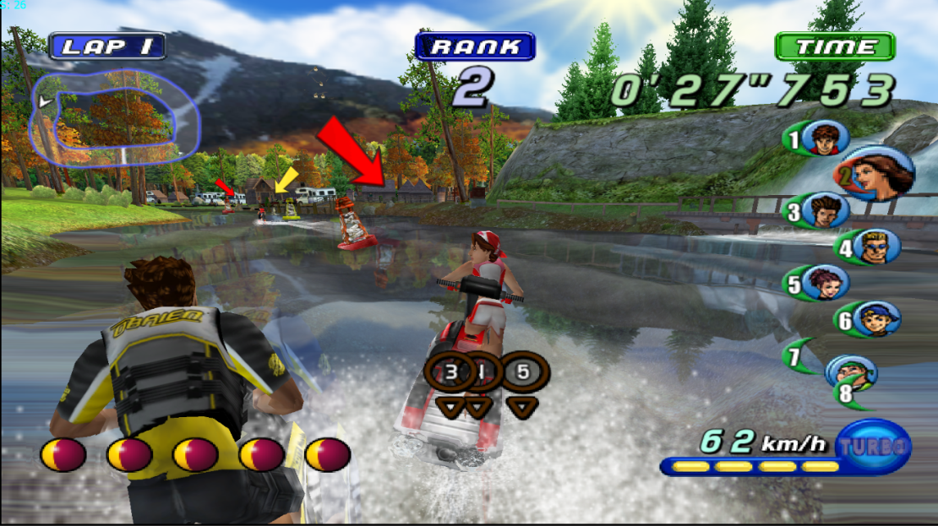
Environment and Waves

Slide 9
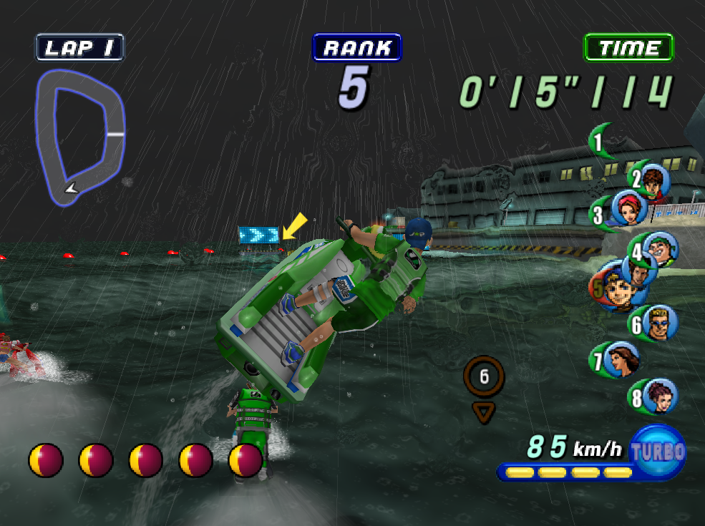
Weather and Waves

Slide 10
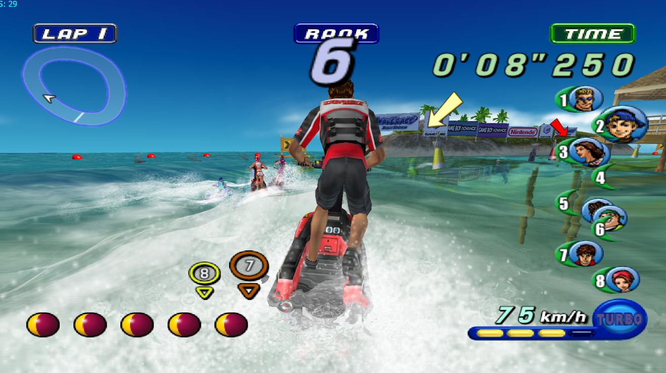
Riding Through Wake

Slide 11
Unique Strategy
Low-Risk Shortcuts – Use Turbo, Miss Single Buoy
High-Risk Shortcuts – Miss Multiple Buoys, Narrow Passageways, Tight Turns, Many Obstacles, Dive Underwater, Break Through Barrier (Failure Costs the Race)

Slide 12
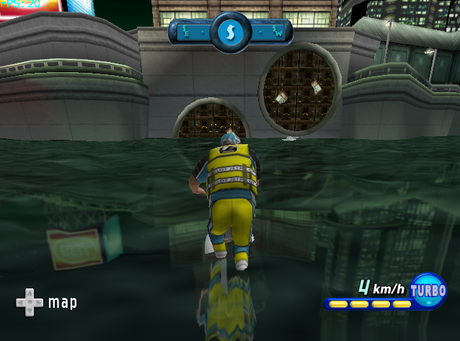
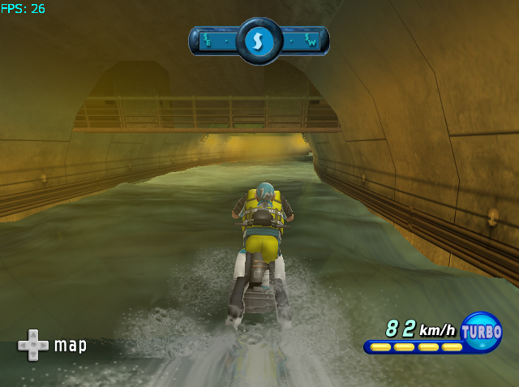
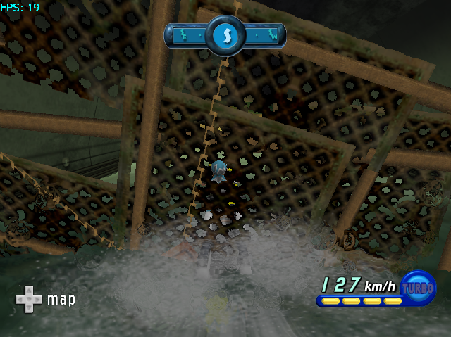
High Risk Shortcut I

Slide 13
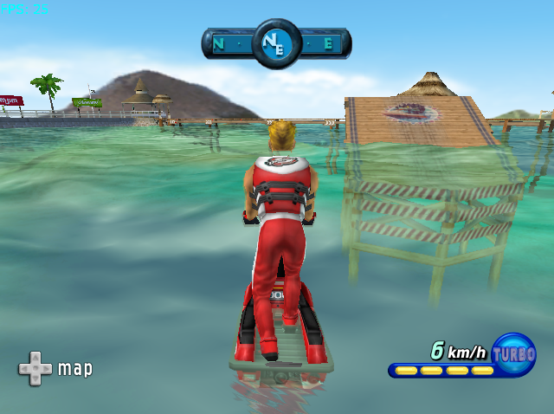
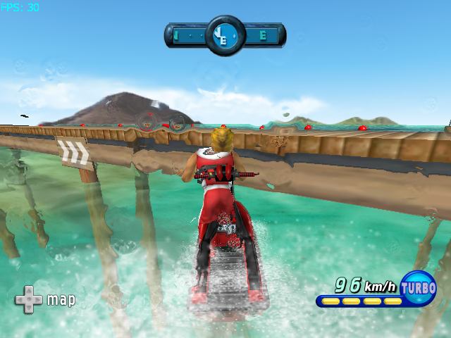
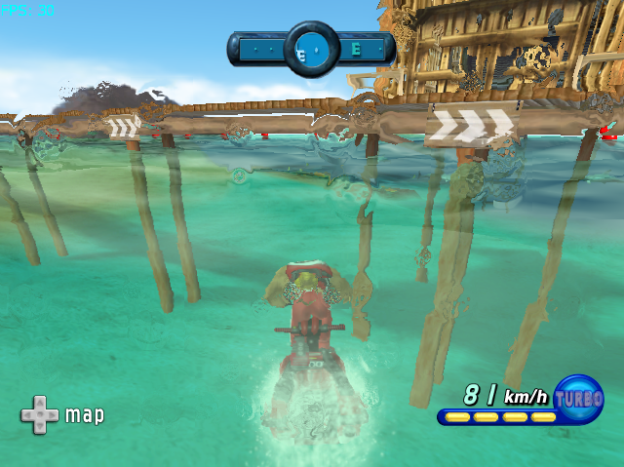
High Risk Shortcut II
Bad…
Good!

Slide 14
Gameplay Variation I
8 Unique Courses
3 Difficulties, Different Buoy Placement
1 of 5 Weather Conditions
(Clear, Clouds, Light Rain, Rain, Storms)
8 x 3 x 5 = 120 Different Race Variations = High Replay Value

Slide 15
Gameplay Variation II
8 Characters
Different Strengths and Weaknesses
Player can Tweak Rider Specifics
4 Different Color Schemes for Wetsuit/Jet-Ski of Each Character

Slide 16
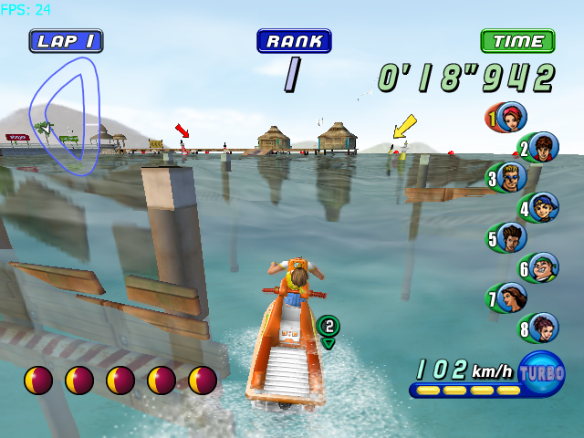
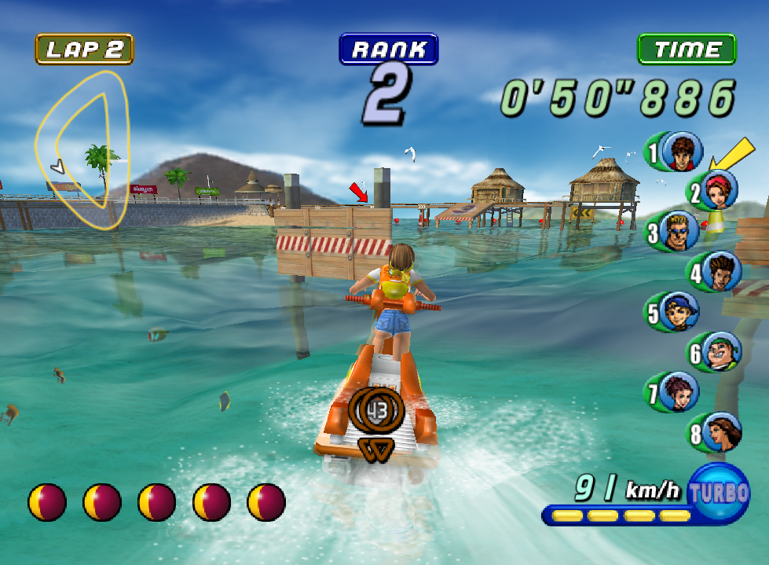
Environment Variation Across Different Laps

Slide 17
Shortcomings
Lacks Rider Reset Button
-Fall = Last Place
-Stuck Facing a Wall
-Slow to Get Off of Land
Map
-Should show buoy placement, course specifics

Slide 18
Overall
Offers Unique Gameplay Experience
Challenging
No Race is the Same
Shortcuts Allow for Strategizing
Multiplayer
Stunning Water Effects for its Time

