Slide 1
9 Innings: 2013 Pro Baseball
Game Evaluation by Justin Hawke

Slide 2
A realistic baseball game for your mobile devices.

Slide 3
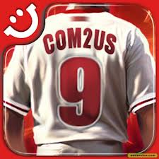
Overview
Quick overview of the Game Developer:
Com2uS is a South Korean mobile and online game development/publishing company established in 1998.
Programmed by: Eungjoo Kim, Jaeryong Lee, Changho Yoon
Art: Hyechin Yu, Chewan Shim
Sound: Sangmi Park

Slide 4
Overview
Quick overview of the Game:
Available in Android market place with a rating of 4.6/5 from approximately 100,000 reviews.
Available in iTunes with a 4 and a half star rating from over 30,000 reviews.
Officially Licensed with the Major League Baseball Players Association (MLBPA)
Sequel to the Popular 9 Innings: Pro Baseball 2011.

Slide 5
Rules
Game modes:
-League -Special
-Friendly -Homerun Derby
No idea is a bad idea
Be creative
Take risks
No criticism allowed

Slide 6
Brainstorming Activity
Card system:
Uses the photos and stats of 1,400 real players across 30 teams.
Combine/enhance cards.
Generate ideas
Use games and exercises to “warm up” your creative thinking
When ideas slow down, try another exercise to generate fresh ideas
Breaking into smaller groups may be helpful
Use a computer to capture every comment/idea

Slide 7
Brainstorming Activity
Online Shop:
Buy/sell/trade your cards.
Track your achievements against other players.
Generate ideas
Use games and exercises to “warm up” your creative thinking
When ideas slow down, try another exercise to generate fresh ideas
Breaking into smaller groups may be helpful
Use a computer to capture every comment/idea

Slide 8
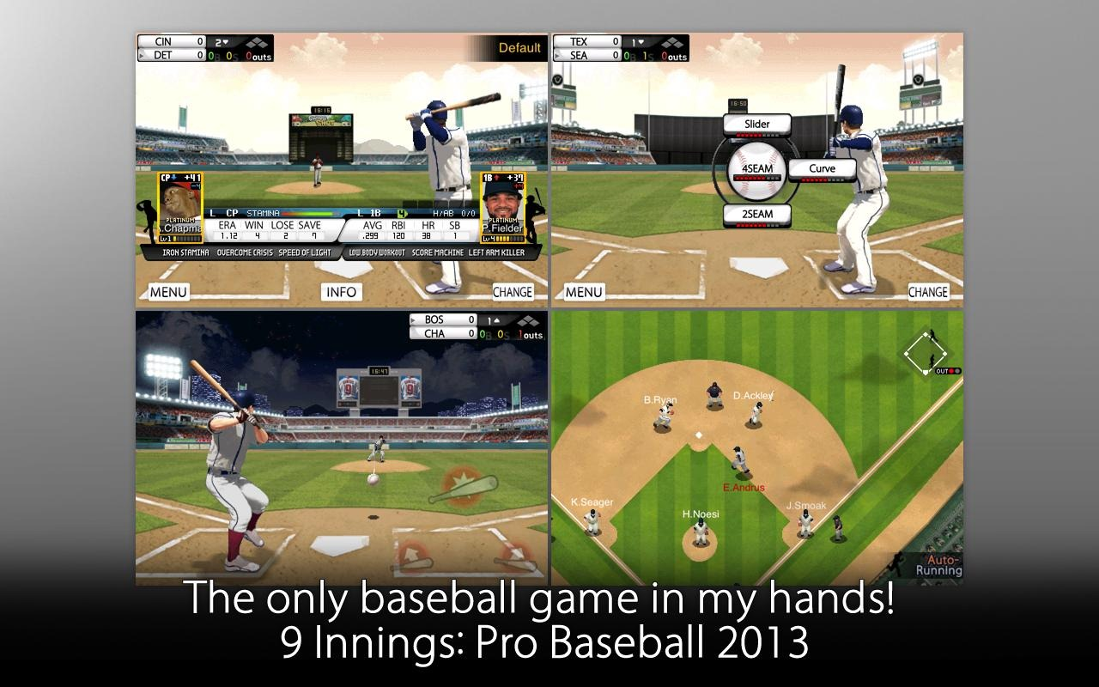
Gameplay: preview

Slide 9
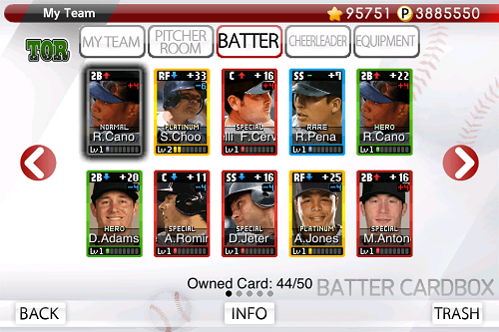
Brainstorming Activity
How to play: Building Your team
5 Starting Pitchers 8 Positional Players
4 Relief Pitchers 5 Backup Batters
1 Closer 1 Cheerleader
Generate ideas
Use games and exercises to “warm up” your creative thinking
When ideas slow down, try another exercise to generate fresh ideas
Breaking into smaller groups may be helpful
Use a computer to capture every comment/idea

Slide 10
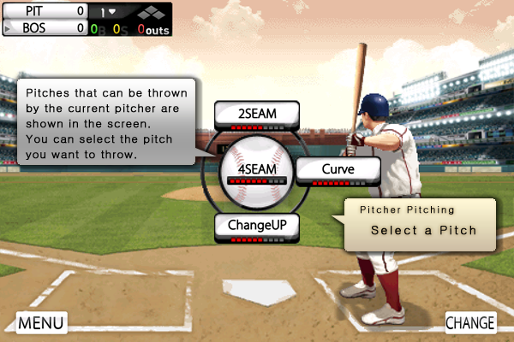
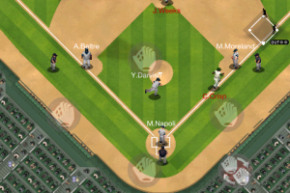
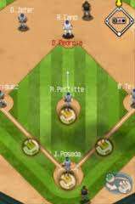
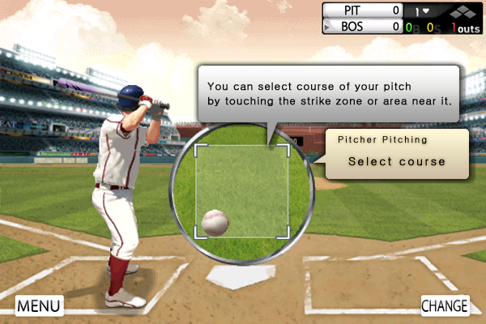
How to play: Defense
Touch the screen to throw to a base or a cut-off man

Slide 11
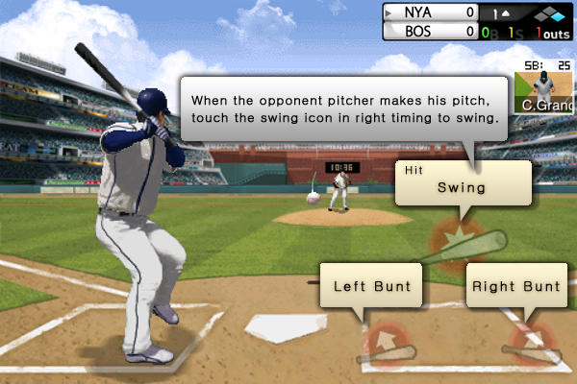
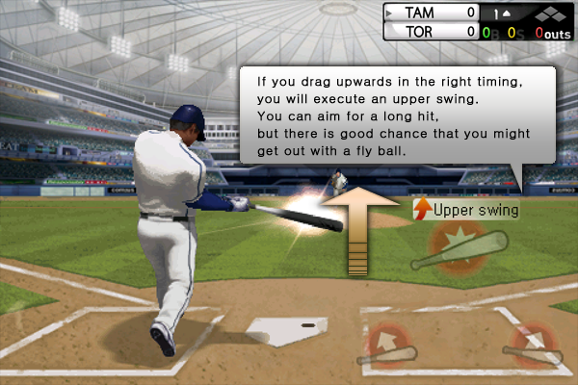
How to play: Offense
Touch the runner to run.

Slide 12
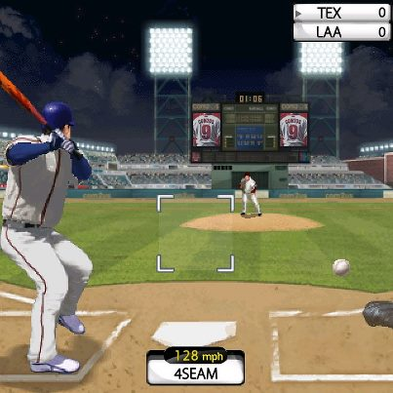
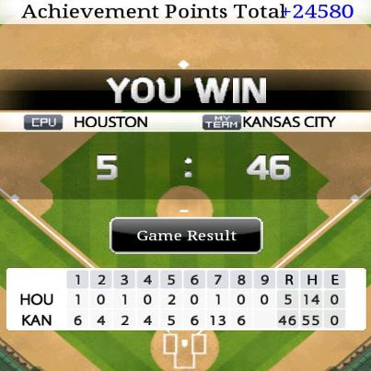
Pros:
Realistic times of days.
30 unique stadiums
Game updates with new player cards.
Huge list of achievements.
FREE!
Cons:
Can’t use real team names.
Steep difficulty curve.
Sometimes bad base running controls.
Addictive

