Slide 1
The Last Story
Review by:
Michael P. Greenleaf
9/17/2012

Slide 2
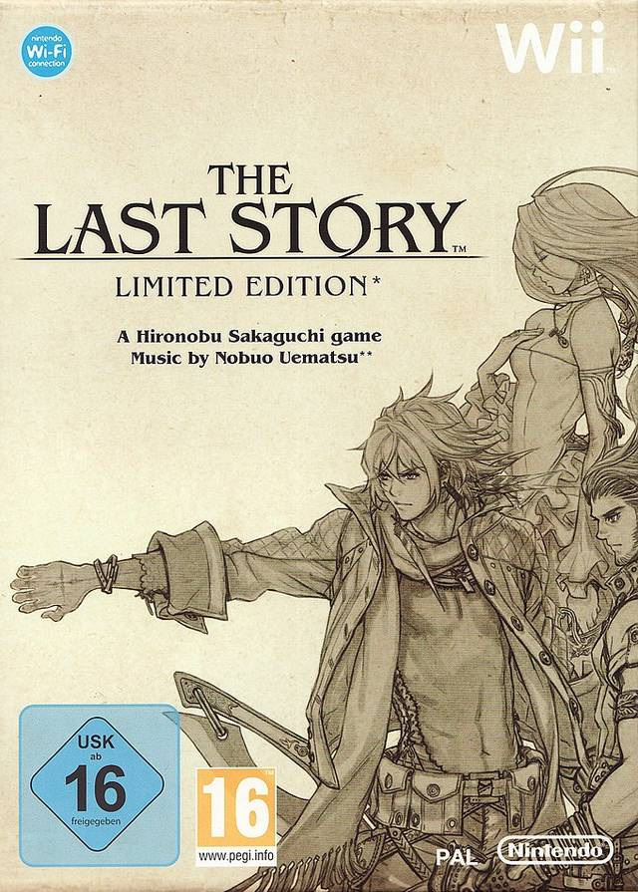
Basic Info
Developer: Mistwalker Studios
Director: Hironobu Sakaguchi
Composer: Nobuo Uematsu
Publisher (US): XSEED Games
Genre: Role-Playing Game
Manual Included: Yes
Price: MSRP $49.99
System: Nintendo Wii
ESRB Rating: Teen
Language
Mild Suggestive Themes
Use of Alcohol
Violence
Notes:
Appropriate audience age-wise is the same as the ESRB rating.
Appropriate audience in regards to content are fans of traditional Japanese-Style Role-Playing Games.
Manual is a standard set of game controls.

Slide 3
Story
The story follows a band of mercenaries that head to Lazulis City for work. They get a job from Count Arganan, which they hope can propel them to knighthood and out of the rough, uncertain lives of mercenaries.
Along the way Zael, this tale’s protagonist, gains the mysterious power of “The Outsider” and the group is confronted with a task greater than they can imagine.
The fight to save Lazulis Island is on, and only Zael and crew can protect it.

Slide 4
Story Cont.
The Good:
Character interactions are what truly carries The Last Story. There is never a dull moment when the mercenary crew is together, whether they are downing booze at the tavern, or engaging in delightful banter during a battle.
The Disappointing:
There is a balance that must be struck in storytelling. If things are too predictable, the audience gets bored. If there are too many plot twists, the audience will be confused, become frustrated, and take the story to be “convoluted.”
The Last Story is, unfortunately, as predictable as a porno.
The player will likely be able to guess the “big surprise” twist for the final boss within the first 3 hours of play (out of 35 hours of total game play, all side quests included).
White Tiger featured prominently in artwork is poorly explained (2 lines of spoken text, a few more lines of text from the in-game library).
Feels like wasted potential.
Similar issue with the “Guardians” mentioned in the backstory of Mirania, one of the mercenaries.
The Ugly: (Avoiding spoilers)
There is one critical mechanical flaw in this game’s storytelling.
At one point in the game a prominent character just disappears from the story, with no explanation. None of the other characters even acknowledge this character’s absence. Later this lost character appears out of nowhere, and suddenly all of the other characters are shocked to see him/her/it. This creates a rather large plot hole, which could have been remedied with a simple “I’m going to help these people over here, you guys go on ahead.”

Slide 5
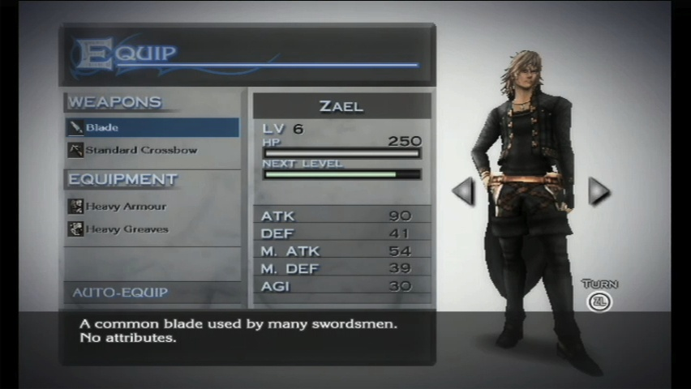
User Interface & Game Play
The Last Story utilizes a fairly standard menu system for item and equipment management.
Players are able to customize the look of their characters by equipping various pieces of armor and different weapons, though the number of different armors is rather small.
Looks can be further customized through the use of dyes, which allow the player to change the color of each piece of armor.
Players can also make parts of their armor invisible (limit = underwear) for a less-is-more kind of look.

Slide 6
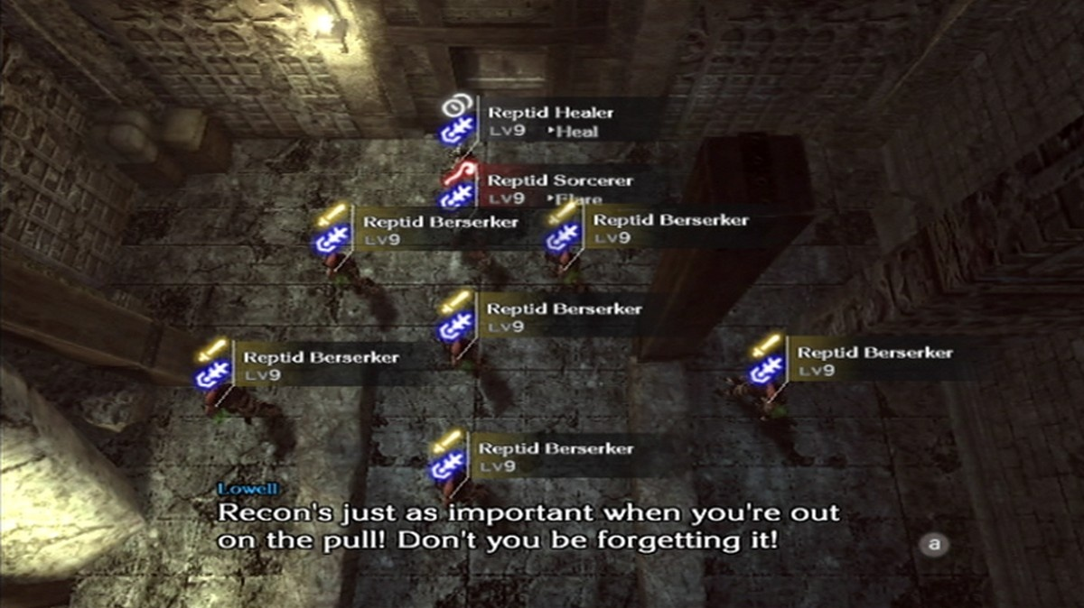
Battle System
During the beginning of a battle, the player is given an overhead view of the battlefield, like in a strategy game.
For most of the game the player will control Zael.
The battle system is more of an Action RPG than a turn-based RPG, though there is a limit to how often certain skills can be used.
Zael can take cover, fire his crossbow from a first-person perspective, manually guard & counter attacks, and “dispel” magic circles located on the battlefield for a variety of effects (heal allies, damage enemies, break the enemy’s guard).
Notes:
Can also target things like bridges to make enemies fall to their death.

Slide 7
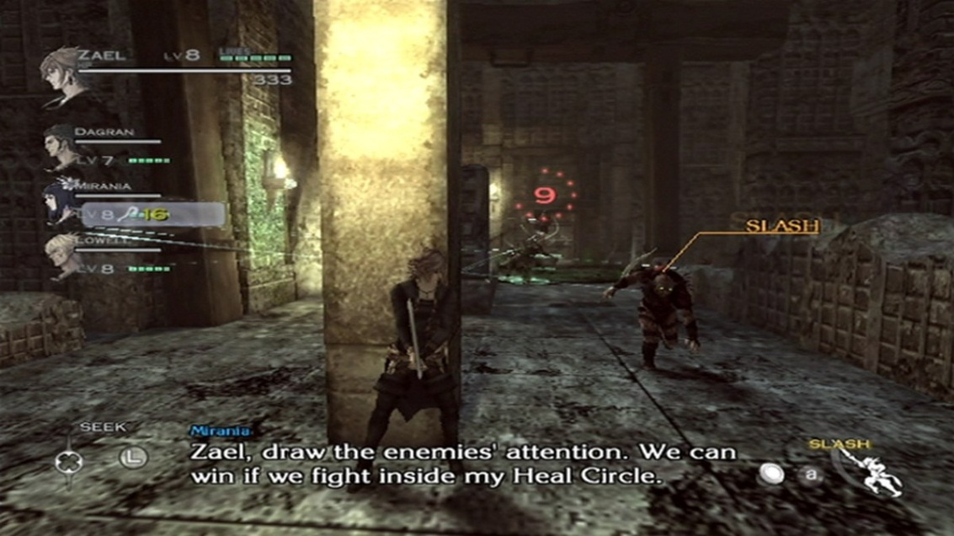
Battle System Cont.
You will engage in fights with other members of your mercenary crew, where the party size will vary throughout the game (max size = 7).
Party members are AI controlled. For the most part the AI is competent, but there are times when your mages may cast an ice spell on an ice-absorbing enemy.
Players can issue commands to their party members using “command mode” when they have a full skill gage. The skill gage does take some time to fill though, so you cannot spam commands.
There is a trade off here: you are limited in how often you can issue commands, but when you do spell casting is reduced down to 2-3s from 12-16s.
Notes:
In practice, the battle system is enjoyable as it has a unique blend of action elements that are not seen in Japanese Role-Playing Games.
But there are some issues.

Slide 8
Battle System Issues
The primary issue with an otherwise refreshing battle system is the lack of customizable controls.
The “A” button is used for too many things:
To roll/dodge
To take cover
To initial Zael’s “Gale Slash,” which is used to dispel magic circles
This leads to moments where the player will initiate actions they did not intend.
Running to a wall for cover can lead to the unintentional triggering of “vertical slash”
Manual vs. Auto Attack Issue
Manual setting allows the player to swing their sword by pressing the “A” button.
Beneficial as Zael will not get “stuck” on enemies as he will with “auto attack”
Bad as using the “manual” setting reduces attack power to roughly 2/3 “auto” and the attack speed is usually slower too, regardless of how fast the player pushes the “A” Button.

Slide 9
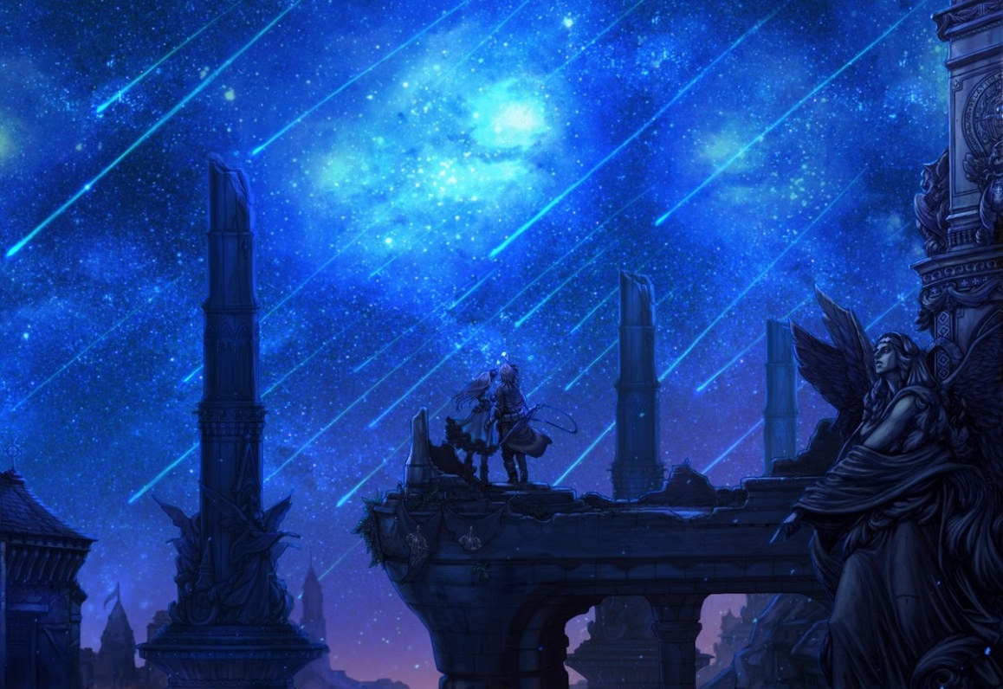
Art Design
In general the game employs a muted color palette, primarily consisting of dark grays, greens, browns, and reds for the backgrounds.
Drawback is that the game is not particularly friendly to people with colorblindness as some treasure chests and obstacles blend into the background.
Wider color palette is mostly reserved for battle effects and special events.
Character models are generally good, though there are not many different enemy models.

Slide 10
Sound
Voice Acting
The British dub is pleasing to the ear. The voice actors generally do a good job and characters sound natural, though there may be a voice or two a player may not enjoy.
Music
The music sets the mood appropriately for each scene.
Still, this is not one of Uematsu’s most memorable outings and there really is not one track that stands out.
Sound Effects
No effect sounds out of place.
Notes:
While writing this review I listened to the OST CD that came with the game, and I never stopped once to replay a track.

Slide 11
Special Features
The Last Story offers two modes of online play:
Cooperative Play
Up to 6 players can join together to take on bosses found in the main game.
Player vs. Player
Players can fight each other.
In each case the player can select a member of the mercenary group to play as.
Winning in Cooperative play or PvP nets the player various rewards
Weapons and items needed to upgrade those weapons.
Weapons can be used in the main game.
Generally speaking, the weapons earned from online play are not as good as ones found in the main game.

Slide 12
Bugs / Glitches
The only bug that comes up consistently is a graphical error.
While chasing an NPC through the city, it is likely that the background will temporarily disappear. Zael and the NPCs are still visible, but navigating the backstreets can become a nearly impossible task while the glitch is in effect.

Slide 13
Comparison to Similar Games
One comparison that comes up often is how The Last Story stacks up against fellow “Operation Rainfall” game “Xenoblade Chronicles,” another Role Playing game from Japan that comes from famed director Tetsuya Takahashi.
Game length
Last Story: 35 hours, all side quests completed
Xenoblade: 140 hours, all side quests completed
Characters
Equally enjoyable main cast of characters
Art Design
Xenoblade contains a wider array of environments
Character models are more refined in The Last Story, but there is a greater variety in armor and weapons in Xenoblade
Music
Both games employed legendary composers (Xenoblade had Yasunori Mitsuda and Yoko Shimomura), but newcomers ACE+ helped deliver the more memorable soundtrack for Xenoblade.

Slide 14
Comparison to Similar Games
Story
Which has the better content is a matter of personal preference, but Xenoblade had fewer plot holes.
Gameplay
Side quest management is better handled in Xenoblade, as there is a list of active quests that tells you which NPC is giving the quest and where they are located.
Battle system: The Last Story takes more risks (trying a cover system), but in practice you are just as active in one battle system as you are in the other.
Overall
While The Last Story should be praised for trying an ambitious battle system, Xenoblade was the more polished game.

Slide 15
Design Mistakes
One design mistake that stands out is how The Last Story is played out through chapters.
The problem is not with the chapter approach in general, but rather with the “optional” chapters.
Players are not always told ahead of time what chapters are optional and which ones advance the story.
At the end of the game there are three chapters to play through, and it is entirely possible to miss out on seeing a significant event that is built up throughout the game if you choose the wrong chapter. Of course, you can reload your safe and play through these chapters if you happen to select the ending chapter, but it is a design flaw that could be easily fixed with better cueing.

Slide 16
Review Summary
Strengths
Wonderful cast of characters to keep player engaged.
Innovative new battle system.
Interactive battle environments.
Fair character customization (visual).
Weaknesses
Limited alternative control options
Story is too predictable
Glaring plot hole
No “signature moment” or moments
Really no moment in the game that sticks out and would make a player want to revisit the game 5-10 years down the line.
Is it Worth Purchasing?
Depends on the price you are purchasing it at.
Overall Score : ~8/10
How Can it be Improved?
Address the weaknesses listed above (close the plot hole)
Flesh out some of the backstories (white tiger, Guardians)
Notes:
If you are into the genre, it is at least worth a rent.

Slide 17
Comments/Questions?

