Slide 1
Game Review
Lorraine Ferraiuolo
Fall 2012
Ah, so this is StarFox!

Slide 2
Game Facts
Developed by Nintendo
3D Action Rail Shooter/”Flight Simulator”
Price
Then: $49.99
Now: Used about $12-20, New about $200
Minimum Hardware Requirements: Nintendo 64 game cartridge and Nintendo 64 Console
You’re more cunning than I thought!

Slide 3
Story
The evil scientist Andross has taken over the Lylat System, and is attempting to over throw the last of the forces against him, located on the planet Corneria. General Pepper of the Cornerian army has hired the mercenary team, StarFox, as their last hope against Andross’s forces
Our army alone can’t do the job. Hurry StarFox!

Slide 4
StarFox Team
All air craft report!

Slide 5
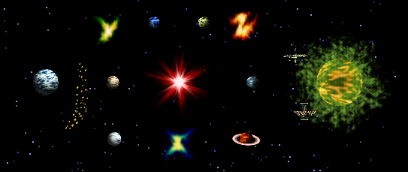
The Lylat System
Sector Y
Aquas
Zoness
Sector Z
Area 6
Venom
Solar
Corneria
Katina
Macbeth
Meteo
Bolse
Fortuna
Titania
Sector X
Deploy all units! CHARGE!

Slide 6
Player’s Role
The player controls the leader of the StarFox team, Fox McCloud, on the mission to bring defeat the enemy forces and bring down the evil Andross
You started without me? Boys, I’m crushed!

Slide 7
User Interface
Main Menu
Level Select
I can’t see anything. Fire anyway!

Slide 8
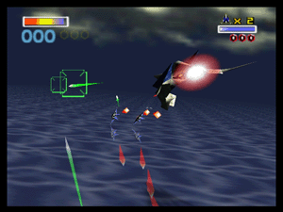
User Interface (in Level)
Lives
Current Health
Current Score
Player
Player’s Crosshairs
Enemies
Stick to the pond Froggy!

Slide 9
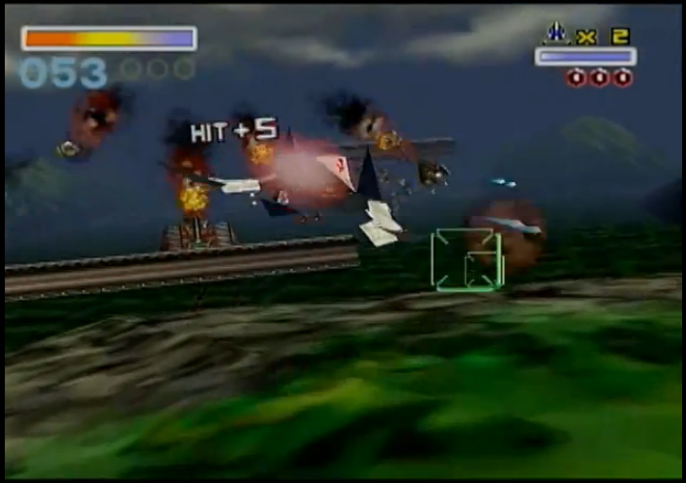
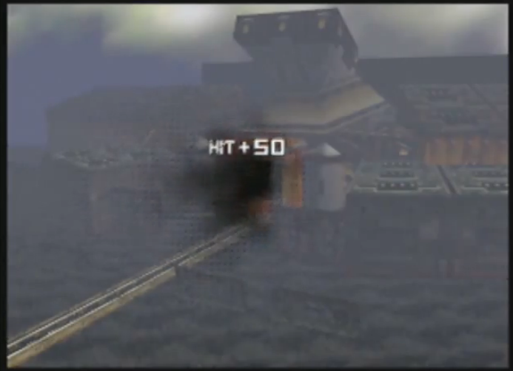
Scoring
Player accumulates points by shooting down enemies
Most enemies are worth 1 point, but some larger foes add 3 or 5 points for being shot down
Bosses are also worth more points, with most adding 10 points once they are shot down
Fox! That’s one of ours!

Slide 10
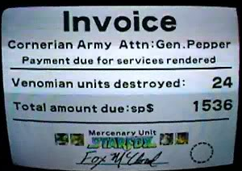
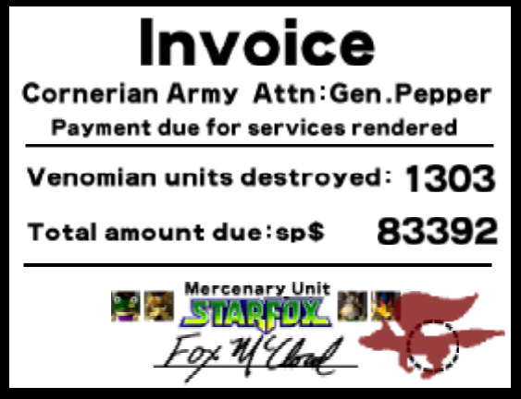
Scoring
As the player advances, each level’s score is added to a total score
Depending on which path is chosen during a given play through, the score can vary pretty substantially
You’re good. But I’m better!

Slide 11
Scoring
Each level has a high score to beat
If that score is reached (or beaten) with all of your teammates alive, a medal is received for that level
Once all the medals are obtained, Expert Mode is unlocked
Medal on Current Run
This can’t be happening!

Slide 12
My Personal High Score: 1396
The view is clear.

Slide 13
Artwork
Lead Artist: Takaya Imamura
Not only worked on the character designs and overall look of the game, but helped with the concepts as well
Location confirmed. Sending supplies.

Slide 14
Sound and Music
Composers: Koji Kondo Hajime Wakai
Both have worked on many other Nintendo franchises, such as Mario and The Legend of Zelda
I’ll take you guys out from the ship!

Slide 15
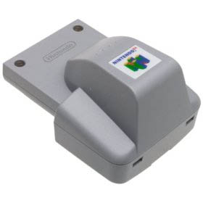
Special Features
Game came bundled with the Rumble Pack
First Nintendo 64 game to make use of it
You can’t beat me! I’ve got a better ship!

Slide 16
Manual
Contains:
Game’s Story
StarFox Team Bios
Game’s Controls
Power-ups
Information about the Different Game Modes
Main Story, Multiplayer VS Mode, Training Mode
Clues about the game’s branching paths
I didn’t expect to have to use this!

Slide 17
Bugs
Haven’t personally encountered any
Apparently there is a way to for the player’s ship to get stuck flying in a loop (from the end of a mid level cut scene) right before the final boss, rendering that play through uncompleteable
I’m monkey food if I don’t leave!

Slide 18
The Good
Easy to pick up and play
Can do a play through of the game in about an hour
Branching paths allow for varied gameplay, and not every level is strictly just a rail shooter
The voice acting and witty one liners
You’ve become so strong.

Slide 19
The Bad
Can’t just sit down and play one level, you have to complete all the ones leading up to it
Entire game MUST be completed in one sitting, there is no save feature for individual runs of the main story
The multiplayer mode has not aged very well
See my ship? Does it look OK to you?!

Slide 20
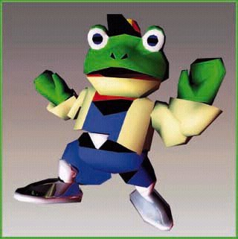
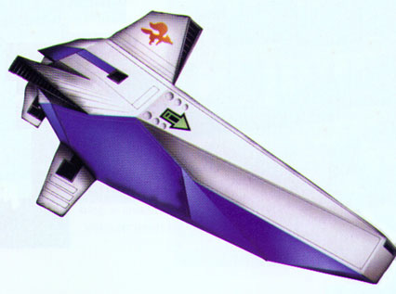
The Ugly
The other vehicles used in some of the levels are much slower, and can break up the fast pace of the rest of the game (I’m looking at you Blue Marine)
Slippy Toad
They’re on me! I’m getting careless!

Slide 21
How does it compare?
At its release it was groundbreaking, making use of the Rumble Pack to add to the immersion
Offers a lot of replayability with branching paths, the unlockable (and more challenging) Expert Mode
Main gameplay has aged really well, and plays great by today’s standards
Caiman here. No problems.

Slide 22
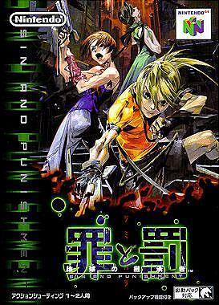
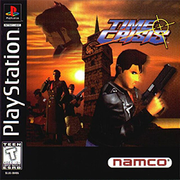
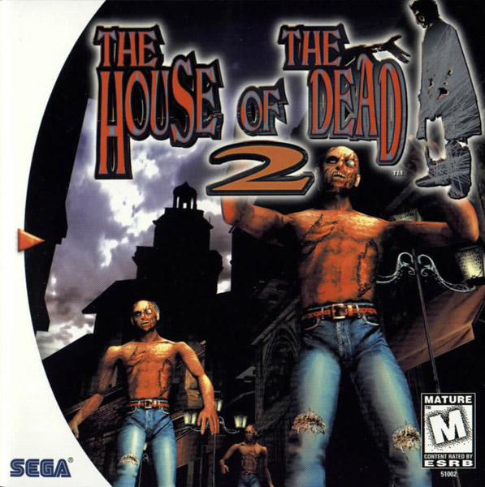
Other Rail Shooters
Did we get ‘em?

Slide 23
Overall
Strengths
Fast paced gameplay
Tons of replayability
Memorable characters and dialog
Easy to pick up and play
Weaknesses
Multiplayer mode does not hold up
Most of the unlockable content is for the multiplayer mode
Levels with other vehicles can break up the game’s pace
Those tin cans are no match for me!

Slide 24
Worth Purchasing?
Absolutely!
Original version is pretty cheap used
Is available on the Nintendo Wii’s Virtual Console system
Has been remade for the Nintendo 3DS handheld, and it is fantastic!
Don’t relax! We’re not done yet!

Slide 25
Nintendo 64 Version
Nintendo 3DS Version
I can’t stop it!

Slide 26
Can it be Improved?
The Nintendo 3DS version offers many improvements on the original
Mid game save between levels
Multiplayer Mode is greatly improved, although it does lack an online mode
Handheld works really well for this game
Can’t let you do that Star Fox!

Slide 27
Mission No. 1
MISSION ACCOMPLISHED

