Slide 1
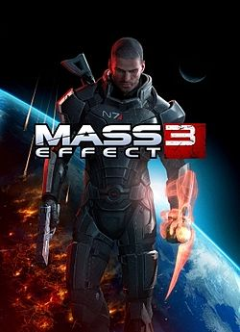
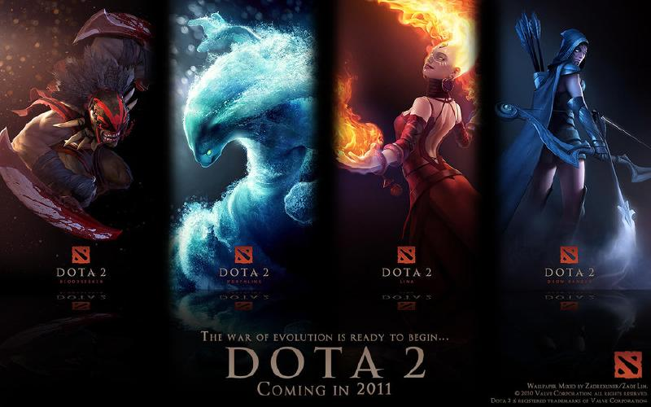
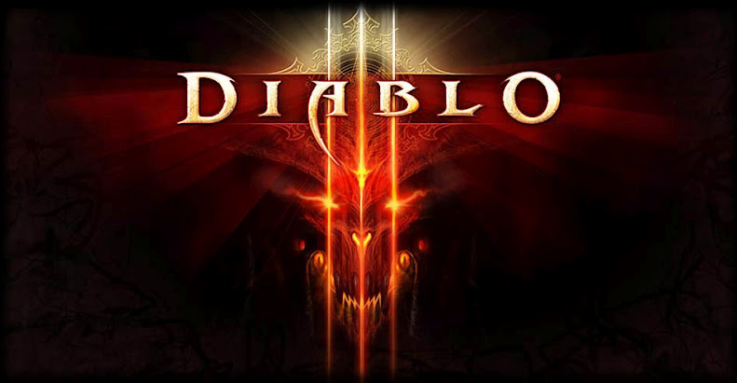
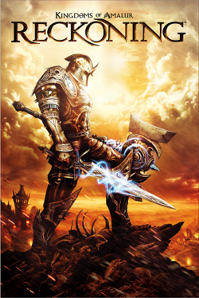
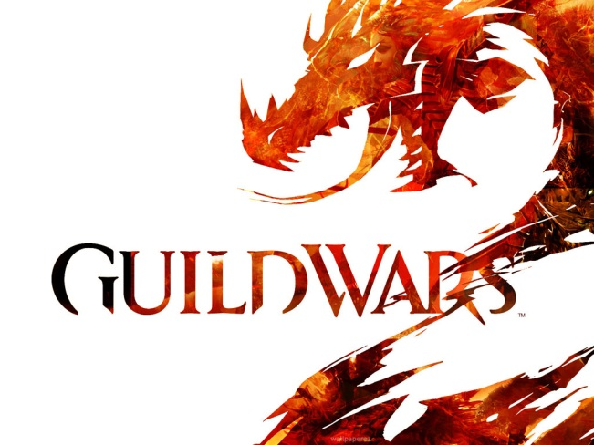
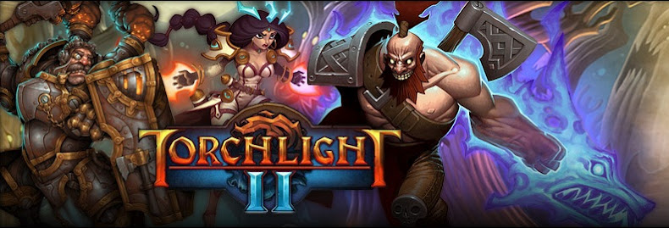
This Summer

Slide 2
Presentation by Haonan Du

Slide 3
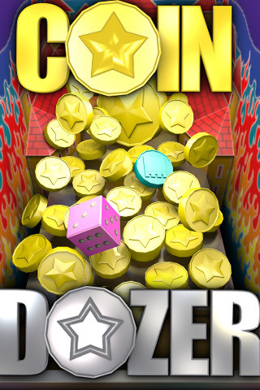
Basic Info
Company : Game Circus LLC
Type of game: Card & Casino
Price: Free or $2.99 for Coin Dozer Pro in app store
Minimum stated hardware requirements: Android system; iOS 3.0 or later.

Slide 4
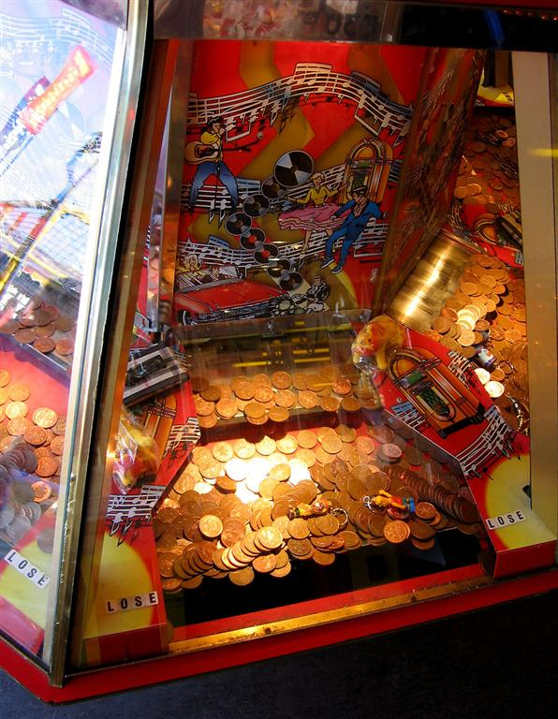
Game Summary
Quick overview:
Just like a COIN DOZER

Slide 5
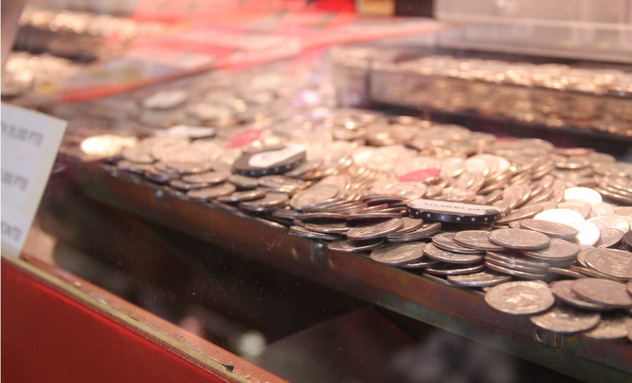
Game Summary
Player's role:
Player… or say coin thrower.
Installation:
Download from
App Stores and
play it!

Slide 6
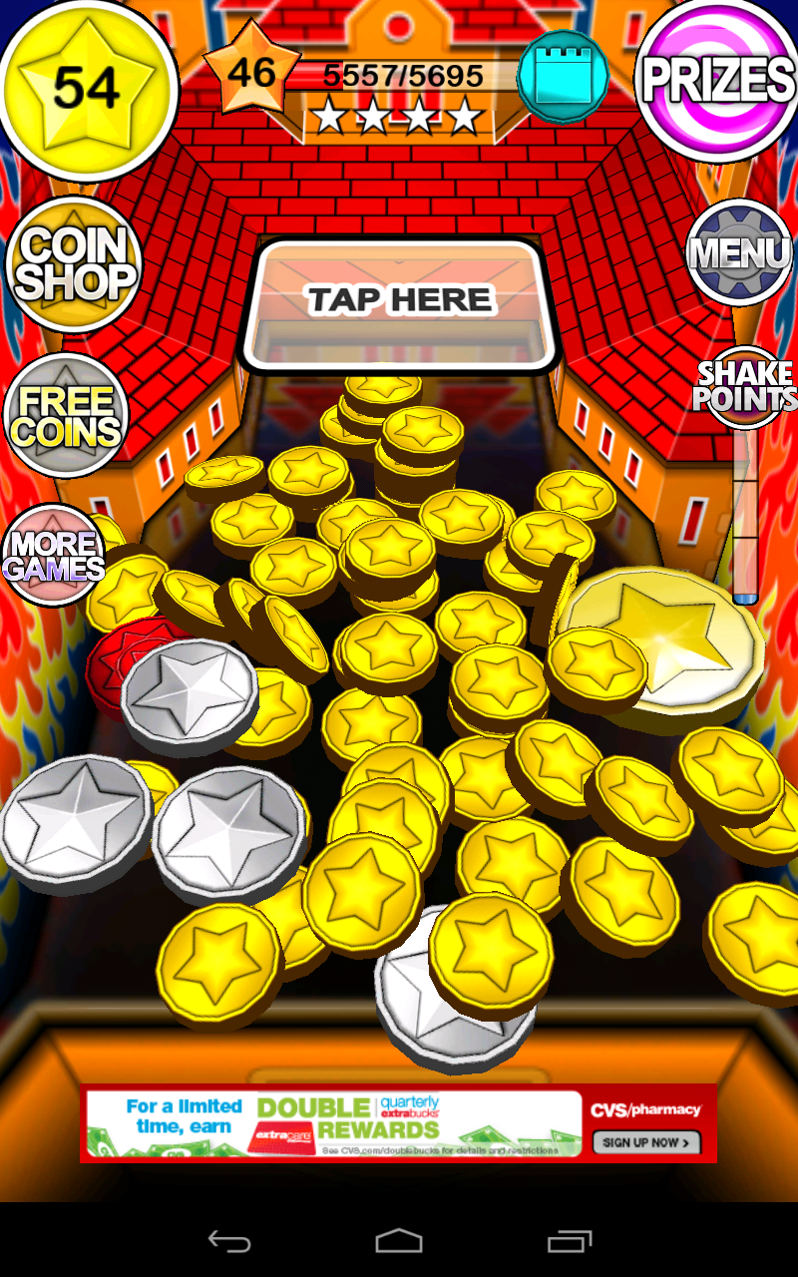
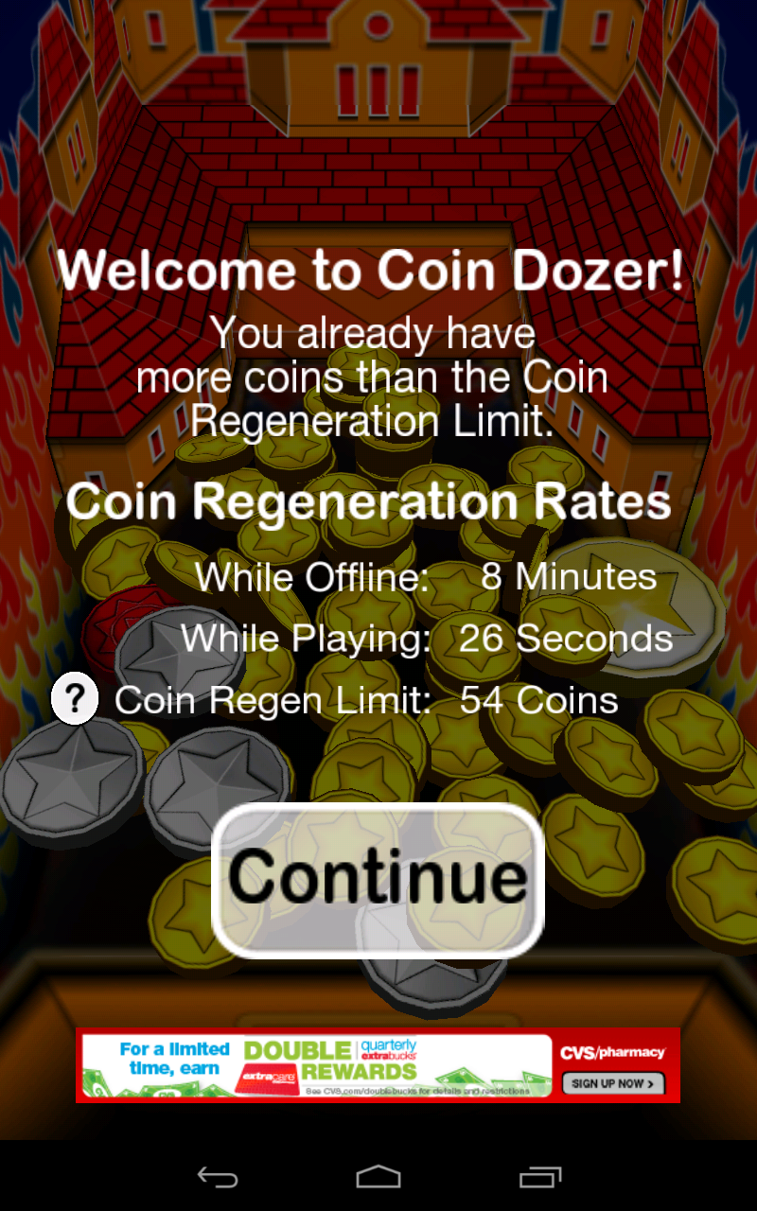
User Interface:
Coin Dozer machine
Advertisement
Some functional buttons

Slide 7
Game Play
Coins you have
Basically insert coins by tapping “TAP HERE” area!
See Prize you got
Earning Coins by push coins into this hole!

Slide 8
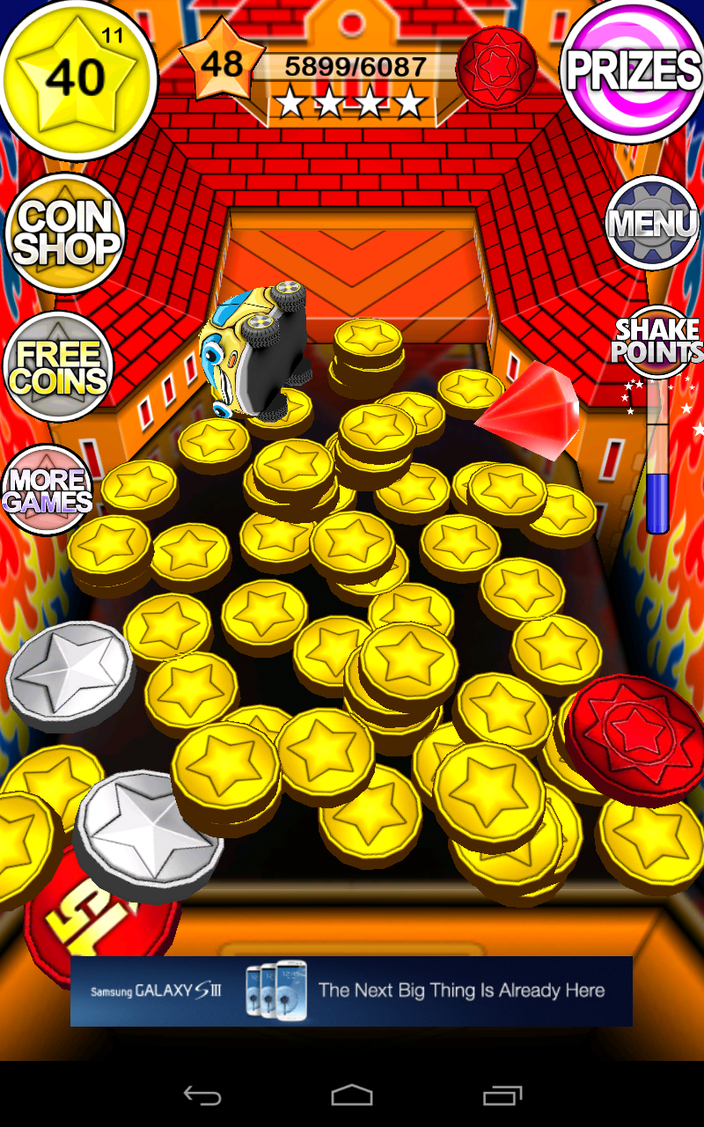
Special features
Count down to earn a new coin.
Maxim coins can insert at a time. Short time cool down.
Level system. Reward a bonus coin each level.
3 levels of Shake Points to shake the machine.
Lost coins if drop into these two holes. Increasing shake points as compensatory
Many kinds of Bonus Coins and collectable toys.

Slide 9
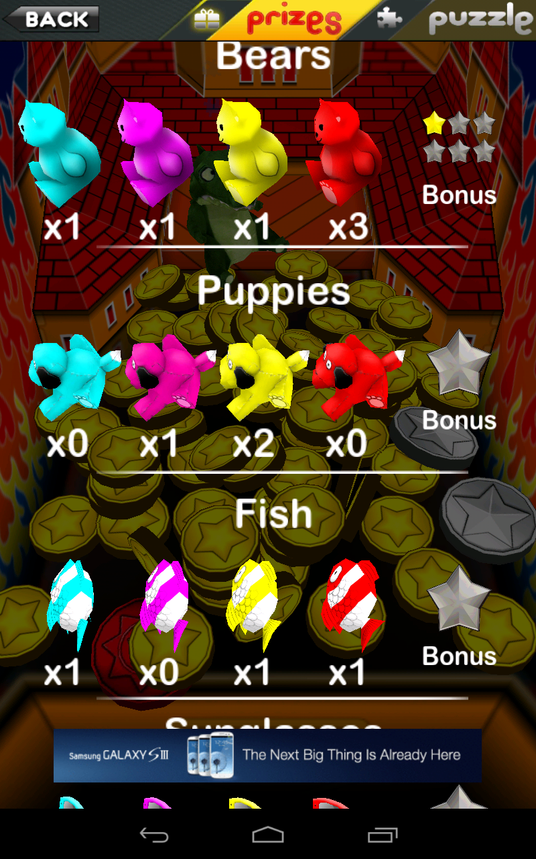
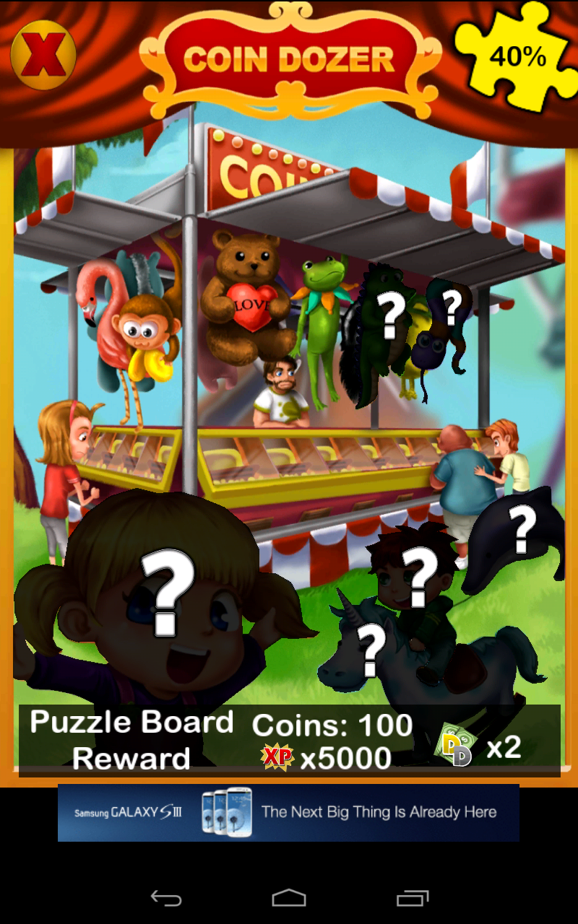
Special features Cont.
Small toys ➔ Prizes
Big toys ➔ Puzzle
Collect a set of toys get a Bonus; Each set has different level of bonus .
Collect a Puzzle Board will have a Super Reward! There are many different Puzzle Boards, unlock a new Puzzle by finishing previous one.

Slide 10
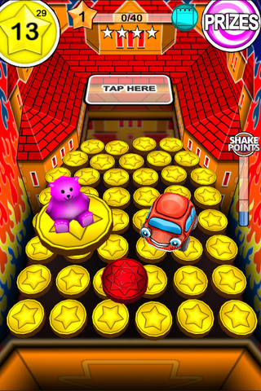
Scoring:
Try to get as many coins as you can.
Artwork:
Simple 3D. Kind of UGLY…
Sound and Music:
Reasonable sound..
Wired congratulation music…
Bugs:
None till now.

Slide 11
Game Review
What is good (fun) about the game? Why?
Collecting toys, though most toys are ugly… Collecting for rewards. Different from Pokémon that collecting as desire.
Different strategy of inserting coins caused by the cool down system.
Player will be kept being surprised by different bonus coins. Feel Lucky!

Slide 12
What is bad (not fun) about the game? Why?
Have to wait for a long time if run out of coins.
Terrible graphic and sound…
Annoying advertisement.

Slide 13
How does it compare to similar games in the same genre?
The similar game should be real Coin Dozer. The advantage of Coin Dozer App is you don’t need to spend real money!
Multiple collectable toys, level system, different rewards make this app better than real dozer machine.

Slide 14
What is the appropriate audience for this game?
All ages.
Especially for students who have seven courses one semester.

Slide 15
Summary
Overall strengths and weaknesses.
Strengths
Weaknesses
Attractive
by
Ugly graphics
Exciting surprise
with
Terrible congratulation music
Strategy using
Tones of collectable elements

Slide 16
Is the game worth purchasing?
#1 app in Japan, UK, Hong Kong, Macau, Nederland, Taiwan, Malaysia, and Philippines! #1 game in France, Belgium, Denmark, and Indonesia! #2 game in the U.S and many more!
---- App Store discreption
The Free version is good enough for most people. Go for a “Pro” version, only if the advertisement hurt you.

Slide 17
How could it be improved?
Better graphic, replace ugly toys, better music.
Shorter waiting time.

Slide 18
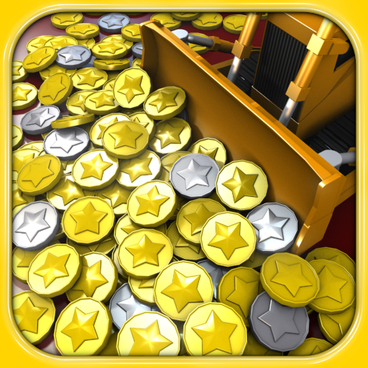
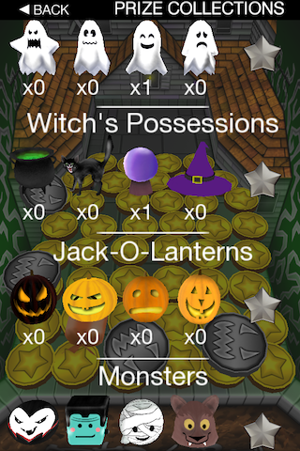
Thank you!

