Slide 1
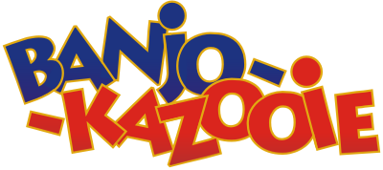
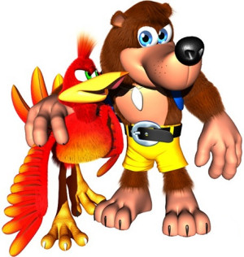
Game evaluation by Evan Cole

Slide 2
Basic Information
Company:
Author: Rareware
Type of game: Platforming, Action-Adventure
Price: $47.99 (initial retail price: 1998)
Minimum Requirements: Nintendo 64 console
and Nintendo 64 controller
Actual Requirements: Nintendo 64 console,
Nintendo 64 controller, Nintendo 64 controller
pack (memory)

Slide 3
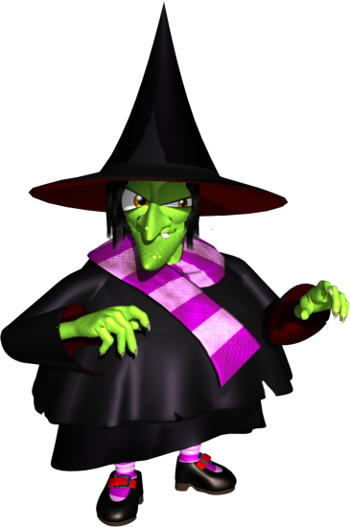
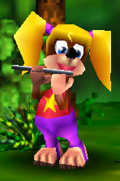
Quick Overview
There are 9 different levels in Gruntilda’s Lair where you must collect musical notes and jiggies (jigsaw pieces).
You can learn different moves and transform into different things (mobility and attacking)
Defeat the final boss, Gruntilda the Witch and save Banjo’s sister, Tooty.

Slide 4
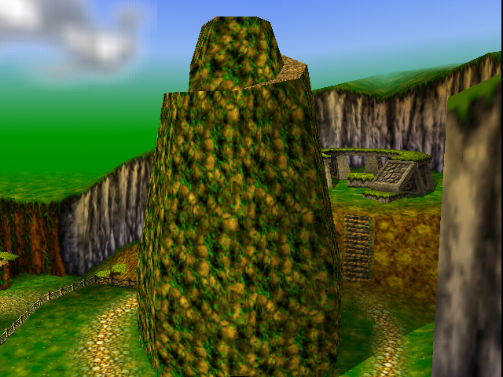
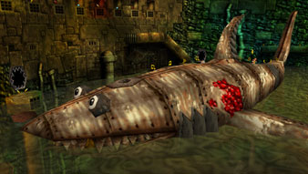
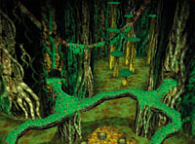
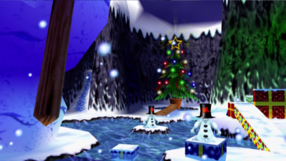
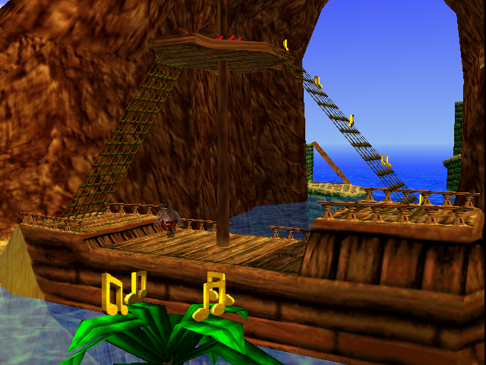
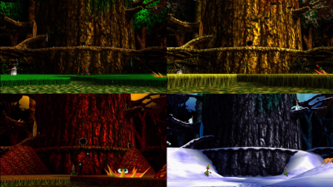
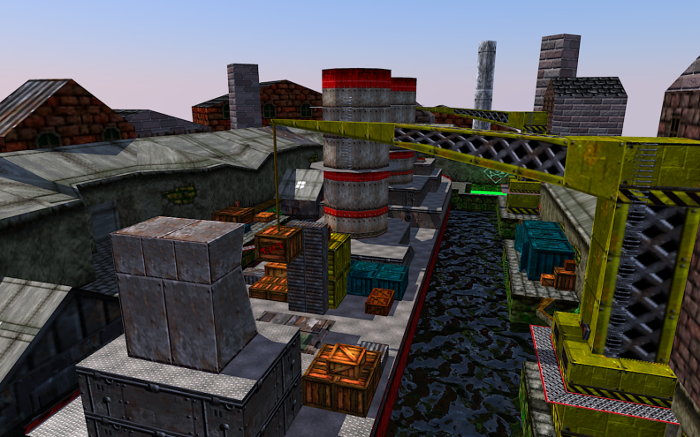
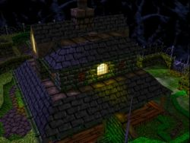
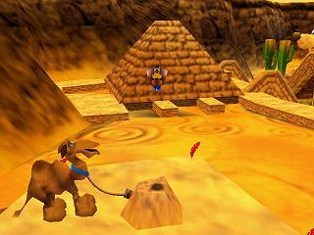

Slide 5
Story Line
Banjo-Kazooie follows the story of Banjo (the bear) and a red bird, Kazooie, who is always kept in Banjo’s backpack. Gruntilda learns from her cauldron that she is not the most beautiful girl of all. In retaliation, Gruntilda abducts Banjo’s sister, Tooty to steal her level of beauty using a machine. Banjo and Kazooie fights through Gruntilda’s Lair to rescue Tooty.

Slide 6
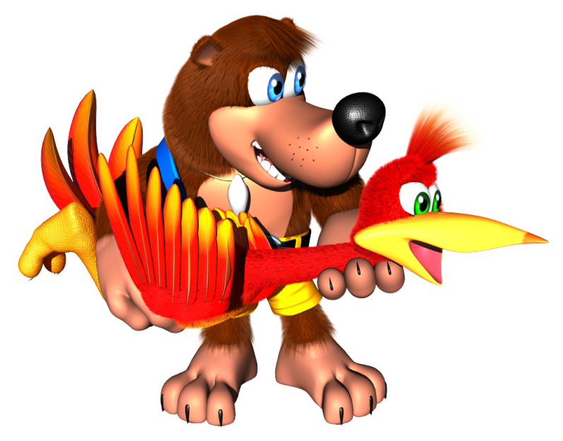
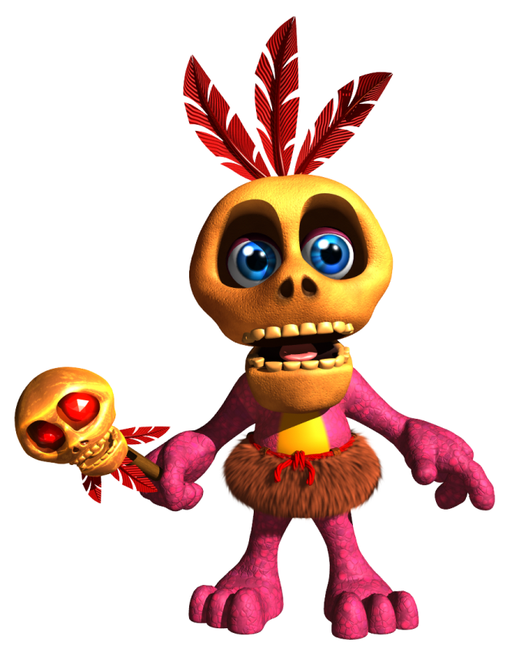
Player’s Role
Your main control is playing Banjo (the bear). You can also use Banjo to control Kazooie (the bird). As you progress through out the game, Bottles (the mole) will teach you different moves to control/use Kazooie (mobility and attacks).
Mumbo Jumbo is another of Banjo’s friend. He will turn you into a creature that is related to the level you are currently in for Mumbo Tokens; for example, if you’re in the level, Click Clock Wood, for 25 Mumbo Tokens, Mumbo Jumbo can turn you into a bumblebee that would allow you to fly and access places that are only for bumblebees.

Slide 7
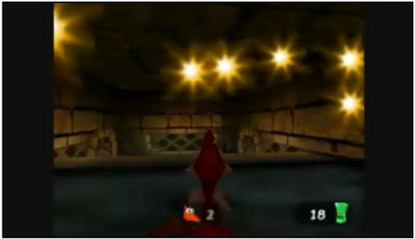
User Interface
The game is in a third-person point of
view.
First-person view in certain moves
(egg shooter)
Honeycombs ( ) are used as Banjo-Kazooie’s life bar.
No blood and gore.
Not difficult to control.
All other counters (jiggies, notes, eggs, feathers) can be seen from the menu.
The game can be saved anywhere.

Slide 8
Gameplay
Straight-forward story line
Pretty much free roam.
Attack monsters in many different ways
- Beak buster, beat barge, forward roll,
Rat-a-tat rap, claw swipe
Many different ways to move
- Run, tip-toe, Fly, jump, swim, talon trot
Complete different levels by collecting jiggies

Slide 9
Scoring
In each level, there are 100 musical notes that are to be collected.
There are 5 Jinjos that are hidden in each level, if all 5 are collected, you will be rewarded with a Jiggy.
There are 10 Jiggies that are hidden in each level, some are on the ground/in air and some are retrieved after completing a task or defeating a boss.

Slide 10
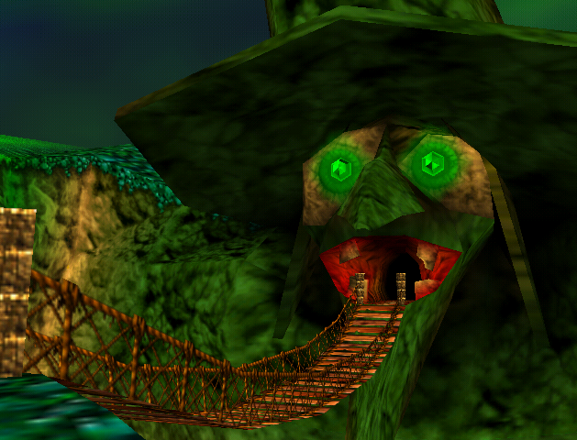
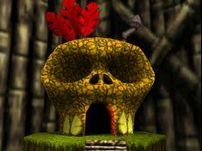
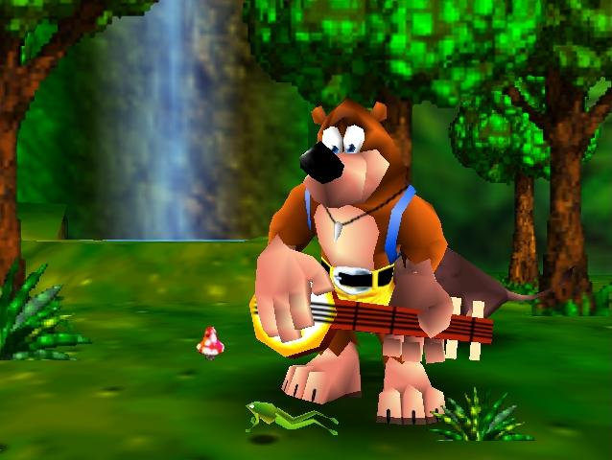
Artwork
The art designs in this game is significantly good for a game that was developed in the 1990’s.
It is a 3-Dimensional environment.

Slide 11
Sound and Music
The game is comprised of orchestra pieces.
Banjo and Kazooie make different noises for every move they make.
Each creature have their own noises, they are louder as you are closer to them.
Jinjos make a whistling noise to indicate that they are near you, that is how it helps you find them.
In the end, just before fighting Gruntilda, you have to take part in her trivial game and some of the questions involve recognizing noises that different creatures make. This tells me that the sound producers did a fantastic job for the player to recognize each sound.

Slide 12
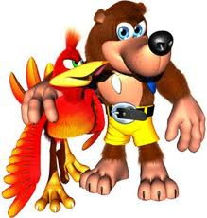
Game Review
Rate me!

Slide 13
What is good about this game?
It’s almost a free-roam game, you can get back to the earlier areas and get things that you might have missed. You can control Banjo-Kazooie in many different ways, so you’re not doing the same moves every single time. It takes time to beat the game, it is not something that can be done overnight. Just about everything in this game is just good.
What is bad about this game?
The enemy AI is a bit weak, sometimes you can get past them without being noticed. The camera system does not offer a very good control; sometimes the view can get stuck behind walls. Also, this game could be too challenging for younger audiences.

Slide 14
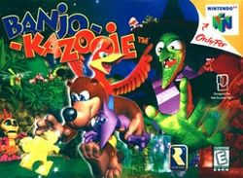
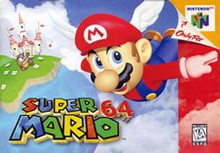
Similar games
The best comparison for Banjo-Kazooie would be Super Mario 64. They both have the same “defeat and rescue” roles (Tooty/Princess Peach and Gruntilda/Bowser). They both have levels that can be unlocked depending on the number of Jiggys/Stars you have. In each level, they both have goals to collect the Jiggys and Stars. Moves in Banjo are similar to Mario, but with the red bird included, there are more different moves you can use in Banjo-Kazooie, compared to Mario. Both games have been given high praise because the gameplay is just incredibly fun, which is why they both are one of the best N64 games of all time.

Slide 15
Appropriate Audience
Pretty much anyone can play this game.
As mentioned in a previous slide, this game may be too difficult for younger audiences.
The ESRB rated this game for EVERYONE (E).

Slide 16
Design mistakes
Almost all monsters in the game are the same in terms of difficulty. They don’t become stronger as you progress throughout.
Gruntilda sightings are rare. You will only see Gruntilda in the beginning and in the ending. Gruntilda should appear from time to time as a distraction after completing a level.

Slide 17
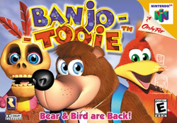
Summary/Closing Statements
Great game with many different possibilities to accomplish levels. Straight-forward “defeat and rescue” storyline. An A+ everywhere from sound to gameplay.
If you still have your Nintendo 64, I’d definitely get this game cartridge on EBay or Amazon and play it. You won’t be disappointed.
This game has a sequel, Banjo-Tooie, where Gruntilda revives and kills Bottles; Banjo-Tooie team up again to defeat Gruntilda. Banjo-Tooie was another success for Rareware.
Banjo-Kazooie is available on XBLA.

Slide 18
Credits/Sources
http://images.wikia.com/supersmashbrosfanon/images/e/e8/Banjokazooie.jpg
http://upload.wikimedia.org/wikipedia/commons/a/ab/Banjo_Kazooie_logo.png
Banjo-Kazooie full soundtrack: http://www.youtube.com/watch?v=TgIkuzYMnFs
http://en.wikipedia.org/wiki/Banjo-Kazooie
http://banjokazooie.wikia.com/wiki/Banjo-Kazooie_Wiki
http://www.gamespot.com/banjo-kazooie/

